Slide 1
Agency
Pitch Deck

Slide 2
About Us
Star Employment Agency is a private recruitment agency based in Compton, California. It has been in the industry since 2012 and was opened by Jacob Smith who was a public relation alumni from DePaul University, Chicago, Illinois.

Slide 3
Vision
Our vision is to :
establish 30 branches nationwide,
acquire global recognition, and
become the most excellent recruitment agency by 2025.
Mission
Our mission is to provide top-notch recruitment agency services and the most suitable jobs for our employers.

Slide 4
The Team
Benedict Olsen
Sophia Jules
Chief Operating Officer
Chief Human Resource Officer
Manages general company operations.
Maximize share prices, market shares and revenues.
Oversees human resource management and industrial relations policies.

Slide 5
The Team
Jimmy Borne
Julia West
Recruitment Officer
Recruitment Officer
Posting and developing job announcements and advertisements.
Applicant’s screening qualifications
Applicant’s status and documentation
Posting and developing job announcements and advertisements.
Applicant’s screening
qualifications
Applicant’s status and documentation

Slide 6
The Problem
According to a survey by Bureau of Labor Statistics conducted in 2016, at least 50 companies in the employment industry closed due to their bad service, questionable commissions and unsettled tax reports. This leads to the rise of unemployed fresh graduates across the California.

Slide 7
Our Solution
Star Employment Agency provides assistance to various applicants who are in need of better employment opportunities. We help them find the most suitable and efficient jobs inclined to their chosen career and skill set for only a 5% commission rate.

Slide 8
Advantages
According to a 2017 study, only 2 recruitment agencies within the state are available to provide job seekers the assistance required. Star Employment Agency will offer best training, requirement and support every applicant’s need to become professionally ready for their desired job. The company has strong networks and connections that will ensure job seekers are taken care of and paid adequately at their new company.

Slide 9
Critical Training Program
Our newly developed program called CRITICAL TRAINING is carefully developed to provide extensive training that will provide the applicants with the necessary skill set for their desired job. Together with our team, we will teach them how to answer interview questions, proper office etiquette, as well as provide them access to a variety of workshops that will increase their chances of getting hired.

Slide 10
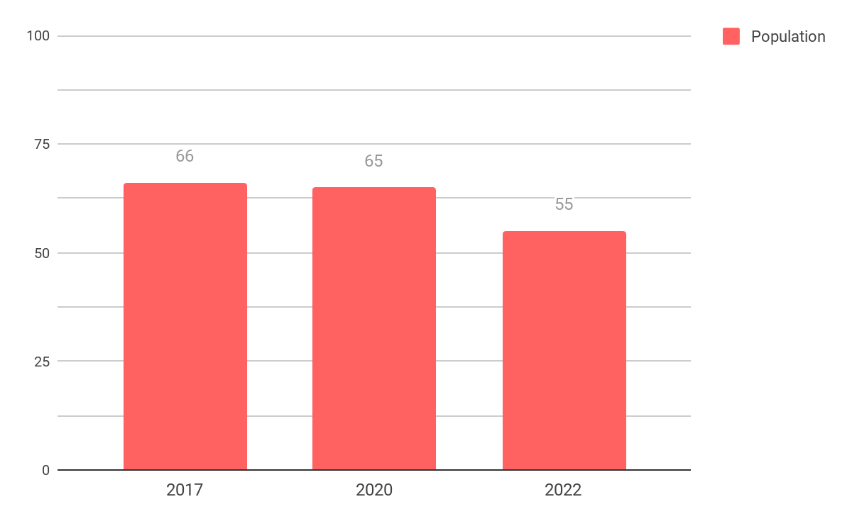
Traction
Based on a census conducted by the bureau, Compton has a total of 96, 455 residents as of 2017. About 60% or at least 57, 873 of the estimated population is comprised of student and unemployed workers aged 18 to 30.

Slide 11
Target Market
The chosen target market will be the residents of California primarily Compton. This specific group of individuals was chosen based on the following factors :
At least 40% of Compton’s population is between the ages of 18 to 50 years old.
About 52% percent of the population is male and 48% percent of the population is female.
Roughly 50% to 60% of the population are students and fresh graduates who are actively seeking jobs.

Slide 12
Competition
Based on a survey conducted in 2017, Star Employment Agency concluded that the following companies will be considered as direct competitors on the basis that they offer similar services :
Czar Recruitment Agency offers training and company job referrals with 10% commission rate.
Compton Employment Agency offers training and company job referrals with 8% commission rate.
EMP Training Center offers offers training and company job referrals with 5% commission rate.

Slide 13
Alternative Solutions
The alternative solutions Star Employment Agency can provide are the following:
Free 2 weeks training allowance ranging from $100 to $200.
Free job consultation and company hunt.
Free requirements assistance.

Slide 14
Business Model
The company will utilize the following business model which will be implemented by early 2019:
[SPECIFY BUSINESS MODEL]
Revenue equivalent to roughly $45,000 to $50,000 will be expected by the end of 2019.

Slide 15
Schedule
The company’s schedule will be as follows :
[SPECIFY COMPANY SCHEDULE]

Slide 16
Investing
In order to officially begin, the company will require a budget estimated between $30,000.00 and $40,000.00. This amount will be collected from the following sponsors :
1. Los Angeles Investment Inc.
2. AXA Insurance
3. Core Tech Merchandise
Each sponsor has agreed to contribute and invest at least $10,000.00 for Star Employment Agency .

Slide 17
Contact Us
Visit our office every Monday to Saturday from 9pm to 6pm at [ADDRESS].
Get in touch and contact any of these details :
[Phone Number]
[Email]
[Website]
[Social Media Account/S]

Slide 18
Thank You

