Slide 1


SUPREME BANK
BIGGER & EASIER
+209 8328784 | supremebank@gmail.com | supreme bank

Slide 2

Monthly Report
Presentation
1
Debit Card
Holders Report
2
Credit Card Holders Report
3
Children Savings
Passbook Report

Slide 3
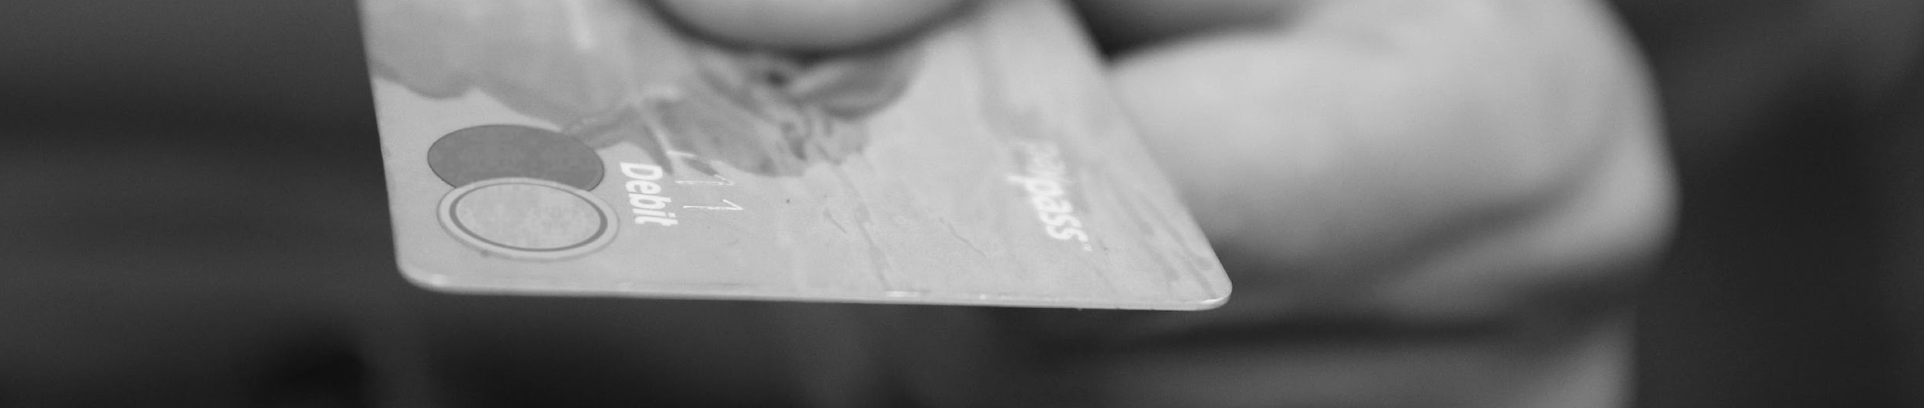
1
Debit Card Holders Report
Debit card holders report will be discussed at the Supreme Bank CEO Meeting Room on March 1, 2023, from 12 PM to 6 PM. This report will be presented to the executive officers of the Supreme Bank for clarification, revision & further development of the newly implemented project of the company.

Slide 4
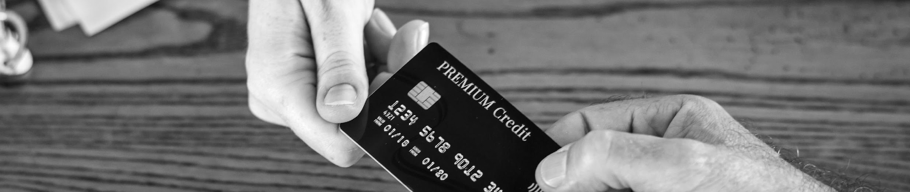
2
Credit Card Holders Report
This report will be discussed at the Supreme Bank Conference Hall on March 1, 2024, from 12 PM to 6 PM. Credit card holders report will be presented for an update, revision, & review by the executives of Supreme Bank.

Slide 5

3
Children Savings
Passbook Report
This implemented project will be discussed & reviewed at Supreme Bank Conference Hall on March 1, 2025, from 12 PM to 6 PM. The project report about children savings passbook is aimed to cover the month of February after its effective implementation last January 30, 2025.

Slide 6
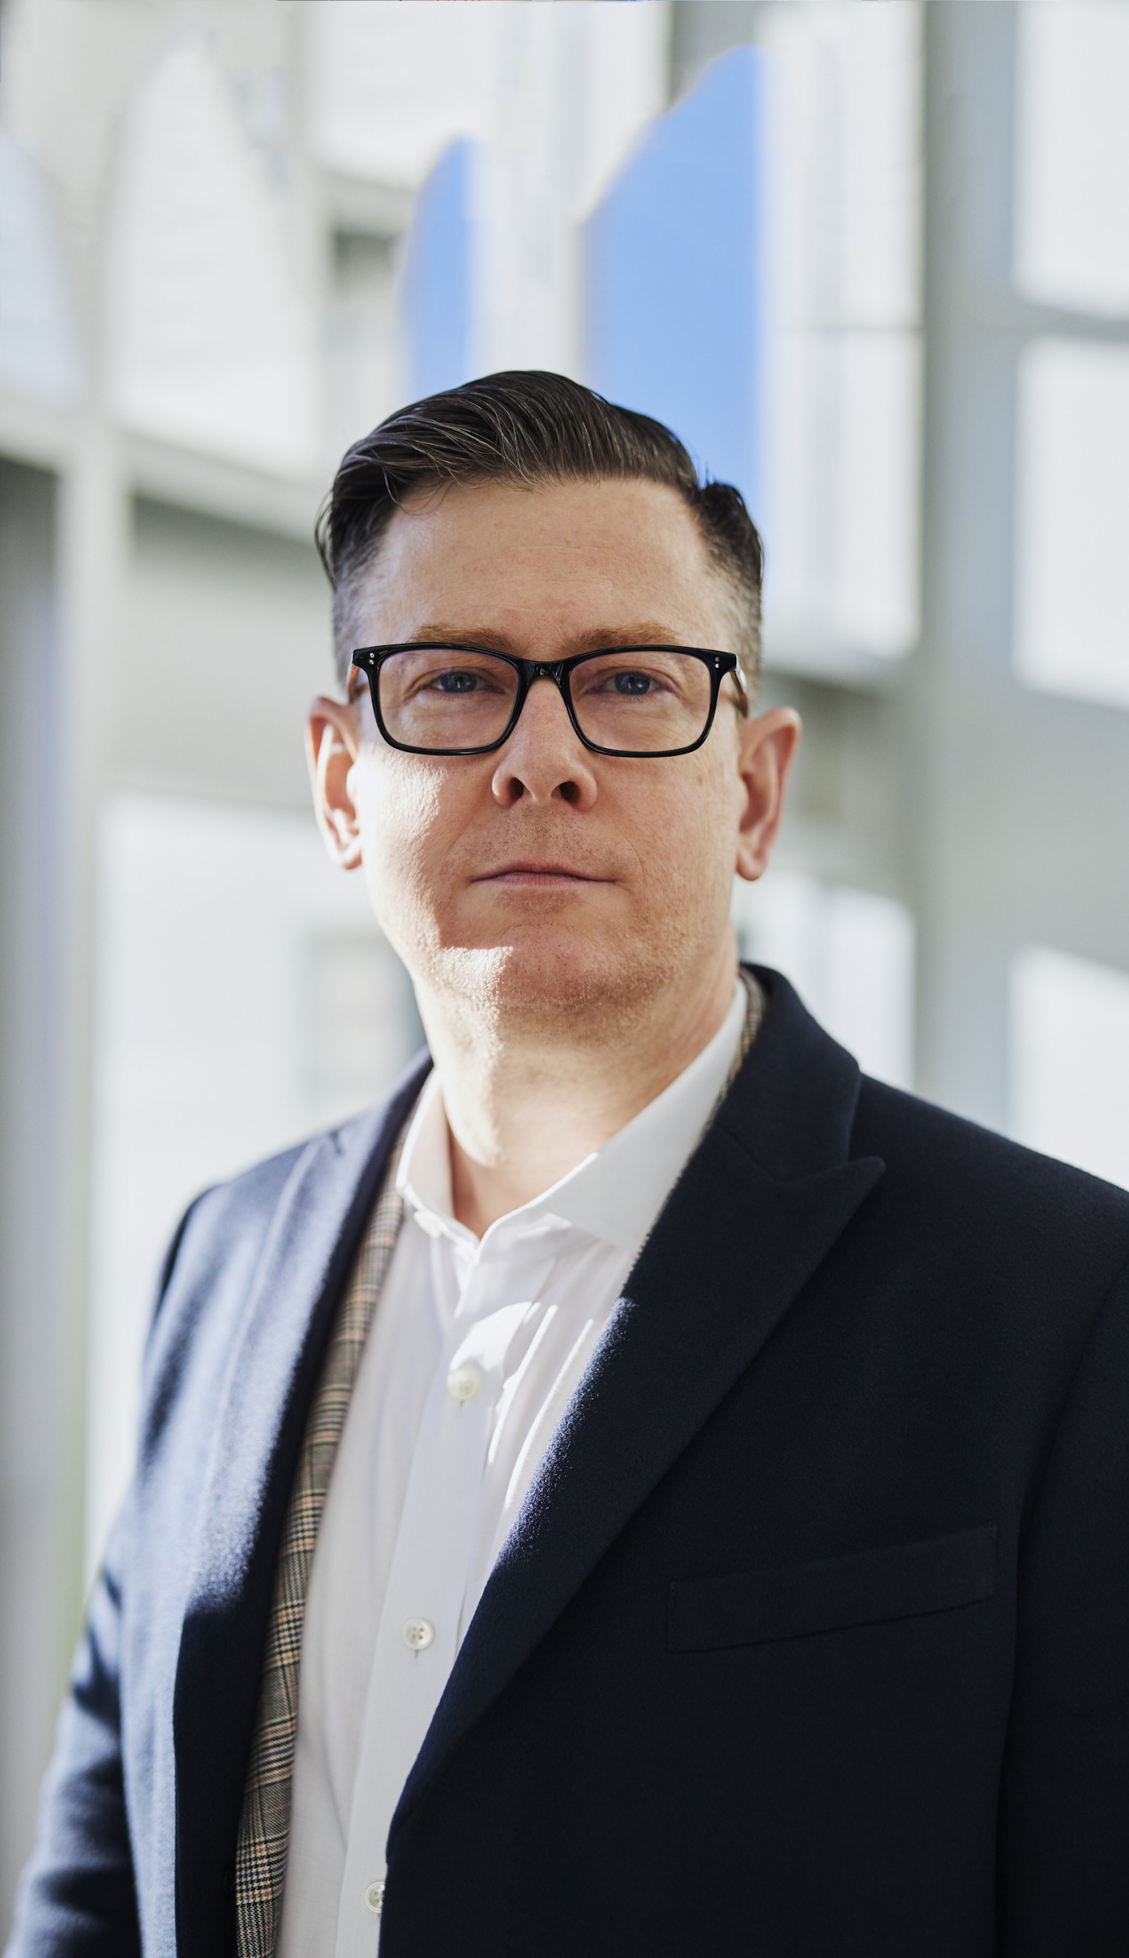
About Us
Ynez Kasparov
Founder & Chairman
Supreme Bank aims to provide highly reliable bank packages for all individual who wish to save their money at a bank they can truly trust. The bank now has over 30,000 active cardholders & members.
Supreme Bank was started by Ynez Kasparov who was a former stockbroker & assistant finance manager. Today, she is better knows as the founder of Supreme Bank.

Slide 7

Testimonials
“
Supreme Bank gives you the best package in the banking industry aimed to save & secure your money.
-Antony Hill, 38, Chief Finance Officer

Slide 8
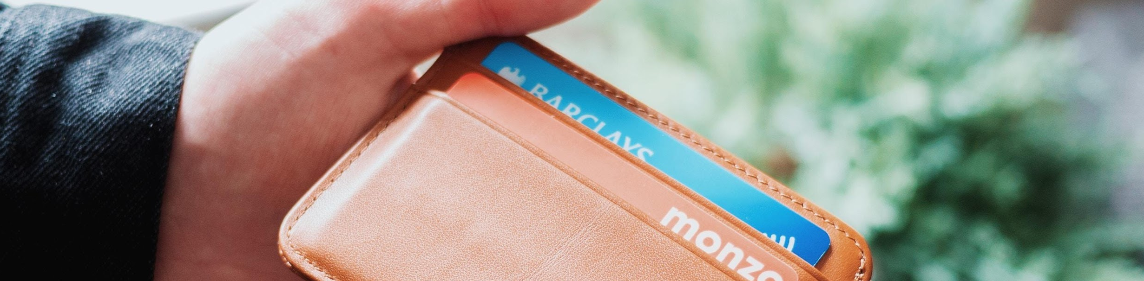
Debit Card Holders Report
1
This is aimed to further promote the non-Supreme Bank clients to avail debit cards & open accounts. 70% of the gained profits from this project will be donated to “Save Tree Foundation” & 30% of the gained profits will be used for the office renovation & system upgrade of Supreme Bank.
This report will give the initial outcome for the first month of the implementation of the new project called “Debit Card Holders” which will provide clients & cardholders with an annual interest rate of 3% exclusive for all debit card holders.

Slide 9
Credit Card Holders Report
2
The project includes new regulations implemented last January 30, 2024, which includes less annual interest for all credit card holders under Supreme Bank & up to 50% rebate on all items bought using the credit card.
The profits accumulated from this project will be used for the extensive marketing & promotion of the projects developed by Supreme Bank which targets to encourage up to 30,000 new clients to open an account & become members of Supreme Bank.
Supreme Bank Conference Hall
March 1, 2024 • 12 PM to 6 PM

Slide 10
Children Savings
Passbook Report
2
The report covers the current status of the project from its sales, profits, & gains for the first month of its activity. Children Savings Passbook aims to give all children whose ages are 5 to 12 years old to have a savings passbook managed by their guardians or parents.
Freebies & prizes such as 40% interest for the first 2 years of payment, free product consultation & up to 20% discount for the first 100 clients who will avail a children savings passbook.
Supreme Bank CEO Meeting Room
March 1, 2023 • 12 PM to 6 PM

Slide 11
Our History
Founded by Ynez Kasparov in 1990, Supreme Bank started as a small bank firm having only $6000 and 2 products in the market. It experienced many challenges throughout its early years in the banking industry. During its 18th year in the banking industry, it achieved its breakthrough and mainstream success as a bank firm with its project called “Save Now, Buy Later”. Today, Supreme Bank is now trusted by various firms & is recognized as one of the leading banks across the country.

Slide 12
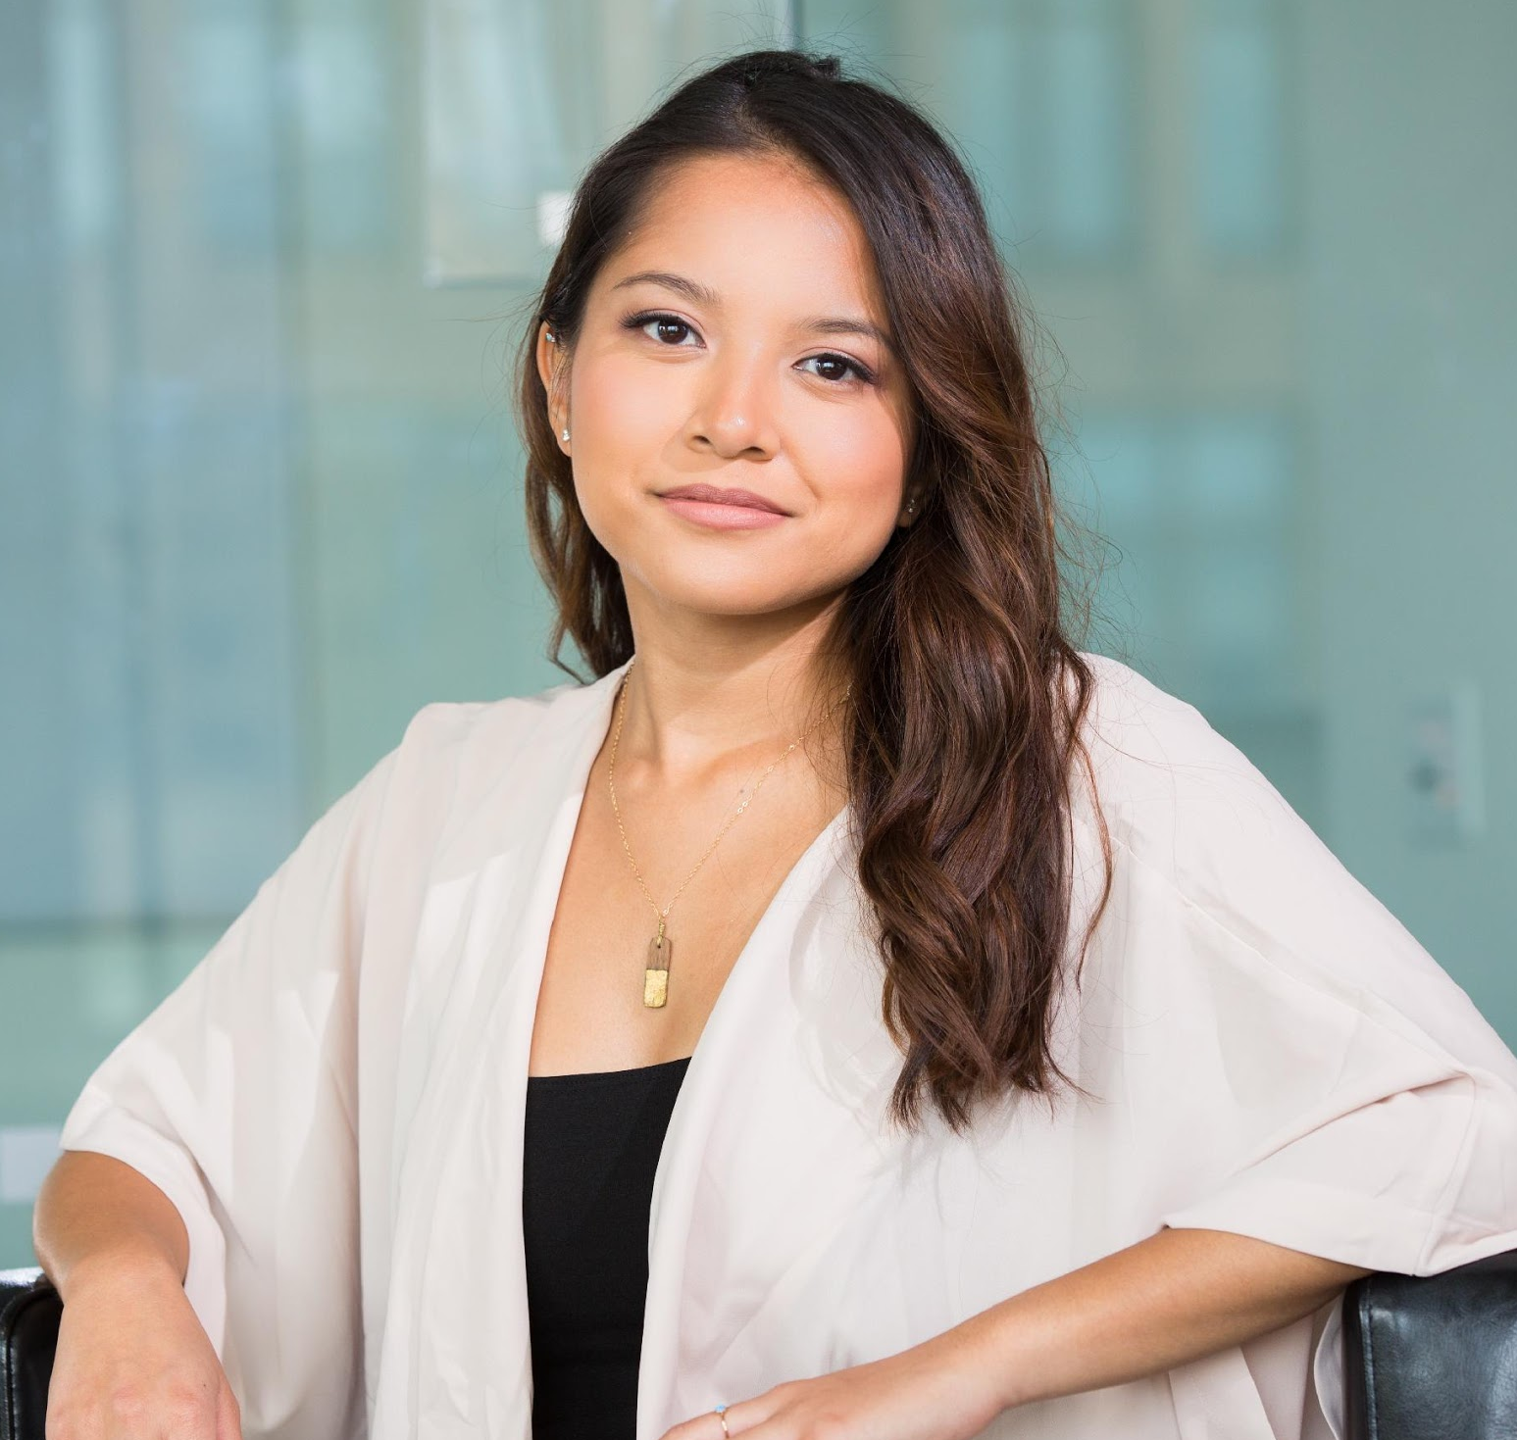
Testimonials
From Clients
“
“The best bank company I ever signed with! Kudos to the top notch & excellent quality of service to all active account holders under Supreme Bank.”
-Garcy Bill, 35, Housewife

Slide 13

Main Goal
Supreme Bank commits itself to provide high quality, reliable, & secure banking services for all of its clients.

Slide 14
Overview of Growth
3
40%
70%
50%
increase in annual profits as of May 2023.
increase in customer service
for the year 2024.
increase in new clients for the year 2025.

Slide 15

What We Offer
Various Convenient Banking Packages
1
3
Quality Assured
Services
Competitive & Effective Monetary Assistance
2
4
Excellent
Customer Care

Slide 16

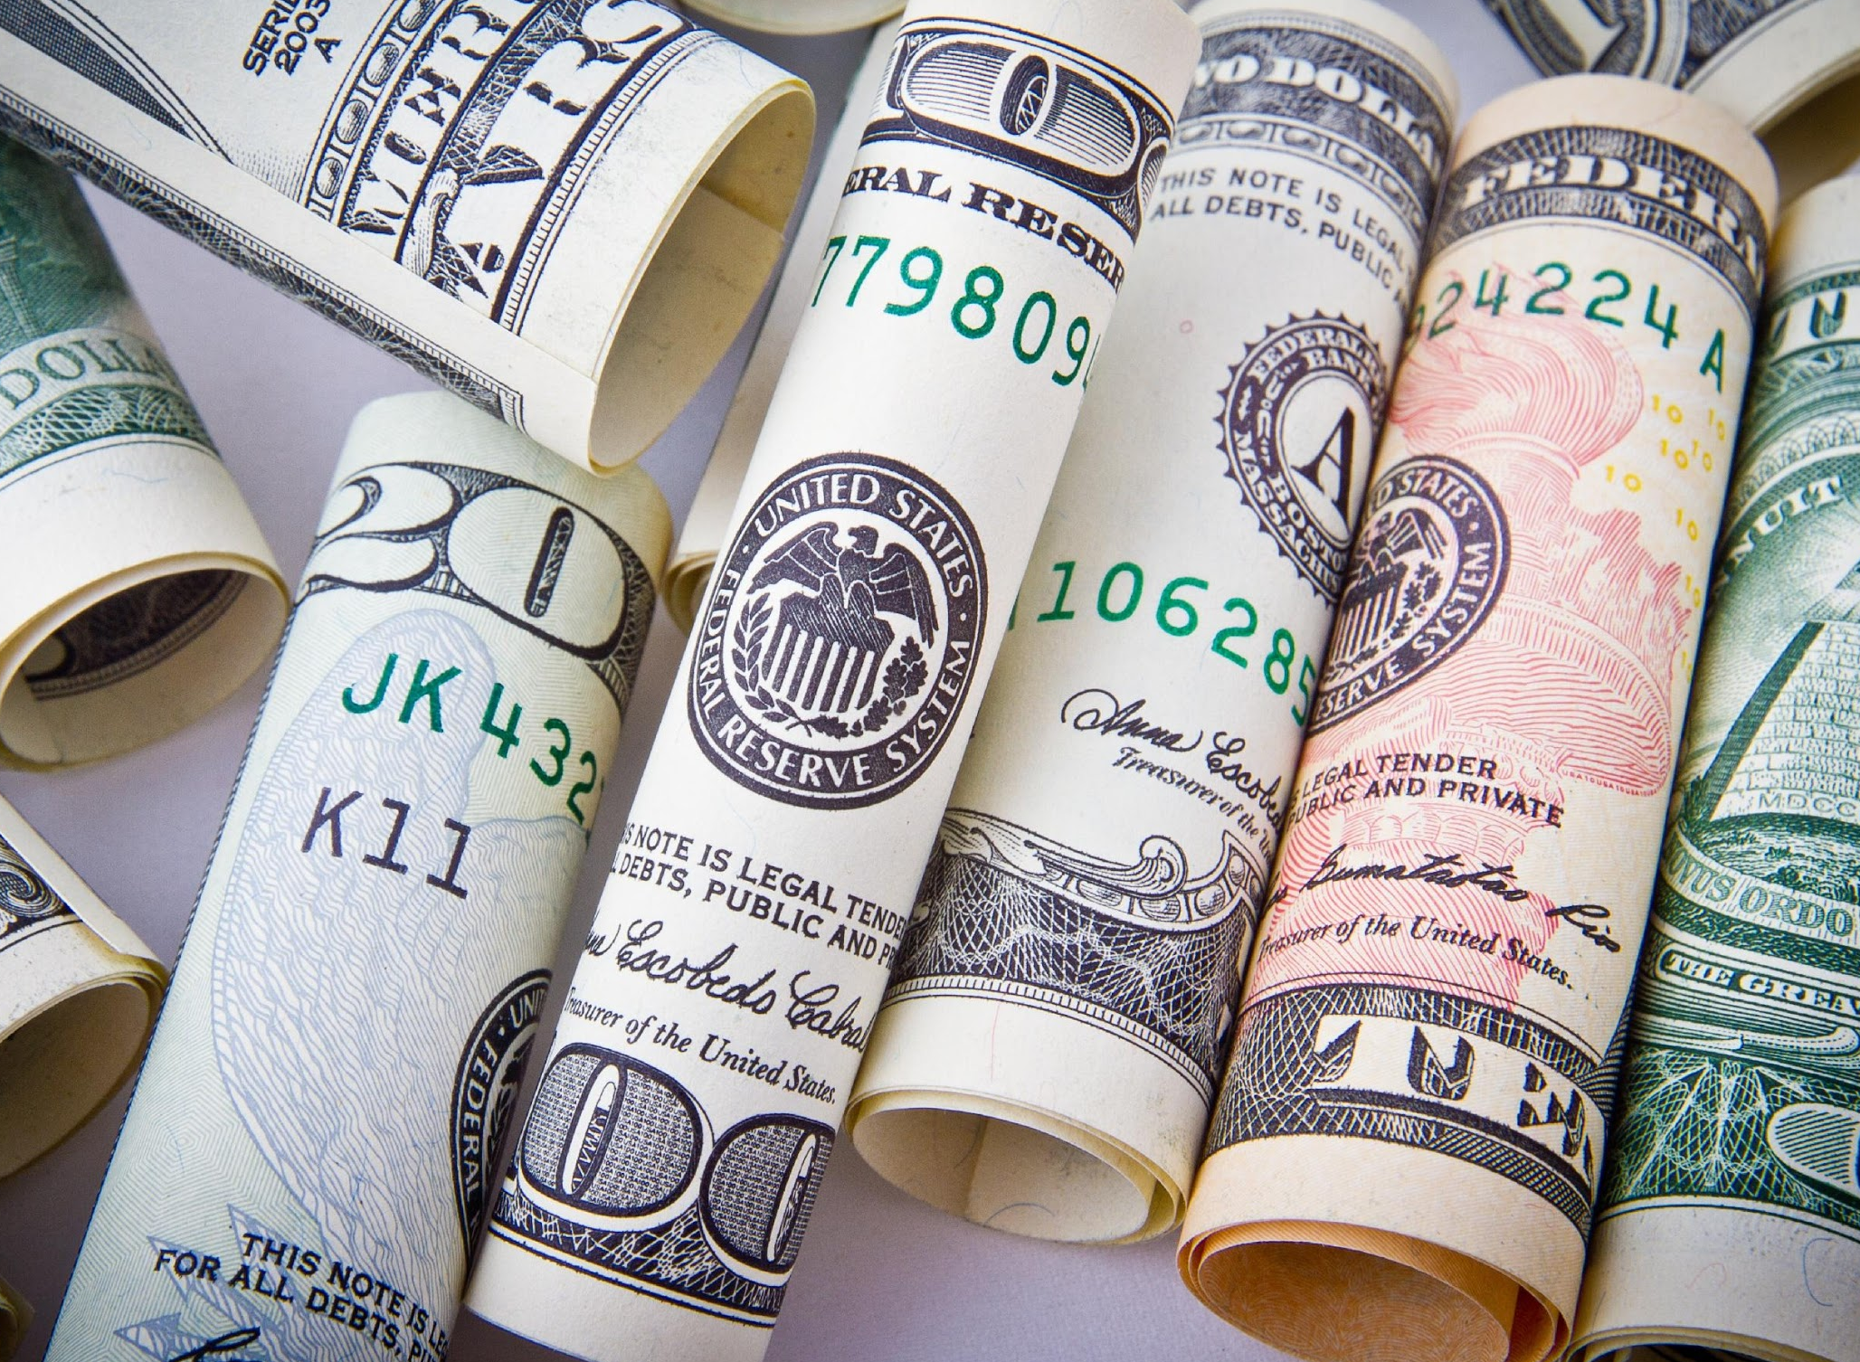


Image Gallery

Slide 17
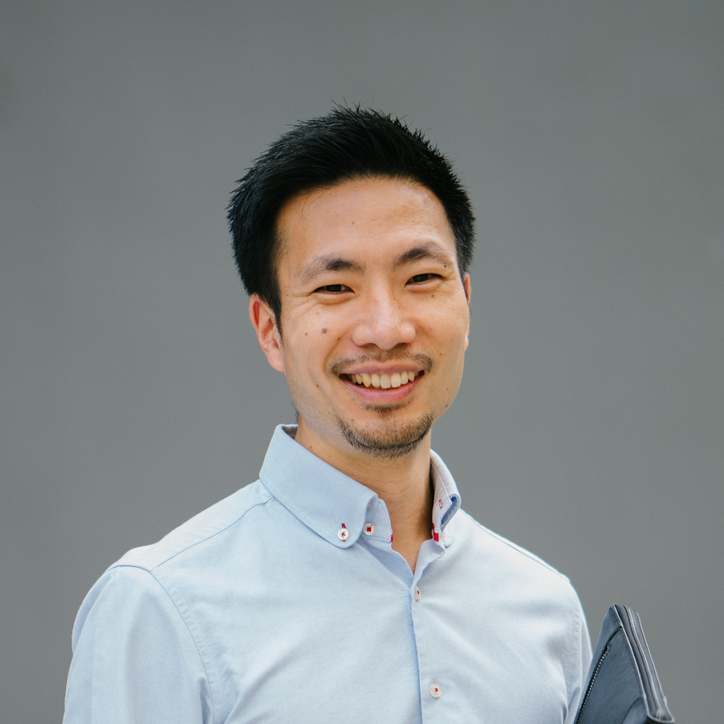

Our Team
Ynez Kasparov
Anthony Hill
Dr. Joseph Blas
Founder & Chairman
Chief Finance Officer
Chief Operating Officer

Slide 18
Thank You!
+209 8328784 | supremebank@gmail.com | supreme bank

