Slide 1

Business Plan
Pitch Deck

Slide 2

About Us
Sweet and Chic is a baking company based in Vienna, Austria. It has been in the industry since early 2000 and was opened by Reno With sconstine was an executive chef in Missouri.

Slide 3


Vision
Sweet and Chic’s vision is to become a well renowned baking company in all of Austria and establish at least 5 branches across Europe by the year 2030.
Mission
Sweet and Chic’s mission is to provide elegantly designed, scrumptious pastries, sweets and desserts.

Slide 4


Food Committee
June Mill
Kate Newman
Chief Creative Officer
Executive Pastry Chef
Manages the company’s branding, marketing and quality of products.
Finalizes and manages pastry design, dessert recipes and the ingredients to be used.

Slide 5


Food Committee
Lawrence Sue
John Bail
Quality Control Inspector
Customer Service Representative
Manages and monitors the quality of products being sold in the market.
Ensures the production standards of the company.
Interacts with the customers by providing information on the bakery and solutions to problems.

Slide 6

The Problem
Yummy Magazine’s survey conducted in 2017 shows that at least 30 baking companies close nearly every year since 2014 due to bad reviews from customers on poor services and overpriced, mediocre bakery goods.

Slide 7

Our Solution
Sweet and Chic sources only fresh, top quality ingredients within Vienna that our well trained and professional pastry chefs utilize in order to create goods that are pleasing to both the eye and the palate. All of the goods will be made available at competitive and reasonable price points.

Slide 8
Advantages
Sourcing and utilization of fresh ingredients produced and sold within Vienna.
Extensive and rigid quality control for all bakery goods being produced and sold.
Provision of top notch baking amenities and baking equipment for all chefs.
Training workshops for all chefs to help them improve their baking skill set.
Competitive and reasonably priced pastries, desserts, and goods.

Slide 9

Fabulosa
“FABULOSA” aims to give you gourmet cakes and pastries fabulously designed by our food committee for a starting price of only €1.

Slide 10

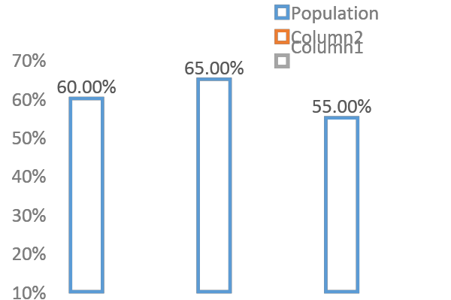
Traction
Based on a statistics report released by the Vienna statistics office, Vienna has a total of 1, 867, 582 residents and a total of 1, 383, 454 annual visiting tourist as of 2017.

Slide 11
Target Market
The chosen target market will be the residents of Austria primarily Vienna. This specific group of individuals was chosen based on the following factors :
Up to 1, 383, 454 tourists visit Vienna annually.
At least 1, 867, 582 of the population are residents of Vienna.
Roughly 30% to 40% of Vienna’s entire population are seeking for affordable and tasty desserts, pastries, and baked goods.
35% of Vienna’s entire population are seeking for affordable and tasty desserts,

Slide 12
Competition
Based on a survey conducted in 2017, Sweet and Chic concluded that the following companies will be considered as direct competitors on the basis that they offer similar services :
€3.50 Fresh Bake Cake Shop offers a wide range of cakes and desserts starting.
€2.50 J & J Desserts offers a wide range of cakes and desserts starting.
€3.99 Betty’s Cake offers a wide range of cakes and desserts starting.

Slide 13

Alternative Solutions
The alternative solutions Sweet and Chic can provide are the following:
Free red velvet cupcakes for the first 100 customers every 1st day of each calendar month.
20% to 30% monthly discounts for Sweet Life Membership Card holders.
Free cake customization and design for Sweet Life Membership Card holders.

Slide 14

Business Model
The company will utilize the following business model which will be implemented by early 2019:
[SPECIFY BUSINESS MODEL]
Revenue equivalent to roughly $45,000 to $50,000 will be expected by the end of 2019.

Slide 15

Schedule
The company’s schedule will be as follows :
[SPECIFY COMPANY SCHEDULE]

Slide 16
Investing
In order to officially begin, the company will require a budget estimated between $30,000.00 and $40,000.00. This amount will be collected from the following sponsors :
1. Vienna Insurance Bank
2. Equity Investment Corp.
3. Carol Baking Supplies & Merchandise
Each sponsor has agreed to contribute and invest at least $10,000.00 for Sweet and Chic.
Each sponsor invest at least $10,000.00 for Sweet and Chic.

Slide 17

Contact Us
Visit our office every Monday to Saturday from 9pm to 6pm at [ADDRESS].
Get in touch and contact any of these details :
[Phone Number]
[Email]
[Website]
[Social Media Account/S]

Slide 18

Thank You

