Slide 1
?
Company Life Financial Corp.
94 Summit St. Davenport, IA 52807 | +9082 09284 | cl@financial.com

Slide 2
ALL YEAR MARKETING PLAN
This will be held at the Downtown Convention on November 14, 2024 from 9am to 6pm. Tickets start at only $19.99 and will feature exclusive freebies like free marketing plan assistance as well as a marketing planner worth $39.99. 60% of the profits from this event will be donated to the Children in the Africa Foundation and the remaining 40% will be utilized for the opening of the new Company Life Financial Corp. branch in Alaska.
BOOST ALL! AN EXPO FOR ALL BUSINESS
Agenda
This special event sponsored by TMX will be held at the Midtown Convention on July 4, 2025 from 10am to 7pm. Tickets start at just $13.99 each and will feature freebies like free marketing strategy to help boost a product, as well as discounts on great product selections. Profits gained from this event will be donated for the office renovation and system upgrade of Company Life Financial Corp.
Alaska branch.
MONTHLY BOARD MEETING
This monthly board meeting will be held on January 04, 2020 at Company Life Financial Corp. conference hall from 12pm to 6pm. This meeting is aimed to track and update the corporation’s status from the years 2015 to 2020. This meeting will also include the revision and review of the new set of marketing strategies, newly developed events and expos and product strategies to boost the corporations profit for the year 2025 to 2030.

Slide 3
Dmitry Knyazev
Chairman & CEO
I am pleased to welcome you to the strongest and most reliable financial company in the country, Company Life Financial Corp.
Although this company started to become one of the fastest growing companies, the Company Life Financial Corp. stayed humble and customer friendly company with their affordable and competitive product packages available for all.
Today, Company Life Financial Corp. has over 8,000 active employees 2 different fully operating branches and 5 soon to be opened branches across the country.
As a company that is dedicated to deliver the best, most reliable and affordable products in the market, we at the Company Life Financial Corp. will strive further to satisfy all of our new and potential customers.

Slide 4
All Year
Marketing Plan
Downtown Convention
November 14, 2024
9am to 6pm
Tickets start at only $19.99 and will feature exclusive freebies like free marketing plan assistance as well as a marketing planner worth $39.99. 60% of the profits from this event will be donated to the Children in the Africa Foundation and the remaining 40% will be utilized for the opening of the new Company Life Financial Corp. branch in Alaska.

Slide 5
Boost All! An Expo For All Business
Midtown Convention
July 04, 2025
10am to 7pm
Tickets start at just $13.99 each and will feature freebies like free marketing strategy to help boost a product, as well as discounts on great product selections. Profits gained from this event will be donated for the office renovation and system upgrade of Company Life Financial Corp. Alaska branch.

Slide 6
Monthly Board Meeting
Company Life Financial Corp. Conference Hall
January 04, 2020
12pm to 6pm
This meeting is aimed to track and update the corporation’s status from the year 2015 to 2020. This meeting will also include the revision and review of the new set of marketing strategies, newly developed events and expos and product strategies to boost the corporations profit for the year 2025 to 2030.

Slide 7
Founded by Dmitry Knyazev in 1989 and has been operating and competing in the financial industry for over 29 years. Company Life Financial Corp. is a proud provider of the newest and most reliable financial assistance products and services for company, family and personal use. Today, it has 2 fully operating offices in Illinois and Manhattan, up to 8,000 active employees and 5 soon to rise branches in Alaska, Arizona, Texas, Ohio and Minnesota.
History

Slide 8
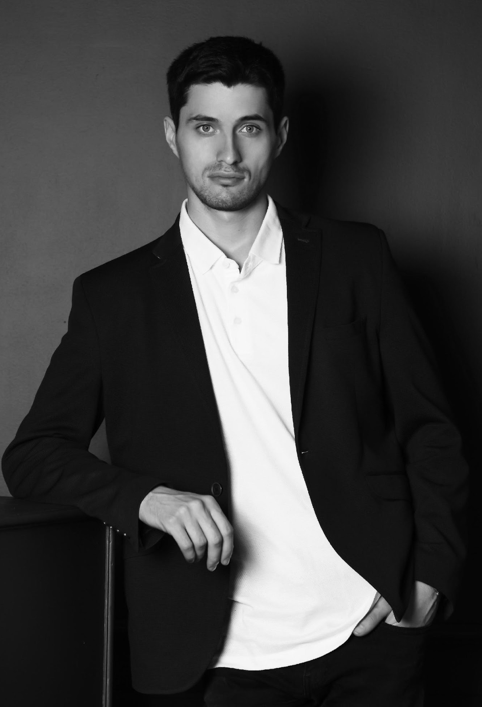
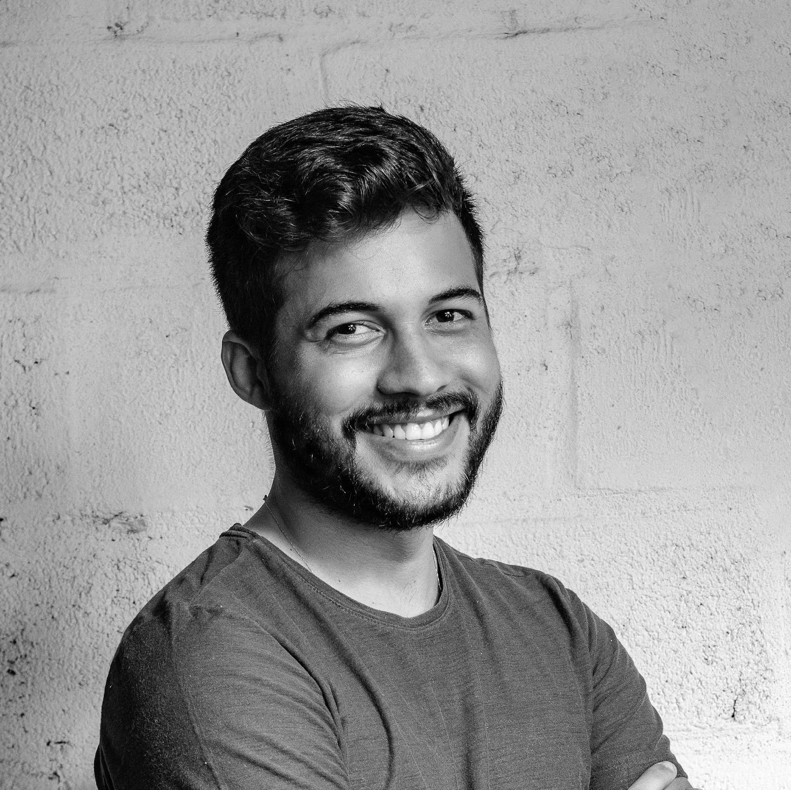
Testimonials
“
Another exciting year awaits for this company delivering more great product selections for all of our valued customers.
- Dmitry Knyazev, 64, Chairman & CEO
“
I am always happy and satisfied with the way the Company Life Financial Corp. assists me with my financial problems. They offer nothing but reliable, secure financial assistance.
- Henry Gaiden, 31, Economist & Professor

Slide 9
Main Goal
Company Life Financial Corp.’s main goal is to help all clients and customers who are in dire need of financial assistance and provide excellent, reliable and quality customer care as well.

Slide 10
Overview Of Growth
70%
Increase in annual profits as of November 2026
40%
Increase in sold company products and packages as of March 2026
60%
Increase in new clients as of March 2025

Slide 11
What We Offer
Free Marketing Strategy Consultations
Affordable Product and Service Packages
Excellent Customer Care
Free Financial Assistance

Slide 12
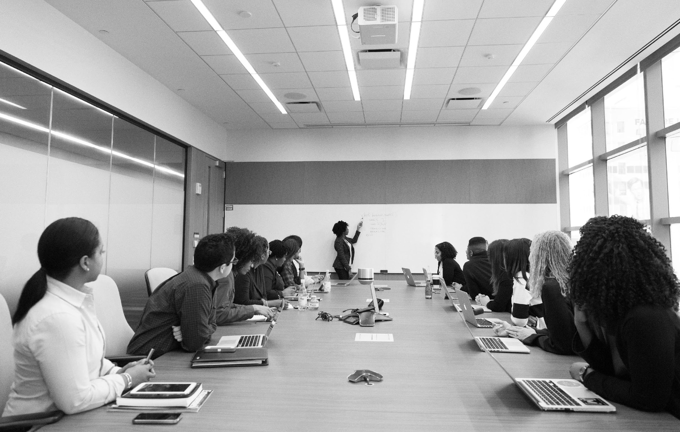
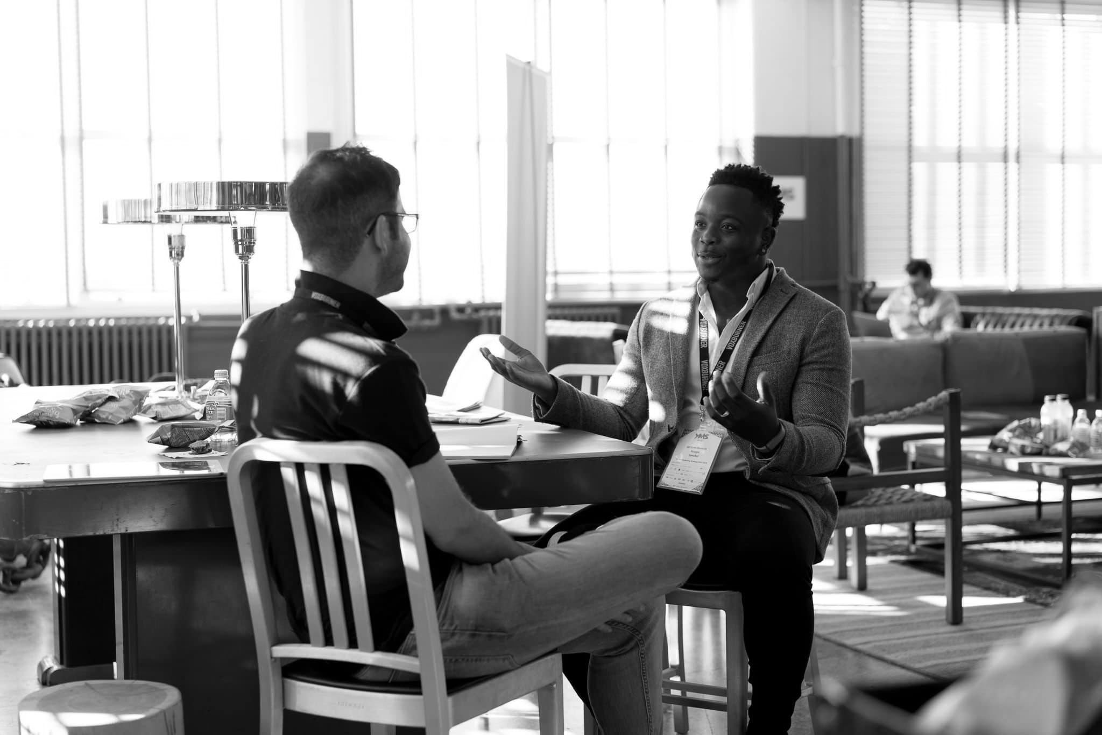
Image
Gallery

Slide 13
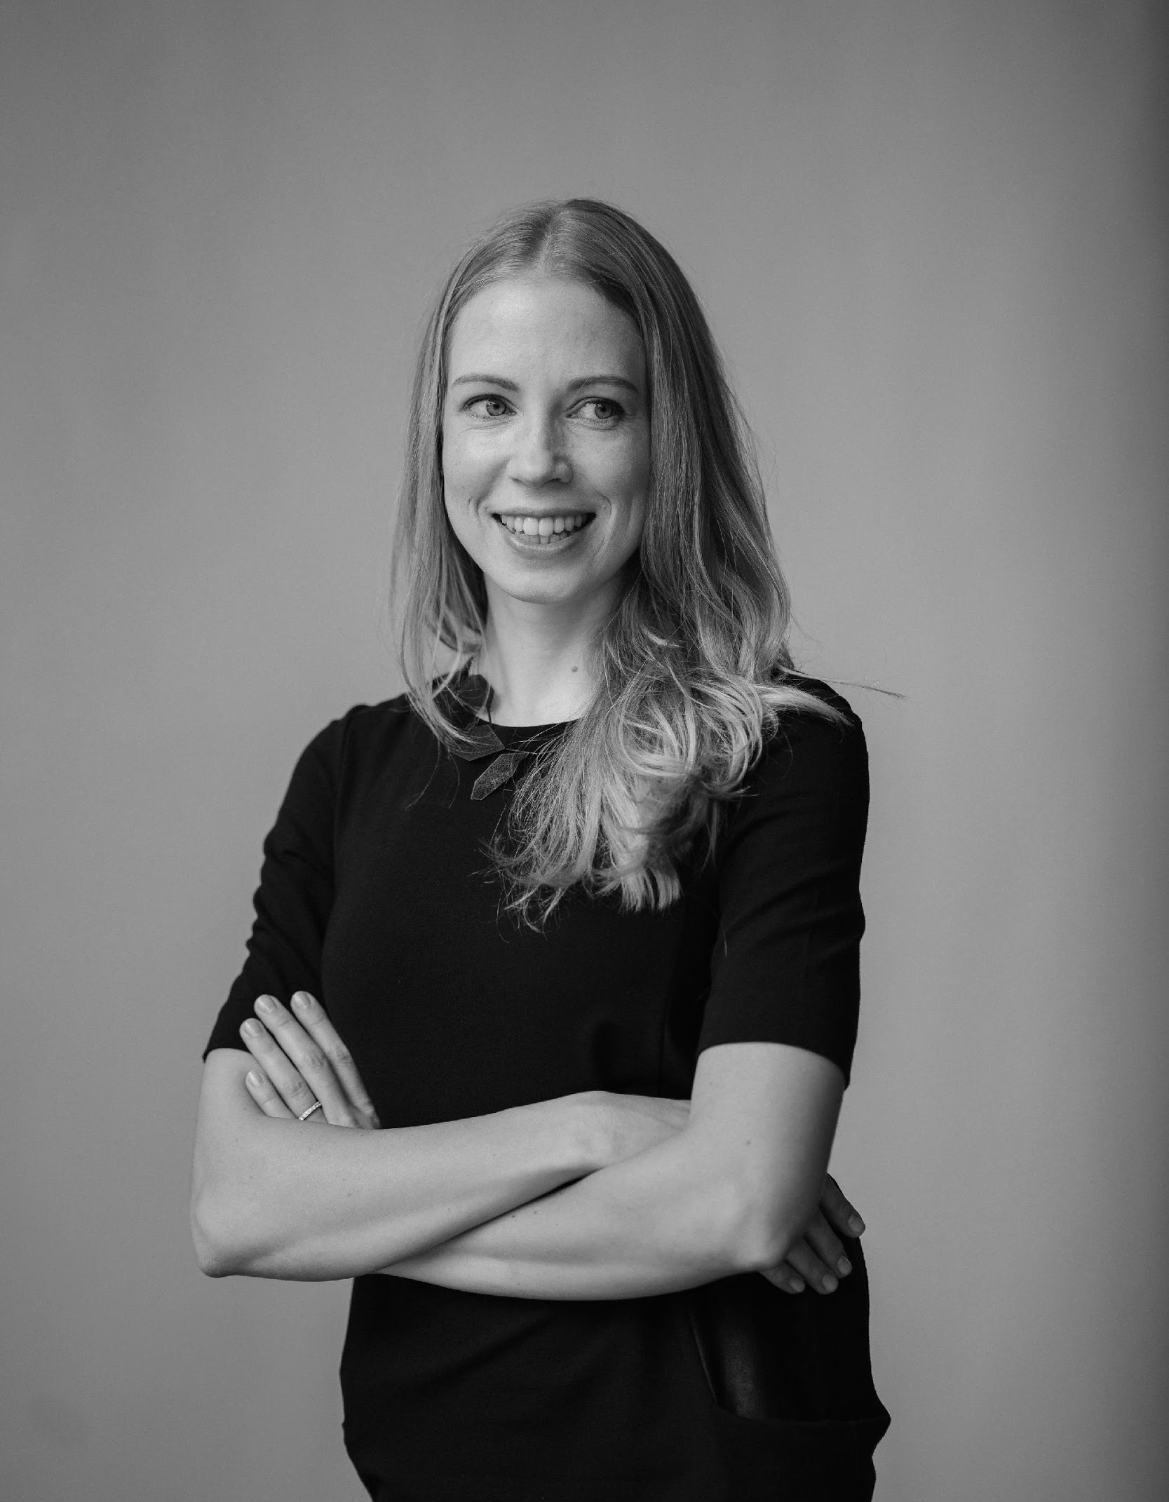
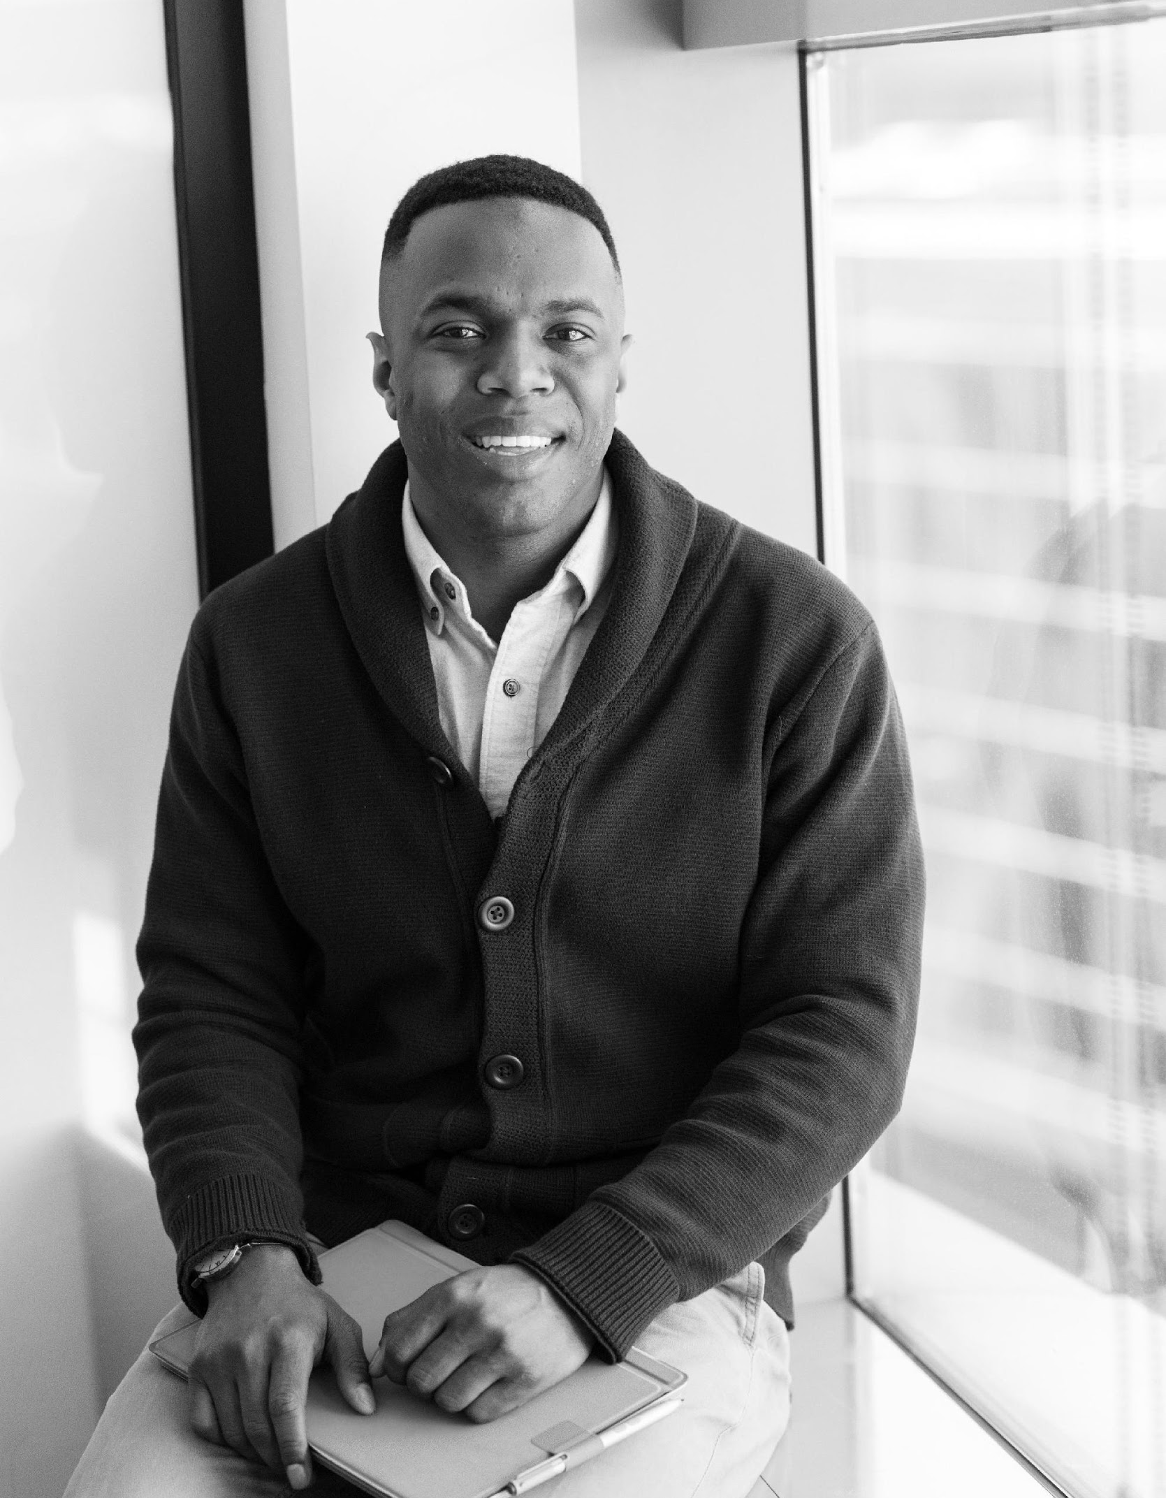
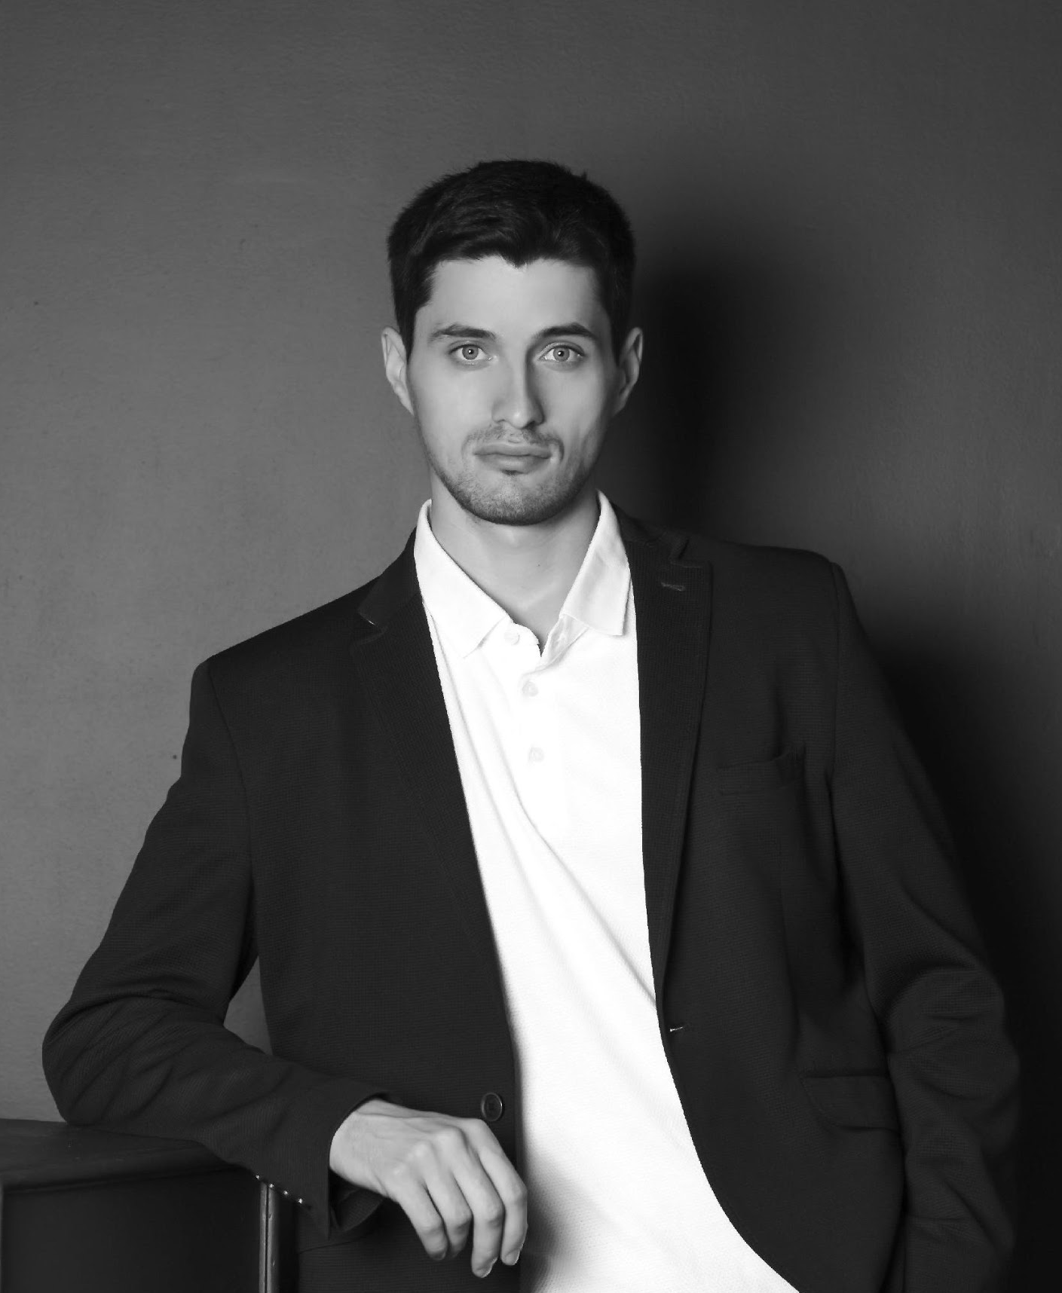
Company
Management
Dmitry
Knyazev
Julia
Kirilenko
West
Faux
Chairman & CEO
Chief Marketing Officer
Chief Operating Officer

Slide 14
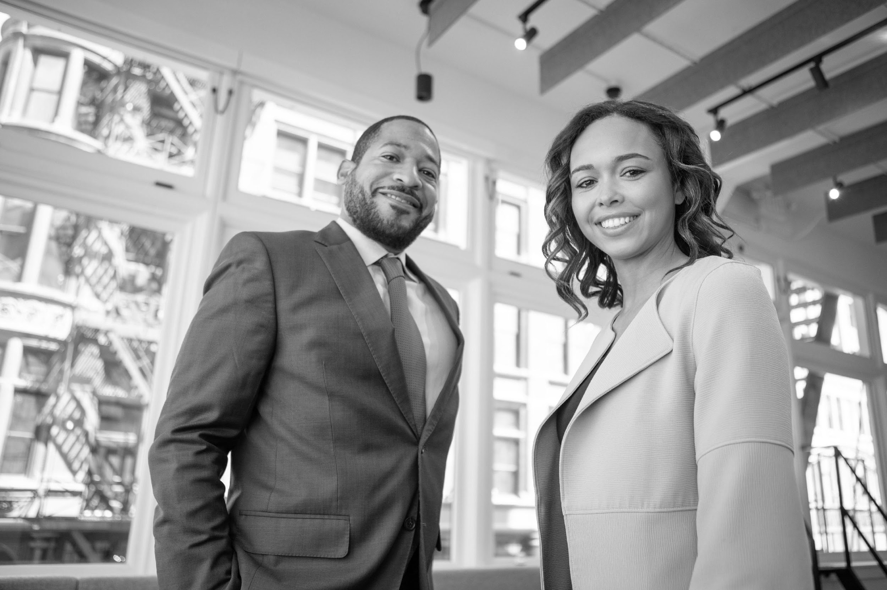
?
Thank
You
cl@financial.com

