Slide 1
POUND FOR POUND
CONSTRUCTION, INC.
+76 37368 8728 | construct@pound.com

Slide 2
UPCOMING PROJECTS

Slide 3
Pioneering Mix is a newly developed project made to increase convenience for the construction of a variety of homes. This will be discussed at Pound for Pound Construction conference room on January 24, 2023 from 12pm to 6pm. Pioneering Mix will be a package that features all the best equipment and construction materials that Pound for Pound Construction, Inc. has to offer.
It aims to be able to provide better quality construction company materials and services at reasonable price points. This project is estimated to generate up to $900, 000 profit for the first 2 weeks of the project implementation.
PIONEERING MIX

Slide 4
1 YEAR MAXIMUM MADE
1 Year Maximum Made is a project that prioritizes strictly emphasizing the 1 year maximum construction agreement. This project will be discussed at Pound for Pound CEO Meeting room on January 21, 2024 from 12pm to 6pm. The project’s main goal is to deliver reliable and quality assured construction services while staying within the time constraint of a 1 year maximum deal.
It will provide the fastest and most efficient construction possible paired with careful and meticulous planning. Additionally, only the sturdiest and most durable of construction materials will be used to ensure top quality and safety. It is estimated to generate up to $500, 000 in profit within the first month.

Slide 5
30 DAYS STRAIGHT
This project is aimed to deliver construction on any types and kinds of property. This project will be discussed and presented at Pound for Pound Conference Hall on January 20, 2025 from 12pm to 6pm. The 30 Days Straight project gives the assurance in delivering efficient and effective reconstruction to any damaged property at very competitive price points. Tentative prices will start at $150.
Profits gained from this project will be used to buy additional new and state of the art construction materials and construction equipments.

Slide 6
ABOUT
Pound for Pound Construction, Inc. is a proud provider of fast and highly dependable services in terms of construction. Started in 1996, Pound for Pound Construction, Inc. showcases the true meaning of pound for pound construction services over other construction companies.
This company has been constructing major sights and buildings all over the country while consistently providing the best possible materials and services for each client. Over the years , this company has garnered awards and recognition from different institutions praising the company’s offered services and efficient work.

Slide 7
TESTIMONIAL
“A construction company that offers nothing but the high quality packages and consistently reliable services, Pound for Pound Construction, Inc is nothing but amazing.”
-Engr. Bill Zoe, 49, Quality Control Officer

Slide 8
PIONEERING MIX
Pound for Pound Construction Conference Room
January 24, 2023
12pm to 6pm
Pioneering Mix is a newly developed project made to increase convenience for the construction of a variety of homes. It will be a package that features all the best equipment and construction materials that Pound for Pound Construction, Inc. has to offer.
It aims to be able to provide better quality construction company materials and services at reasonable price points. This project is estimated to generate up to $900, 000 profit for the first 2 weeks of the project implementation.

Slide 9
1 Year Maximum Made is a project that prioritizes strictly emphasizing the 1 year maximum construction agreement. The project’s main goal is to deliver reliable and quality assured construction services while staying within the time constraint of a 1 year maximum deal. It will provide the fastest and most efficient construction possible paired with careful and meticulous planning.
Additionally, only the sturdiest and most durable of construction materials will be used to ensure top quality and safety. It is estimated to generate up to $500, 000 in profit within the first month.
1 YEAR MAXIMUM MADE
Pound for Pound CEO Meeting Room
January 21, 2024
12pm to 6pm

Slide 10
This project is aimed to deliver construction on any types and kinds of property. The 30 Days Straight project gives the assurance in delivering efficient and effective reconstruction to any damaged property at very competitive price points. Tentative prices will start at $150. Profits gained from this project will be used to buy additional new and state of the art construction materials and construction equipments.
30 DAYS STRAIGHT
Pound for Pound Conference Hall
January 20, 2025
12pm to 6pm

Slide 11
HISTORY
Pound for Pound Construction, Inc. was founded by Engr. Brian Iowa in 1996 and started as a small construction supply store. The company faced lots of challenges and problems during its starting years in the construction industry which made it stronger. In 2008 the company experienced its success and breakthrough because of its excellent construction of the Kennedy Public Park in Oakland, California. Today, Pound for Pound Construction has garnered numerous awards and positive recognition in the construction industry and aims to expand its logo and brand across the country.

Slide 12
CLIENT TESTIMONIAL
“With their best quality and efficient time constructing management, Pound for Pound Construction, Inc. gives you nothing but amazing service and quality assistance in construction service.”
-Jeremy Brenner, 48, Home Builders Association

Slide 13
MAIN GOAL
Pound for Pound Construction, Inc. aims to become the top leader of construction services through quality assured construction packages and efficient time management.

Slide 14
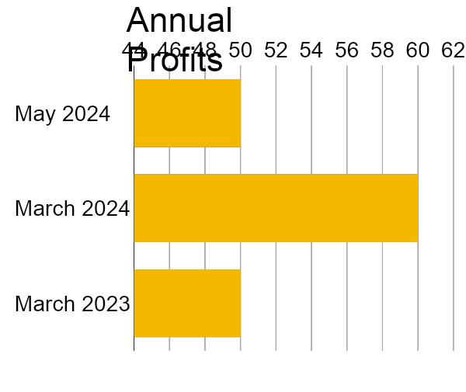
OVERVIEW OF GROWTH
40% increase in annual profits as of May 2024.
60% increase in construction service approval as of March 2025.
50% increase in new clients as of March 2023.

Slide 15
WHAT WE OFFER
The Best Construction Service
Efficient Construction TIme Management
Extensive and Meticulous Construction Planning
Friendly and Quality Assured Customer Service

Slide 16
IMAGE GALLERY

Slide 17
THE TEAM
Engr. Brian Iowa
Founder & CEO
Rose Yumimoto
Chief Marketing Officer
Engr. Bill Zoe
Quality Control Officer

Slide 18
THANK YOU!
+76 37368 8728
construct@pound.com

