Slide 1
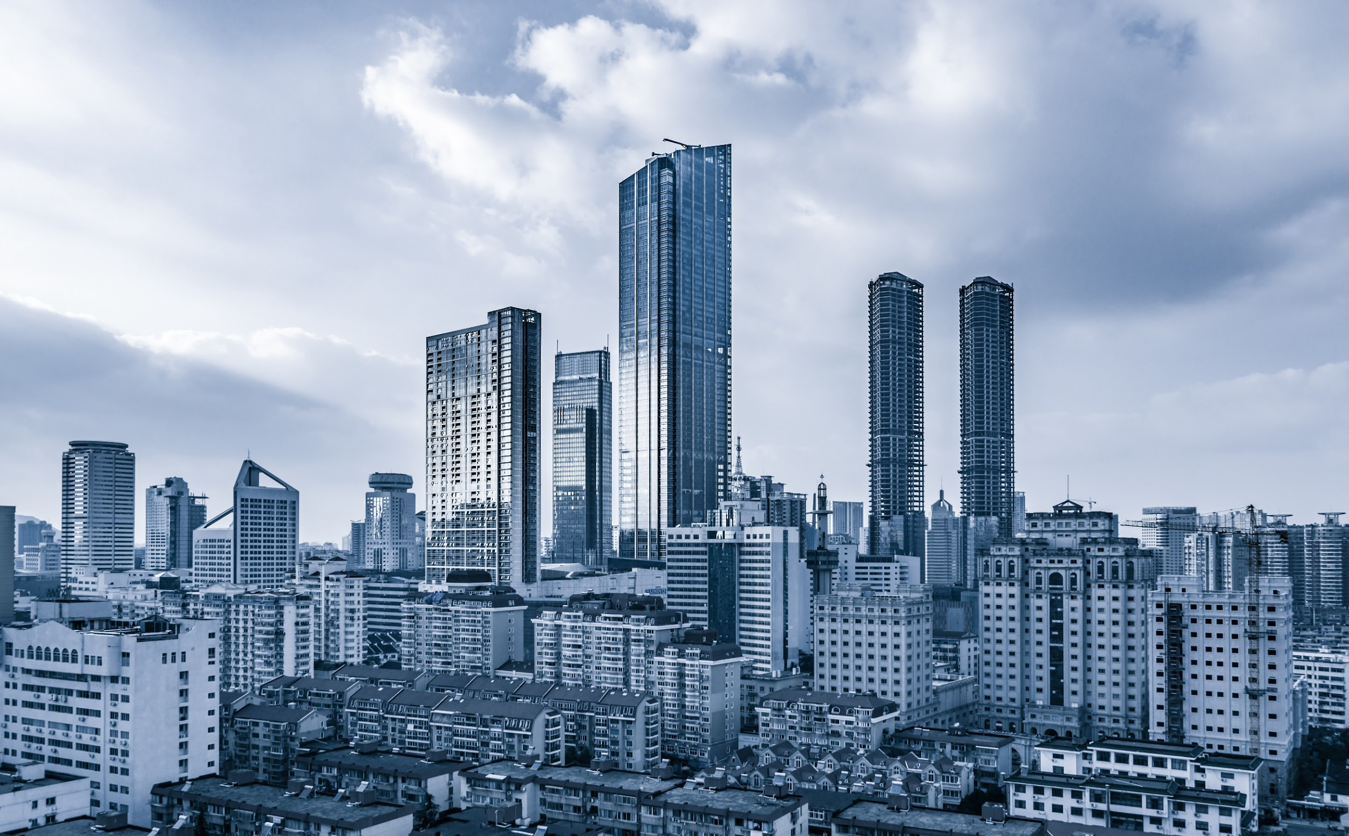
Corporate
Pitch Deck

Slide 2

About Us
Happy Coffee Brewing Company is a coffee manufacturing company based in Seattle, Washington. It was founded by Jon Quest in 2001, a previous coffee farmer.

Slide 3
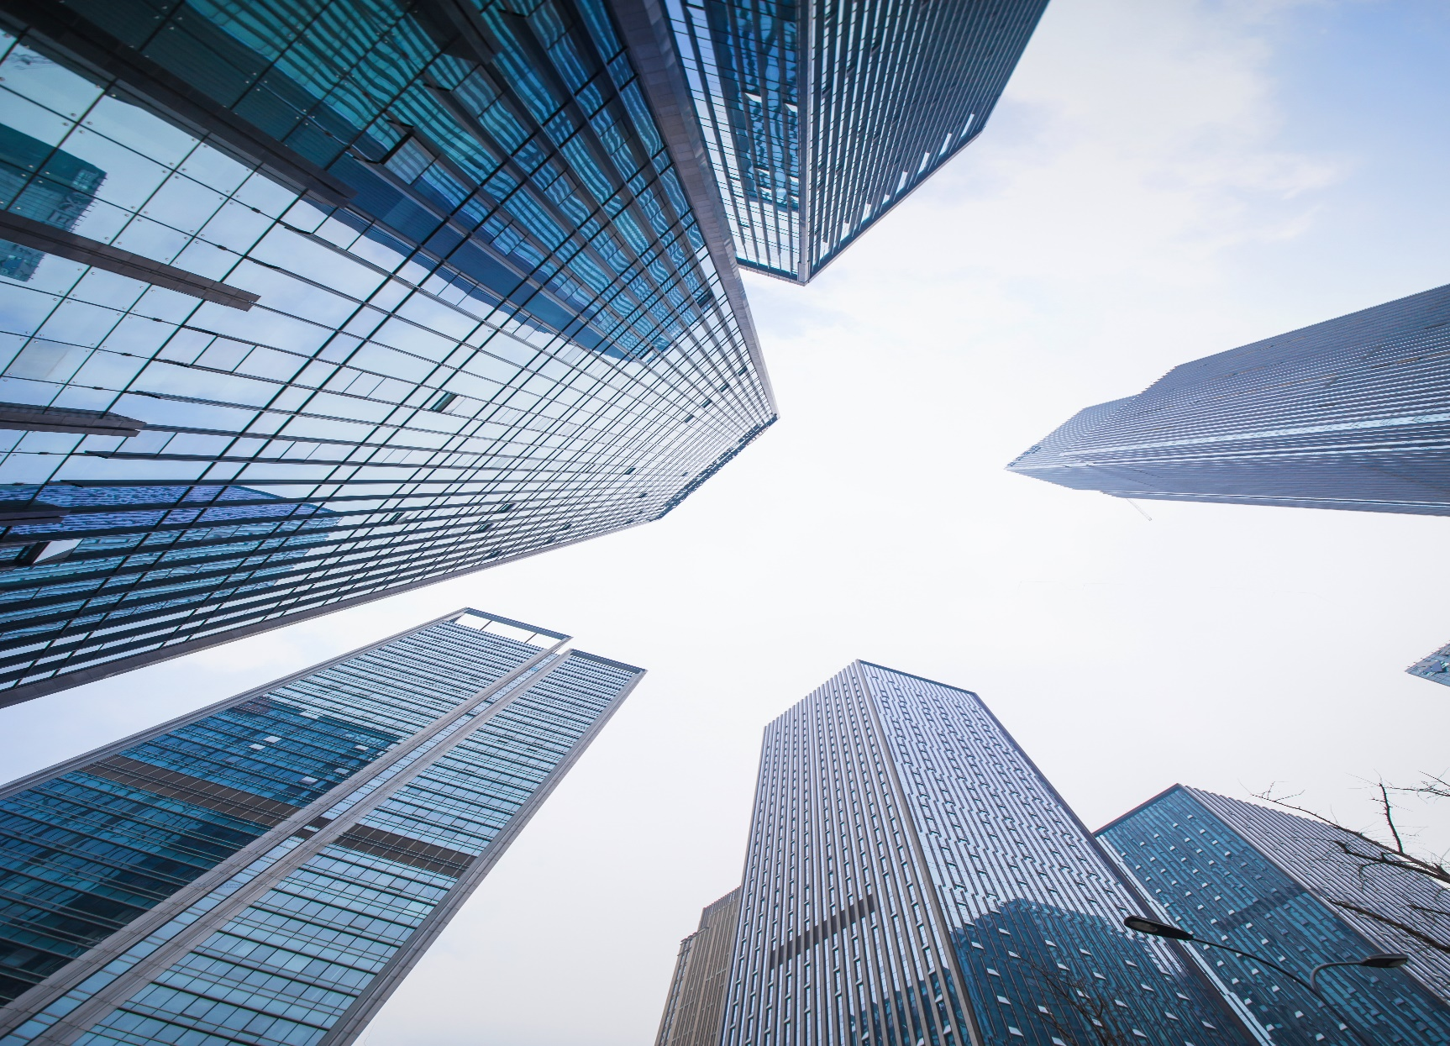
Vision
Our vision is to become the top leading brewing company across the country and to establish at least 3 branches by the year 2030.
Mission
Our mission is to provide top quality coffee and coffee based drinks for all caffeine enthusiasts around the globe.

Slide 4
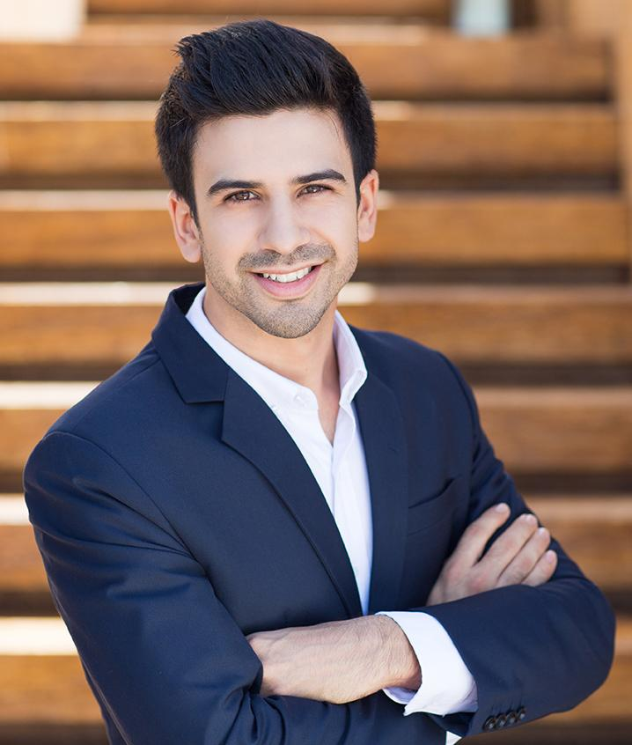
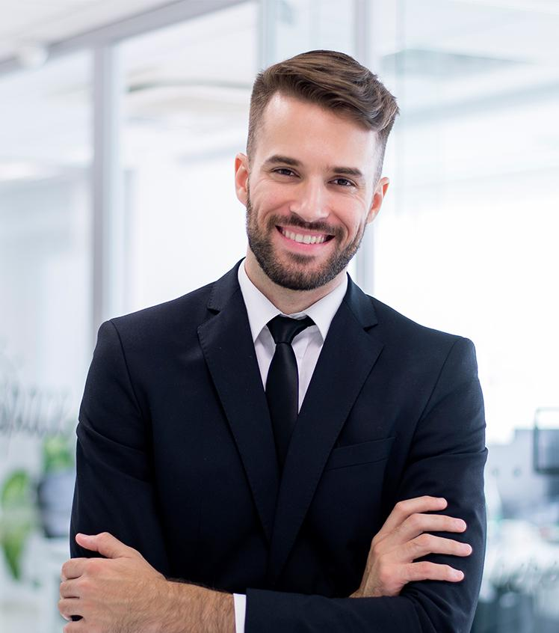
Management
Jon Quest
Steve Berry
Chairman & CEO
Chief Operating Officer
Promulgates and executes any and all managerial decisions.
Manages the company’s growth and performance in its daily operations

Slide 5
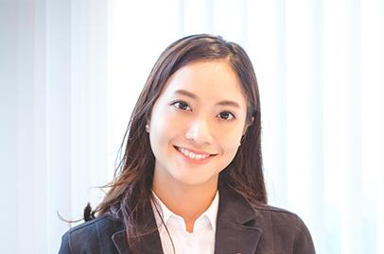
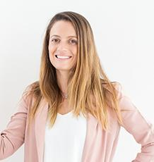
Management
Cassandra Twin
Ana Gold
Chief Quality Officer
Chief Creative Officer
Monitors the consistent quality standards of products.
Manages the company’s market, brand and image to the public.

Slide 6
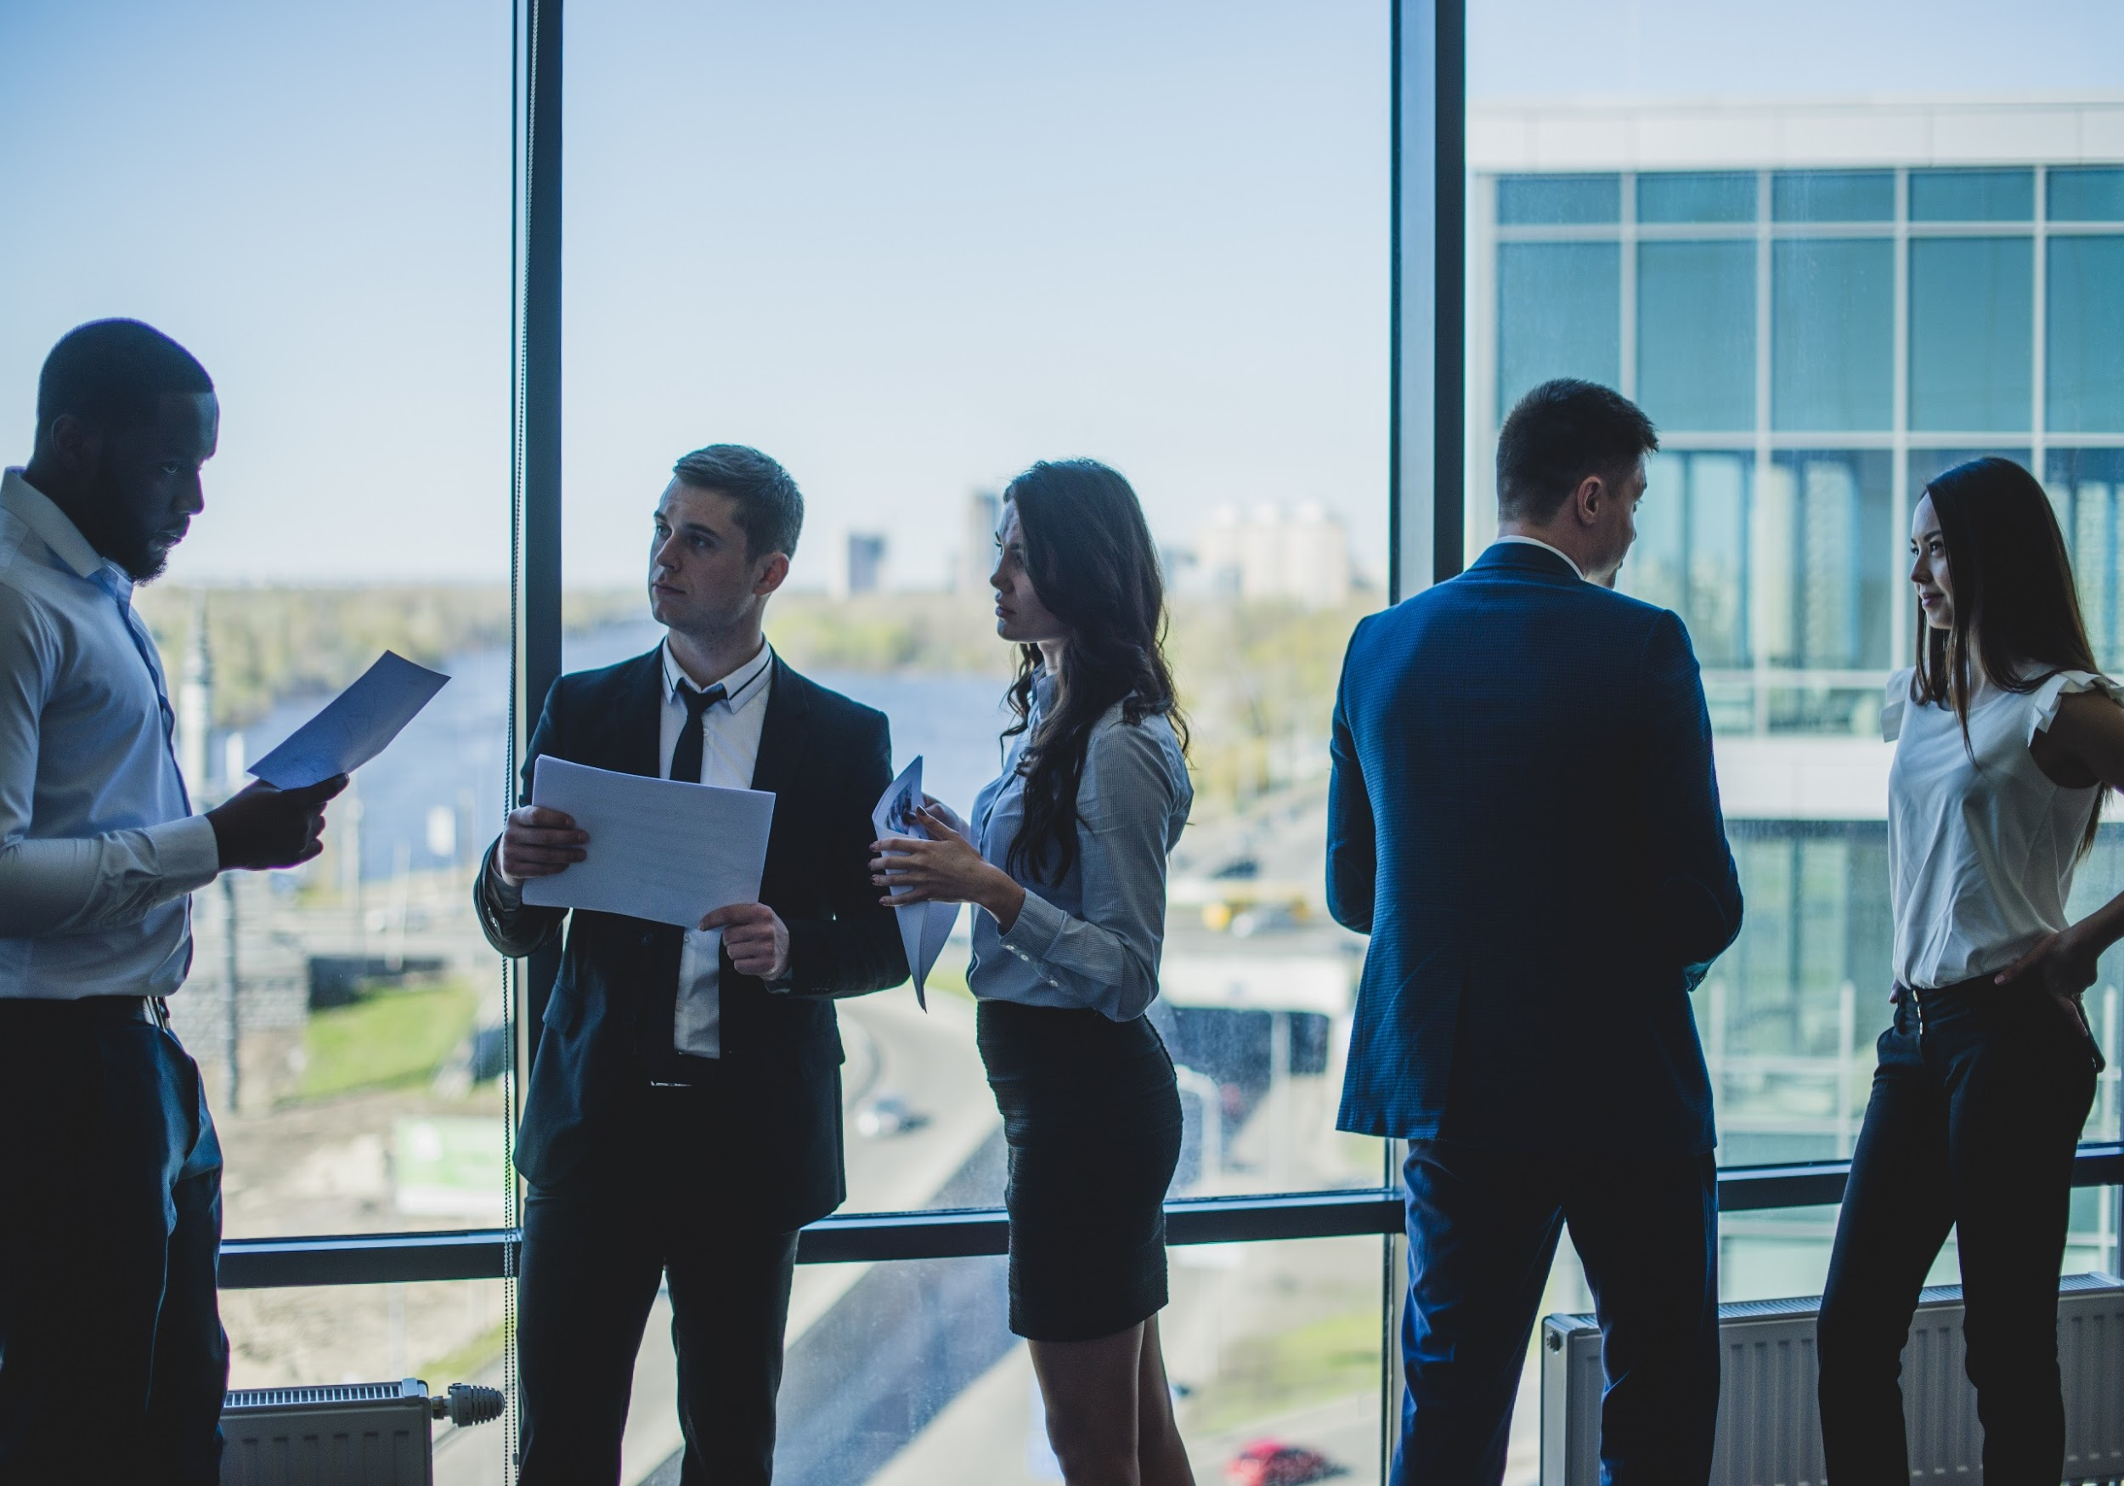
The Problem
The Food and Drug Administration’s survey shows that nearly 30 brewing companies fail to gain their desired monthly profits due to (1) lack of effective marketing strategies and (2) failure to provide quality, affordable coffee and coffee based beverages.

Slide 7

Our Solution
Happy Coffee Brewing Company will provide the public with internationally and locally sourced coffee brews, coffee based drinks, and pastries that are delicious and affordable. In order to draw a larger customer base, a diverse marketing strategy consisting of both physical and online based marketing products will be utilized.

Slide 8
Advantages
Internationally sourced coffee beans will be utilized for a unique coffee tasting experience.
Locally sourced coffee beans to help locals taste the best of what Seattle can offer.
Air conditioned and well designed interiors along with outdoor garden seating options.
Free Wi-Fi and free 2 hours of parking.
Implementation of extensive marketing strategies such as flyers, banners, and official social media pages for better traction and better communication with clients.
Distribution of suggestion cards to all customers so that company will be updated with what products and services customers want.

Slide 9

Right Blend
A newly developed project called “RIGHT BLEND” is aimed to provide the best blend of fresh coffee mixed with new taste for an affordable price which starts at only $2.99.

Slide 10

Traction
Based on a census conducted by the administration, Seattle has a total of 725, 000 residents and a total of 40 million tourists visiting the state annually as of 2017. This proves to be a great opportunity for Happy Coffee Brewing Company to serve more customers as well as establish a strong connection with its target market.

Slide 11
Target Market
The chosen target market will be the residents of Washington, particularly Seattle. This specific group of individuals was chosen based on the following factors :
49%
Seattle’s population are individuals working 9 to 5 jobs.
Adults in Seattle’s entire population are coffee drinkers.
613, 859
35%
Population seek quality, affordable coffee and coffee based beverages.

Slide 12
Competition
Based on a survey conducted in 2017, Happy Coffee Brewing Company concluded that the following companies will be considered as direct competitors :
$3.99
$4.99
$6.99
Fresh Farm Coffee offers coffee starting price
Superior Taste Brewing Company offers coffee starting price
Coffee Delight offers coffee and coffee based beverages starting price

Slide 13

Alternative Solutions
The alternative solutions Happy Coffee Brewing Company can provide are the following:
Coffee, coffee based drinks, and pastries starting at $2.99.
20% to 30% off coupons to be given out on a monthly basis.
Weekly statistics for all product reviews through customer comment cards.

Slide 14

Business Model
The company will utilize the following business model which will be implemented by early 2019:
[SPECIFY BUSINESS MODEL]
Revenue equivalent to roughly $100,000 to $120,000 will be expected by the end of 2019.

Slide 15
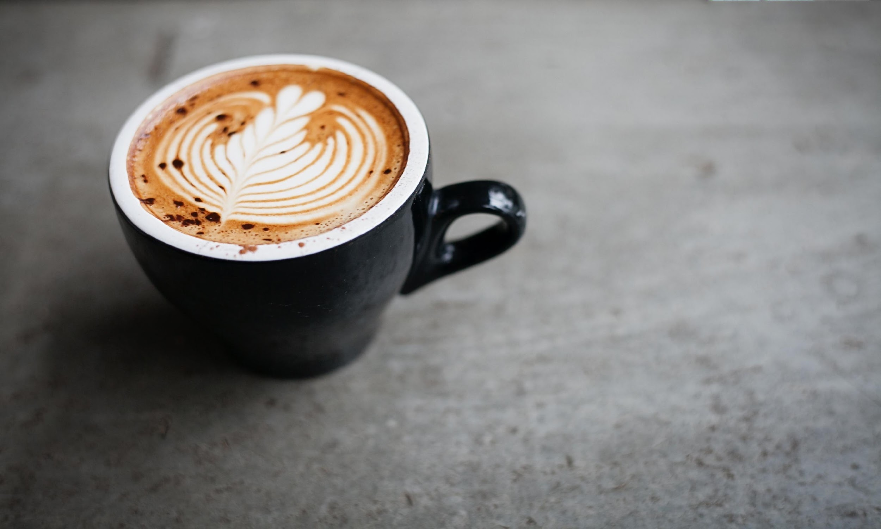
Schedule
The company’s schedule will be as follows :
[SPECIFY COMPANY SCHEDULE]

Slide 16
Investment And Sponsorship
In order to officially begin, the company will require a budget estimated between $80,000.00 and $90,000.00. This amount will be collected from the following sponsors :
1. Daterra Coffee Farm
2. National Bank Financial Investment Corp.
3. All-Natural Farm Inc.
Each sponsor has agreed to contribute and invest at least $30,000.00 in the Happy Coffee Brewing Company.

Slide 17
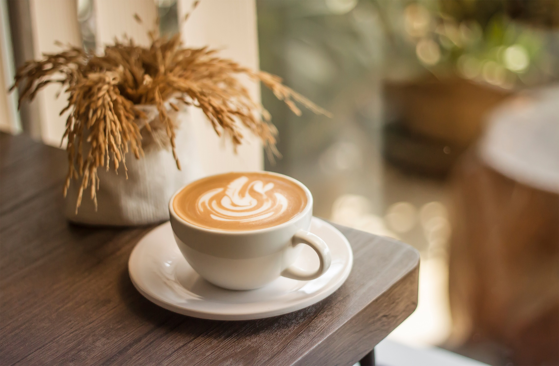
Contact Us
Visit our office every Monday to Friday from 9am to 6pm and Saturday from 9am to 4pm at [ADDRESS].
For more information contact any of these contact details :
[Phone Number]
[Email]
[Website]

Slide 18
Thank You

