Slide 1
Genlomark
Listen
to your
Market
Digital Marketing Pitch Deck
Roger P. Rouse
rogerrouse@gmail.com
830-968-4207
www.genlomark.com
807 Prospect Valley Rd.
Rancho Dominguez, CA 90220, USA

Slide 2
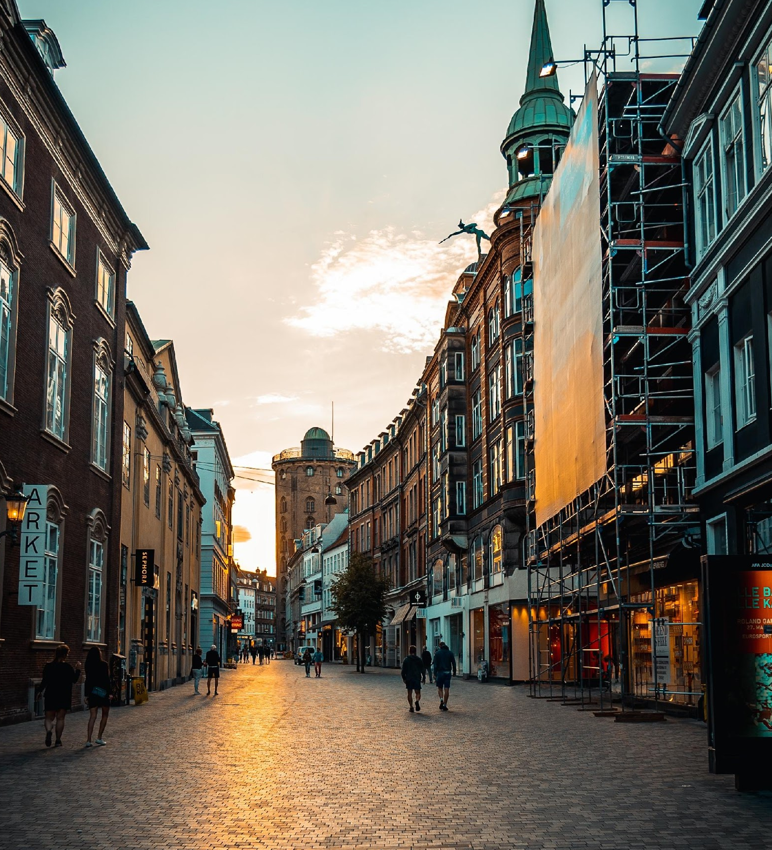
The Company
Executive Summary
Mission
Vision
Philosophy
Outlook
Organizational Structure
Team
Upcoming Offers
Pricing Strategy
Marketing Plan
Market Research
Overview of Growth
Asset
Testimonial
Listen
to your
Market

Slide 3
Genlomark
The Company
The
Company
Genlomark offers digital marketing & data handling for social media accounts & company websites. It’s important for businesses in the current global market to have an active presence online & virtually interact with potential clients in order to thrive in the current global market.

Slide 4
Genlomark
Executive Summary
Executive
Summary
Genlomark helps clients with their content marketing & web design needs. The company’s skilled team of professional content managers & web designers will provide clients with innovative, efficient solutions to boost their online traffic & establish their brands in the market.

Slide 5
Genlomark
Mission
Mission
The goal of Genlomark is to connect companies to their clients online through effective SEO solutions.

Slide 6
Genlomark
Vission
Vision
Genlomark aspires to stay relevant in the age of digital marketing & see itself grow into a formidable SEO company in the industry.

Slide 7
Genlomark
Philosophy
Philo-
sophy
Genlomark believes in applying creativity, simplicity, honesty & efficiency to their work in order to achieve its goals of providing the best service to clients.

Slide 8
Genlomark
Outlook
The digital marketing industry is currently on the rise & continues to grow because the internet is becoming a prime space for businesses & consumers to meet & engage with each other.
Outlook
The rising number of users who go online to do transactions is pushing businesses to improve their online activity, making SEO service providers integral in conducting their business in this modern age.

Slide 9
`
`
Genlomark
Organizational Structure
Organizational
Structure
The Digital Marketing industry has always been a major hit for people around the country due to the following:
Type of Industry: SEO Industry
Business Structure: Sole Proprietorship
Ownership: Sole Proprietorship, Roger P. Rouse

Slide 10
Genlomark
Philosophy
Organizational
Structure
The company’s operations is led by the CEO. The Project Manager, the Client Management Director, Technical Director & Creatives Director are all under the CEO.
It is the Project Manager who oversees the different projects the company has & works with the Client Management Director who meets with prospective clients, promote the company’s services & plan with them the different services that the company can do for them.
The Technical & Creatives directors along with their team of web designers & content creators carry out the services & strategies that the clients need for their websites, social media accounts, etc.

Slide 11
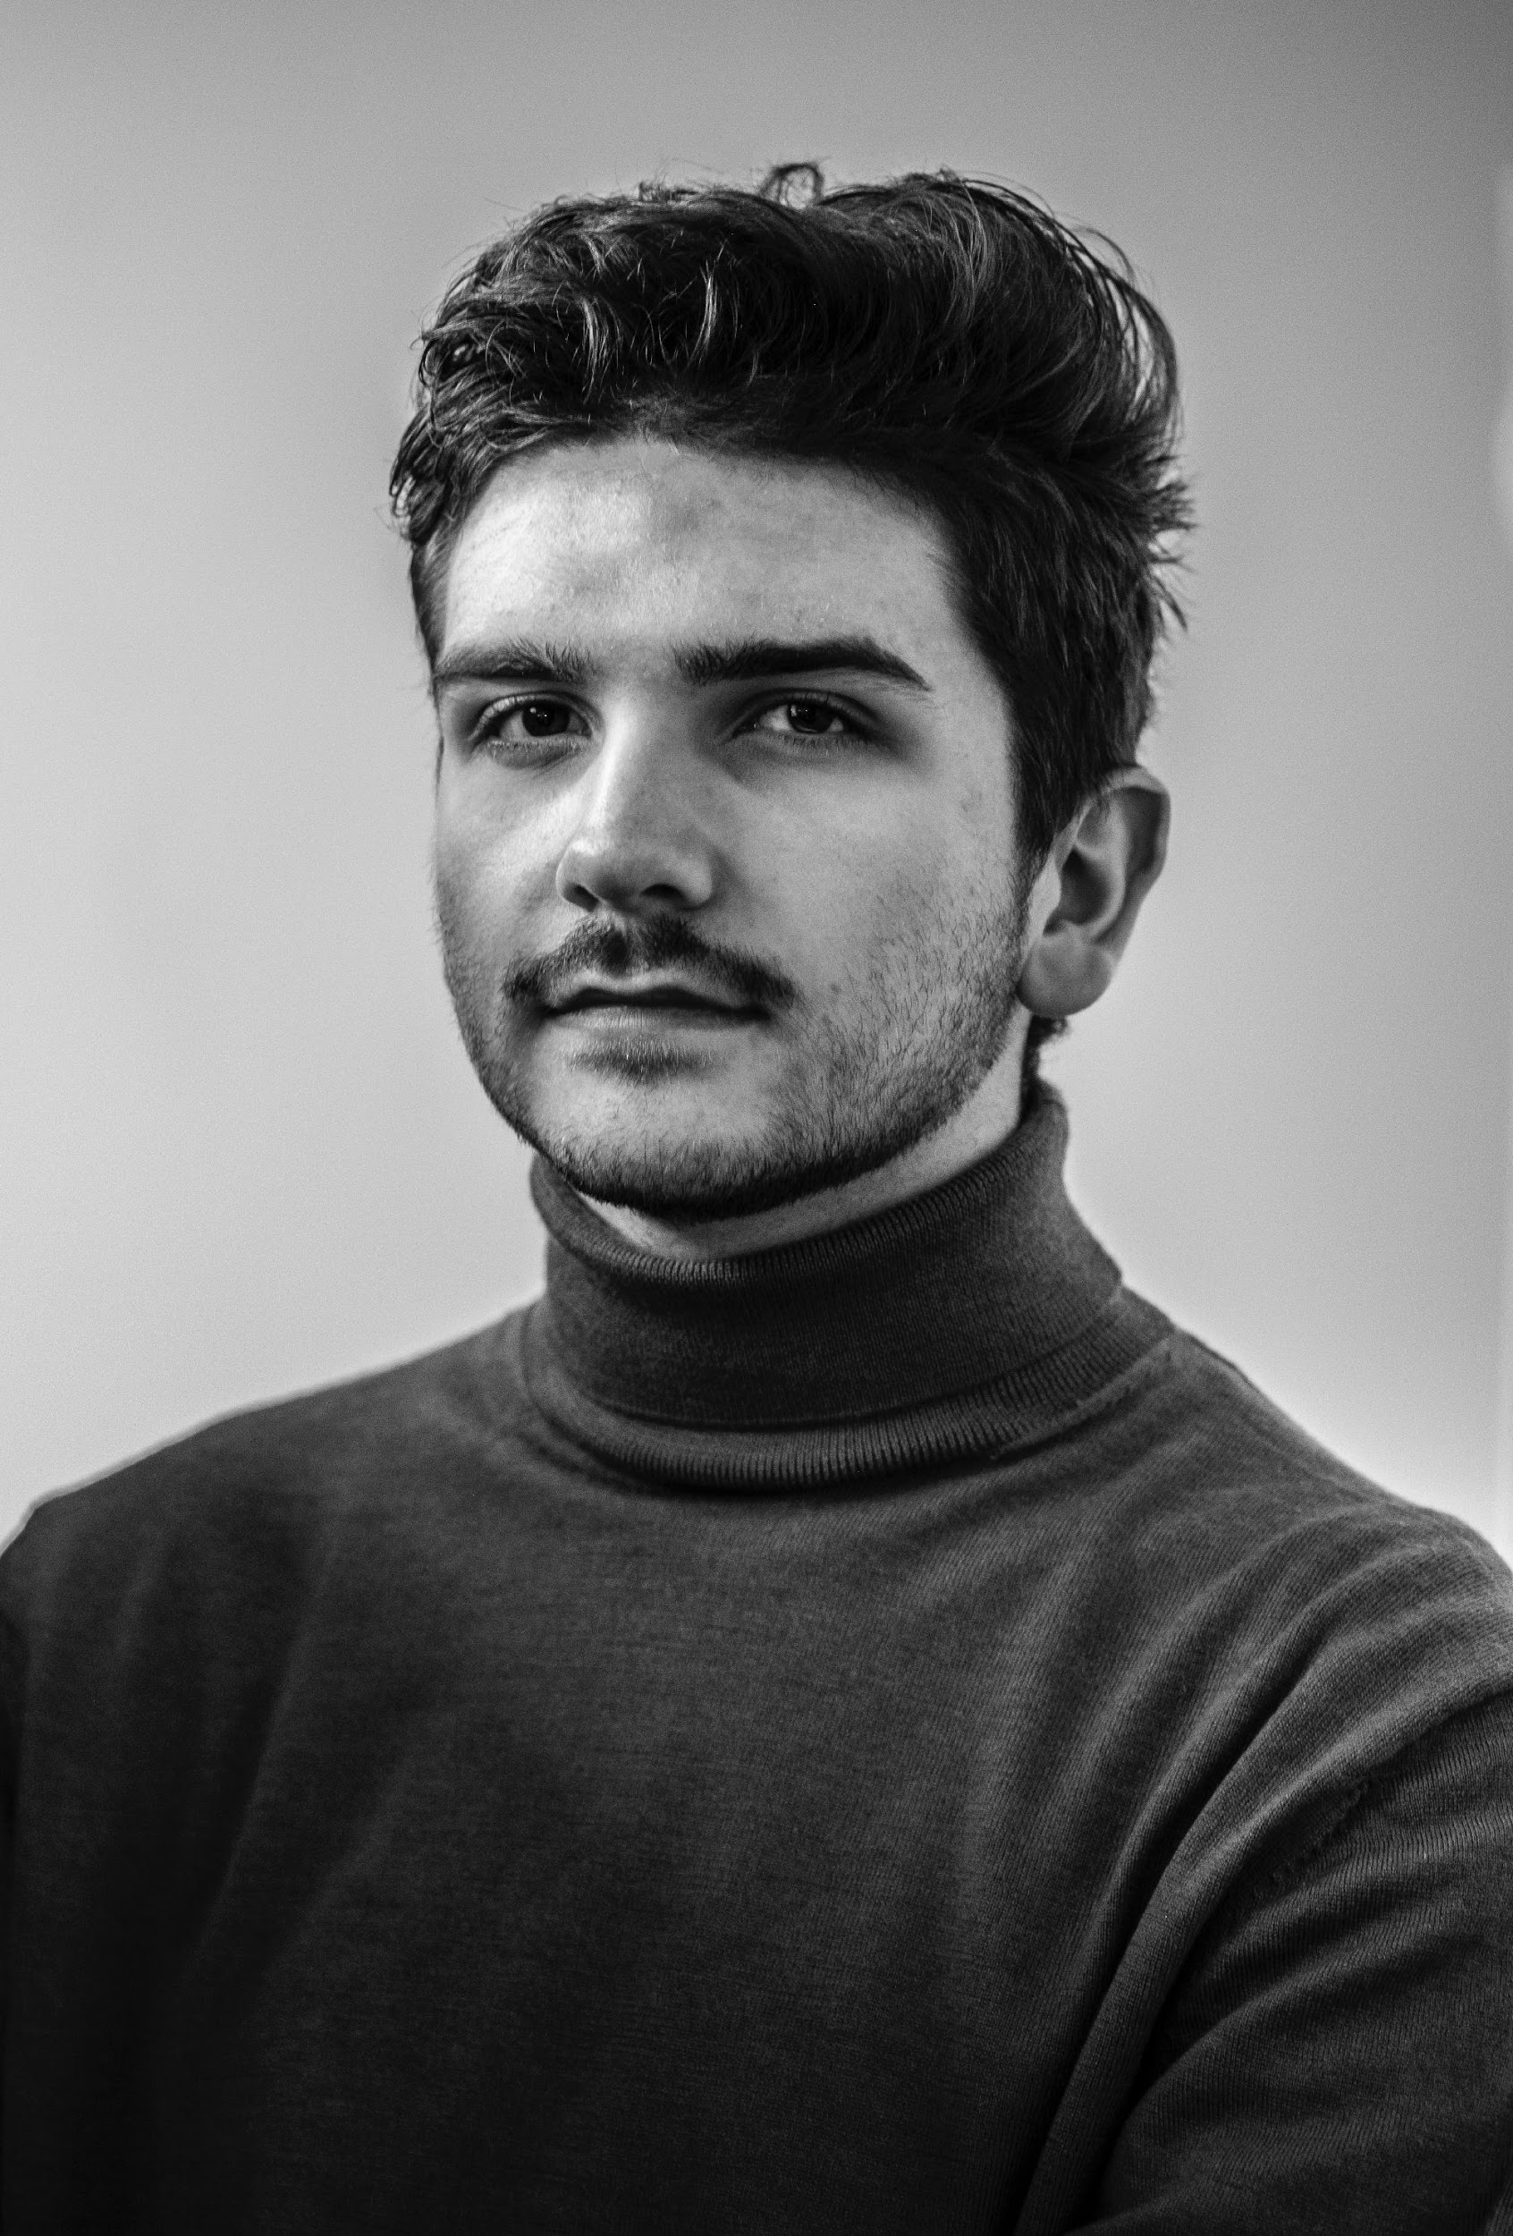
Genlomark
The Team
Jake Dewey
Julia Marie
Alex Anderson
Founder & CEO
Chief Marketing Officer
Chief Operating Officer

Slide 12
Genlomark
Upcoming Offers
Genlomark commits itself to provide you the latest Design Trends & perfect Digital Marketing for business .
Upcoming
Offers
2027’s Upcoming New Trend:
Modern Web Designs
New Trend for Digital Marketing

Slide 13
Genlomark
Pricing Strategy
Pricing
Strategy
Genlomark is known for its simple yet efficient digital marketing services that have greatly improved online traffic & visibility of the content & websites of its clients.
Genlomark uses a combination of cost-plus & price bundling when offering its services.
This combination best suits the company & is common in the industry.
Formula:
Profit Margin
= 1- (Expenses/Net Sales)
Marie’s
Profit Margin
= 1 - ($114,000/$350,000)
= 1-0.33
= 0.67 or 67%

Slide 14
Genlomark
Marketing Plan
Marketing
Plan
65%
Local
Business
Genlomark seeks to promote its brand to local businesses & those that have operated for 3 years or less using social media to reach the target market. To keep the accounts active, promotional videos & other content will be posted regularly. In addition to digital marketing, Genlomark will also use traditional methods of contacting these businesses through cold emails.
30%
Promotional
Videos
05%
Traditional
Methods

Slide 15
Genlomark
Market Research
Market
Research
The demand for digital marketing services has increased from businesses in order to boost their online visibility to stay relevant & profitable. All due to the rise of online business transactions & information being spread online as well. SEO companies are challenged to continuously find more creative & efficient ways to market their clients’ brand online.

Slide 16
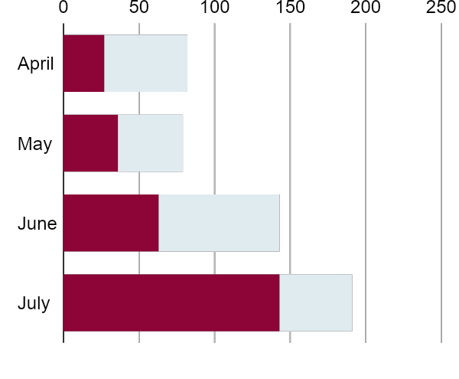
Genlomark
Overview of Growth
Overview
of Growth
60% increase in annual profits as of May 2021.
70% increase in satisfaction with purchased clothing as of March 2021.
45% increase in clientele base as of March 2021.

Slide 17
Genlomark
Total Asset
Non-Cash Assets from Start-Up | $40,000
Cash Requirements from Start-up | $50,000
Additional Cash Raised | $30,000
Cash Balance on Starting Date | $80,000
Total Assets | $200,000
Total
Asset

Slide 18
Genlomark
Testimonial
“
Barbara
Galavan,
Thanks to Genlomark, I’ve been able to get my website some great clients!
26, Online Entrepreneur
”

Slide 19
Genlomark
Testimonial
Testimonial
Pandora’s Box
“
Genlomark had such a great impact on my businesses. Definitely a blessing for us hustlers out there.
Donna
Blumenthal
23, Blogger
”

Slide 20
Genlomark
Testimonial
“
Peter
Smith
Genlomark has helped me get my products & businesses a lot of attention. They do such a great job!
33, Online Influencer
”

Slide 21
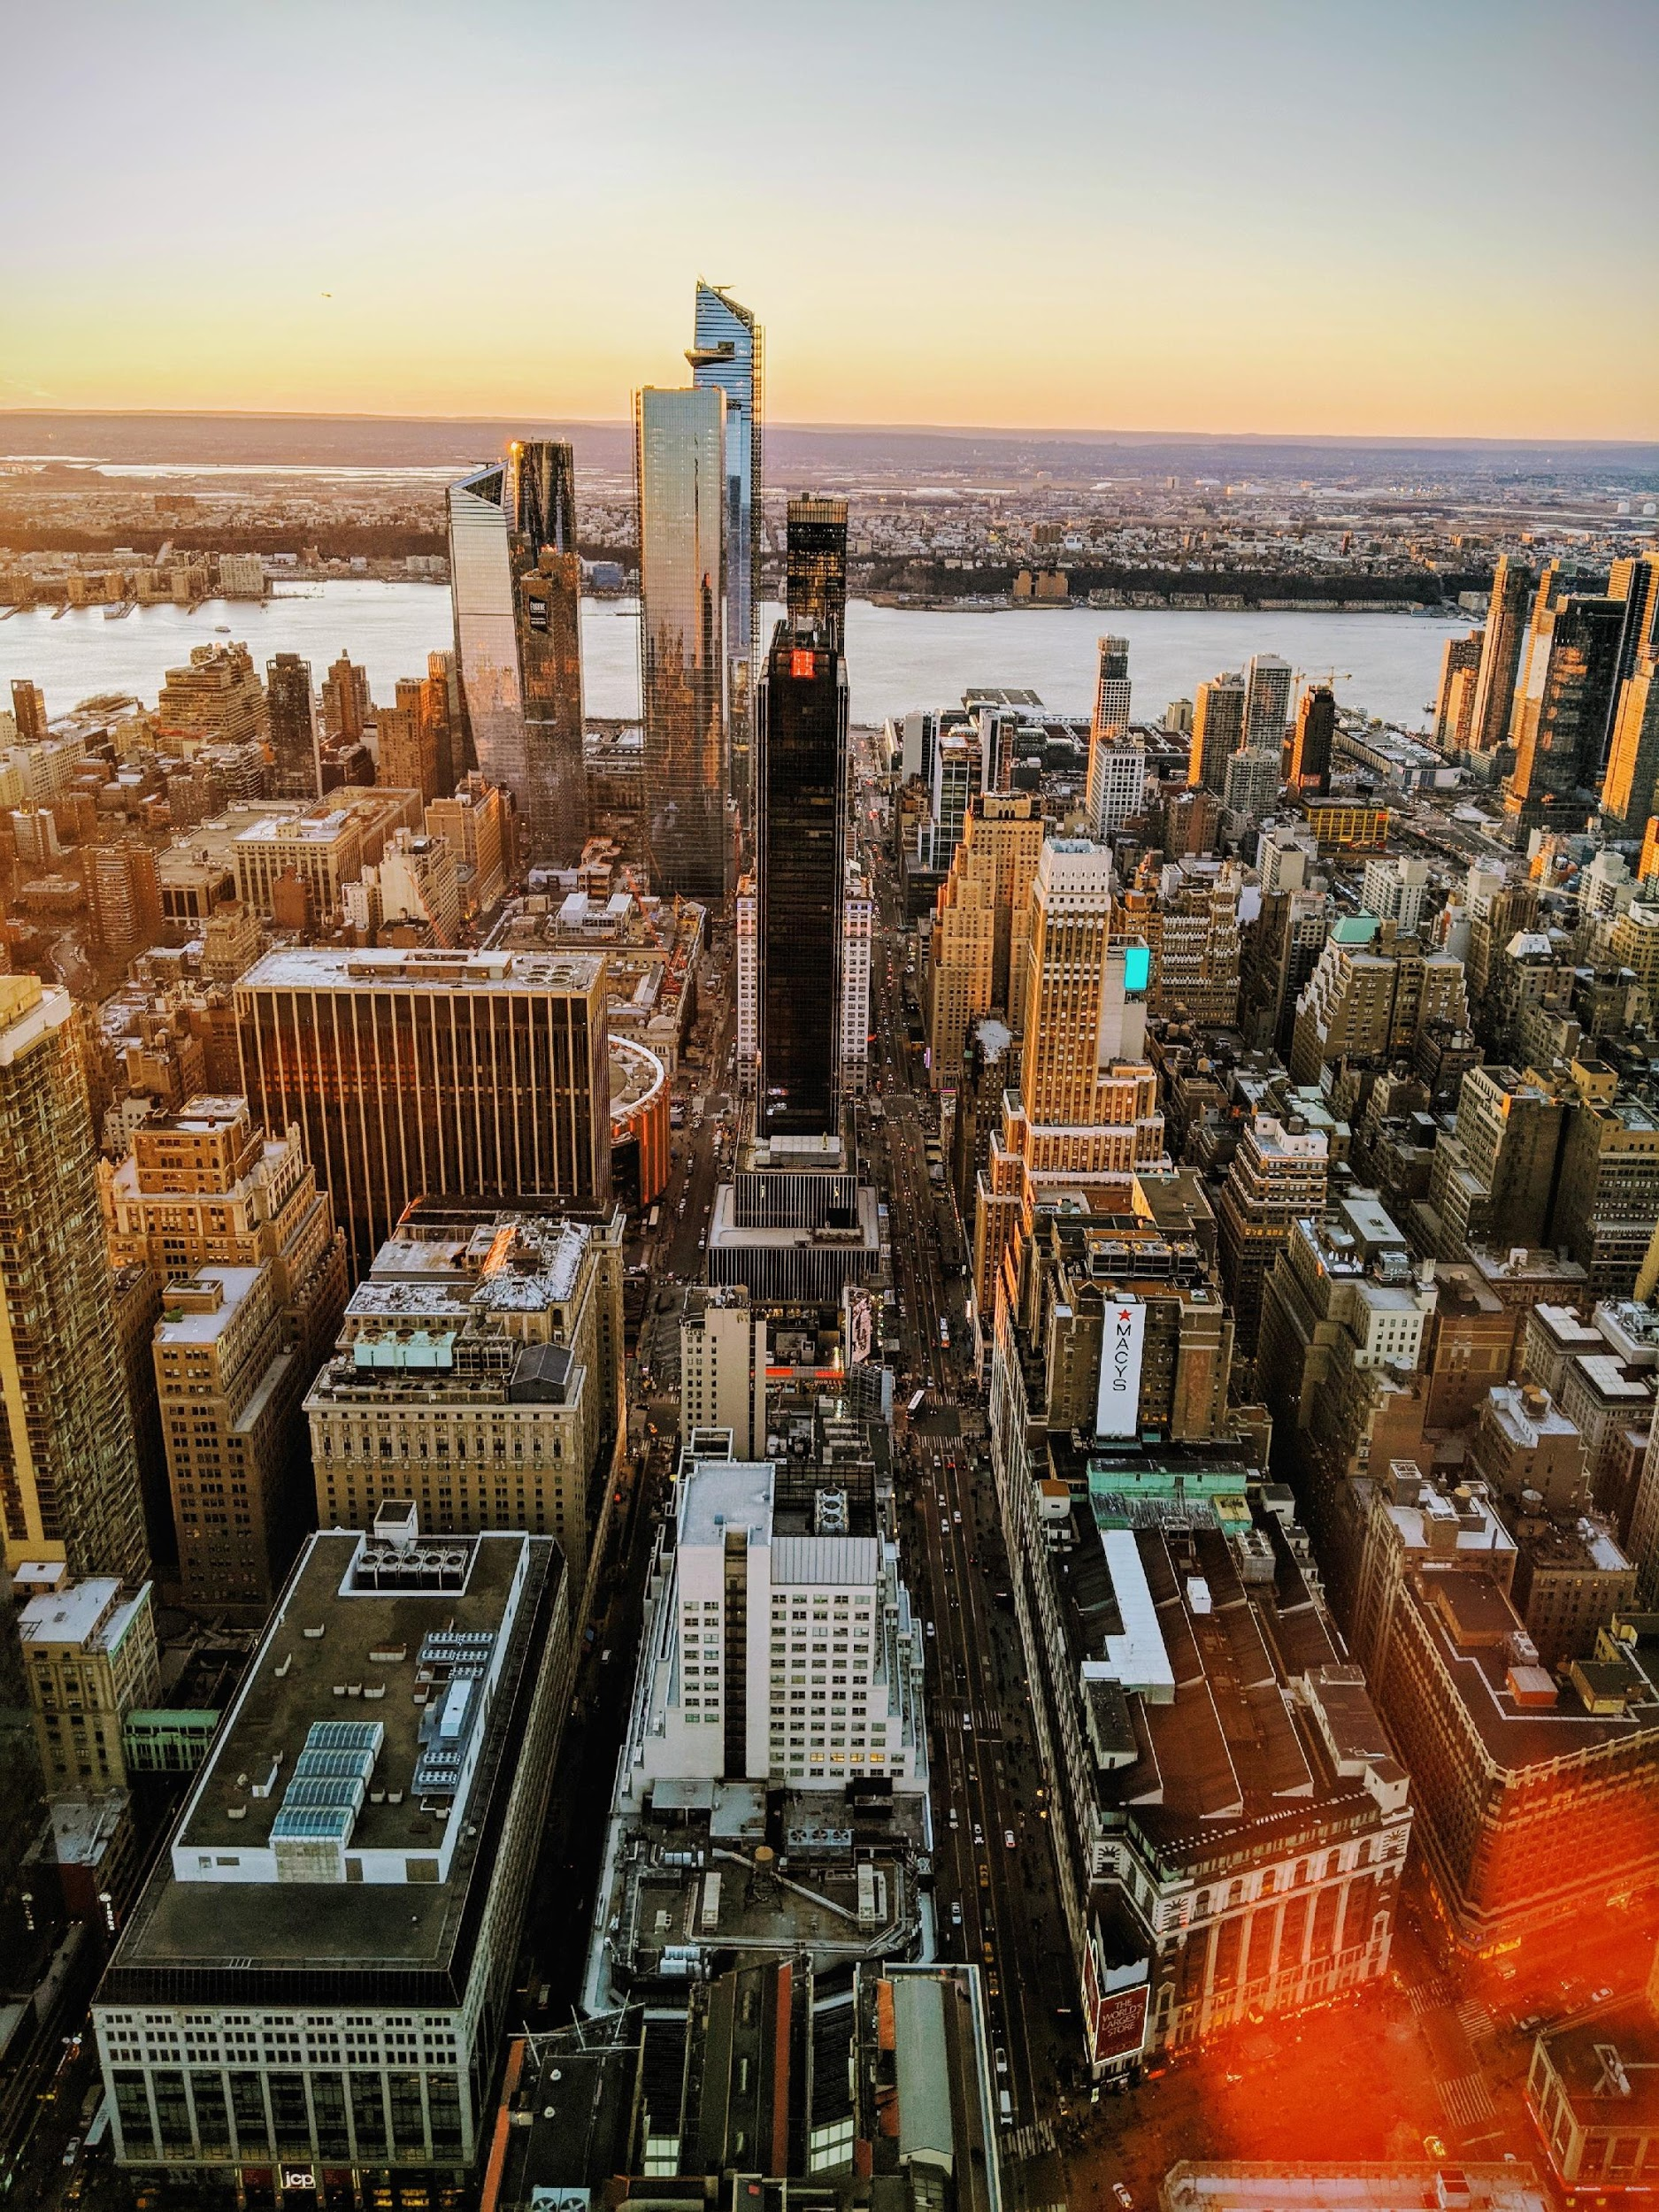
Thank
You
lindacw@genlomark.com
+736 83729

