Slide 1
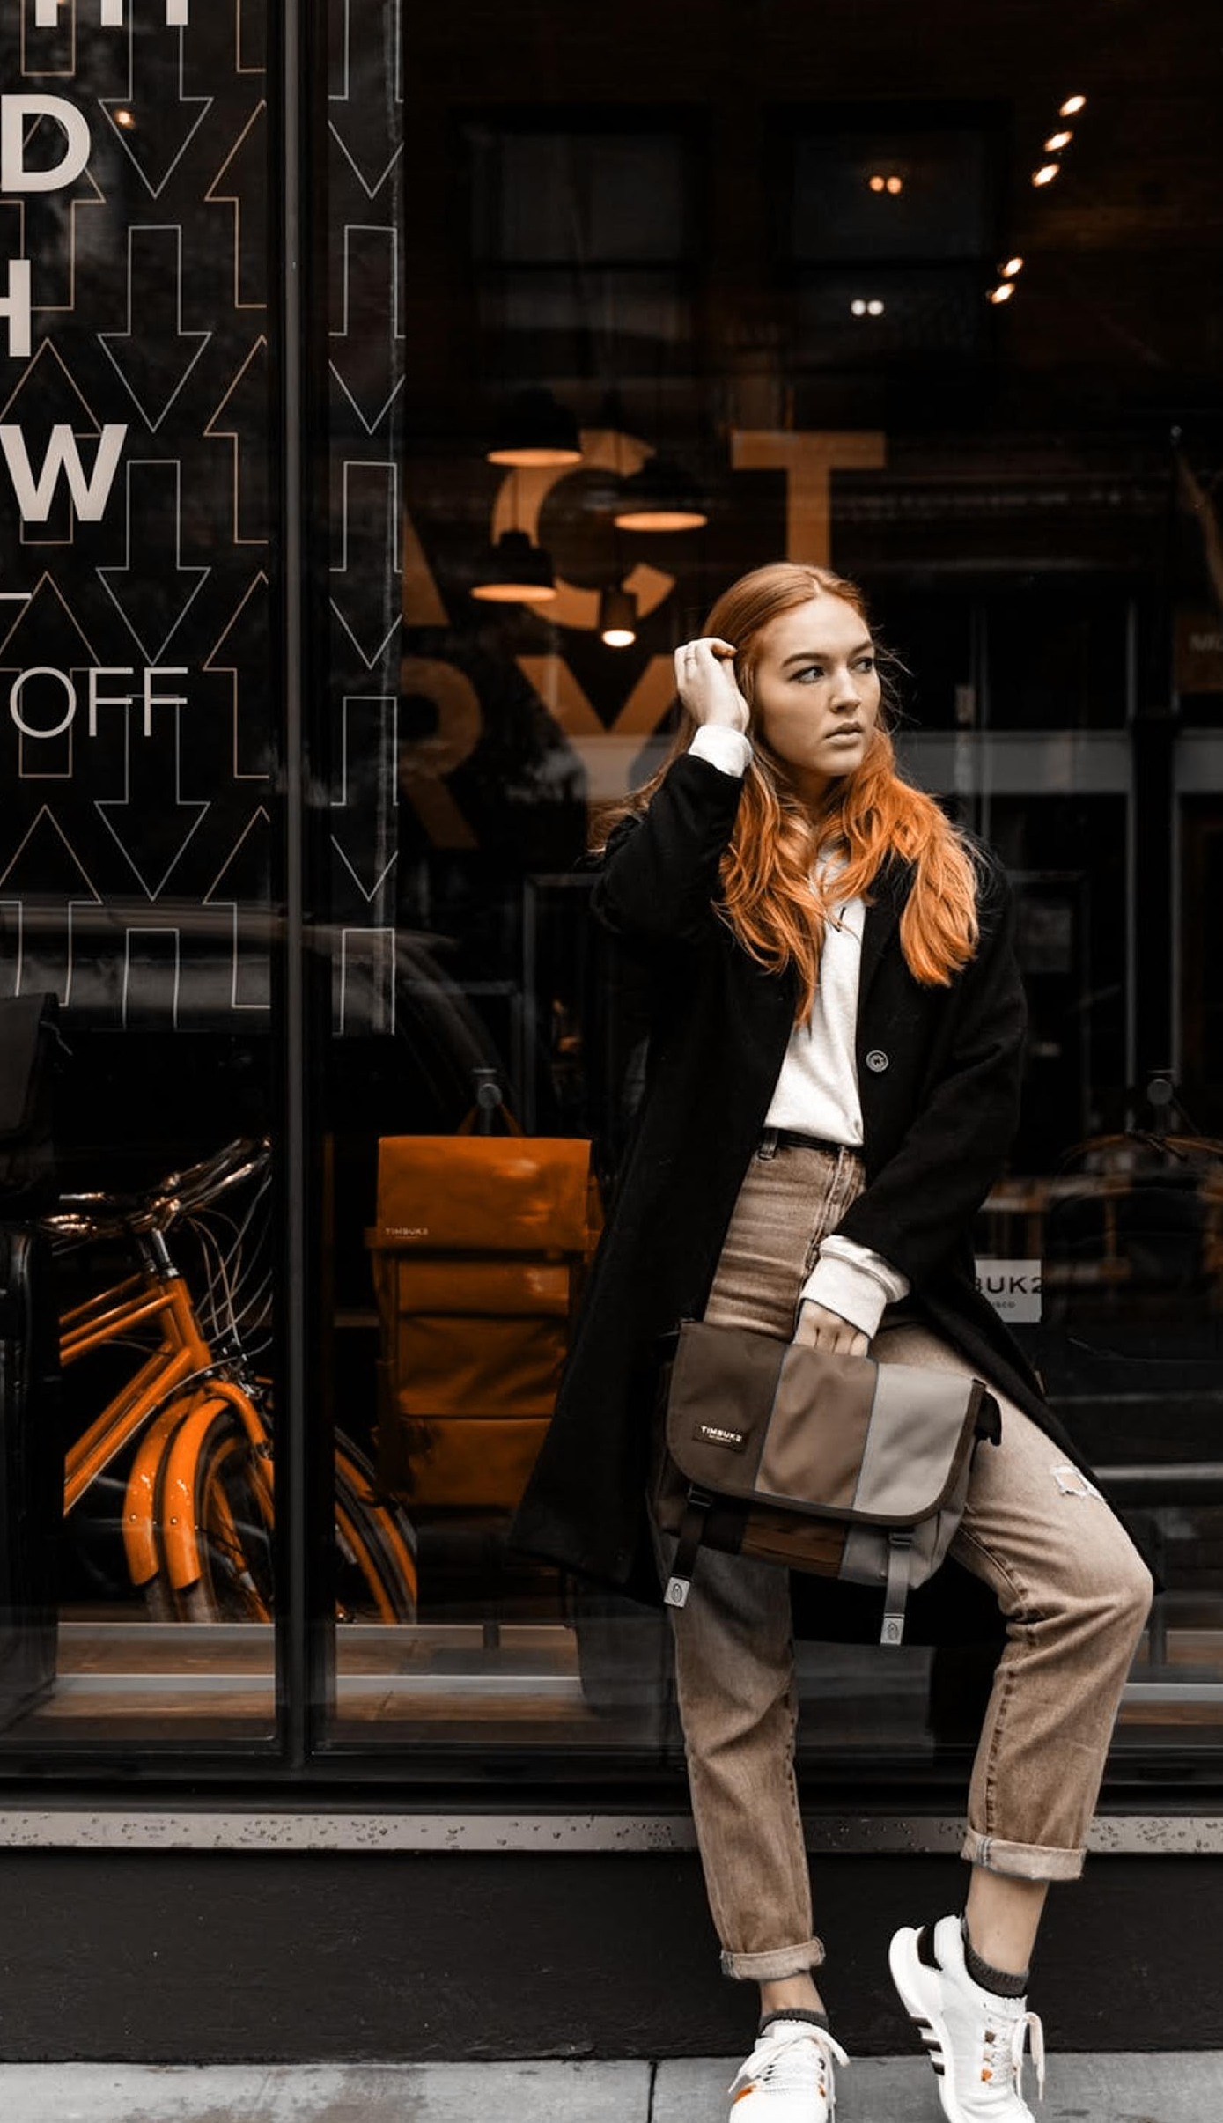
Stefan Clothing Co.
P i t c h D e c k

Slide 2
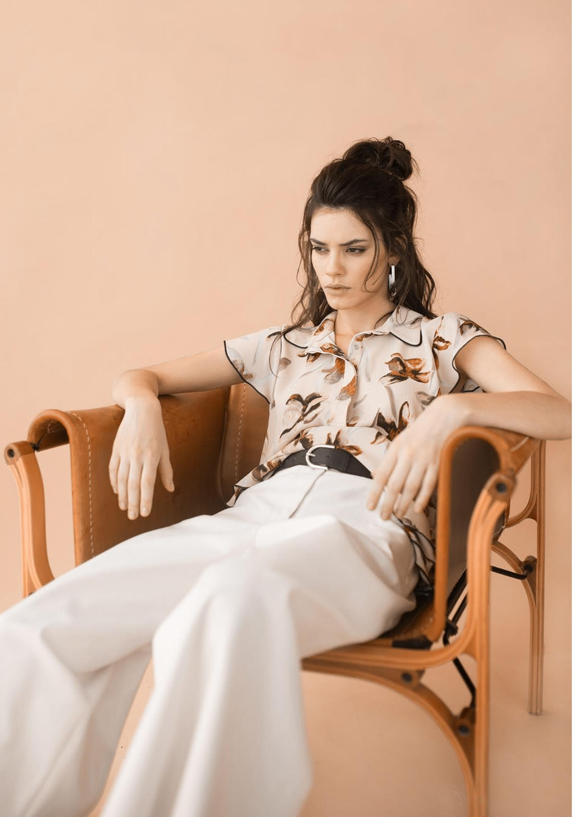
Stefan Clothing
About
We are passionate, intense, & driven company. We are also reliable & competent. When we set our mind on a goal, there is nothing that can stop us since we always have the tenacity to succeed. As a professional fashion design company, We are interested in all things related to arts & design. We also have a high business acumen. We always look forward to new experiences & awesome opportunities. We also like to grab golden opportunities right away for it’s a way for us to get out of our comfort zone.

Slide 3
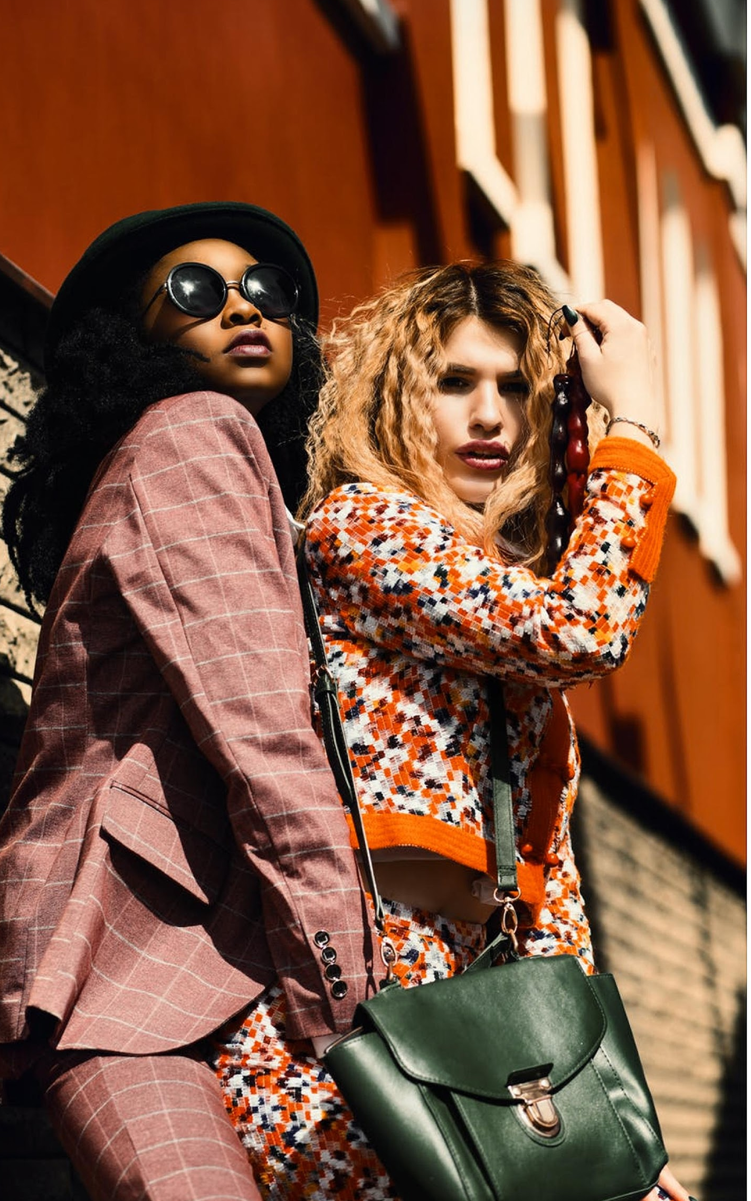
Stefan Clothing
Vision
We strive to be a global leader in fashion-knit and fashion outerwear by empowering innovation and design to provide total customer satisfaction.
We strive to be a caring and well-managed organization for our business partners ,customers and employees, and a responsible corporate citizen to our society.

Slide 4
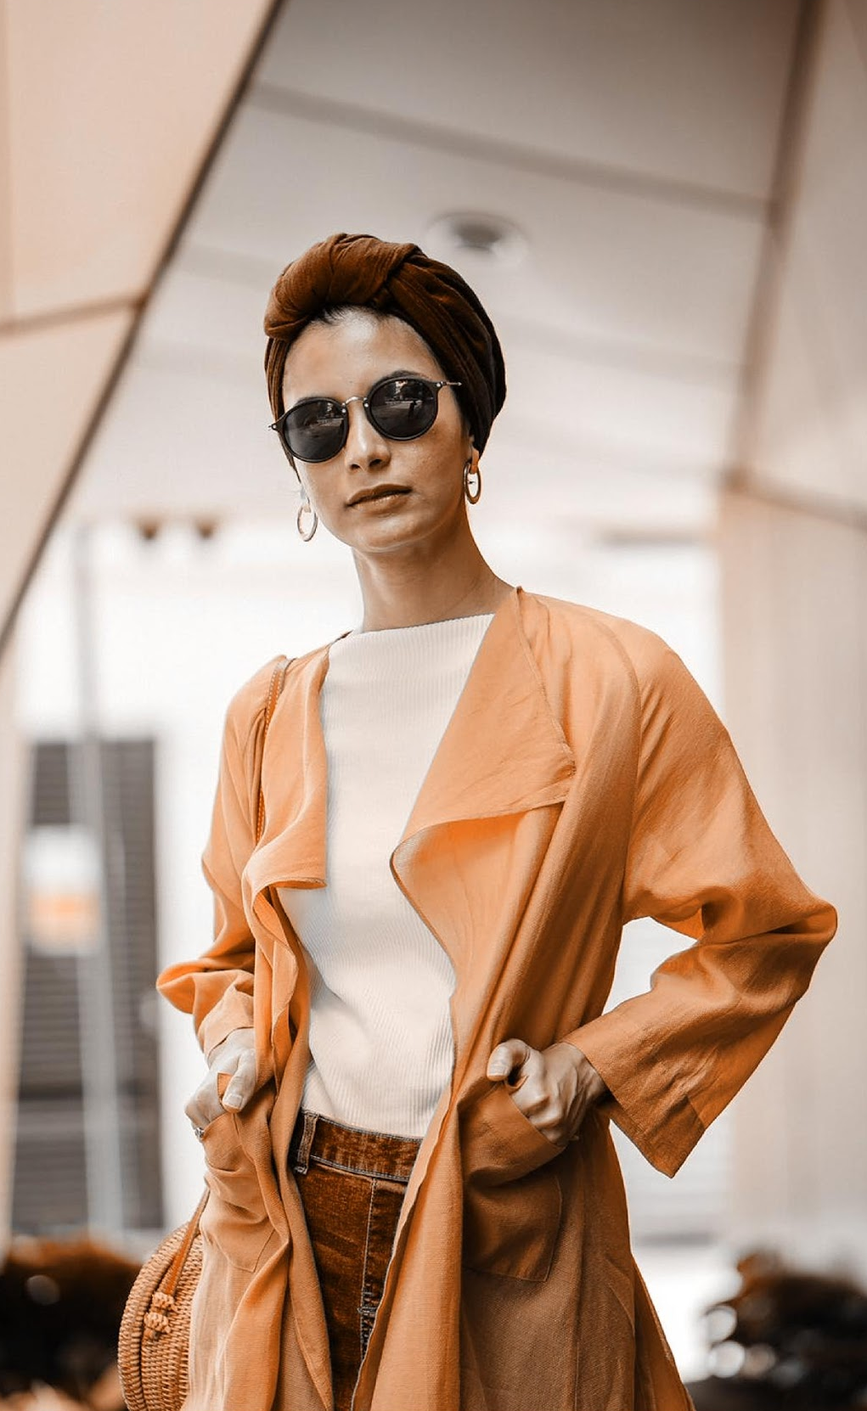
Stefan Clothing
Mission
To innovate, to lead, to enhance, to provide best-value products and services to global customers.
To make a difference through our branding to stay ahead of fashion trends, market changes and the latest technology.
To enhance the quality of life for our business partners,customers and employees.

Slide 5

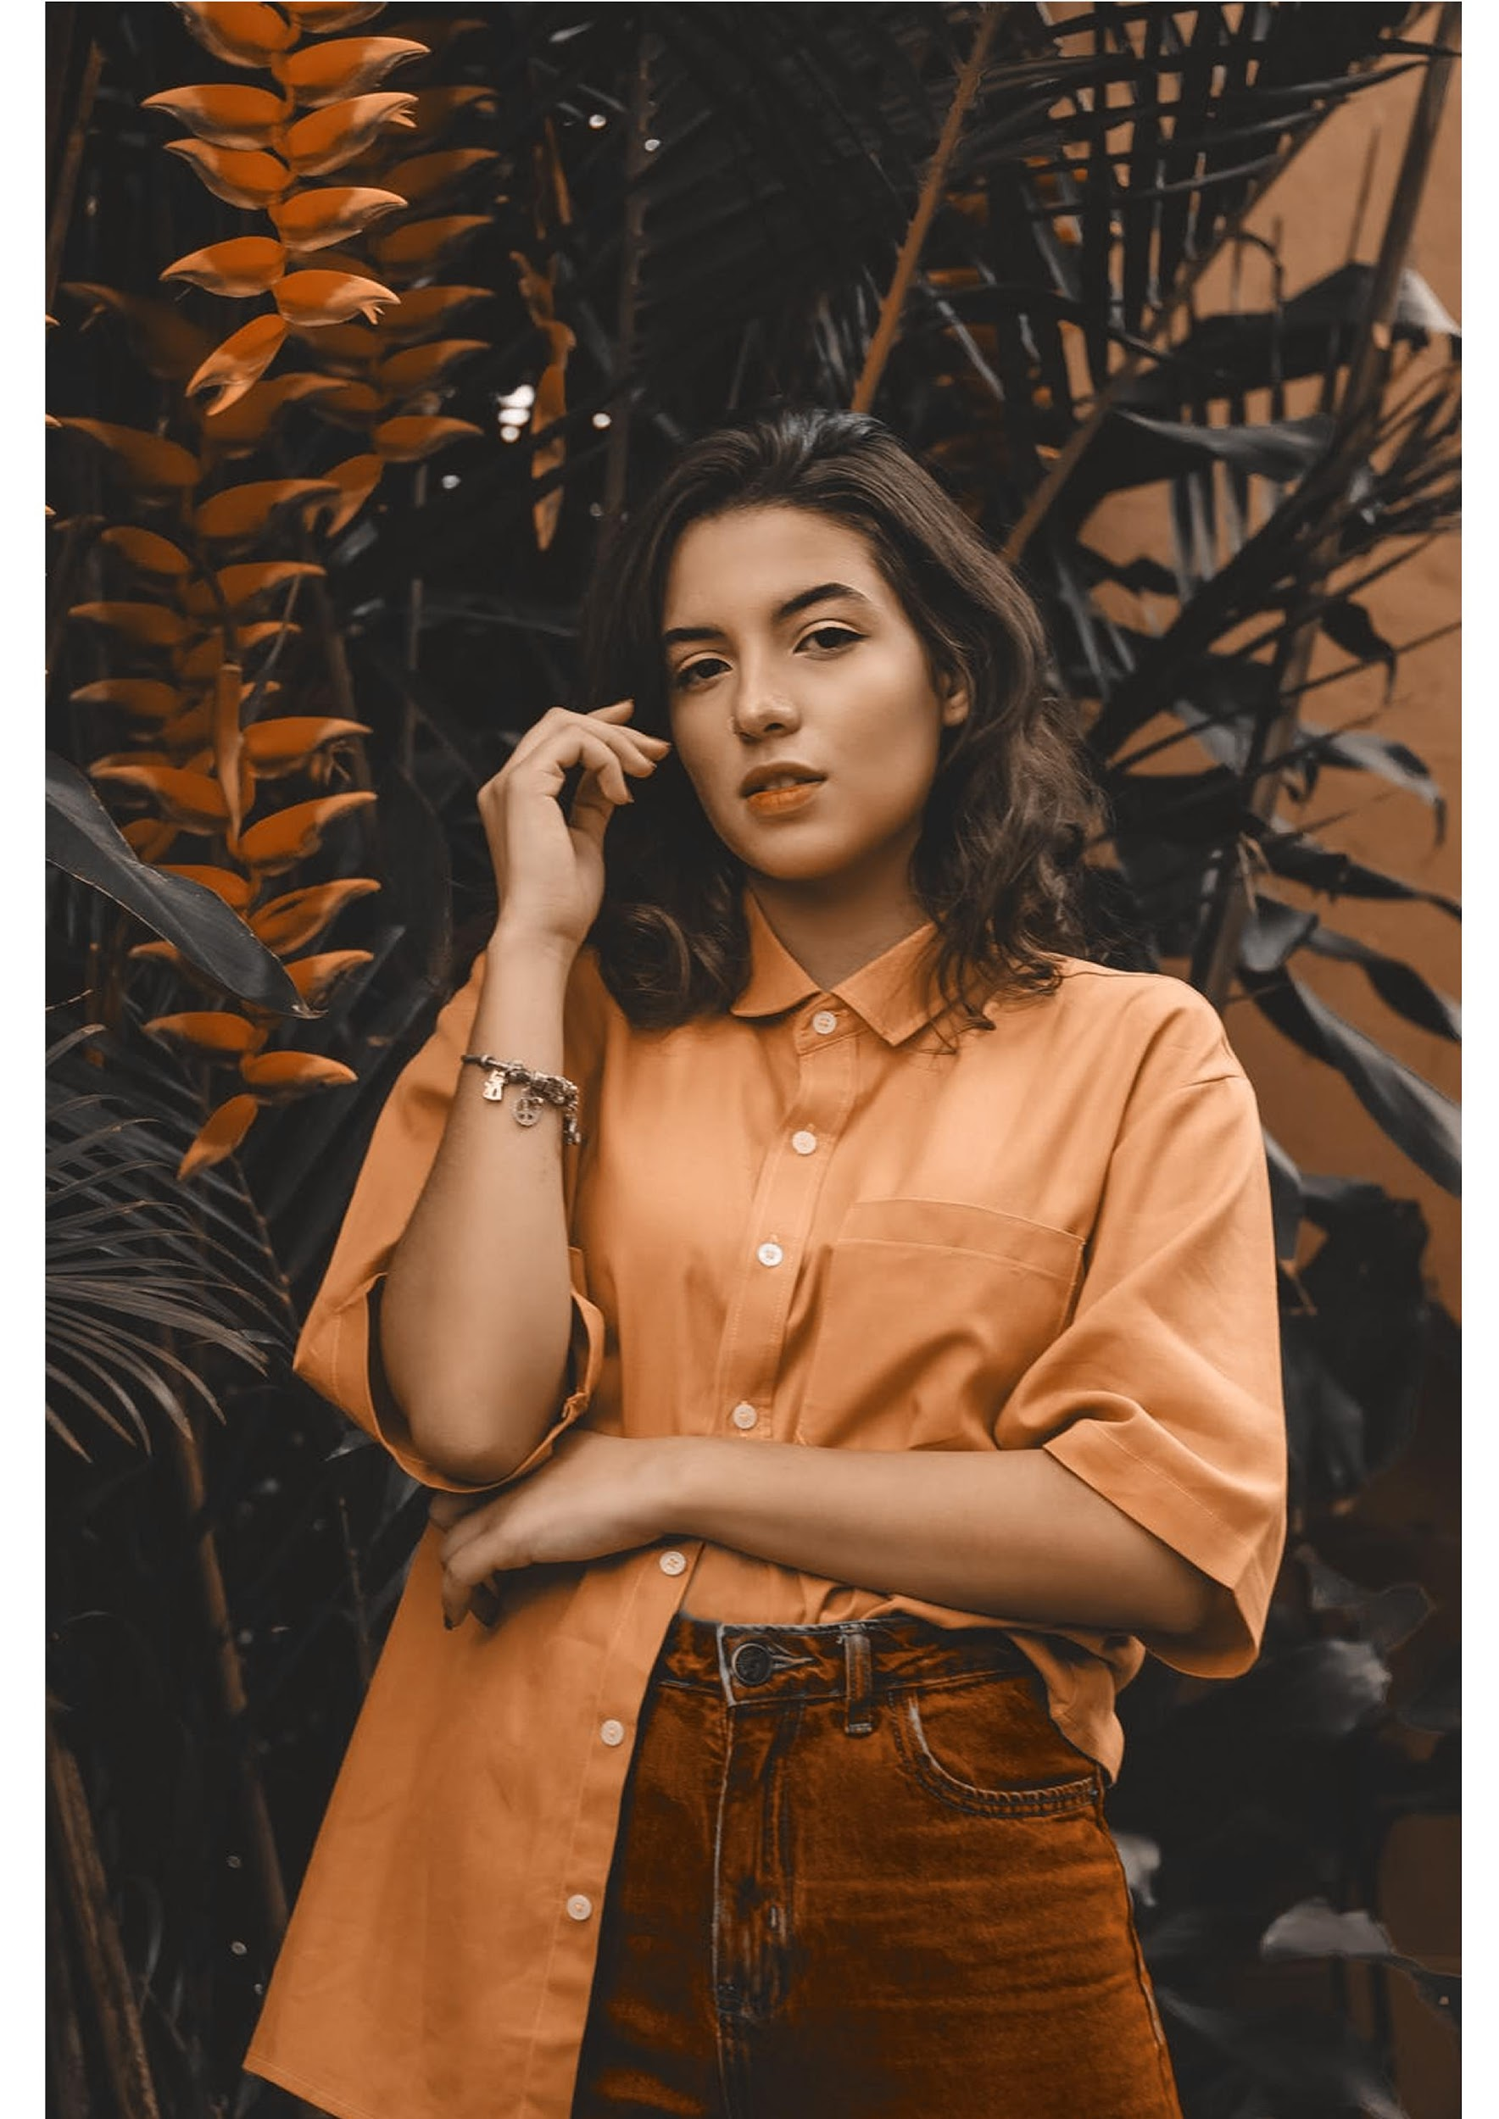
The Team
Jenny Newman
Sapphire Cressman
Ruby Crest
Founder & CEO
Chief Operating Officer
Chief Marketing Officer

Slide 6
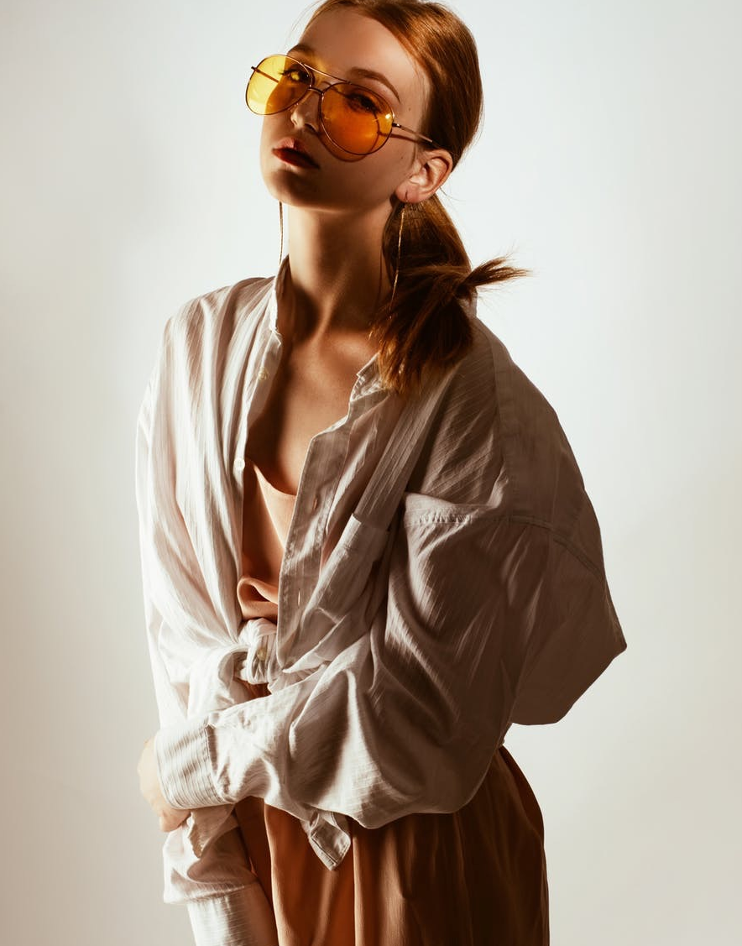
Stefan Clothing
Our Goal
We strive to be a caring and well-managed organization for our business partners , customers and employees, and a responsible corporate citizen to our society.
To make a difference through our branding to stay ahead of fashion trends, market changes and the latest technology.
To enhance the quality of life for our business partners,customers and employees.

Slide 7
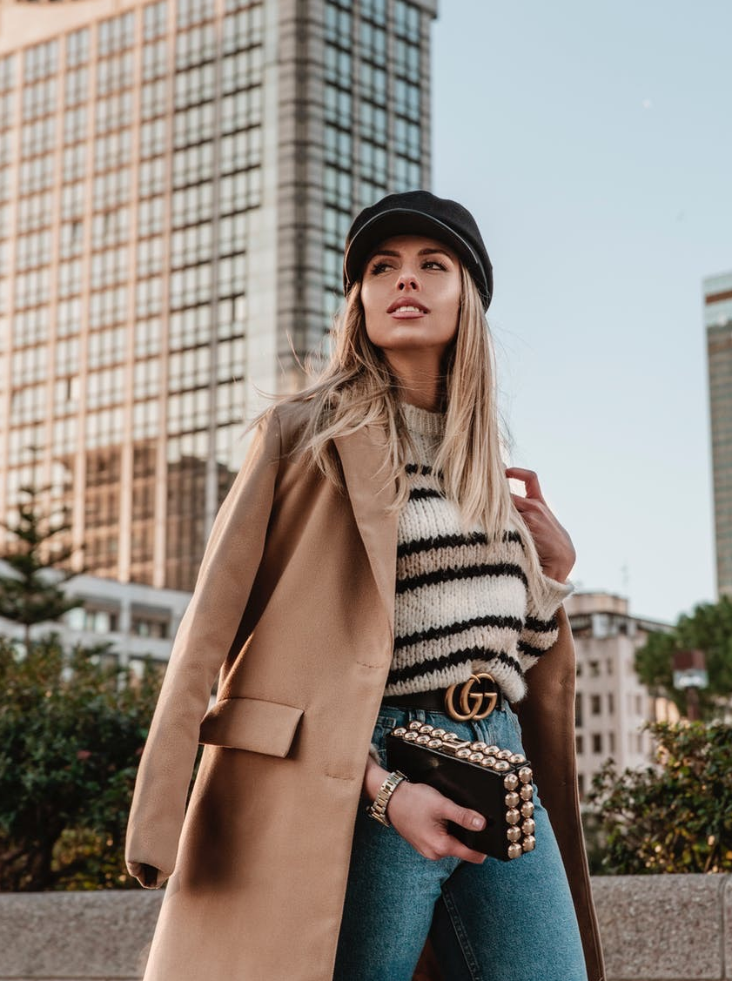
Stefan Clothing
Value Proposition
The Clothing products are tailored according to the style and specifications of its target users. The features & designs are based after the results of a series of consultations with Fashion professionals that the designers had worked with.
Pricing Strategy
Stefan Clothing uses a cost-plus pricing strategy. It is accessible & affordable to more users in the target demographic.

Slide 8
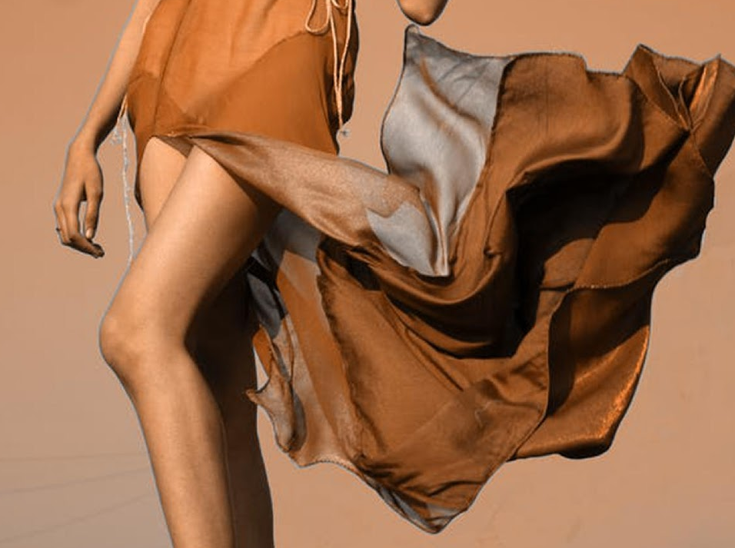
Stefan Clothing
Marketing Analysis
The Clothing industry is one of the major driving forces for economic growth on a global scale. This is due to the prevalence of the use of the Internet, apps, & mobile gadgets. Since the preferences of consumers are diverse, the challenge for Fashion Designer is to come up with solutions that suit their wants & needs. will post promotional videos on its site & social media accounts to create interest for the brand. The videos will consist of advertisements in the form of short films featuring stories of the target clients using the Designer clothes & promotions pertaining to the free, unique designs.

Slide 9
Stefan Clothing
28 %
Overview of Sales
45 %
The Clothing products are tailored according to the style and specifications of its target users. Stefan Clothing Fashion commits itself towards producing excellent quality brand & fashion by serving our beloved & valued customers with trendy pieces.
74.6 %
33.5 %
Coats
Stefan Clothing Fashion commits itself towards producing excellent quality brand & fashion by serving our beloved & valued customers with trendy pieces.
Dress
Jeans
Lingerie

Slide 10
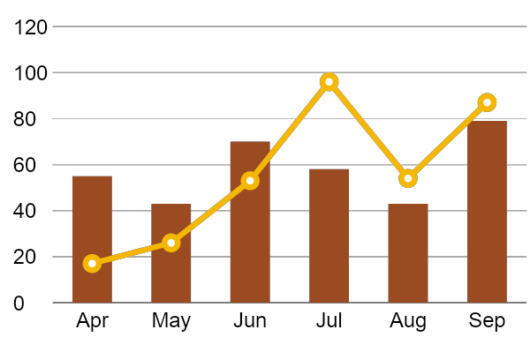
Stefan Clothing
Growth Overview
The Clothing products are tailored according to the style and specifications of its target users. There is an increase in annual profits as of April 2022. There is an increase in customer satisfaction with produced products as of June 2024. Also there is increase in shops sold products in the market as of March 2023.

Slide 11
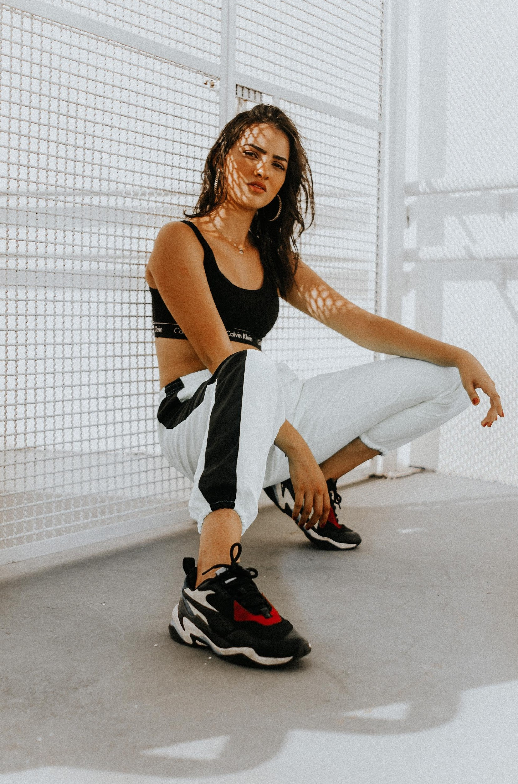
Stefan Clothing
Organizational Structure
The CEO of the company is the head of operations. Under the CEO is the Marketing Division Head & Fashion Development Division Head.
The head of the Marketing Division is responsible for creating & implementing marketing plans, strategies & market research. The team in this department also manages client concerns & collaborates with the Fashion Development division in resolving any design issues.

Slide 12
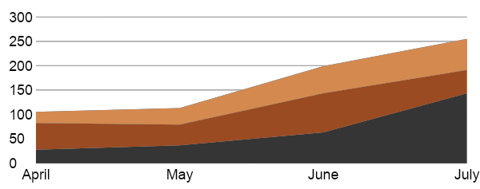
Stefan Clothing
Customer Satisfaction
The head of the Marketing Division is responsible for creating & implementing Analytic Strategies, & market research.
The team in this department also manages client concerns & collaborates with the Fashion Development division in resolving any design issues.
74.6 %
33.5 %

Slide 13
Stefan Clothing
Company Milestones
Short-term Goals | Milestones
Social media brand marketing | Reached 50% of audience target.
Garment waste management | Minimized garment waste for up to 30%
Long-term Goals | Milestones
Partnership with Dawson Garment Franchise | Contract signing on February 2027
Brand expansion in New York & New Jersey | Budget proposal drafted as of July 2026

Slide 14
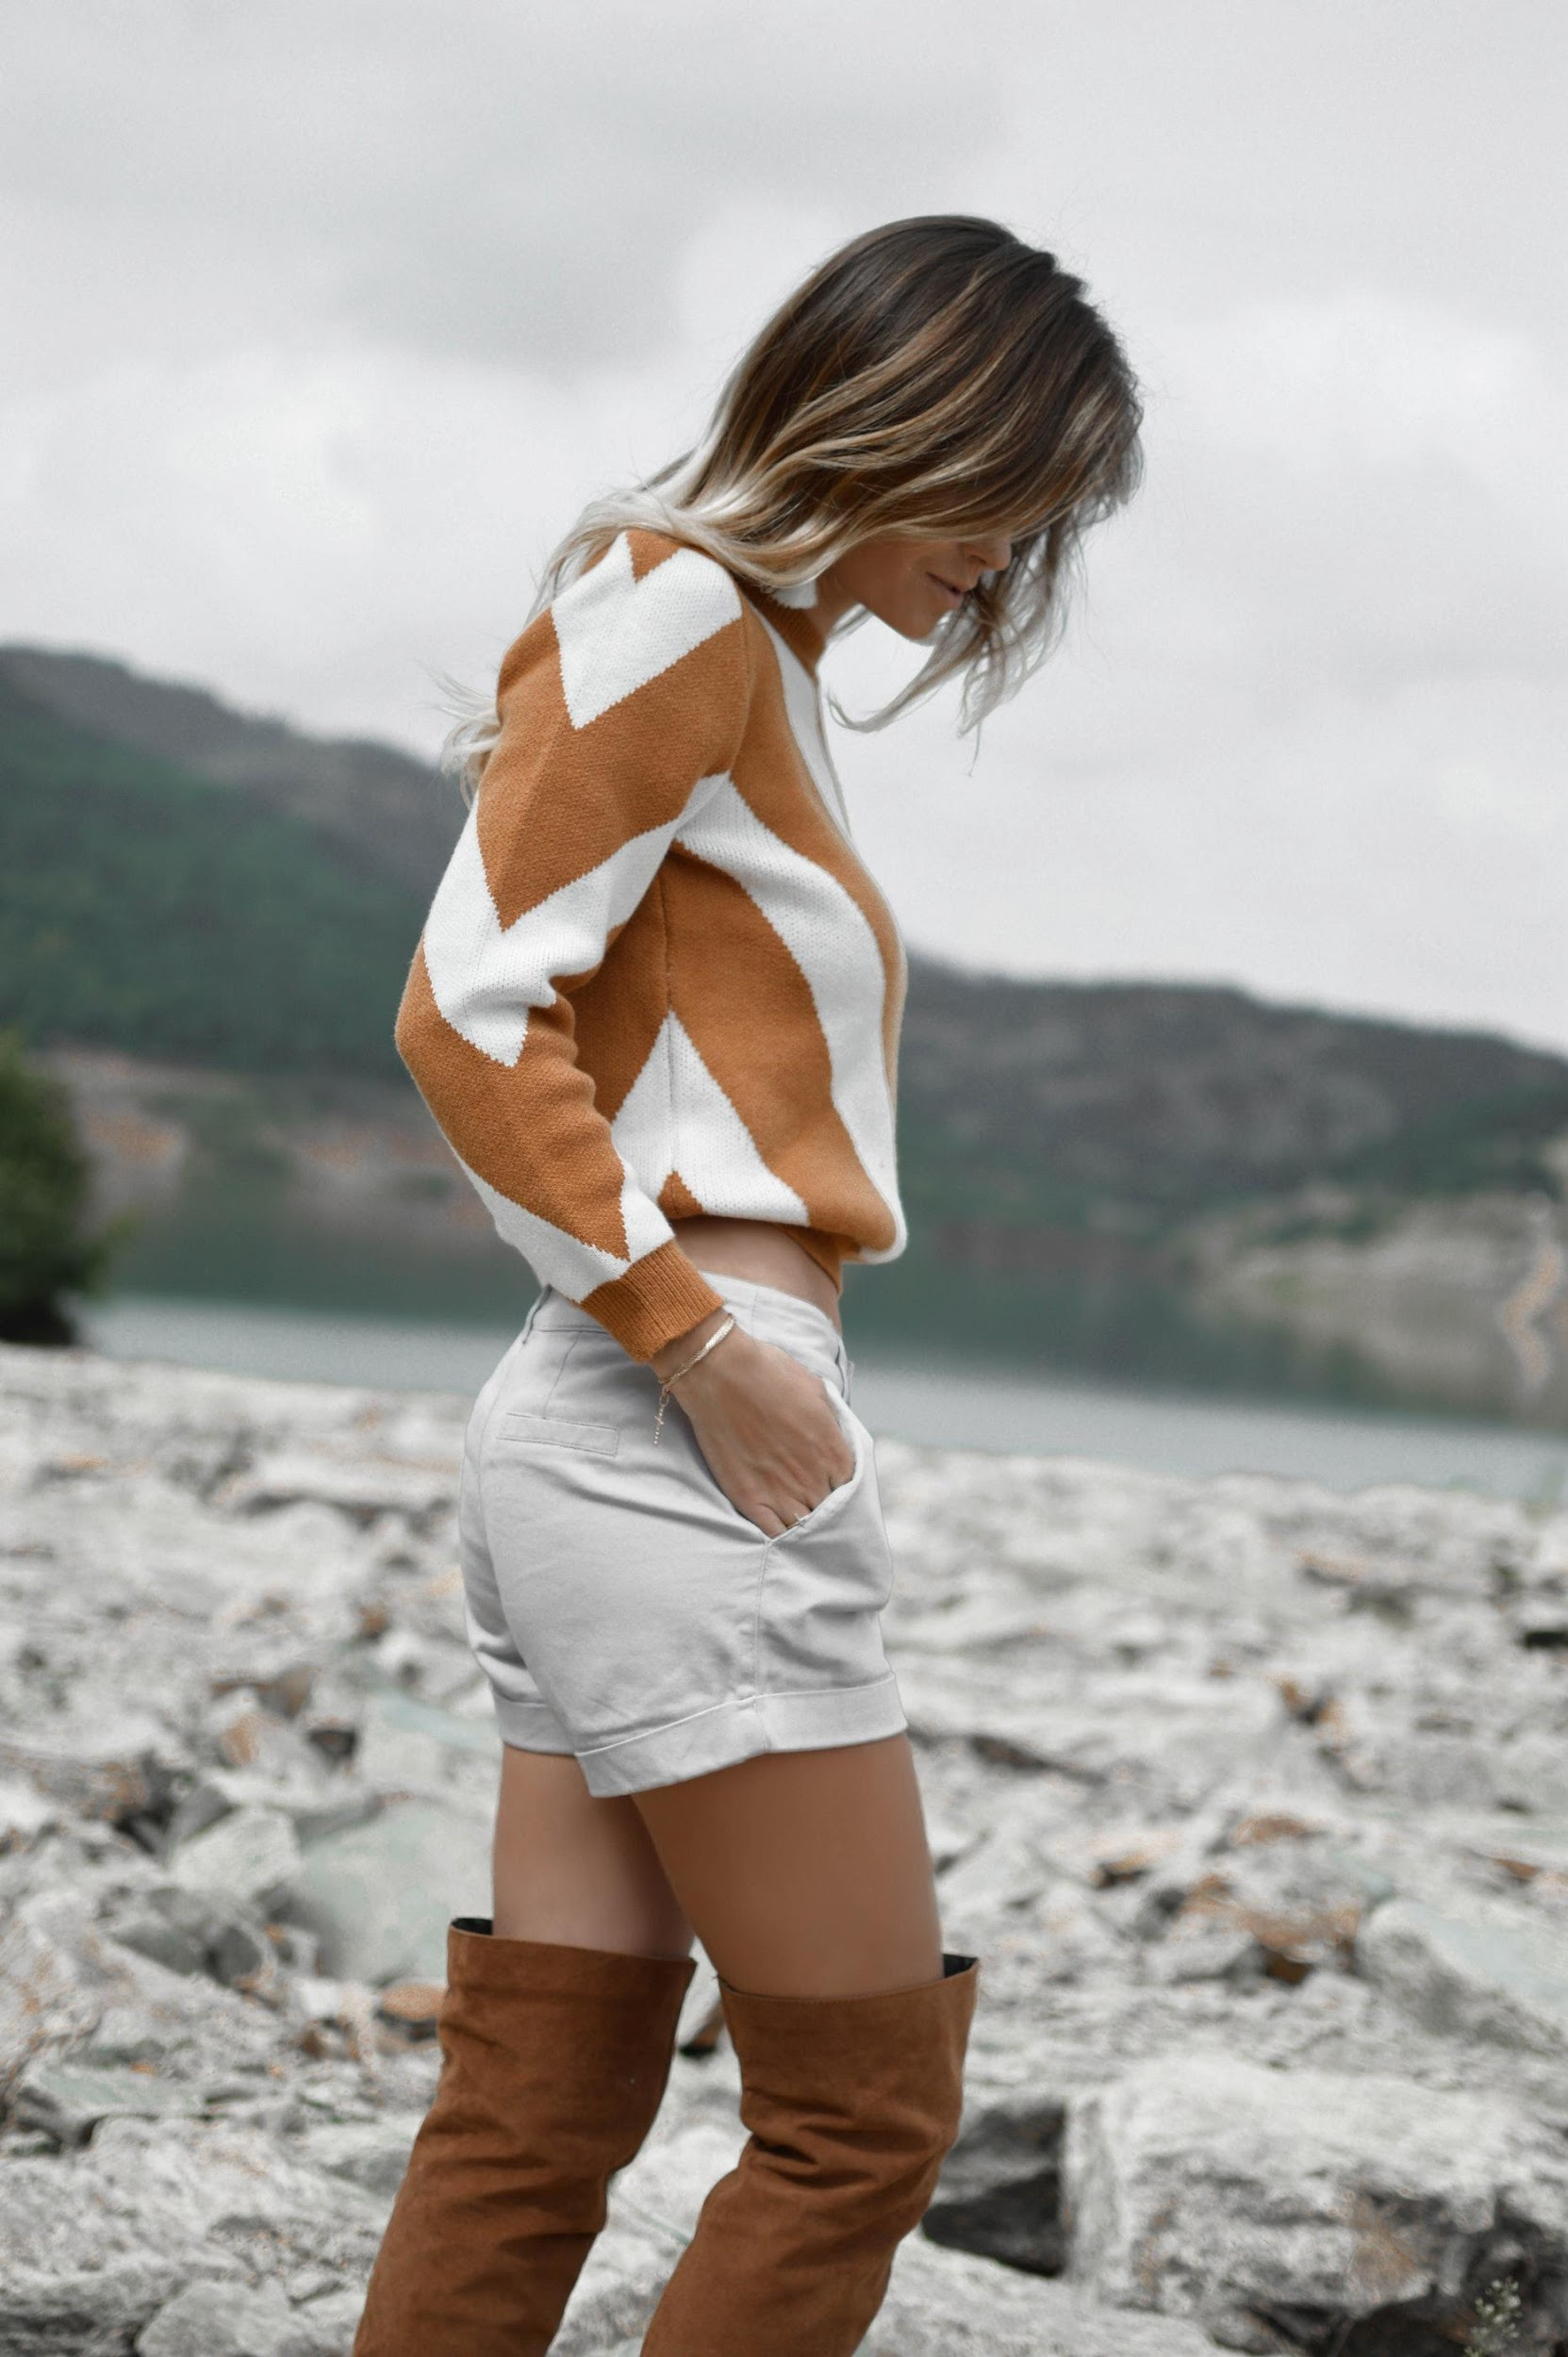
Stefan Clothing
Outlook
The fashion industry has always been a major hit for people around the country due to the following:
Reflects the identity & culture of a user, Promotes confidence & creativity, Another form of art, and
One step to being hip & on-trend
“
“ fashion world
towards a new era”
”

Slide 15

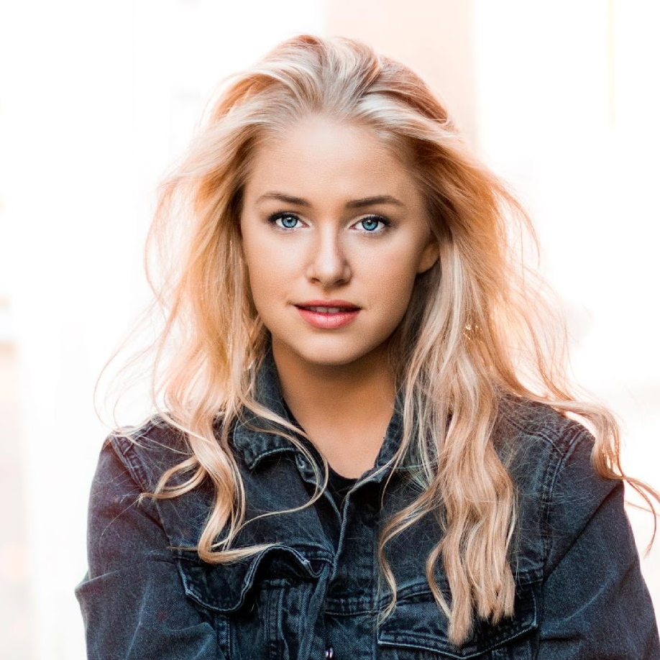
Testimonials
Stefan Clothing was a worthwhile investment for me. Knowing that I can’t have many of the things I used to have when I was younger, I needed all the help I could get in style. Now I can with Stefan Clothing”
^{- Cyndia D. Thomas, 53, Nurse}
“My dad isn’t getting any younger. I needed as much assistance as I could in terms of keeping his fashion alongside his medication without having to take up too much of my personal work as well. I’d highly recommend this to any elderly (or those assisting the elderly) any day.”
- Wylang J. Wyans, 32, Engineer

Slide 16
Thank You
Stefan Clothing Co.

