Slide 1
The Runaways
A Film Proposal by Pink Rose Productions, 2029
+209 8328784 • pinkroseproduction.com
pinkroseproduction@gmail.com

Slide 2
Categories
Storyline
Characters
Actors
Crew
Budget
Production Timeline
Sponsors
Release Date

Slide 3
Storyline
At 25, Prince Hanson Madden is next in line to the British throne. After being entangled in a corruption scandal that had none of his involvement, he escapes to America & disguises as a commoner. There he meets Paris Swift, a famous yet self-absorbed pop star who runs away from all of her showbiz commitments after being accused as a married politician’s mistress. Hate & disgust initially befall the two after an awkward meeting, but both realize they want a simple & carefree life away from the lives they are used to.
Synopsis

Slide 4
Storyline
Theme
The movie’s theme is about breaking free & making choices.
Logline
A British prince & an American pop star run away from their homes after getting involved in each of their scandals.
Tone
Romantic-comedy treatment with drama on the side.

Slide 5
Storyline
Running
Time
Inspiration
Budget
Asian romantic
comedy films.
120 minutes
$25 million

Slide 6
Storyline
Original
Soundtrack
5 original songs; 2 of which will be sung individually by the main actors of the film.
Release Date : November 16, 2029

Slide 7
Characters
Paris Swift
American pop star. She is the best-selling artist of the world. Behind the limelight, she is strictly controlled by her mother & brother. She had to put up with the rules set for her. She started her career at 14 years old, but her reputation is ruined after she gets accused as a mistress.
Main
Characters
Hanson Madden
British prince. Next in line to the throne at 25. While he is being groomed as king, he gets involved in a corruption scandal inside the charity he’s handling. This prompts him to escape to America & live a lowkey life.

Slide 8
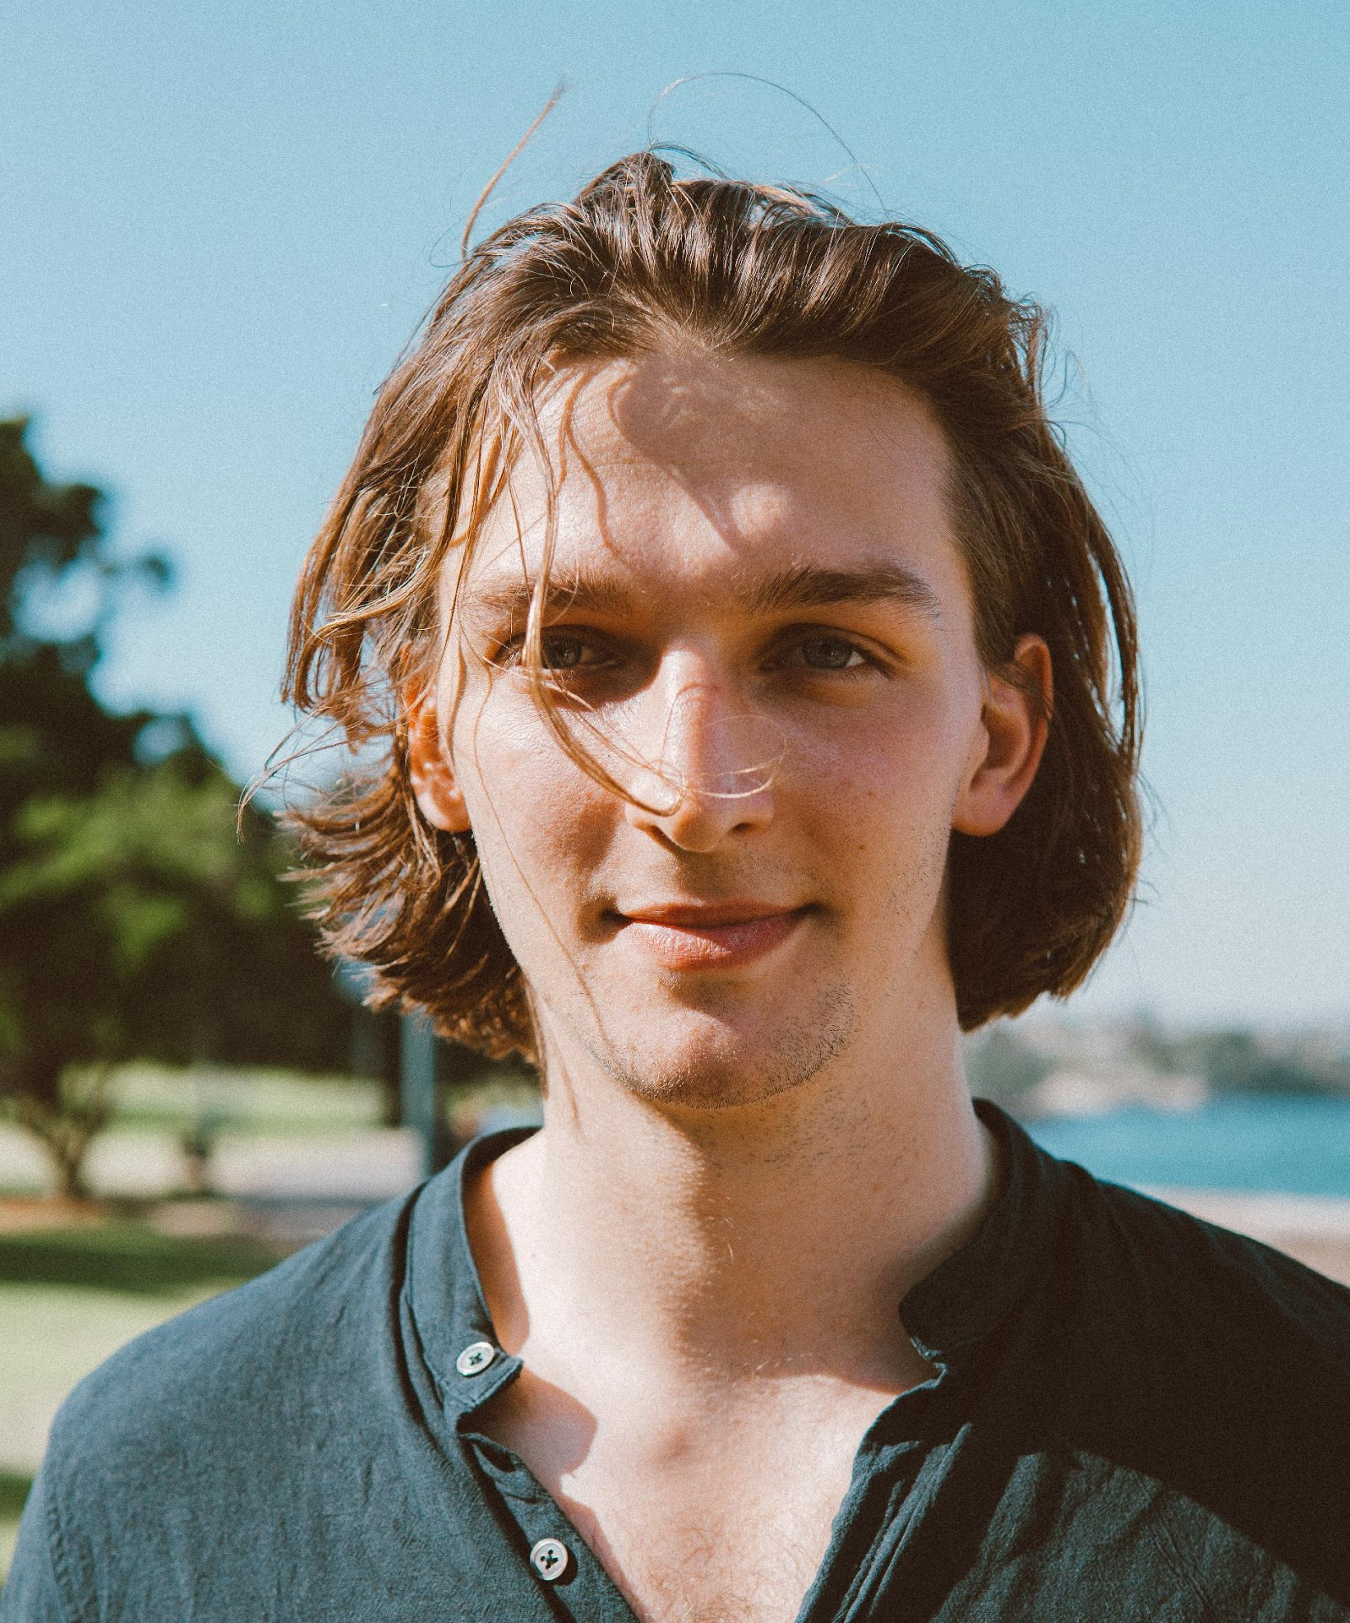
Actors
Mike Anders
Anders has won 2 Golden Berry Award for Best Actor in 2022 & 2023. His notable films are “Wild Ride With The Wind”, “Experiment #245” & “Sandra’s Eye”. In addition to that, Anders also writes lyrics & does demo tracks of pop star Ludwig Smith, Janice Mars & Gidou. He was born & raised in Manchester, England. This is his first American movie.

Slide 9
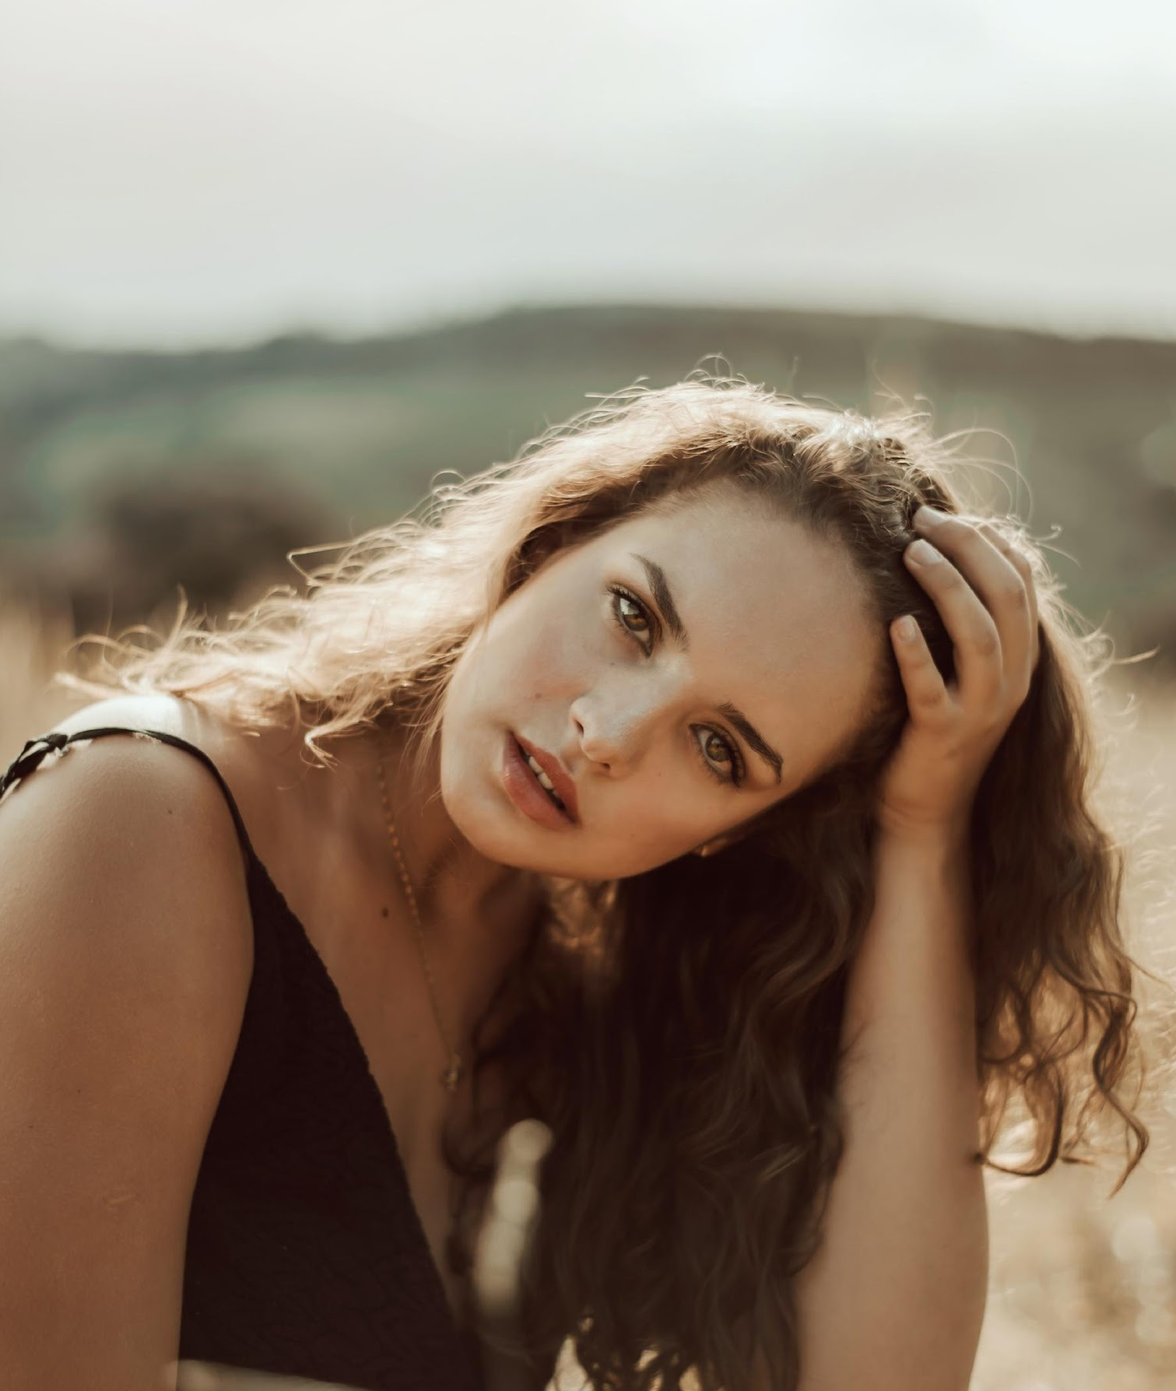
Actors
Celine Collins
Prior to her acting career, Collins is an emerging pop star with five #1 singles on the Worldwide Music Chart. She did small roles for television & cameo appearances in films. Auditions were held for the main female role. Collins beat 3,000 other auditionees. Collins has released 3 extended plays so far. This is her first major acting role.

Slide 10
Crew
Lisa Jones
Writer
Lisa Jones is known for writing the films “The Brotherhood Manifesto”, “Silent Night”, “The Promise” & “Seven Kingdoms”. She also wrote the limited series “Harper’s Tales” that aired on SBC-25 for 10 episodes. Jones also served as a creative director for the sitcom “Harry & Sandy” for 10 years.

Slide 11
Crew
Jones Donell
Director
Donell is known for directing historical films “The Japanese Princess” and “The Last Guardian”, which both earned her awards worldwide. Prior to her directing stint, she worked as an animator & graphic designer. She eventually directed the short films “I Know You” & “Gracie’s Diary”. Both short films became shortlisted in the Leon Film Festival in Spain. This is her first romantic-comedy movie as director.

Slide 12
Crew
Waldo Granger
Executive Producer
Waldo Granger is the owner of Harper Films. He is known for producing the films “Highway Midnight” & “Songs of Summer”. Both films were box-office hits & recognized as modern classic films of the 21st century. Granger is also the head of the streaming site Glazo, where all American films from the 1970s are readily available in a beautifully restored condition.

Slide 13
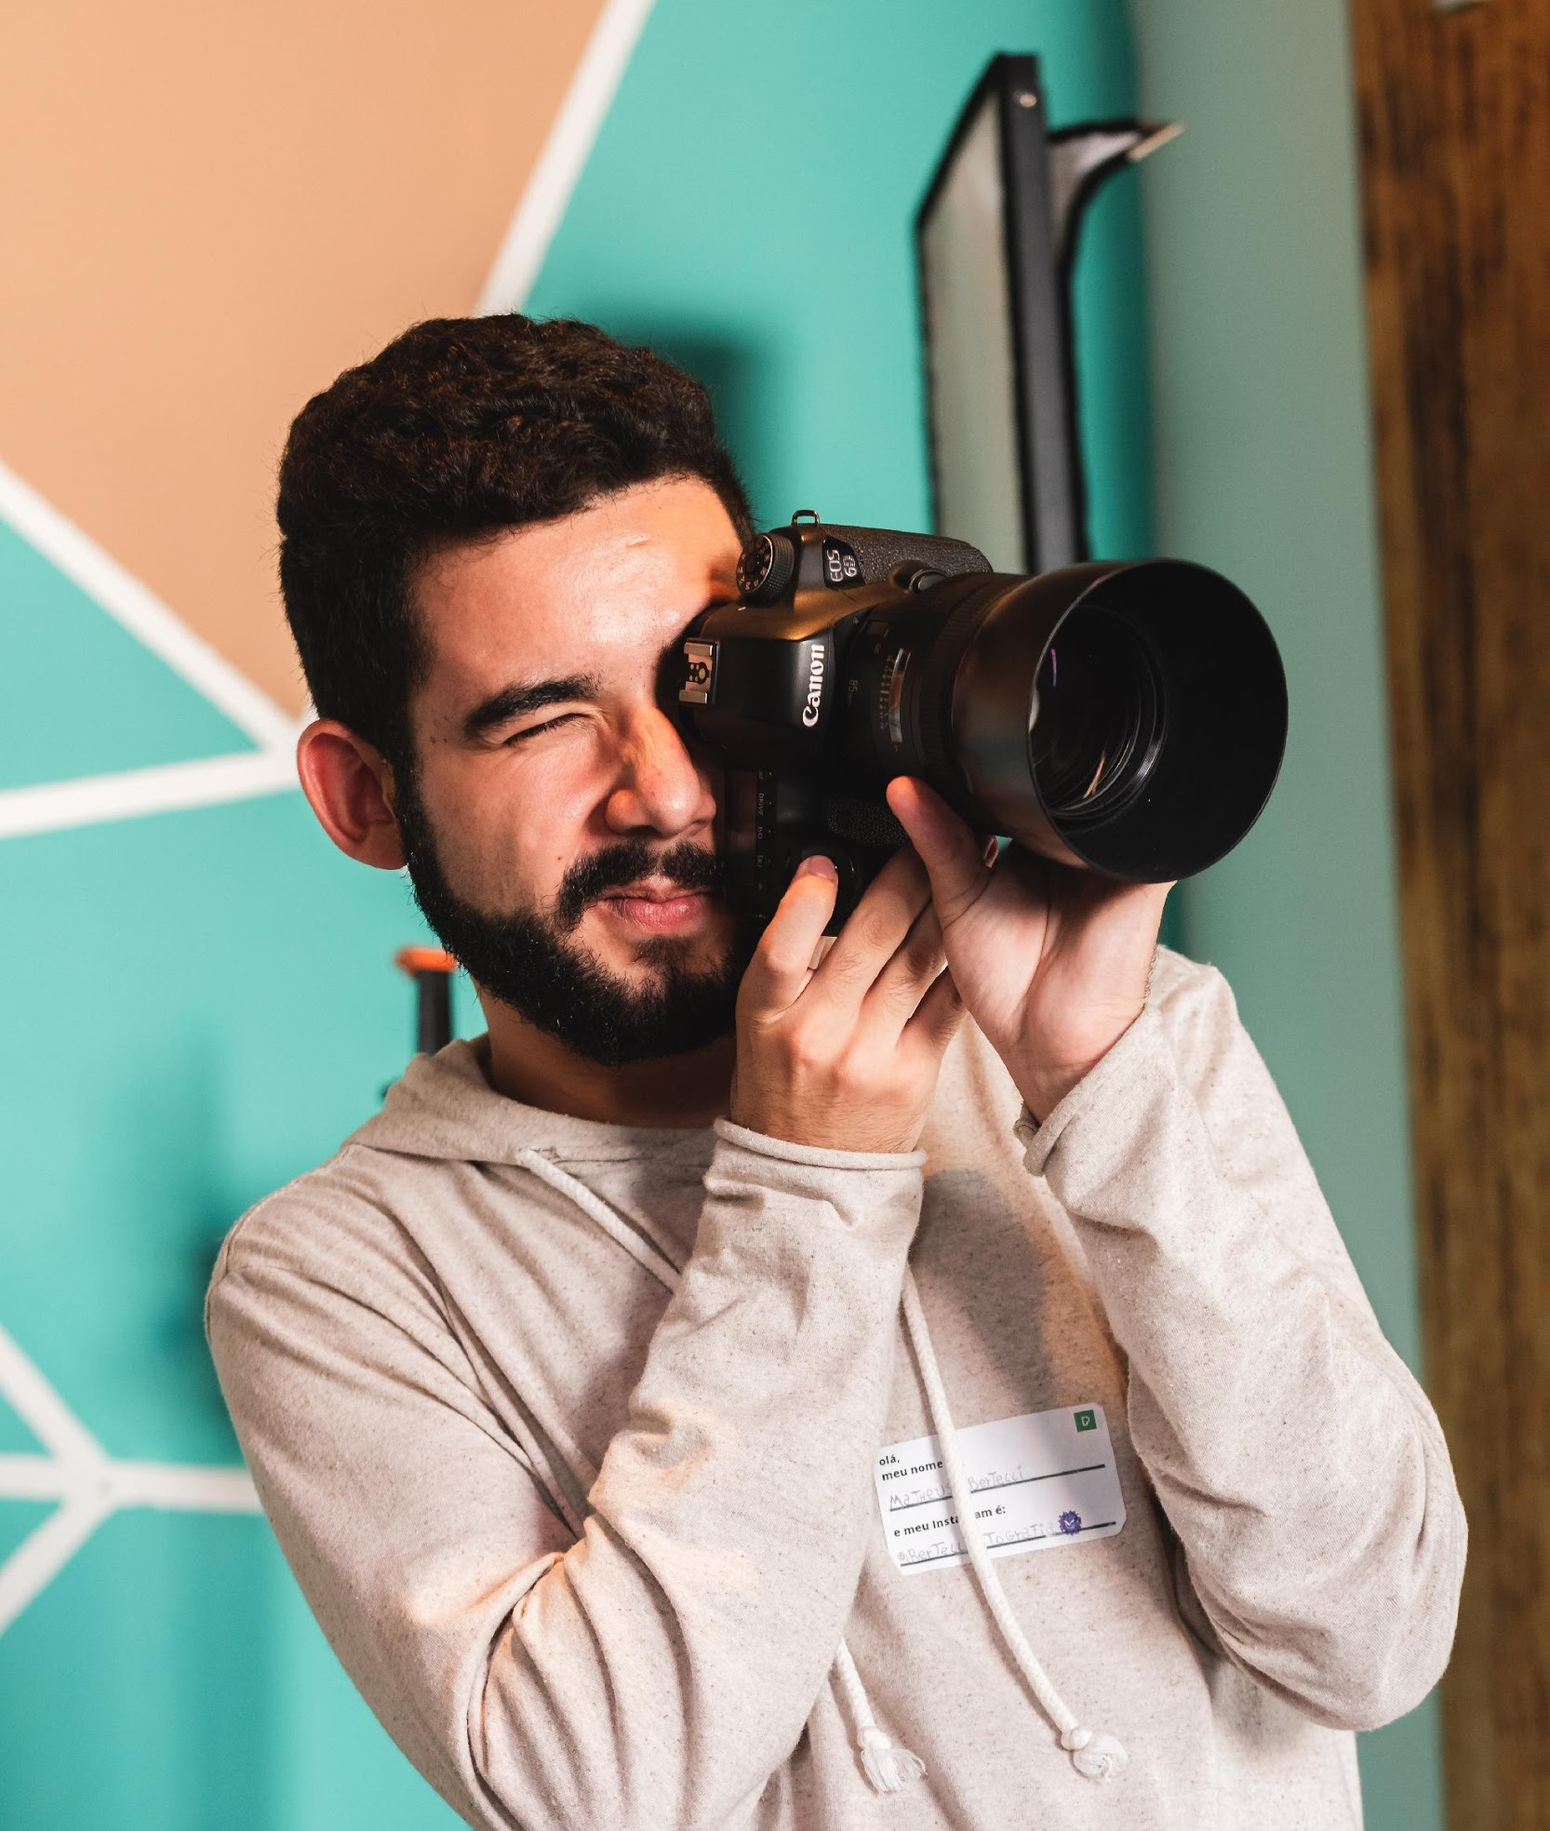
Crew
Samuel Croft
Director of Photography
Samuel Croft is a trusted cinematographer of America’s most famous director for 15 years. His exceptional eye for detail & camera shots are evident in the films “The Broken Woman” & “First Date”. He won awards worldwide for his brilliant cinematography.

Slide 14
Production Timeline
Writing & revising of the script.
Pre-Production (4 months)
Getting actors & directors for the film.
Arranging the utilities, props & other needs.
Securing permits & locations as indicated in the script.

Slide 15
Production Timeline
Table reading of the script & story conference.
Pre-Production (4 months)
Announcement of the film through news & other media channels.
Screen test to see if actors are suitable
on cam.
Shooting of the movie poster.

Slide 16
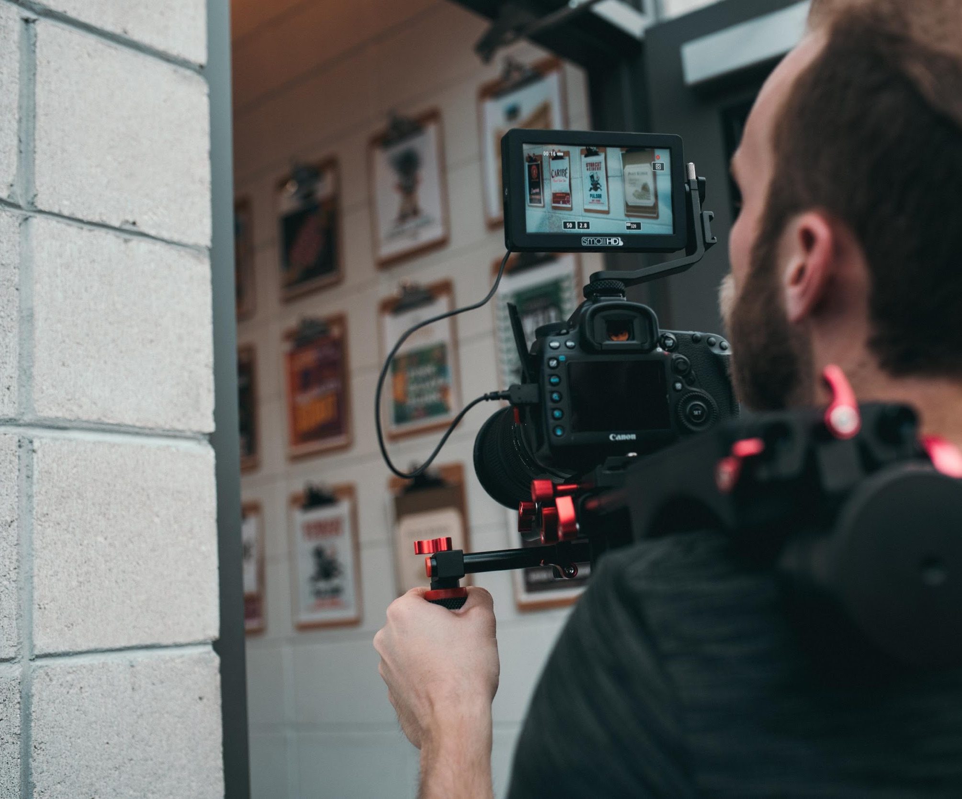
Storyline
Production
(6 months)
Script is finalized for shooting.
Shooting of the scenes in determined locations.
Reshoot in case
of unforeseen circumstances.
Sound mixing, props, utility & medical team are present.

Slide 17
Storyline
Post-Production (4 months)
Editing of the raw footage based on the script.
Dubbing of the lines.
Playdates & theaters are already secured.
Teasers, snippets, full trailer & poster are released.
Promotions are
done on all media channels.

Slide 18
Storyline
Screening Areas
Canada
United Kingdom
United States of America
Spain
South Korea
Mexico
Philippines

Slide 19
Thank You!
+209 8328784 • pinkroseproduction.com
pinkroseproduction@gmail.com

