Slide 1


FITNESS &
WELLNESS GYM
+6473 832829
gym@fitness.com

Slide 2

WEIGHTS AND GAINS
This program project launch will be held at Fitness & Wellness Gym Grounds on March 20, 2023 from 8am to 6pm. This will promote an extensive weight exercise program available for all. Admissions to this project launch will start at $24.99 which includes 2 days unlimited use of gym equipment and 30% off on a lifetime Fitness & Wellness Gym Membership card.
Profits from this project launch will be donated to the “Clean Up Drive Project” organized by One Earth Foundation.

Slide 3

WEIGHTS AND GAINS
This newly developed fitness project will be held at Fitness & Wellness Gym Hall on April 1, 2024 from 9am to 9pm. It will showcase different strategies and exercises for all weightlifting enthusiasts. Admission to this fitness project will start at $24.99 and will entitle all attendees to 25% off on selected weightlifting equipment and a 15% discount on a lifetime Fitness & Wellness Gym Membership card. Profits will be used for the equipment and system upgrade of Fitness & Wellness Gym.

Slide 4

60-DAY WEIGHT LOSS
This new fitness project will be held at Fitness & Wellness Gym on February 24, 2023 from 9am to 10pm. This event was organized by Jordan Warlow who is best known for his “Action Stunt” course which promotes an efficient way to lose weight in 60 days. Admission starts at $30 and will entitle all availers to a free 3-day “Action Stunt” trial kit as well as a chance to be part of the special training program conducted and headed by Jordan Warlow himself. Profits will be used as a monetary assistance for the “Save Earth Foundation”.

Slide 5

60-DAY WEIGHT LOSS
Fitness & Wellness Gym offers you the best fitness and training experience at affordable and convincing price points. This gym started in the year 1999 and hassine then been recognized by numerous athletes and sports enthusiasts.
Fitness & Wellness Gym has high standard, well built quality equipment, lifetime membership card and fitness package options in addition to state of the art facilities.
Michael Boulder
Founder & Owner

Slide 6
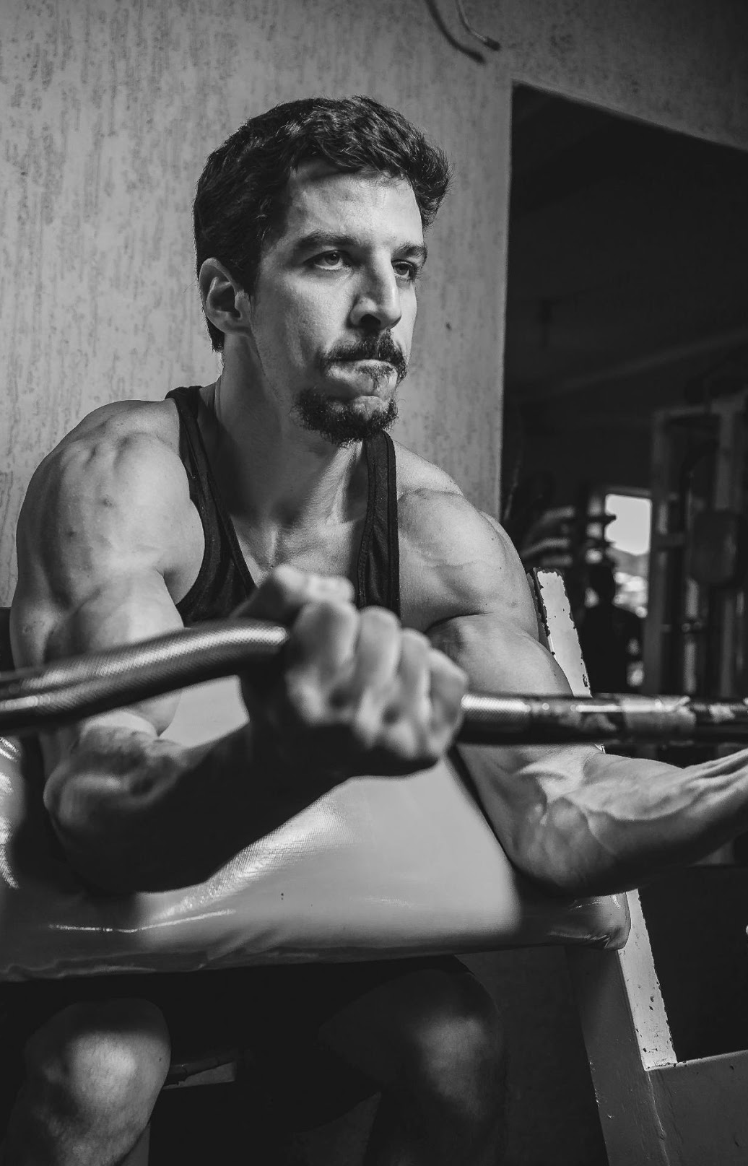
MANAGEMENT TESTIMONY
“Fitness & Wellness Gym is here to provide the best experience of fitness and exercise training program which are best, affordable and the most effective way to lose or gain weight.”
-Brolin Smith, 29, Fitness Trainer

Slide 7

WEIGHTS AND GAINS
Fitness & Well Gym Grounds
March 20, 2023
8am to 6pm
This will promote an extensive weight exercise program available for all. Admissions to this project launch will start at $24.99 which includes 2 days unlimited use of gym equipment and 30% off on a lifetime Fitness & Wellness Gym Membership card.
Profits from this project launch will be donated to the “Clean Up Drive Project” organized by One Earth Foundation.

Slide 8

This event will showcase different strategies and exercises for all weightlifting enthusiasts. Admission to this fitness project will start at $24.99 and will entitle all attendees to 25% off on selected weightlifting equipment and a 15% discount on a lifetime Fitness & Wellness Gym Membership card.
Profits will be used for the equipment and system upgrade of Fitness & Wellness Gym.
COMPETITIVE WEIGHTLIFTING
Fitness & Well Gym Hall
April 1, 2023
9am to 9pm

Slide 9

60-DAY WEIGHT LOSS
Fitness & Well Gym
February 24, 2023
9am to 10pm
This event will showcase different strategies and exercises for all weightlifting enthusiasts. Admission to this fitness project will start at $24.99 and will entitle all attendees to 25% off on selected weightlifting equipment and a 15% discount on a lifetime Fitness & Wellness Gym Membership card.
Profits will be used for the equipment and system upgrade of Fitness & Wellness Gym.

Slide 10

HISTORY
Founded by Michael Boulder, Fitness & Wellness Gym started its operation in the year 1980 and is known for its fitness training equipment, facilities, and programs. Fitness & Wellness Gym aims to encourage and inspire all people who are in dire need of fitness and exercise training assistance.

Slide 11

MEMBERS TESTIMONY
“Fitness & Wellness Gym never failed to provide me with the best fitness training program experience.”
Michael Woods, 24, Student

Slide 12
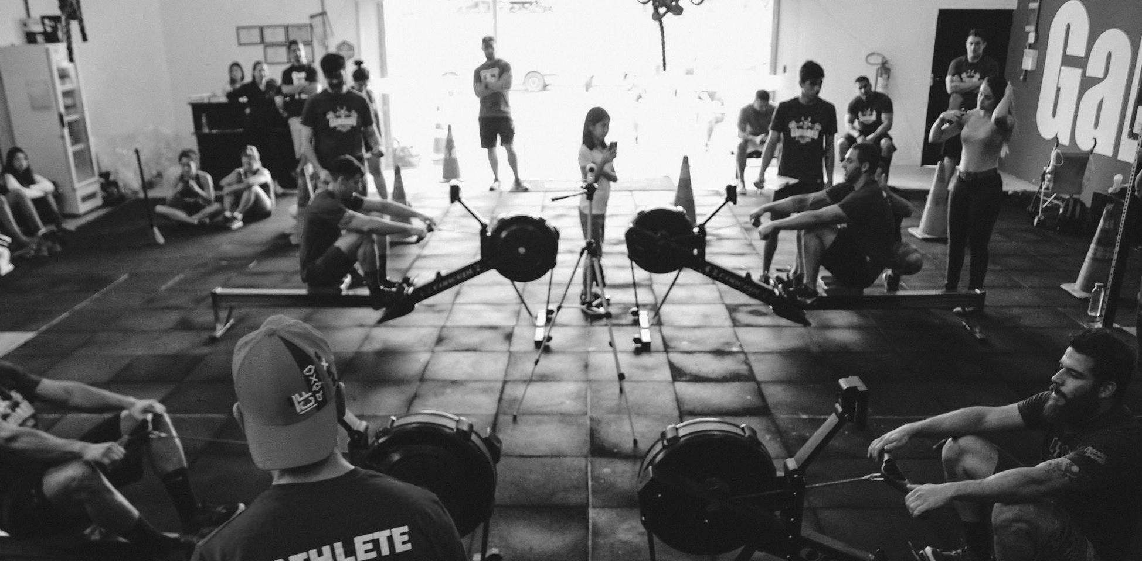
MAIN GOAL
Fitness & Wellness Gym commits to providing for and inspiring all people who are in dire need of fitness and exercise training assistance.
Profits from this project launch will be donated to the “Clean Up Drive Project” organized by One Earth Foundation.

Slide 13

OVERVIEW OF GROWTH

Slide 14
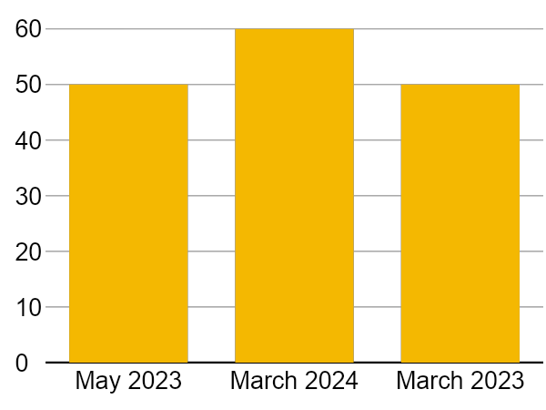
OVERVIEW OF GROWTH
50% increase in annual profits as of May 2023.
60% increase in fitness package inquiries as of March 2024.
60% increase in new fitness gym members as of March 2023.

Slide 15

WHAT WE OFFER
State of the Art Facilities
High Standard Gym Equipment
Quality Assured Services
Friendly Customer Care

Slide 16


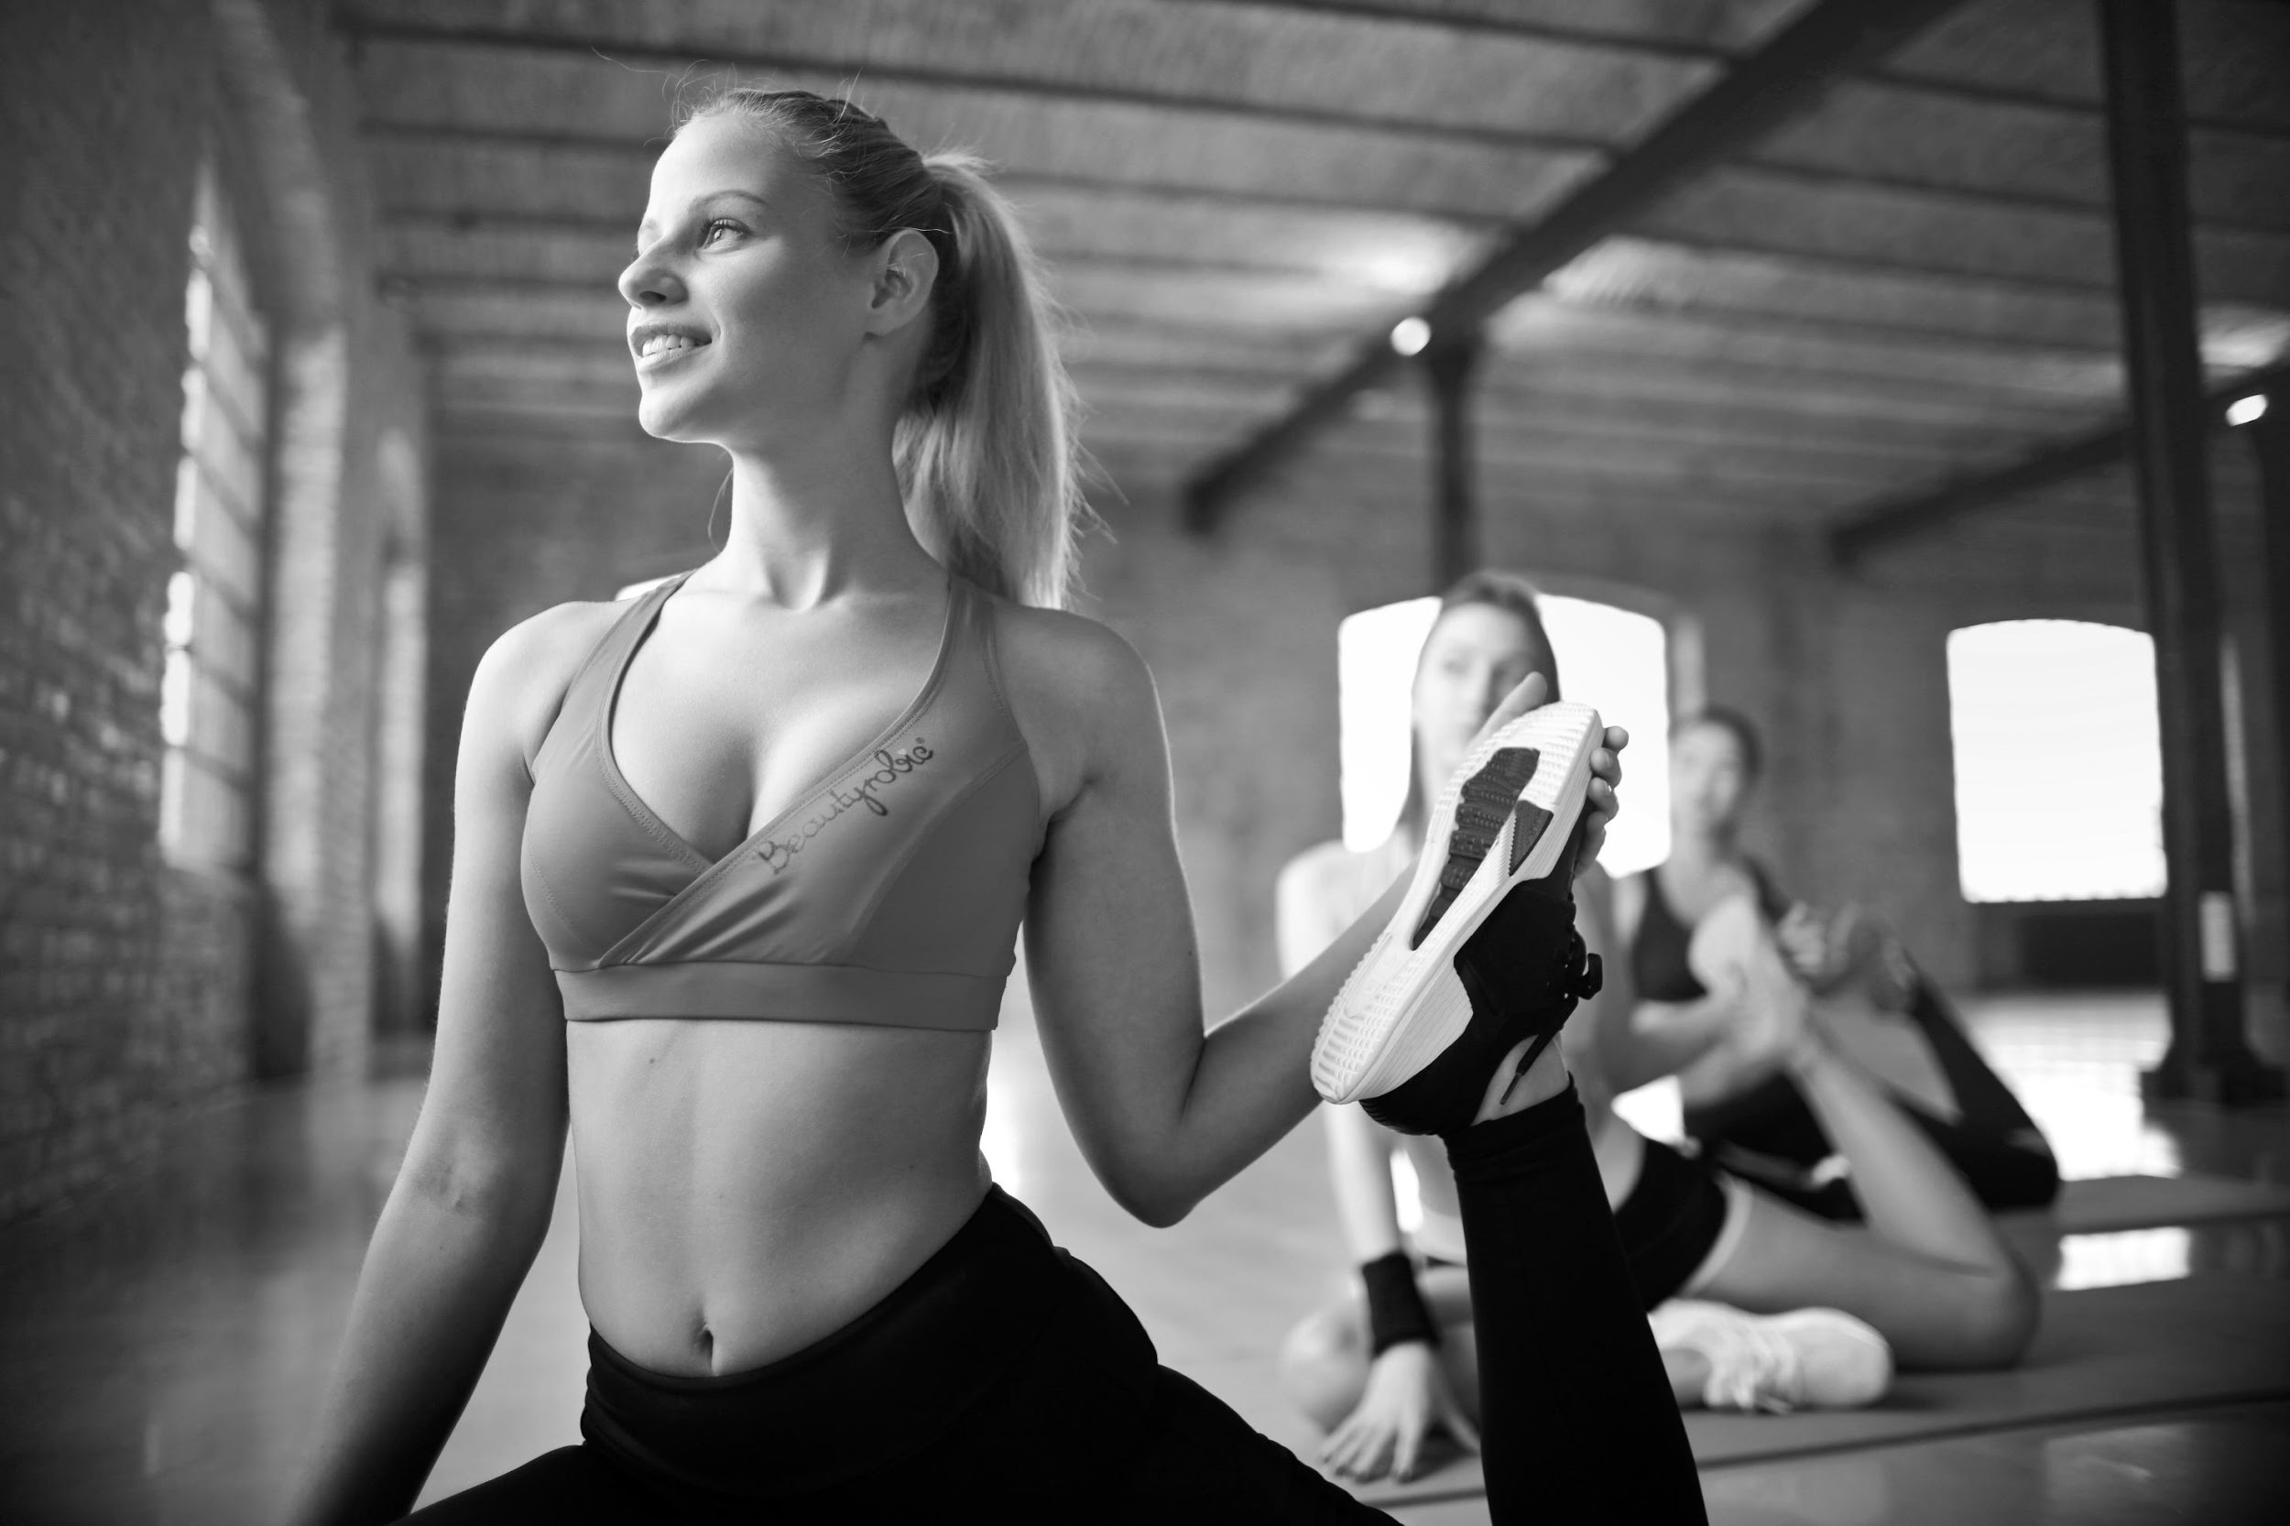


Slide 17



THE TEAM
Michael Boulder
Chairman & CEO
Smith “Big Boss” Quest
Fitness Trainer Head
Brolin Smith
Fitness Trainer

Slide 18

THANK YOU!
+6473 832829
gym@fitness.com

