Slide 1
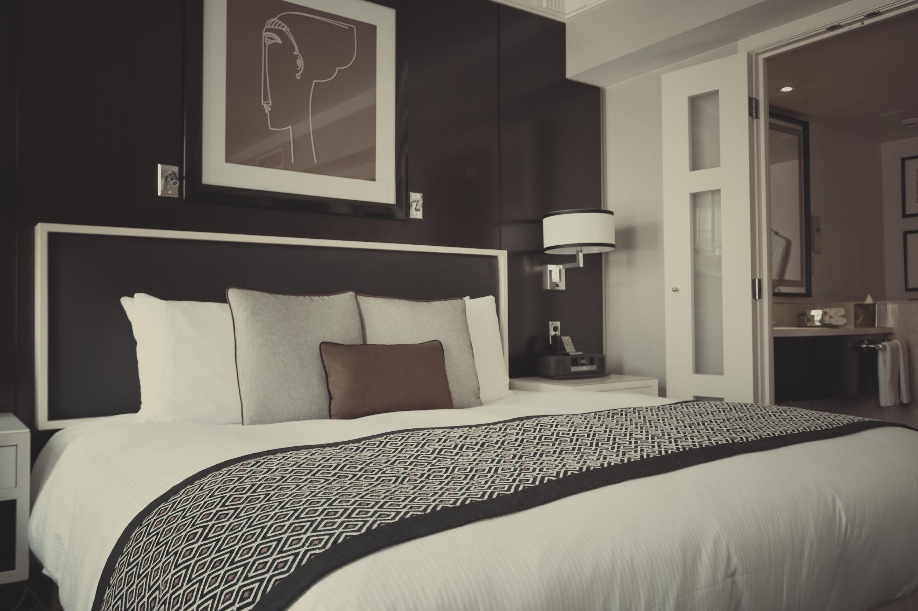
THE MELVIEW HOTEL
^{ANNUAL REPORT}

Slide 2
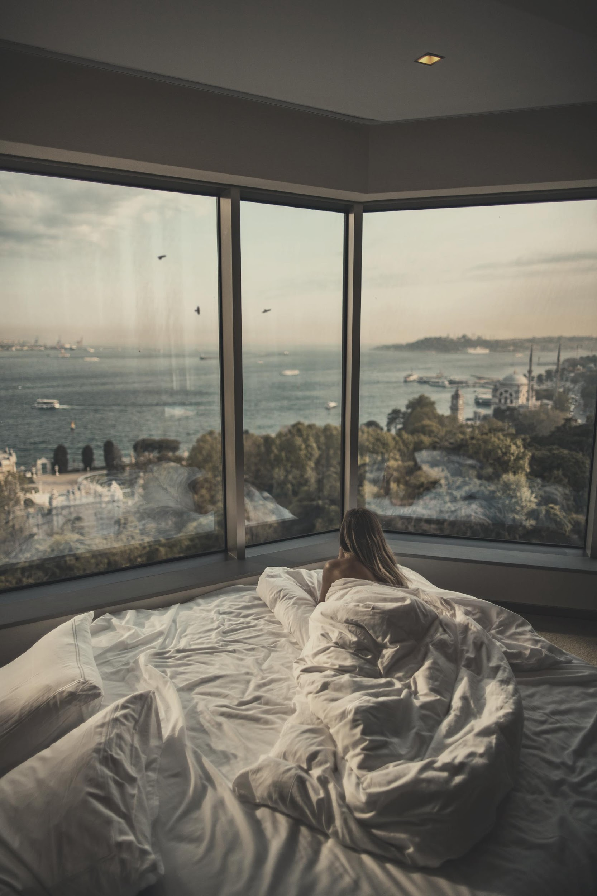
AGENDA
PROFITS
All financial reports from the different departments will be reviewed, calculated, determined, and analyzed. The results will then be analyzed and the board will come to a mutual decision on how the profits are to be split and utilized for the remainder of 2021.

Slide 3
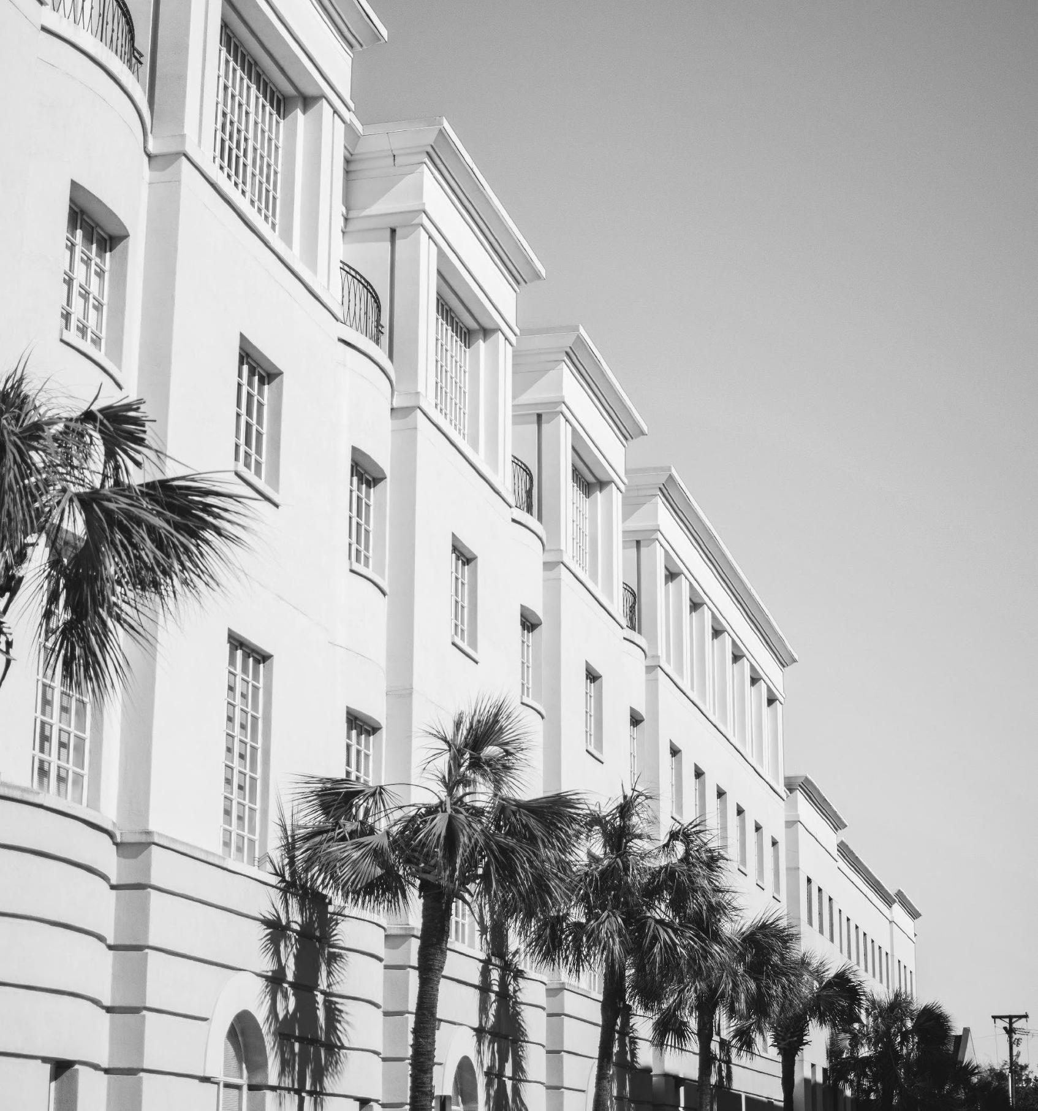
PROJECTS
Projects for the entirety of the year 2021 will be discussed as well as the projected profits each will gain. Additionally, future projects will be discussed in further detail with regards to budget, departments involved, and final ticket prices.

Slide 4
The board will review the results of the commentary cards collected so far from the visitors and guests for the year 2021. These comments will be utilized for the creation of improvement plans and programs to help provide a better experience for all.
PROFITS

Slide 5
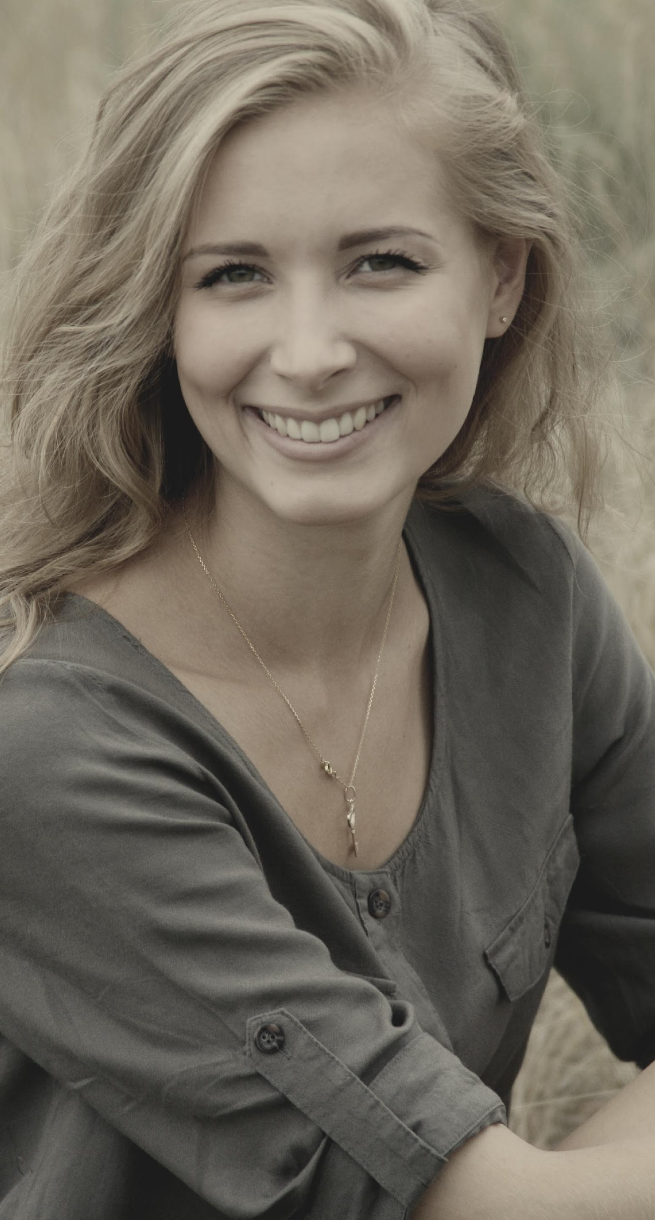
^{Welcome to the Melview Hotel!}
I am happy to have witnessed my childhood dream of owning and running a hotel finally take off. It’s also great to see the success it has achieved and the awards it has won thanks to the hardworking staff and management. This year holds a lot of exciting new changes for the Melview Hotel.
We are excited and thrilled to announce the construction of our new amenities as well as future events such as concerts and charity events.
I hope and pray that Melview will continue to be the reliable and luxurious escape that all guests expect and more.
MARY MELVIEW
Founder & CEO

Slide 6
“
This year holds a lot of exciting new changes for the Melview Hotel.
”

Slide 7
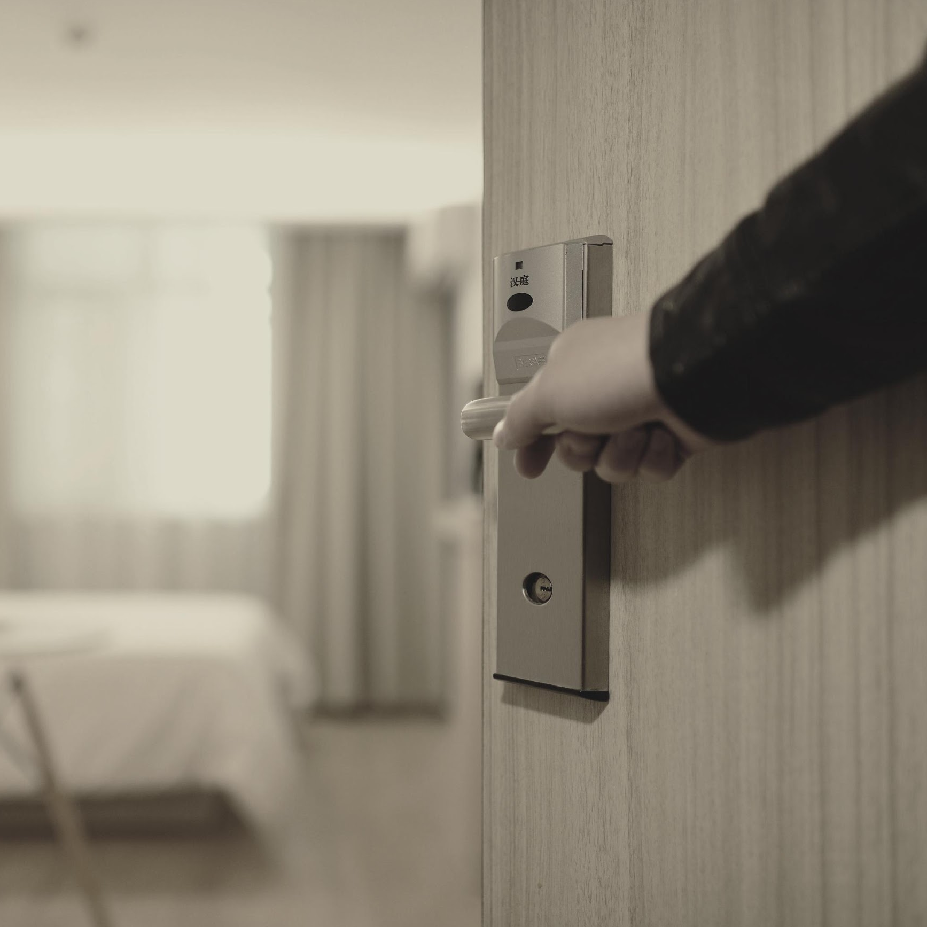
HISTORY
The Melview Hotel was founded in the year 2005 by Mary Melview who is a former real estate agent. She wanted to create a hotel that boasted luxurious amenities and accommodating staff that would be made available to all at very reasonable price points.
Today, the hotel resides on a lush lot by the beach and offers spectacular views of the city both day and night. Additionally, the hotel has won more than 30 prestigious awards all throughout its 15 years of operating.

Slide 8
SUMMER SUNDOWN
May 20, 2021 | 5pm onwards | Sunset Shore
Tickets to this concert will be $30 each and will feature some of today’s hottests DJs such as DJ Mark Miller, DJ Rave, and Twixy Turvy. Profits from this concert will be utilized to improve the current construction of the new function rooms and French themed restaurant known as Je T'aime Paris to better serve the guests.

Slide 9
Tickets to this event will be $50 each and will entitle all attendees to a Hawaiian style buffet, free flowing cocktails, a pyro show, and goodie bags. 60% of profits will be donated to the “Save Hawaii’s Beaches” foundation.
40% of profits will be utilized for maintenance of the Seaview room such as shore clean up and littering prohibition measures.
GRAND HAWAIIAN LUAU
June 30, 2021 | 5pm onwards | Seaview Room

Slide 10
YEAR END BOARD MEETING
December 20, 2021 | 1pm to 5pm | Diamond Ballroom
Members of the Board will discuss about the current status of the Melview Hotel from July 01, 2021 to December 10, 2021. The agenda of this meeting is to update all members with the current progress and growth of the hotel as well as identify areas for improvement.

Slide 11
“If you are looking for a grand, accommodating, and spacious hotel to host your events, then the Melview hotel is truly an excellent choice. My birthday could not have been any better.”
-Jill Lim, 32, Manager of Tall Towers

Slide 12
ANNUAL BOARD MEETING
Members of the Board will be having their meeting at the Diamond Ballroom on July 01, 2021 from 1 pm to 5 pm in order to discuss about the current status of the Melview Hotel from January 01, 2021 to June 30, 2021. The agenda of this meeting is to update all members with the current progress, profit, and improvement measures to be implemented at the Melview Hotel for the second half of 2021.

Slide 13
OVERVIEW OF GROWTH
25%
increase in monthly profits as of May 2021.
30%
increase in satisfaction with projects (concerts, events, etc.) held.
63%
of customers would like to see more affordable meals at the restaurants within the hotel.

Slide 14
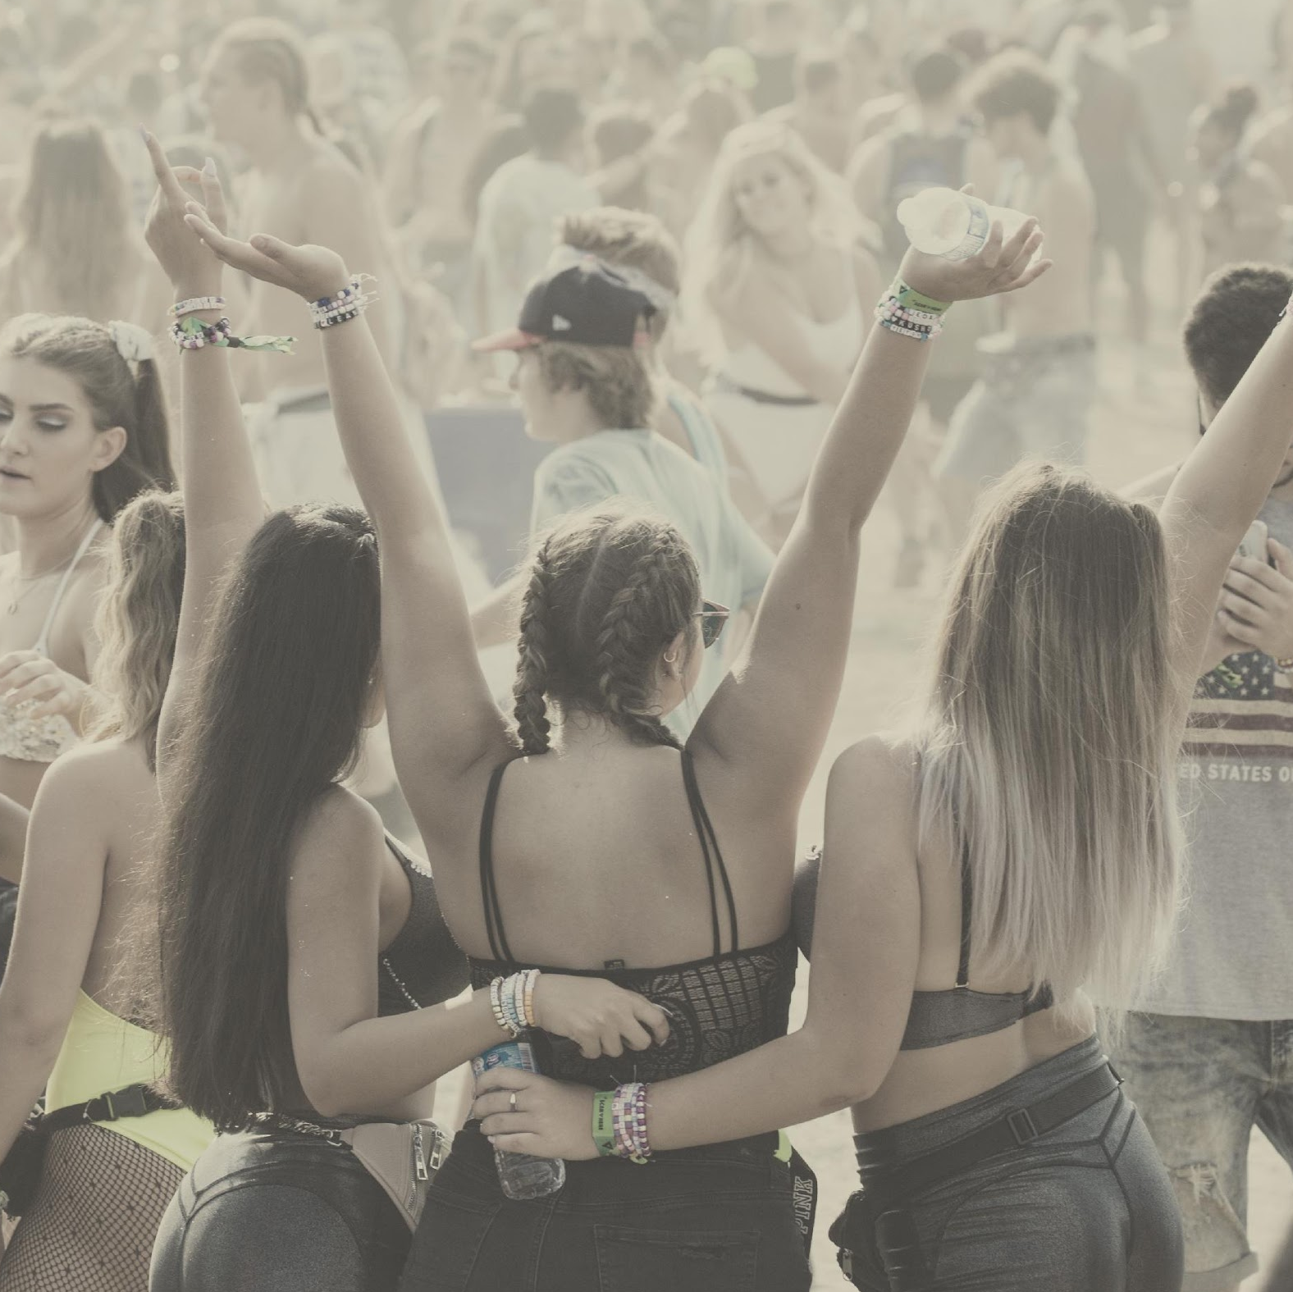
WHAT WE OFFER
^{Hotel Rooms}
^{Event Planning}
^{Function Rooms}
^{Food and Entertainment}

Slide 16
THE TEAM
JILLIAN JUNG
MARY MELVIEW
JOHN DOE
^{President}
^{Founder and CEO}
^{Vice President}

Slide 17
THANK YOU!
²⁰²⁻⁵⁵⁵⁻⁰¹⁷⁸
^{melview_hotel@gmail.com}

