Slide 1
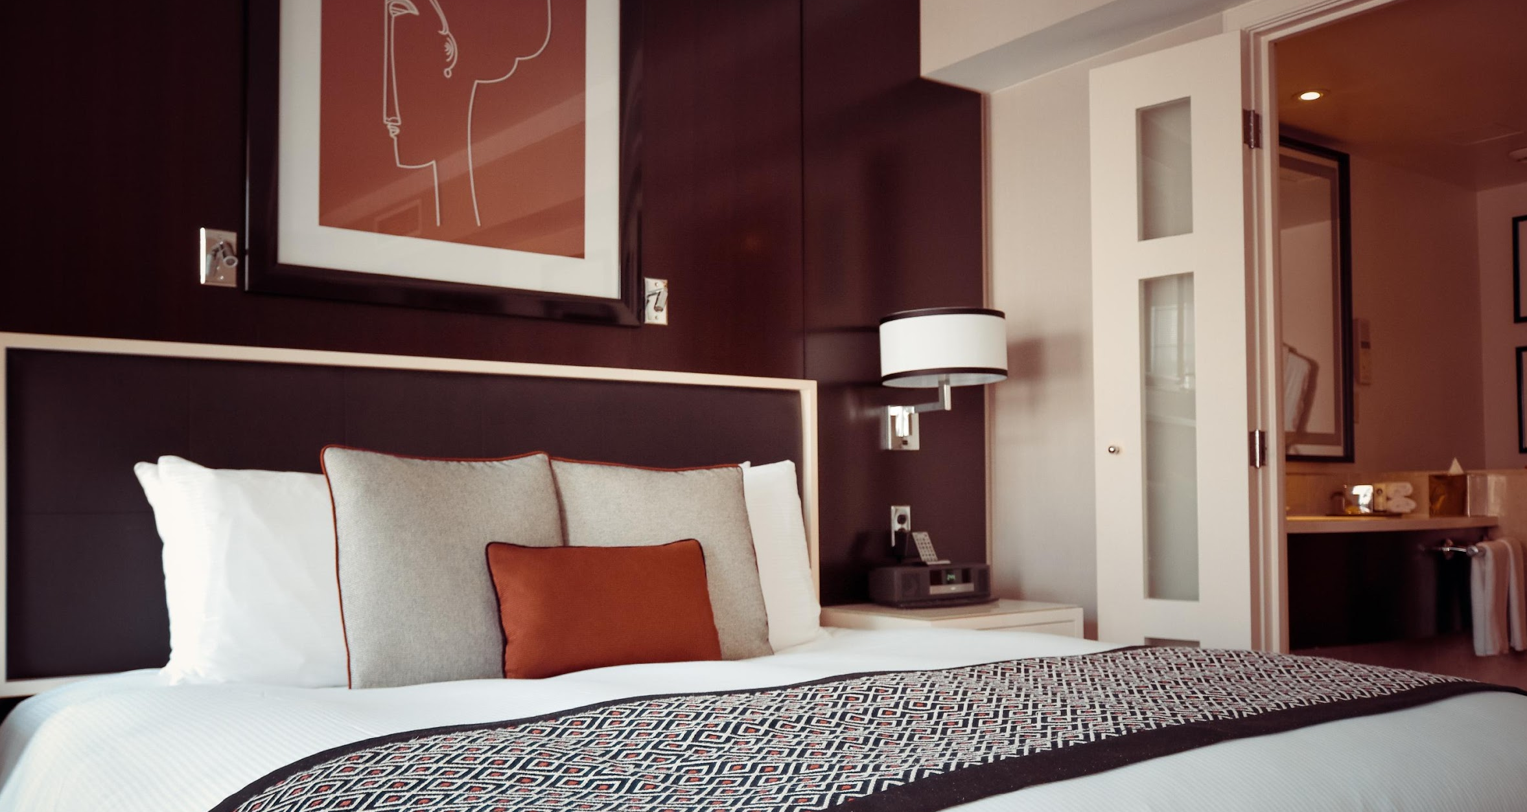
The Melvin Hotel
⁸⁴⁷⁻⁴⁸⁵⁻⁵²⁸⁶
4849 Thomas Street, Palatine, Illinois

Slide 2
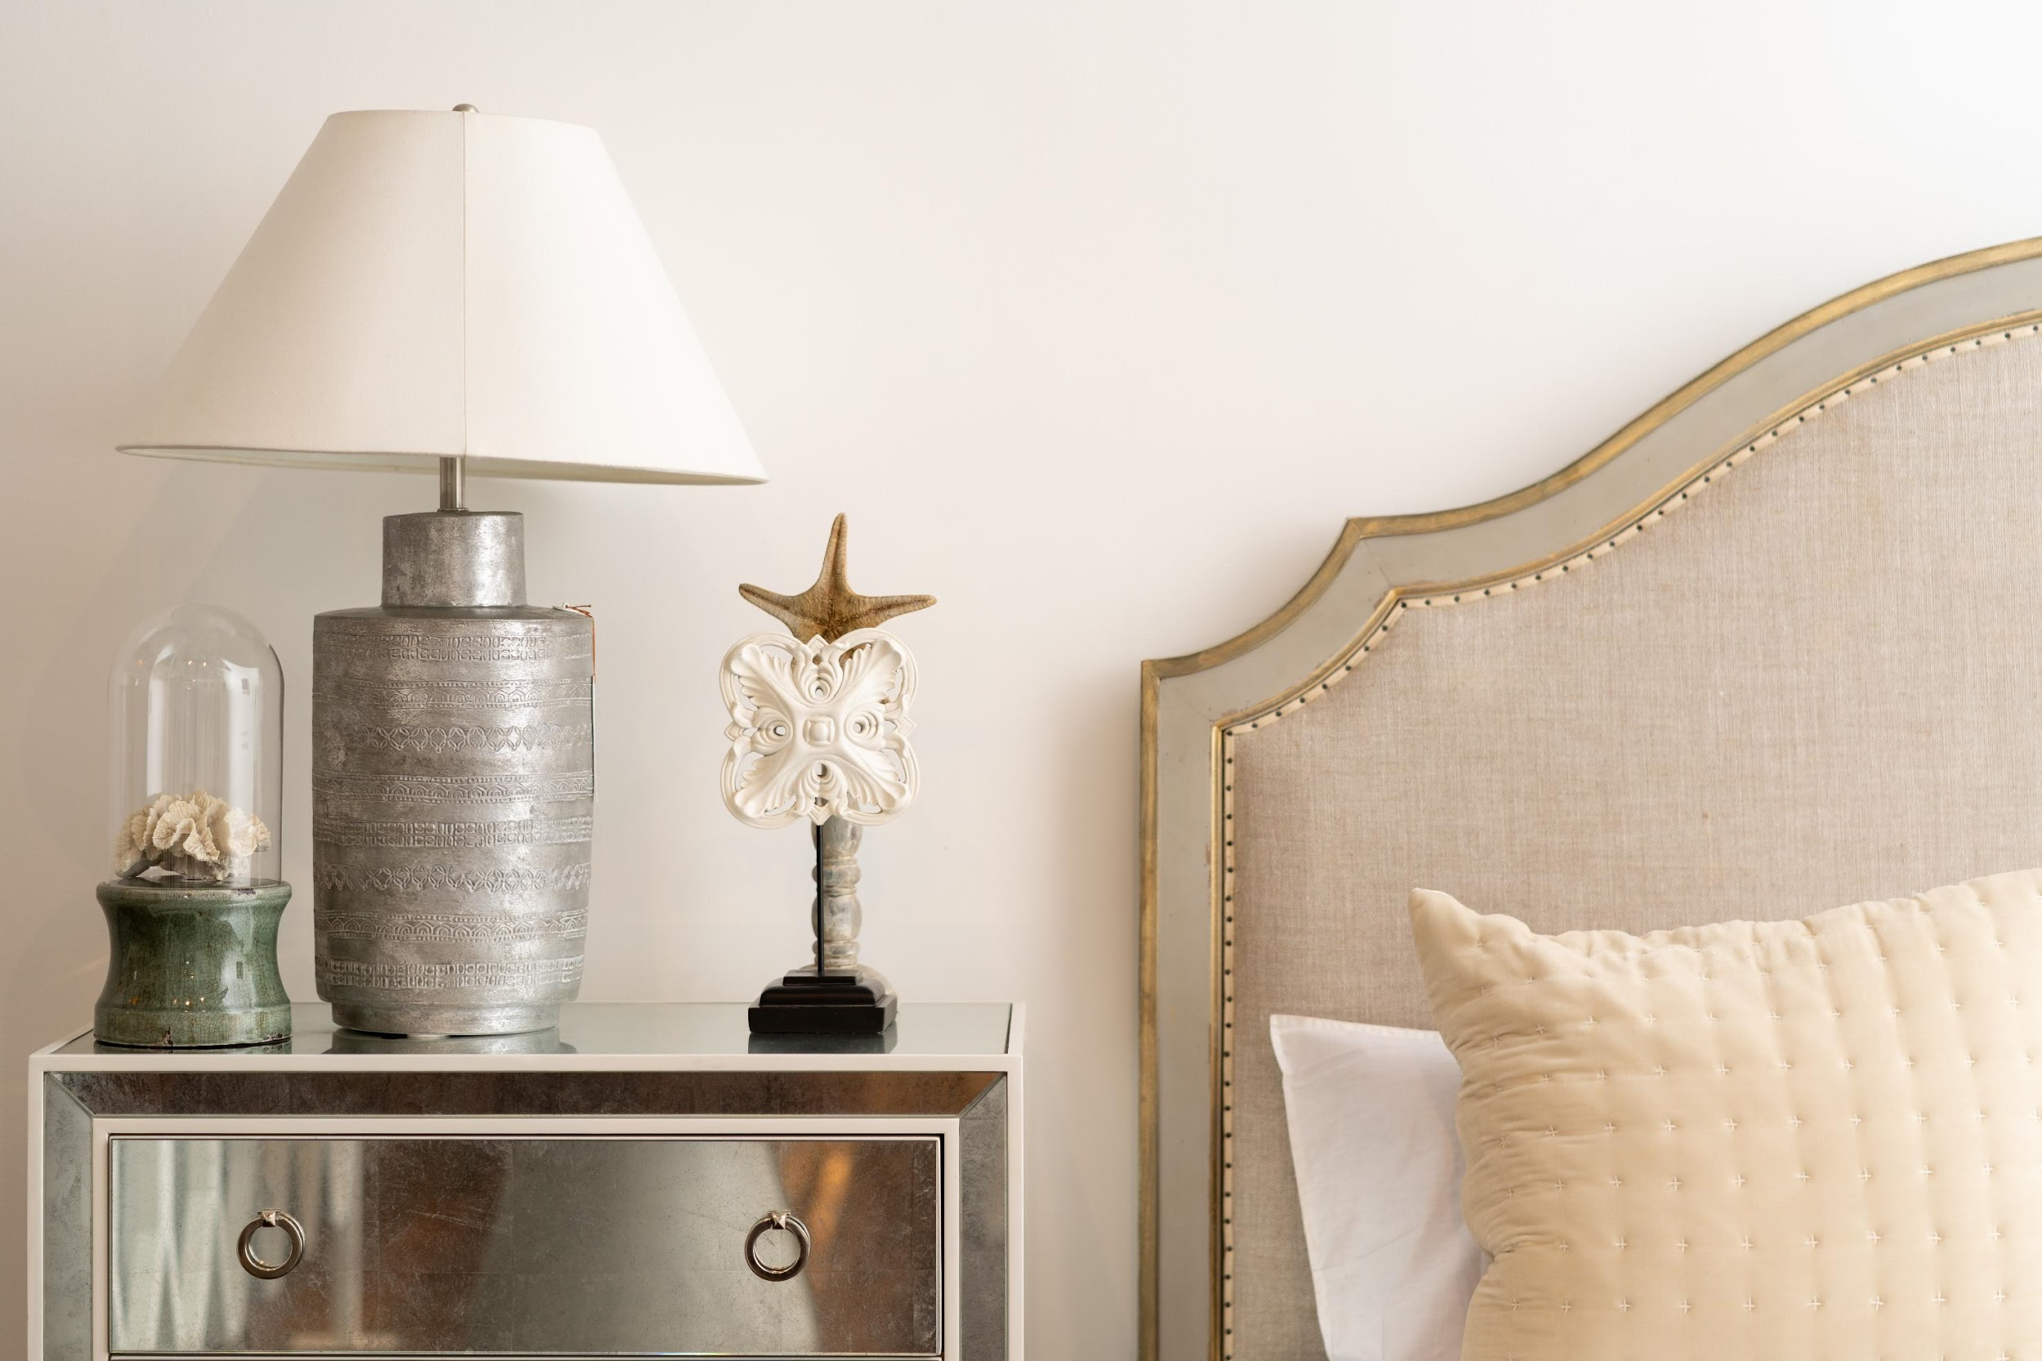
The Agenda

Slide 3
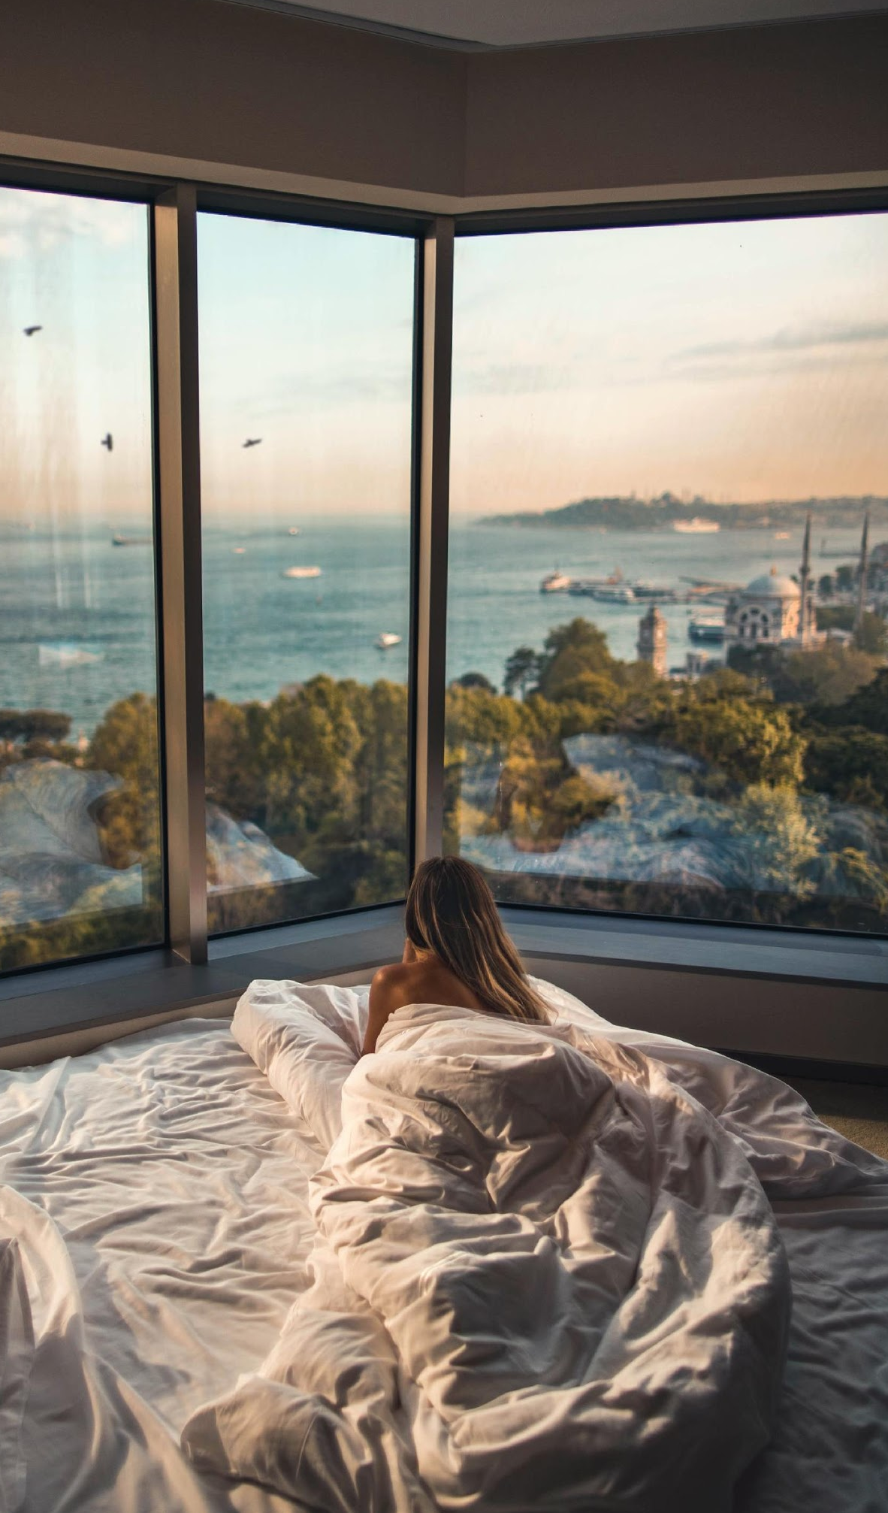
Summer Sundown
This summer concert will be held at the Sunset Shore on May 20, 2021 from 5pm onwards. Tickets to this concert will be $30 each and will feature some of today’s hottest DJs such as DJ Mark Miller, DJ Rave, and Twixy Turvy.
Profits from this concert will be utilized to improve the current construction of the new function rooms and French themed restaurant known as Je T'aime Paris to better serve the guests.

Slide 4
Grand Hawaiian Luau
This event will be held at the Seaview room on June 30, 2021 from 3pm to 8pm. Tickets to this event will be $50 each and will entitle all attendees to a Hawaiian style buffet, free flowing cocktails, a pyro show, and goodie bags. 60% of praofits will be donated to the “Save Hawaii’s Beaches” foundation.
40% of profits will be utilized for maintenance of the Seaview room such as shore clean up and littering prohibition measures.

Slide 5
Annual Board Meeting
Members of the Board will be having their meeting at the Diamond Ballroom on July 01, 2021 from 1 pm to 5 pm in order to discuss about the current status of the Melview Hotel from January 01, 2021 to June 30, 2021.
The agenda of this meeting is to update all members with the current progress, profit, and improvement measures to be implemented at the Melview Hotel for the second half of 2021.

Slide 6
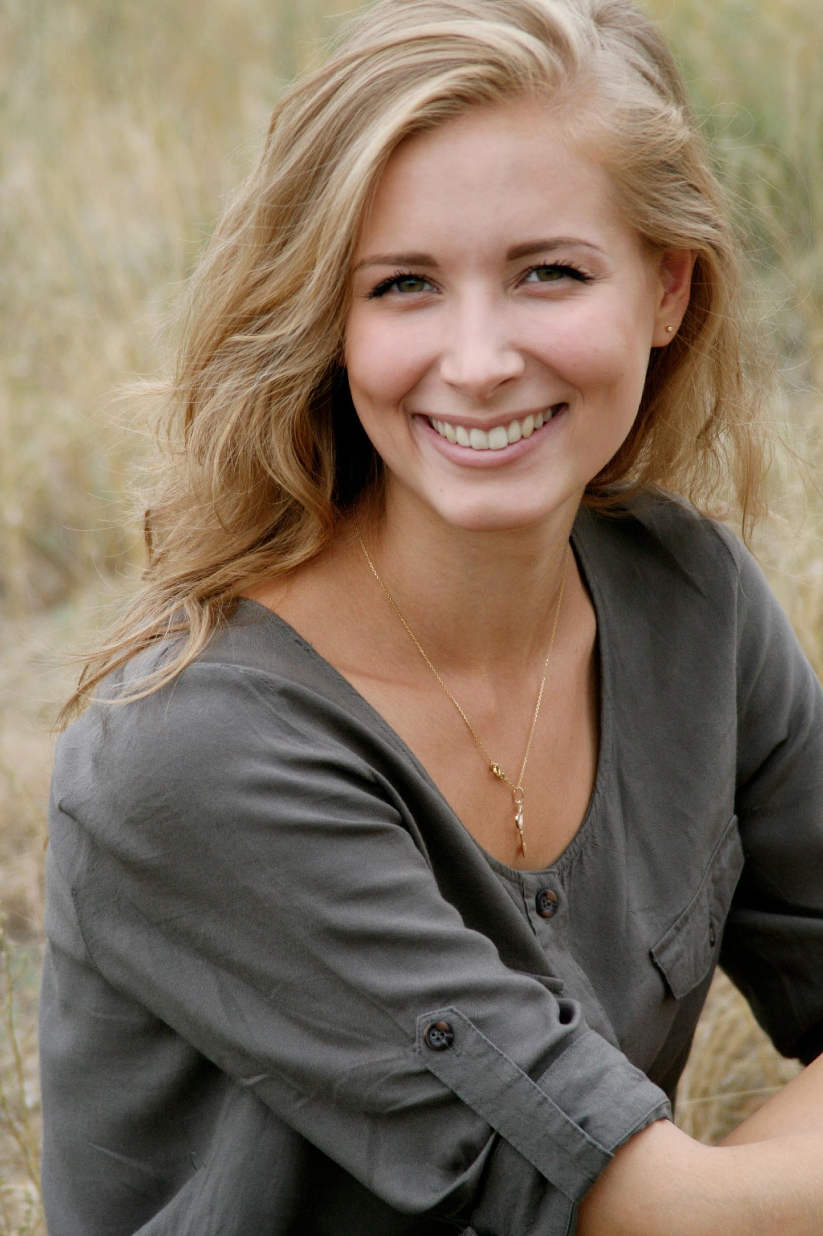
Mary Melview
Founder and CEO
^{Welcome to the Melview Hotel!}
I am happy to have witnessed my childhood dream of owning and running a hotel finally take off. It’s also great to see the success it has achieved and the awards it has won thanks to the hardworking staff and management.

Slide 7
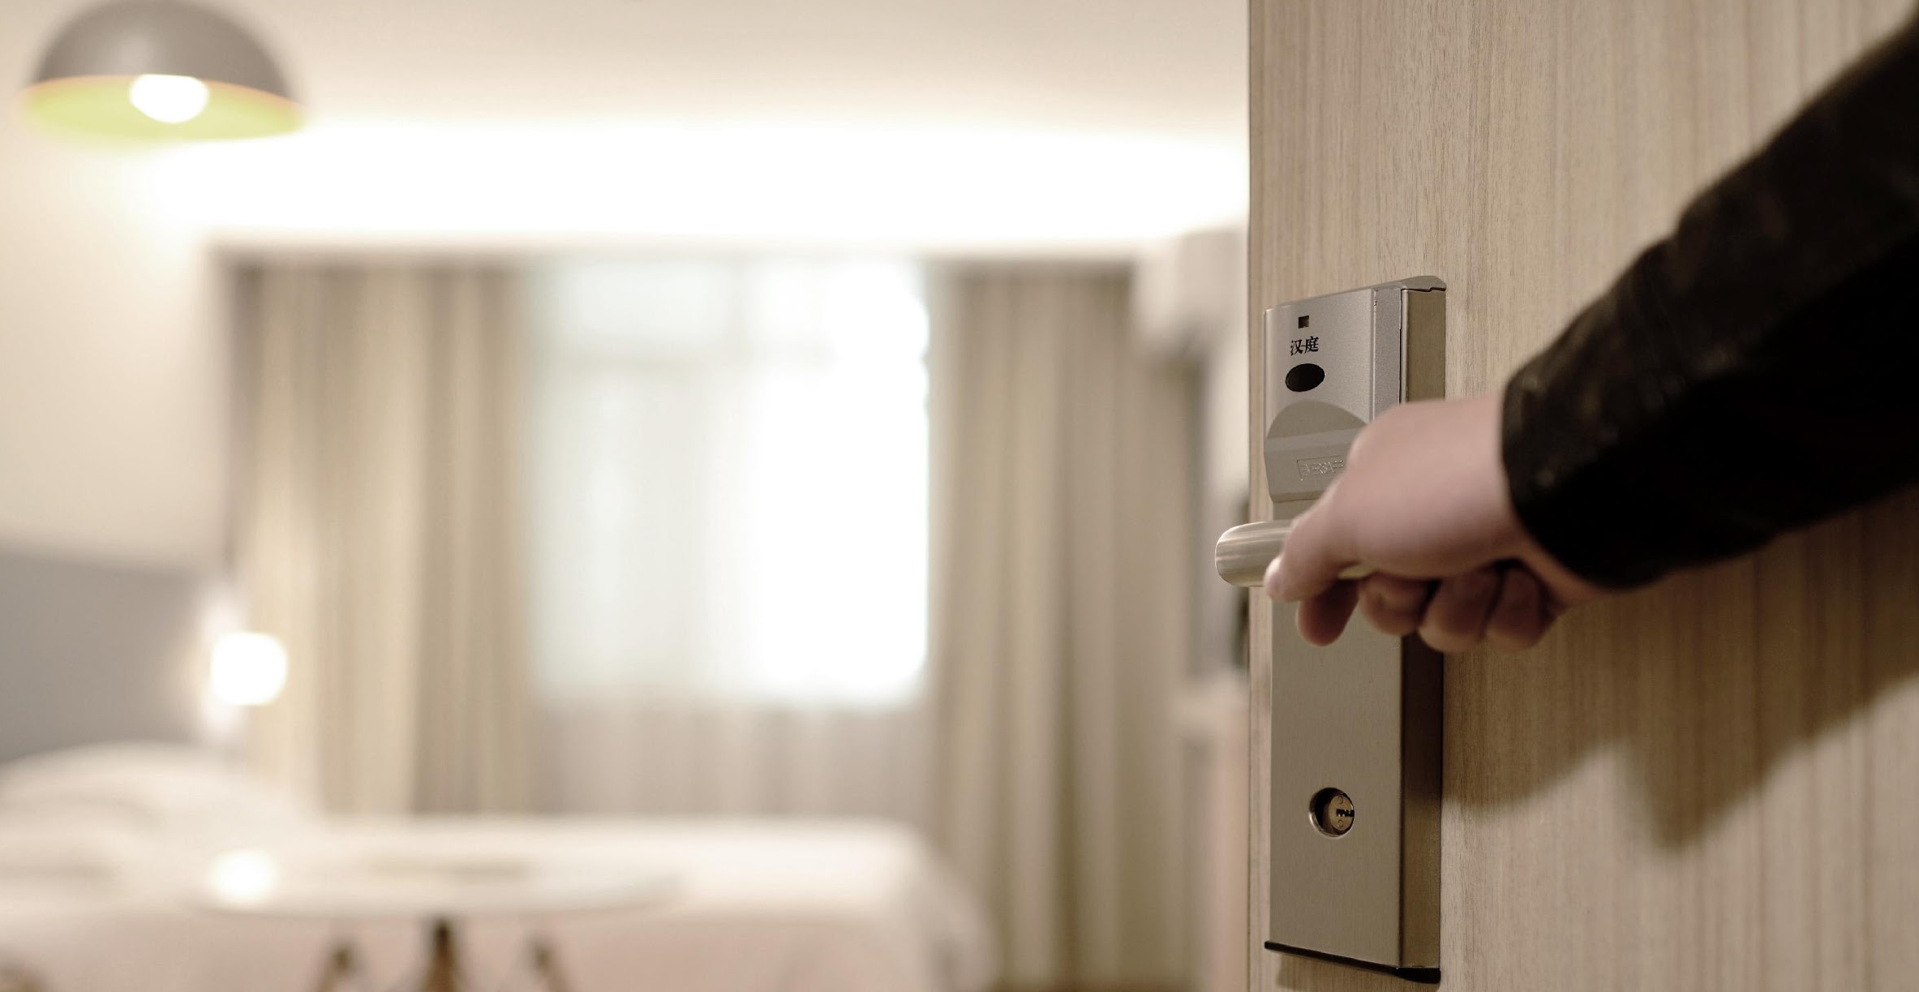
This year holds a lot of exciting new changes for the Melview Hotel. We are excited and thrilled to announce the construction of our new amenities as well as future events such as concerts and charity events.
As a thanks to our loyal clients, we will also be offering discounts and offers more often in order for them to avail of our services at lower rates. Gift coupons will also now be available. I hope and pray that Melview will continue to be the reliable and luxurious escape that all guests expect and more.

Slide 8
“
This year holds a lot of exciting new changes for the Melview Hotel.
”
- Mary Melview

Slide 9
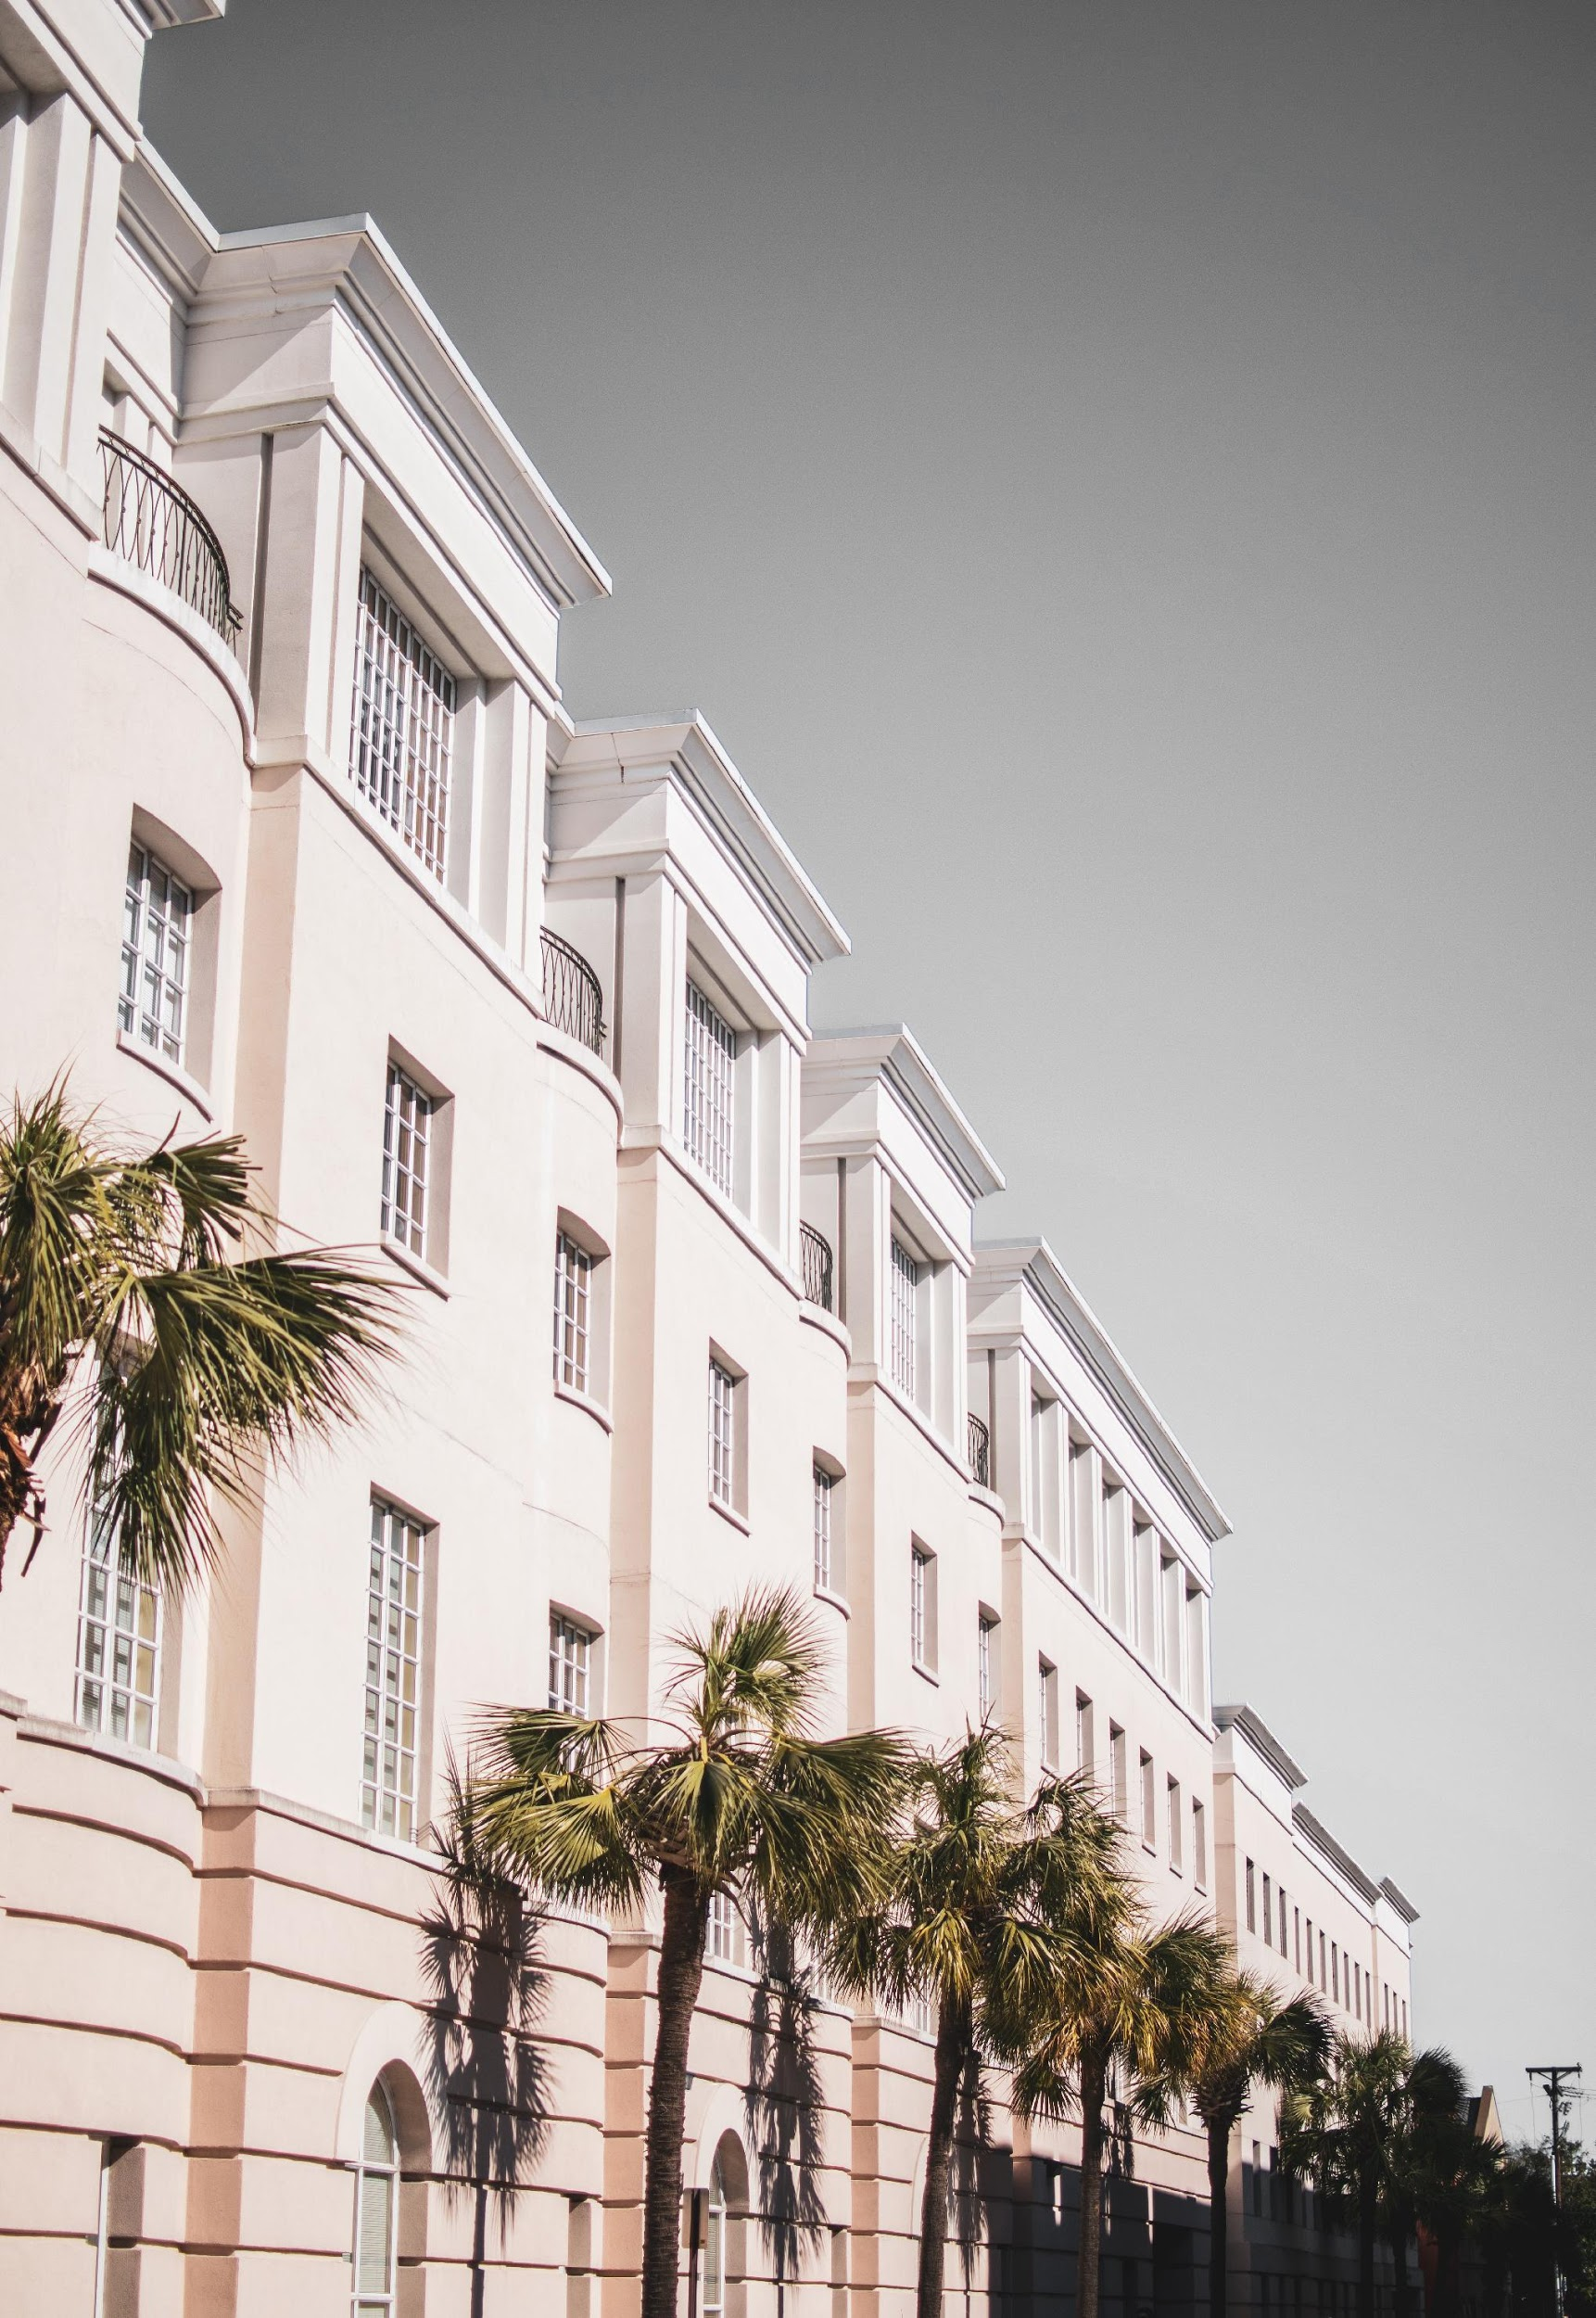
History
The Melview Hotel was founded in the year 2005 by Mary Melview who is a former real estate agent. She wanted to create a hotel that boasted luxurious amenities and accommodating staff that would be made available to all at very reasonable price points.
Today, the hotel resides on a lush lot by the beach and offers spectacular views of the city both day and night. Additionally, the hotel has won more than 30 prestigious awards all throughout its 15 years of operating.

Slide 10
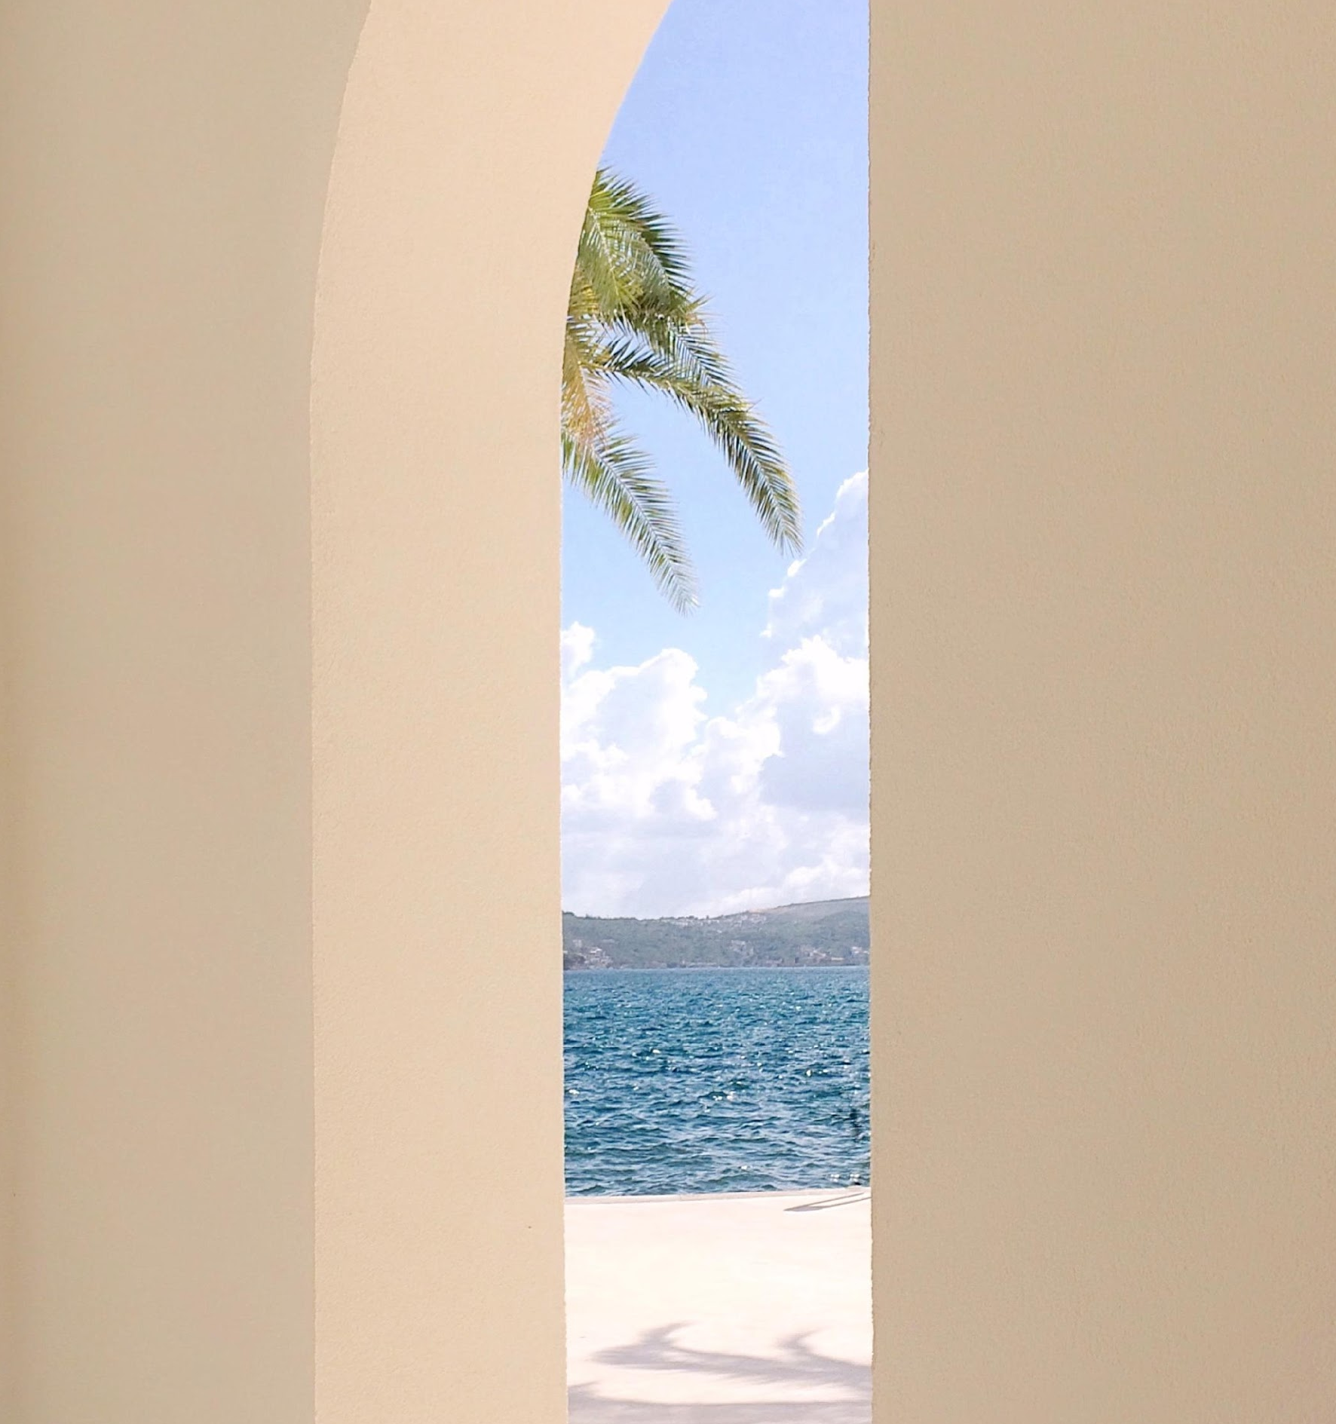
Summer Sundown
^{May 20, 2021}
^{5pm onwards}
^{Sunset Shore}
Tickets to this concert will be $30 each and will feature some of today’s hottests DJs such as DJ Mark Miller, DJ Rave, and Twixy Turvy. Profits from this concert will be utilized to improve the current construction of the new function rooms and French themed restaurant known as Je T'aime Paris to better serve the guests.

Slide 11
Grand Hawaiian Luau
^{June 30, 2021}
^{3pm to 8pm}
^{Seaview Room}
Tickets to this event will be $50 each and will entitle all attendees to a Hawaiian style buffet, free flowing cocktails, a pyro show, and goodie bags. 60% of profits will be donated to the “Save Hawaii’s Beaches” foundation. 40% of profits will be utilized for maintenance of the Seaview room such as shore clean up and littering prohibition measures.

Slide 12
Annual Board Meeting
^{July 01, 2021}
^{1pm to 5pm}
^{Diamond Ballroom}
Members of the Board will discuss about the current status of the Melview Hotel from January 01, 2021 to June 30, 2021. The agenda of this meeting is to update all members with the current progress, profit, and improvement measures to be implemented at the Melview Hotel for the second half of 2021.

Slide 13
“
If you are looking for a grand, accommodating, and spacious hotel to host your events, then the Melview hotel is truly an excellent choice. My birthday could not have been any better.
”
Jill Lim
^{32, Manager of Tall Towers}

Slide 14
Main Goal
The main goal of the Melview Hotel is to be able to better serve all of its visitors and guests, to make them feel at ease and that they are always welcome to stay.

Slide 15
Overview of Growth
25% increase in monthly profits as of May 2021.
50% increase in satisfaction with food services as
^{of March 2021.}
75% increase in room reservations as of March 2021.

Slide 16
What We Offer
^{Hotel Rooms}
^{Function Rooms}
^{Event Planning}
^{Food and Entertainment}
^{Conference Hall}
^{Parking Spaces}

Slide 17
Image Gallery

Slide 18
The Team
^{Mary Melview}
^{Founder and CEO}
^{Jillian Jung}
^{President}
^{John Doe}
^{Vice President}

Slide 19
Thank You
²⁰²⁻⁵⁵⁵⁻⁰¹⁷⁸
^{melview_hotel@gmail.com}

