Slide 1

Investor
Pitch Deck

Slide 2

2
About Us
Joules Investment Fund Inc. is an investment company based in Denver, Colorado that has been operating since 1990 and founded by Victor Joules, a former stockbroker and businessman.

Slide 3

3
Vision
We envision ourselves and aspire to be an investment company accredited and well recognized by Relbanks as one of the leading investment companies in the Colorado area with over 5 branches operating by the year 2030.

Slide 4

4
Mission
Our mission is to provide a variety of convenient and reliable investment services and options for all individuals who are in need of financial advice and support.

Slide 5
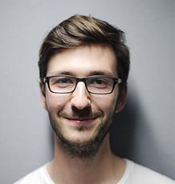

Investment Advisory Team
Dwayne Hope
Team Leader
Manages the overall performance and work of various teams in all departments.
Janet Johnson
Finance Advisor
Assists and guides customers in selecting the most beneficial and convenient investment for them.

Slide 6

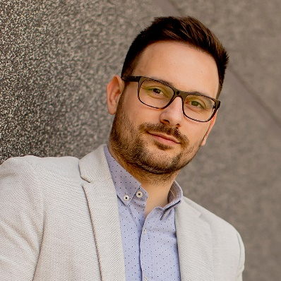
Investment Advisory Team
Peter Shell
Finance Advisor
Assists and guides customers in selecting the most beneficial and convenient investment for them.
Vance Kennedy
Customer Service Representative
Provides clients with solutions to their problems as well as provides information on products and services they are interested in.

Slide 7

7
The Problem
The Entrepreneur Magazine survey conducted in 2016 showed that 7 out of 10 people around the globe have experienced “boiler room” and “pump and dump” investment scams at least once. Due to this, they have lost confidence in investing their money in another investment company.

Slide 8
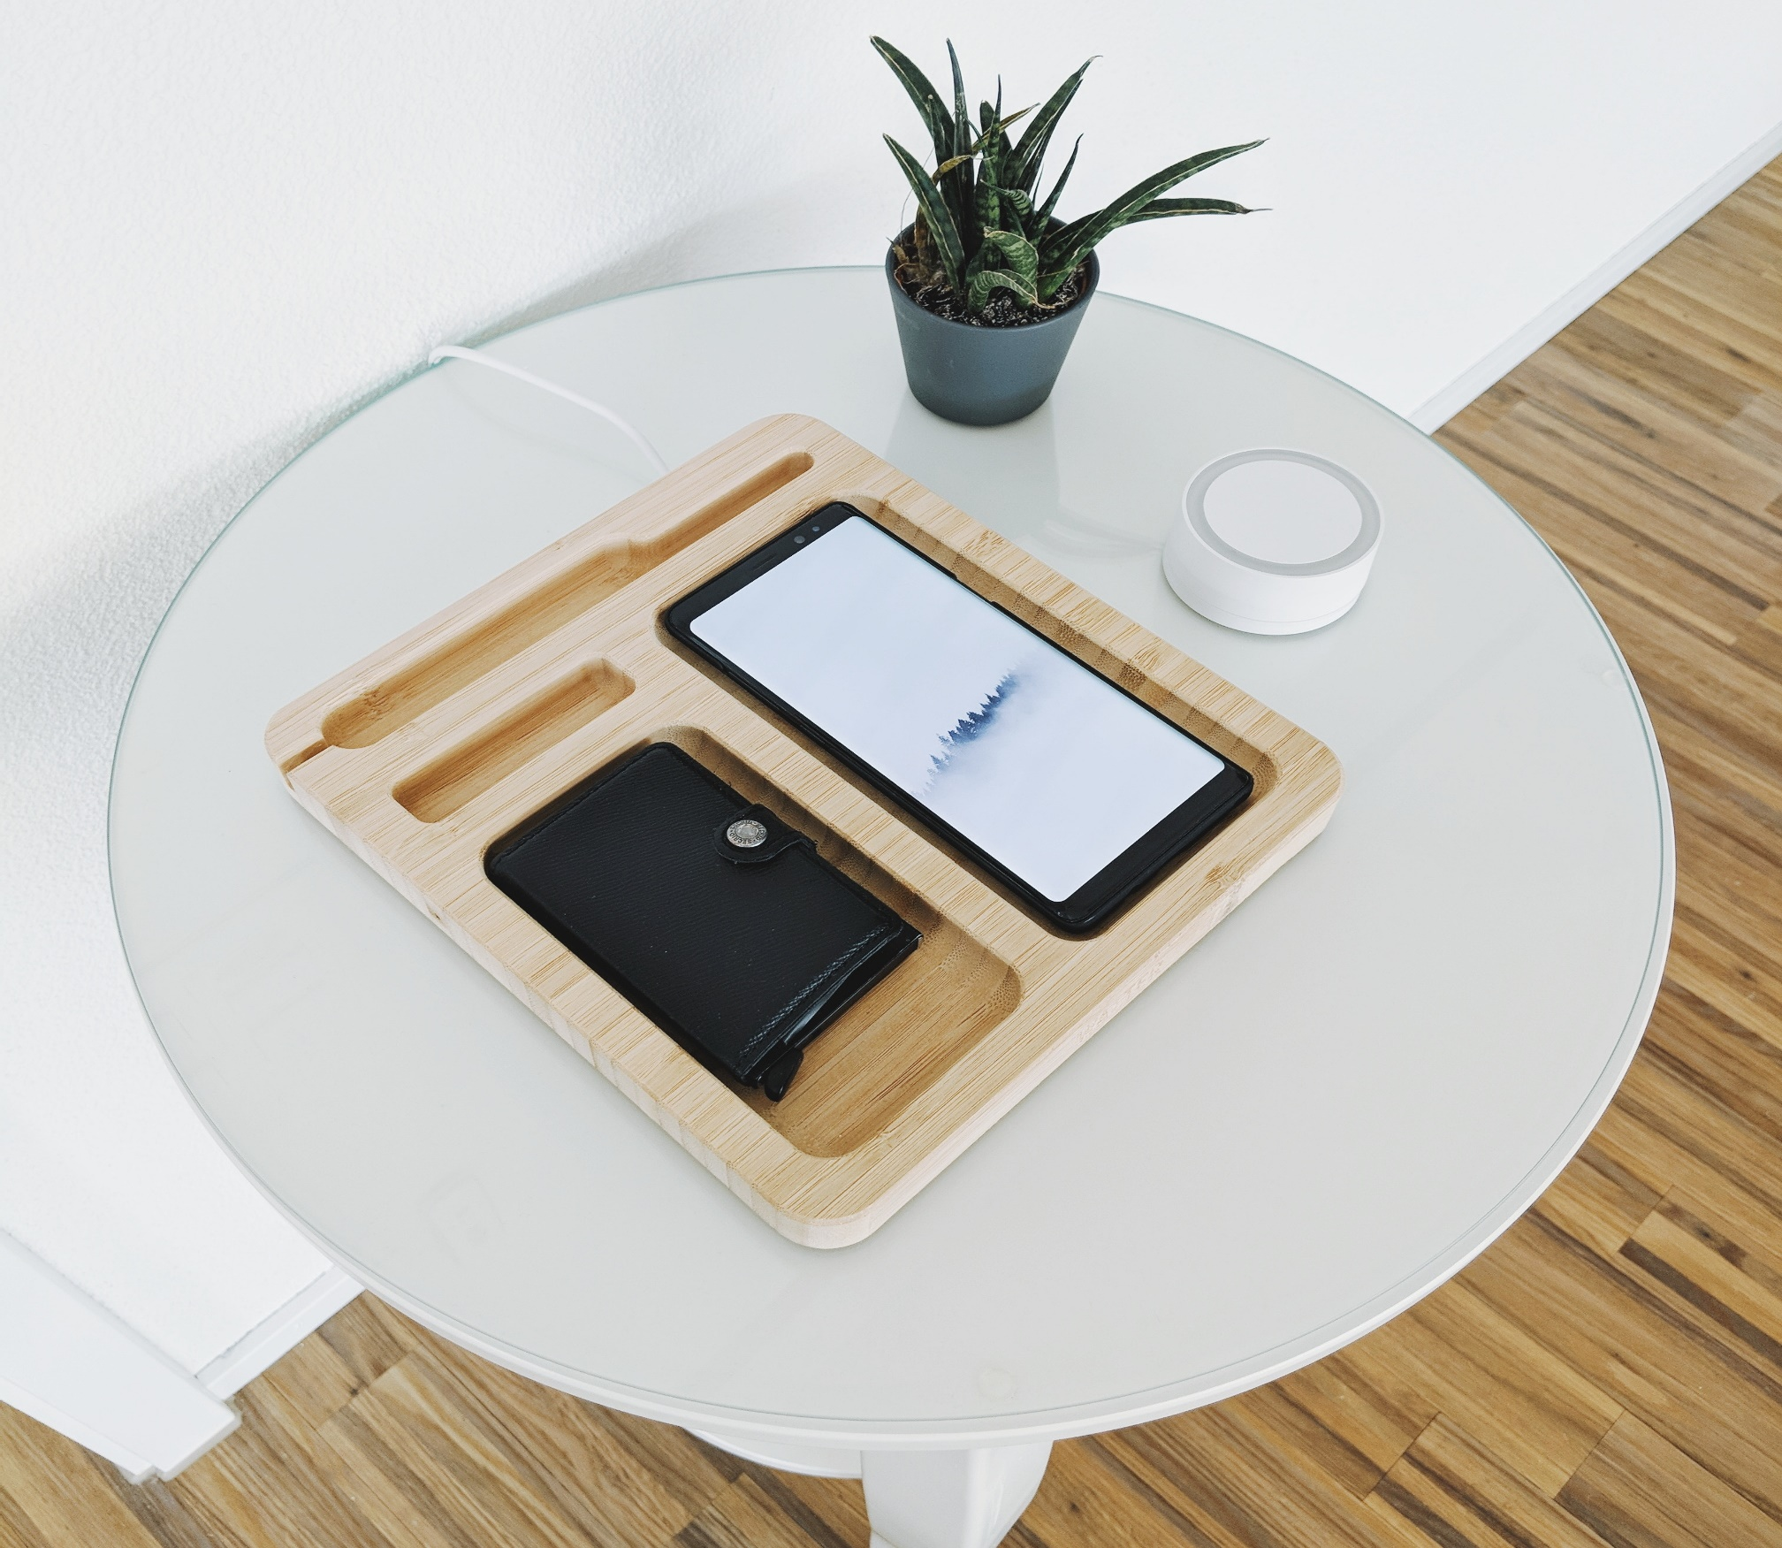
8
Our Solution
Joules Investment Fund Inc. offers the most secure investment guide for all who wish to enter the investing industry. We provide confidential legal assistance as well as state of the art security systems that have been developed by the famous Swiss security company, Encryption Inc.

Slide 9
9
Advantages
Joules Investment Fund Inc. will provide you with
State of the art Swiss banking accounts and systems for maximum security.
Affordable and convenient investment schemes, plans, and packages.
Trustworthy lawyers, investment agents, and personnel who will always keep any and all transactions confidential.
Extensive marketing and an impressive roster of connections with top notch companies and businesses.

Slide 10

Run And Gun
“RUN AND GUN” is a new project aimed to provide 30 effective investment strategies that would assist the clients in the investment strategy of their choice. The Run and Gun project will be available to all clients and will be available at $599.99.

Slide 11

11
Traction
Based on a census, Denver has total of 704, 621 population as of 2017. About 41% of the population are interested in starting an investment career and would like to invest in a company that prioritizes security and confidentiality.

Slide 12
12
Target Market
The chosen target market will be the residents of Denver. This specific group of individuals was chosen based on the following factors :
At least 3% of the entire population of Denver have a monthly personal income of $300, 000 to $500, 000.
60% percent of this population is in the middle class with monthly income ranges from $40,000 to $100,000.
The 80, 000 individuals of the entire population of Denver are between 22 to 45 years old.

Slide 13
13
Competition
Based on a survey conducted in 2016, Joules Investment Fund Inc. concluded that the following companies will be considered as direct competitors :
$999.99
Big Ben Investment Inc. offers investment options starting at
$1,999.99
Sunny Investment Fund offers investment options starting at
$2,499.99
Colorado National Investment Corp. offers investment options starting at

Slide 14

14
Alternative Solutions
The alternative solutions Joules Investment Fund Inc. can provide are the following:
Free personal financial advisor consultation.
1 month extensive marketing campaign and outreach program.
[SPECIFY ALTERNATIVE SOLUTIONS].

Slide 15

Business Model
The company will utilize the following business model which will be implemented by early 2019:
[SPECIFY BUSINESS MODEL]
Revenue equivalent to roughly $350,000 to $400,000 will be expected by the end of 2019.

Slide 16

16
Schedule
The company’s schedule will be as follows :
[SPECIFY COMPANY SCHEDULE]

Slide 17
17
Investment & Sponsorship
In order to officially begin, the company will require a budget estimated between $250,000.00 and $300,000.00. This amount will be collected from the following sponsors :
1. Helping Hand Foundation
2. Eco-brick Development Foundation
3. Green Life Foundation Inc.
Each sponsor has agreed to contribute and invest at least $100,000.00 for Joules Investment Fund Inc.

Slide 18

Contact Us
Visit our office every Monday to Friday from 9am to 6pm and Saturday from 9am to 4pm at [ADDRESS].
For more information contact any of these contact details :
[Phone Number]
[Email]
[Website]
[Social Media Account/S]

Slide 19

Thank You

