Slide 1
2030 MARKETING STRATEGY
Bright Marketing Agency
(012) - 3456 - 7879 | marketing@bright.com

Slide 2
TODAYS AGENDA
01
ALL OUT SMASH
This one day all out sale will be held at the West Bay Showroom on January 14, 2021 from 10am to 6pm. Tickets start at $20 per person and will entitle attendees to a free tech agent consultation and a raffle ticket to the $1, 000 cash raffle. The profits gained from this event will be used to improve and upgrade the facilities of the One Earth Foundation.
02
MARKET MADNESS SALE
This annual grand sale will be held at the West Bay Convention on May 3, 2022 from 9am to 6pm. Tickets start at $30 and will entitle attendees to a variety of exclusive discounts. 70% of total profits will be donated to the Give A Tree Project organized by One Earth Foundation and the remaining 30% profits will be used to improve the facilities and upgrade the system of Bright Marketing Agency.
03
TRI MONTH BOARD MEETING
Members of the Board will be having their tri month meeting at the Blue Fin Restaurant on February 13, 2020 from 12 pm to 5 pm to discuss the general status of Bright Marketing Agency. This board meeting will also include plans and regulations that will be implemented to boost the performance and status of the company.

Slide 3
Ben Olson
Founder & CEO
As the Founder & CEO of this company I present to you the future of Bright Marketing Agency!
The previous years of this company was tough and challenging. But together, we managed to solve and surpass all the obstacles we faced during our tenure as being the underdog in the marketing industry.
Today, we strive further to hold our position as a top performing company in the marketing industry through our newly designed and developed events and programs. This year will give Bright Marketing, Inc. new opportunities to become an even more reliable and efficient company in the marketing industry.
Being grateful to our loyal customers and beloved sponsors, I am proud to say that we have extensively developed All Out Smash and other events that we hope will draw in more. Together with our staff and loyal clients, Bright Marketing Agency will achieve success and stabilization together.

Slide 4
OUR HISTORY
First established in 2005 by Ben Olson, Bright Marketing Agency is a proud provider of superior marketing guidelines and plans. With nearly 13 years of experience, Bright Marketing Agency has been providing the best and excellent products for all marketing companies. Today, Bright Marketing Agency has 5 fully operating branches across the country.

Slide 5
TESTIMONIALS

Slide 6
“Bright Marketing Agency is an agency that is passionate in providing effective marketing plans and guidelines that you can certainly trust.”
-Ben Olson, 51, Founder & CEO

Slide 7
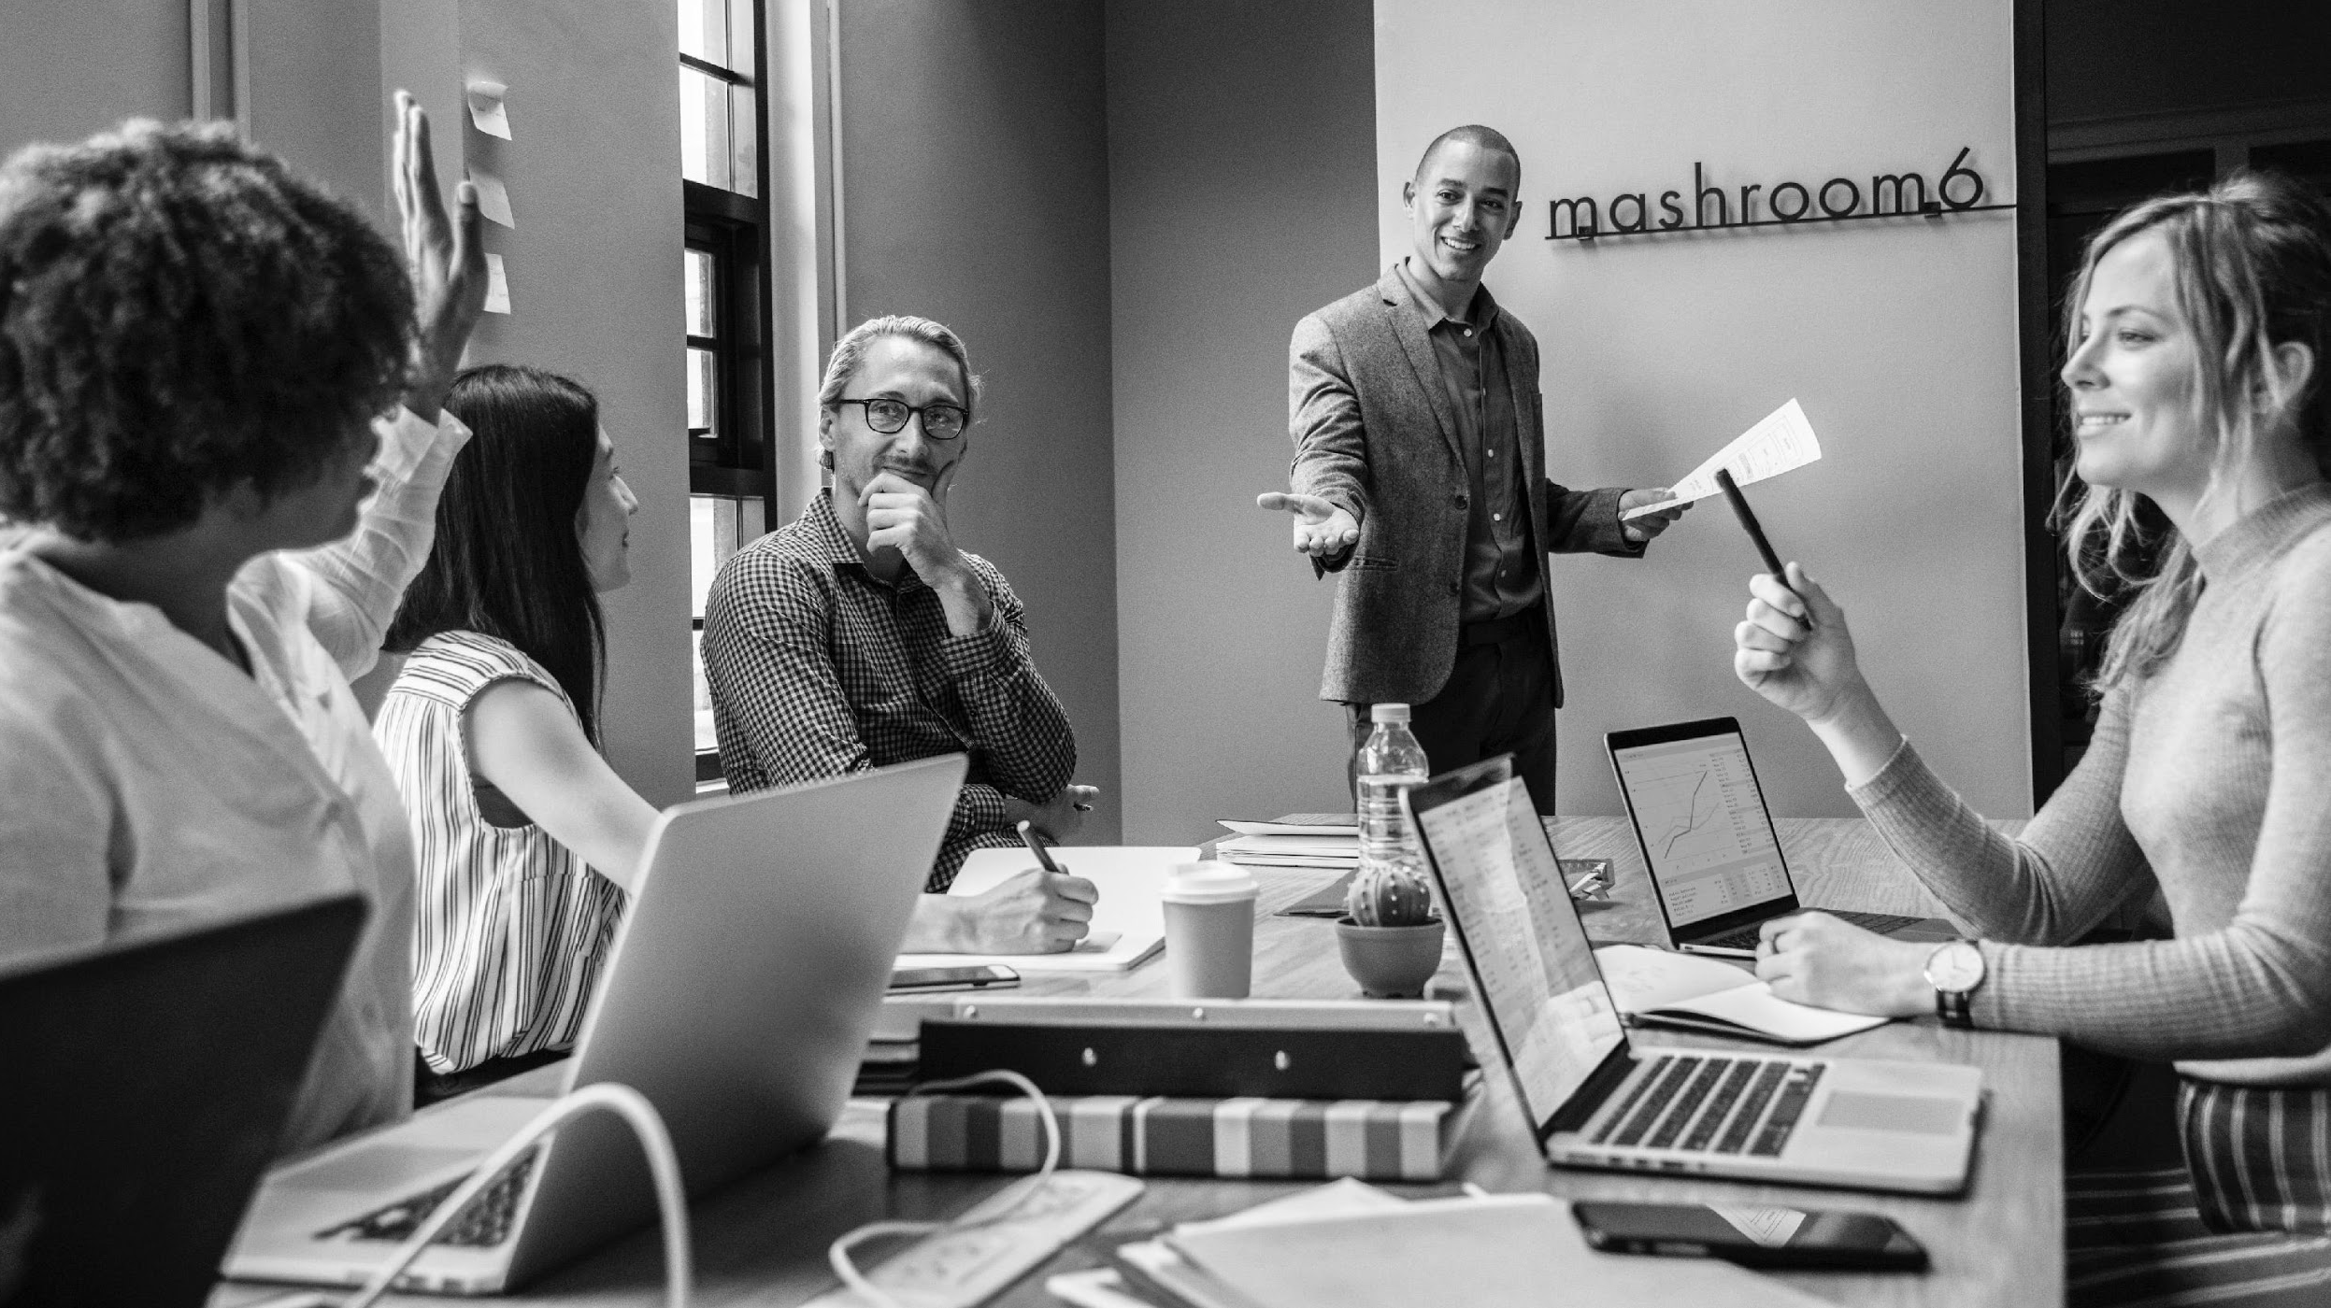
ALL OUT SMASH
January 14, 2021 | 10am to 6pm
West Bay Showroom
Tickets start at $20 per person and will entitle attendees to a free tech agent consultation and a raffle ticket to the $1, 000 cash raffle. The profits gained from this event will be used to improve and upgrade the facilities of the One Earth Foundation.

Slide 8
MARKET MADNESS SALE
January 14, 2021 | 10am to 6pm
West Bay Convention
Tickets start at $30 and will entitle attendees to a variety of exclusive discounts. 70% of total profits will be donated to the Give A Tree Project organized by One Earth Foundation and the remaining 30% profits will be used to improve the facilities and upgrade the system of Bright Marketing Agency.

Slide 9
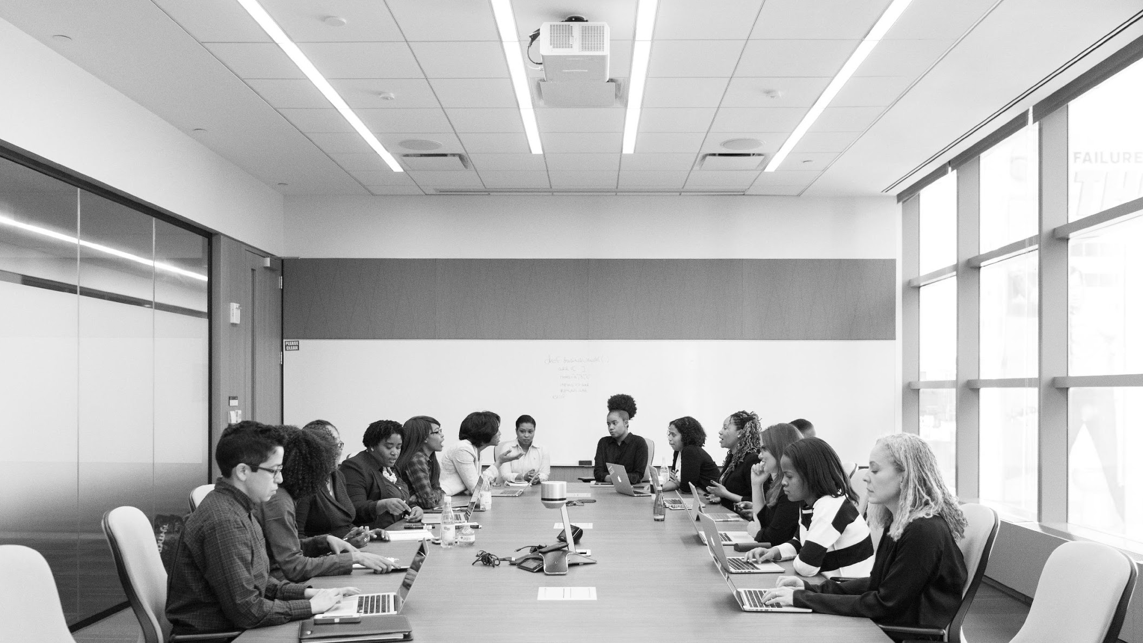
TRI MONTH BOARD MEETING
February 13, 2020 | 12pm to 5pm
Blue Finned Restaurant
This board meeting discuss the general status of Bright Marketing Agency which will also include planning, review and implementing changes and regulations to boost the performance and status of the company.

Slide 10
TESTIMONIALS FROM GUESTS
“
I am always happy and satisfied with my purchases at Bright Marketing Agency. They do their best to help me find effective marketing strategies that are best suited to my needs at comparatively affordable prices.
“
-Carol Duncan, 29, Real Estate Broker

Slide 11
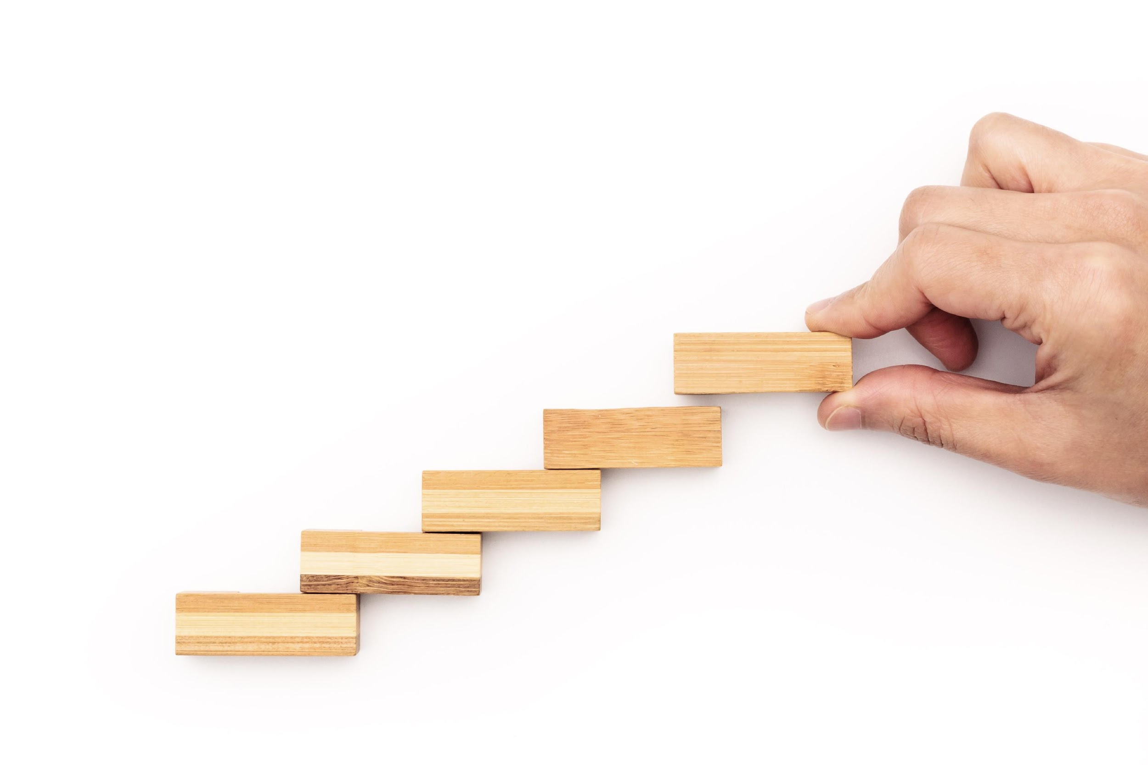
MAIN GOAL
The main goal of Bright Marketing Agency is to become a leading marketing agency across the country by offering and producing the best marketing guidelines and plans for all marketing based companies.

Slide 12
OVERVIEW OF GROWTH
60%
increase in annual profits as of May 2021.
70%
increase in satisfaction with developed website templates as of March 2021.
45%
increase in clientele base as of March 2021.

Slide 13
WHAT WE OFFER

Slide 14
Competitive Marketing Strategies
Best Digital Web Layouts
Affordable Product and Service Packages
Friendly Customer Care & Service

Slide 15
SOCIAL MEDIA CHANNELS
FACEBOOK
TWITTER
INSTAGRAM
brightmarketing.com
@brightmarketing_agency
@brightmarketingagency

Slide 16
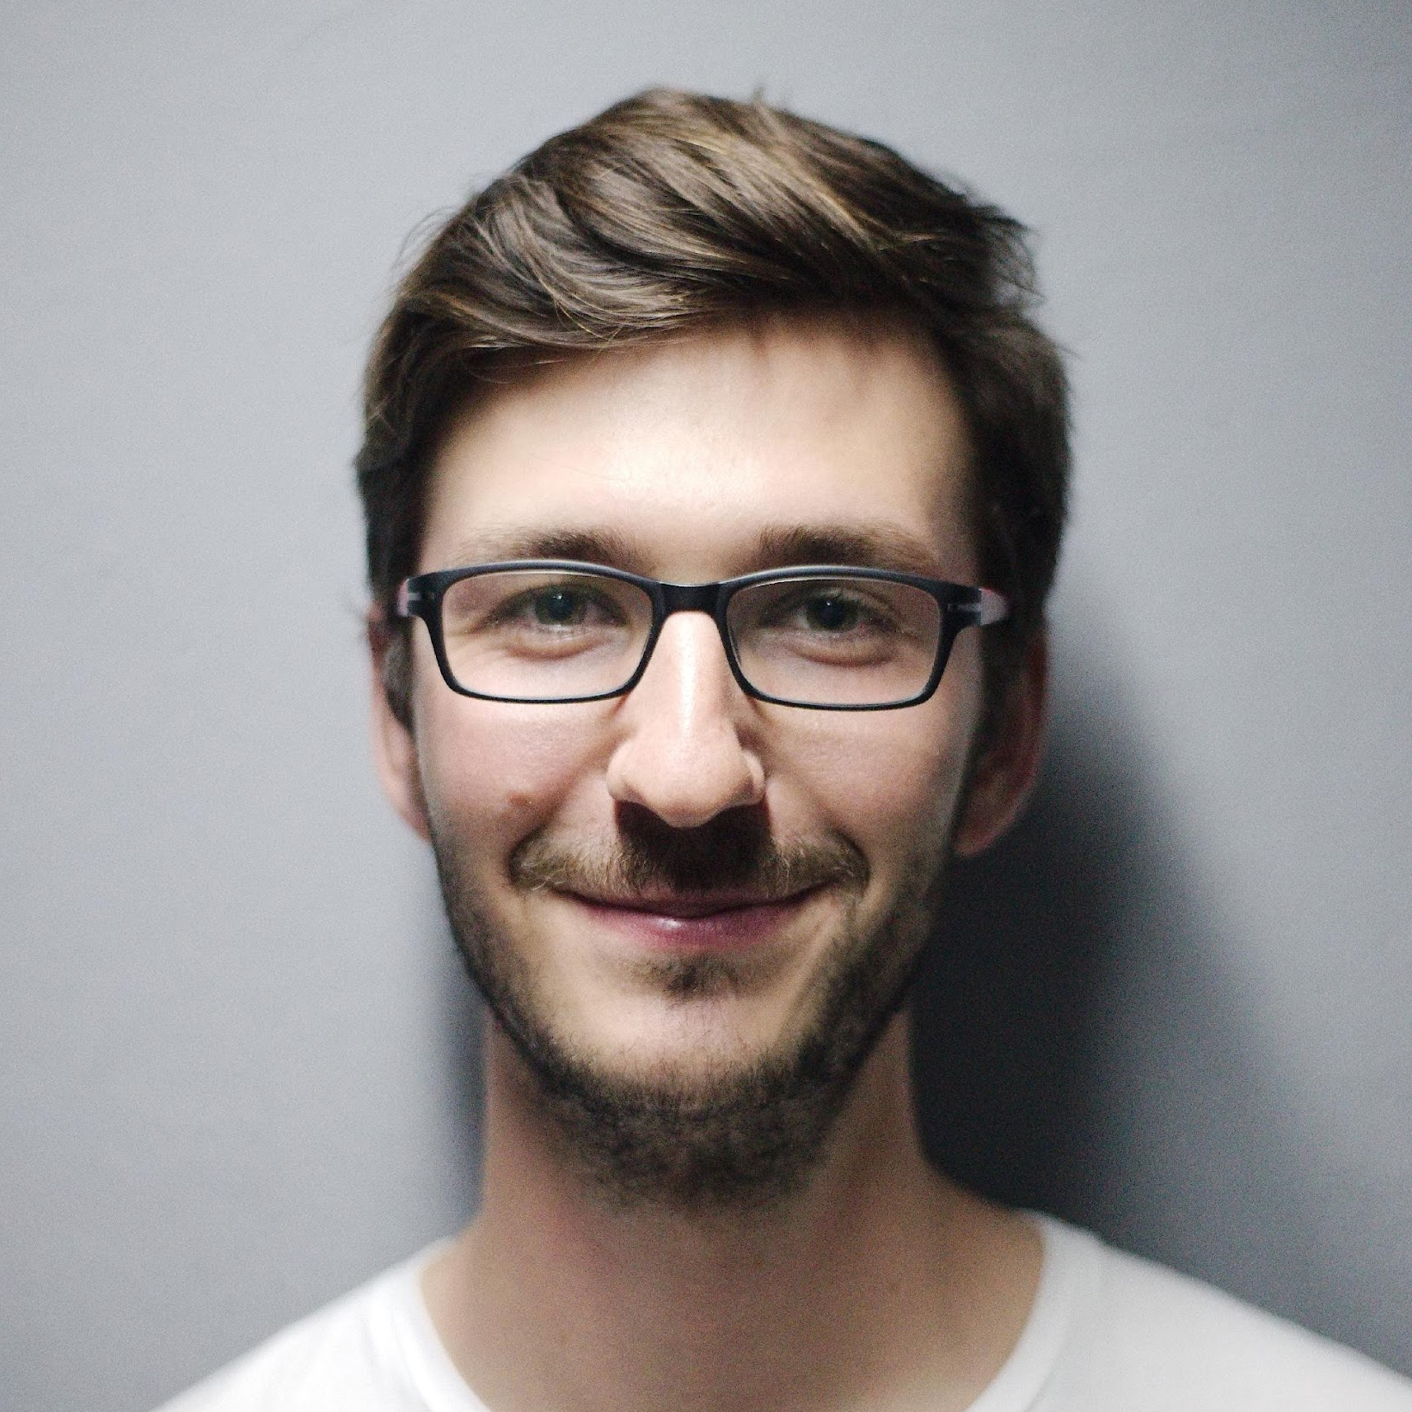
MANAGEMENT
Mason Williams
Mark Herring
Ayn Peterson
Chief Executive Officer
Chief Marketing Officer
Tech Consultant

Slide 17
CONTACT
ADDRESS
358 S. Addison Ave. Lake Worth, FL 33460
NUMBER
+1234-567-890
EMAIL
brightmarketingagency@email.com
BRIGHT MARKETING AGENCY
(000) 111 2222 | dm@brightmarketing.com

Slide 18
END

