Slide 1
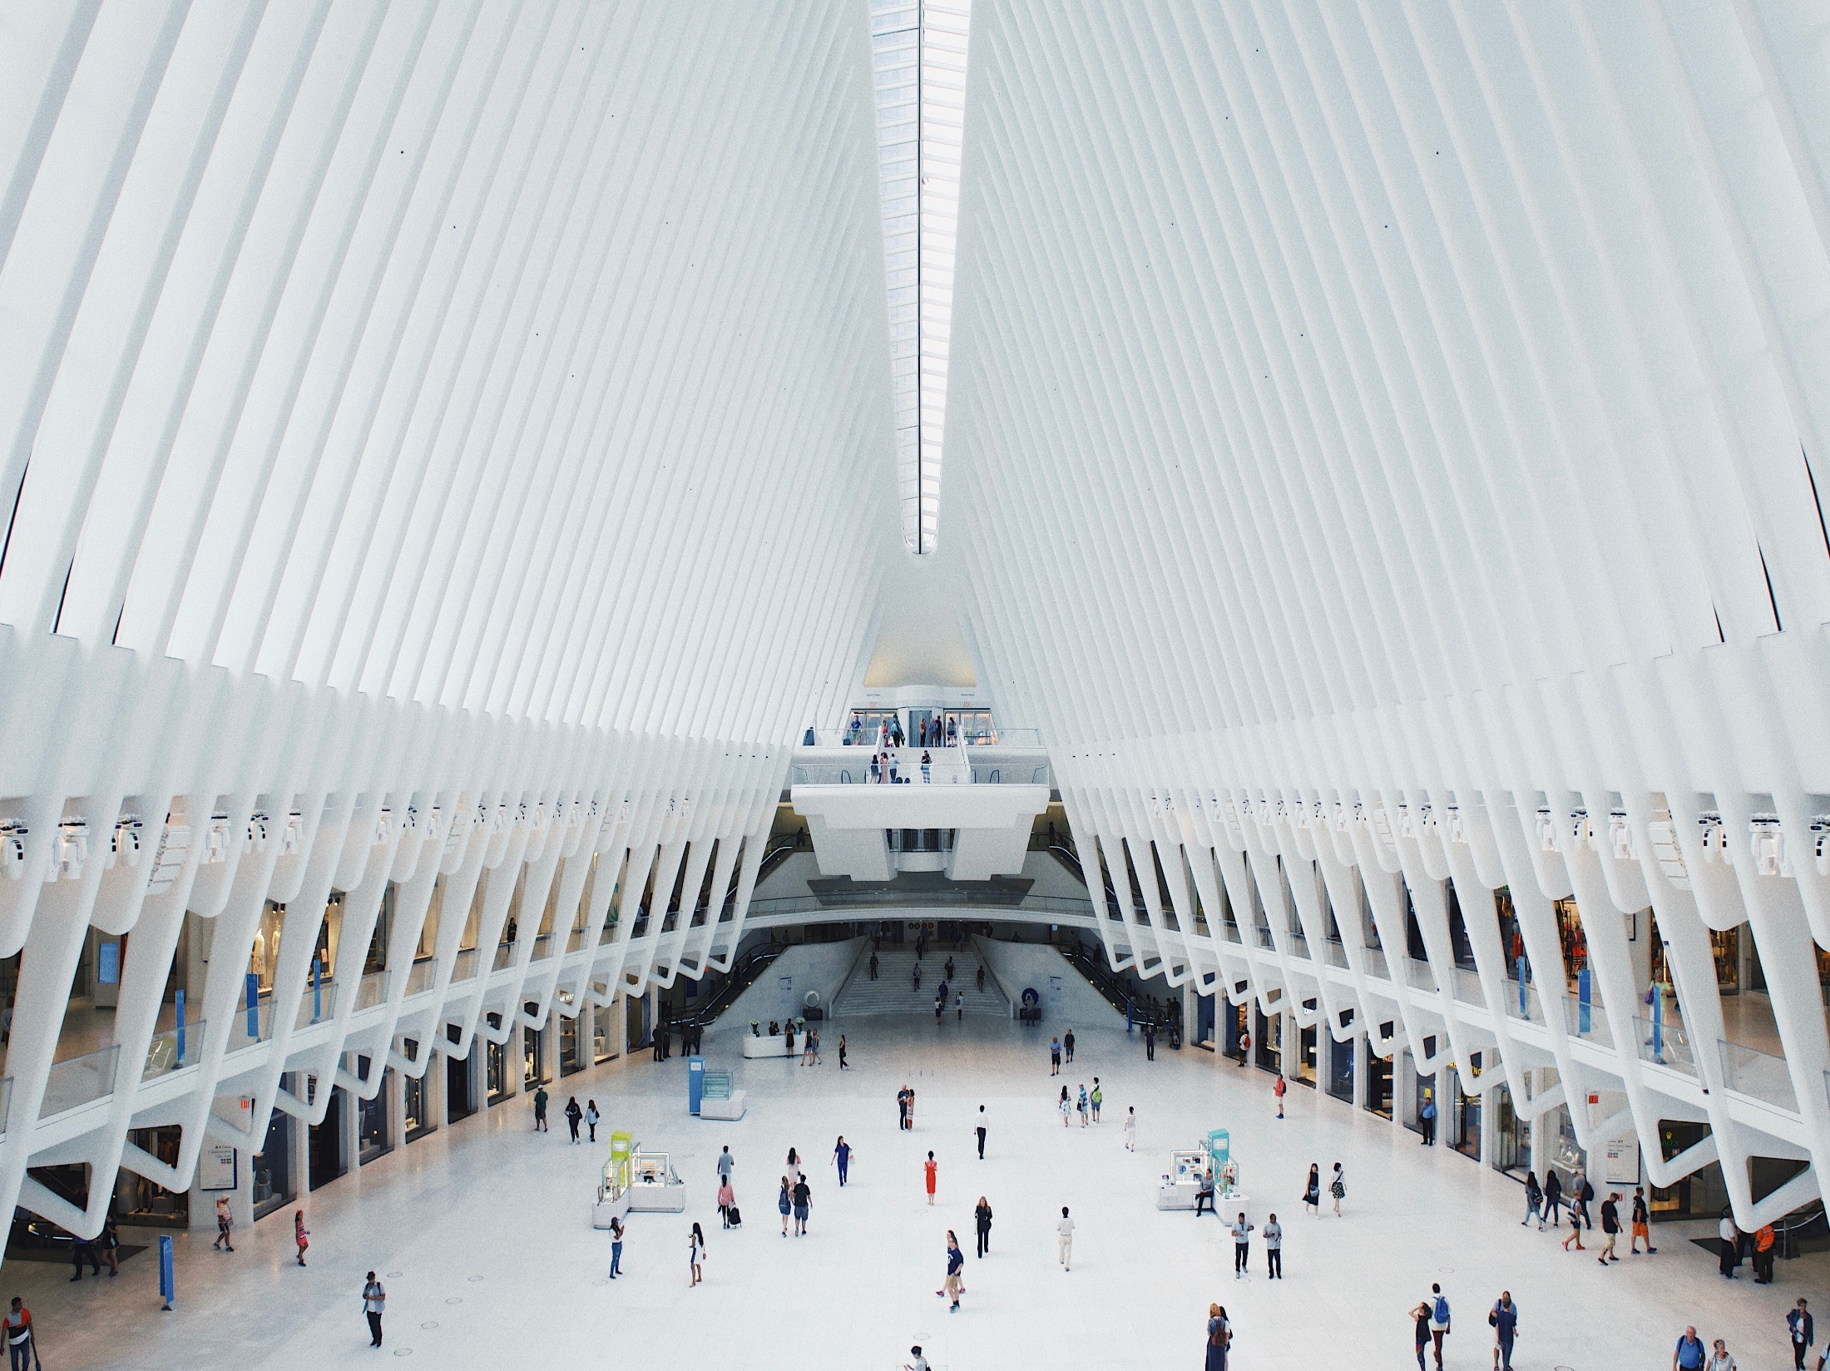
Marketplace
Pitch Deck

Slide 2
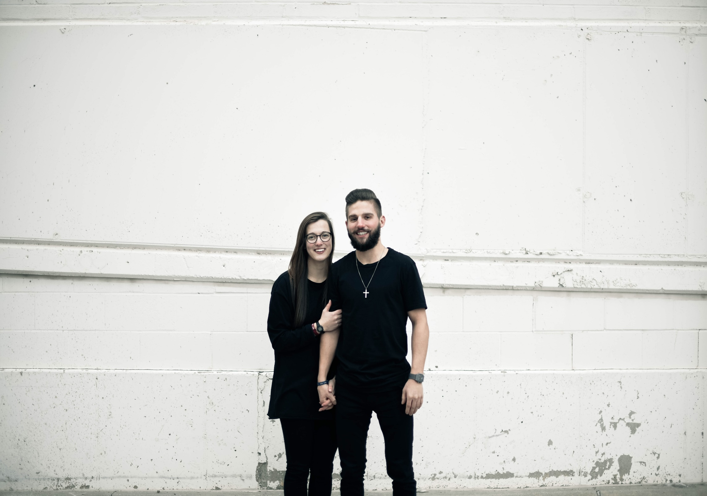
About Us
Assorti UltraMarket is a multiple merchandise market based in Phoenix, Arizona. Operating since 1980, it was established by the late Catherine Summers who was an entrepreneur and philanthropist.

Slide 3

Vision
Assorti UltraMarket’s vision is to be :
A globally diverse marketplace, and
To market multiple authentic delicacies around the world

Slide 4

Mission
Assorti UltraMarket’s mission is to provide only the highest quality products possible from various countries across the globe so as to ensure that all customers get their money’s worth every time.

Slide 5
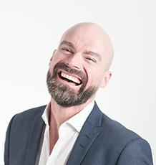
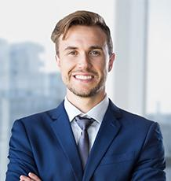
The Team
Olivia Good
Chief Operating Officer
Manages and sustains the company’s development and growth, financially and technically.
Steve Johnson
North & South American Department Head
Manages the quality and cost of American made products being sold and imported in the market.

Slide 6
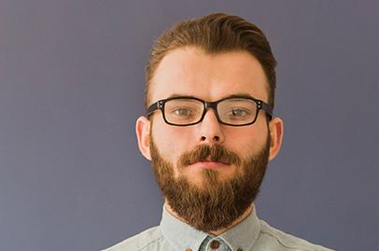
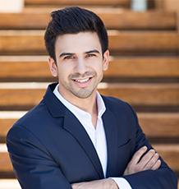
The Team
Jeff Cheng
Asia - Pacific Department Head
Manages the quality and cost of Asian made products being sold & imported in the market.
Greg Devadovski
European Department Head
Manages the quality and cost of European made products being sold & import in the market.

Slide 7
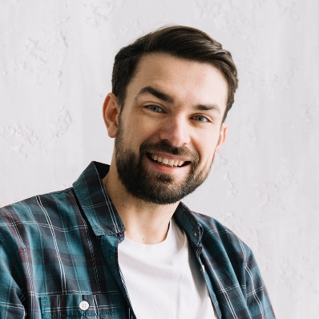
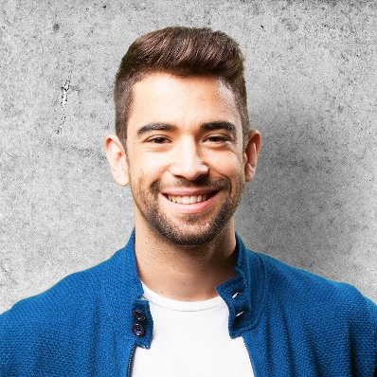
The Team
James Onwosuka
African Department Head
Manages the quality and cost of African made products being sold & import in the market.
Greg Devadovski
European Department Head
Manages the quality and cost of European made products being sold & import in the market.

Slide 8

The Problem
According to the book published by Will Kymlicka in 1999, around 60% of marketplaces around the world fail to provide the authenticity and diversity of goods promoted by countries around the world. Additionally, most of the marketplace in the said percentage fail to deliver the pure freshness of every product provided and sold. This results in multiple low reviews and dissatisfaction from both local residents and travellers around the world.

Slide 9

Our Solution
Assorti UltraMarket offers a diverse array of products. We possess a professionally dedicated team consisting of well expertised marketers from specific continents. They have studied the authenticity of products and goods being promoted by various cities within these continents.

Slide 10

Advantages
The Arizona area lacks a diverse marketplace, which is why we will aim for top notch quality and freshness in all of the products and services we provide. The market will provide authentic products from around the world that clients can purchase and enjoy.

Slide 11

United Culture
Our newly launched project, “UNITED CULTURE”, is aimed to give the most famous and authentic assortment of delicacies from all 7 continents around the world. With over 6000+ available products, Assorti Ultramarket will become a convenient one stop shop for those looking for an international tasting experience.

Slide 12

Traction
Based on a census conducted by the Bureau of Arizona; Phoenix, Arizona has a total of 1, 626, 078 residents and 100, 000 tourist as of 2017. About 70% or 1, 208, 254 of the combined population are individuals who spend on average between $30 to $200 and buy food, clothes and assorted products from public markets on a monthly basis.

Slide 13
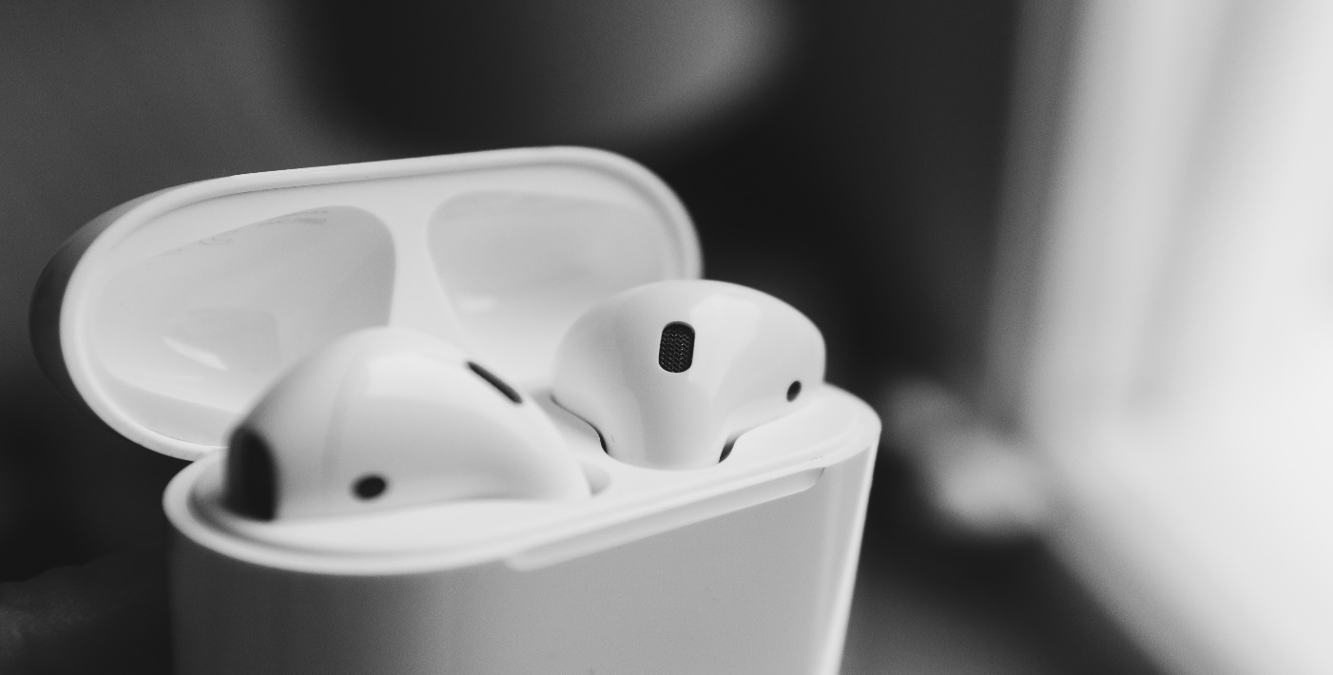
Target Market
The chosen target market will be the residents of Phoenix, Arizona. This specific group of individuals was chosen based on the following factors :
[FACTOR]
[FACTOR]

Slide 14
Competition
As of 2018, Assorti UltraMarket concluded that the following companies are direct competitors on the basis that they offer similar products and services :
Oriental Mall offers a variety of East Asian made goods ranging from $20 to $300.
North Coast Market offers a variety of Northern European made products ranging from $50 to $500.
Oceania SuperMarket offers a variety of Oceanian made products ranging from $400 to $300.

Slide 15

Alternative Solutions
Assorti UltraMarket will provide solutions such as the following :
[SOLUTION]
[SOLUTION]

Slide 16
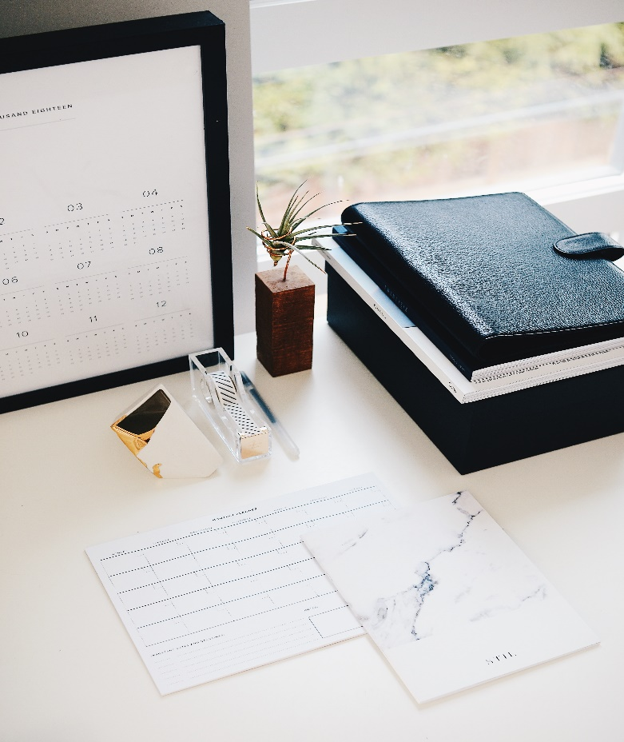
Business Model
The company will utilize the following business model which will be implemented by January 2019:
[SPECIFY BUSINESS MODEL]
Revenue will be expected by April 2019.

Slide 17

Schedule
The company’s schedule will be as follows :
[SPECIFY COMPANY SCHEDULE]

Slide 18
Investment & Sponsorship
In order to officially begin, the company will require a budget estimated between $300,000.00 and $500,000.00 and will be collected from the following sponsors :
1. AsiaPac Goods Inc.
2. N.E.W.S Foods and Beverages Enterprises
3. Global Brewery
This budget will be utilized as follows :
50%
30%
20%
10%
Starting Capital
Imported Products
Employee Salaries
Others

Slide 19

Contact Us
Visit our Market every Monday to Sunday from 9am to 11pm at [ADDRESS].
Contact [NAME OF COMPANY] through any of these contact details :
[Phone Number]
[Email]
[Website]
[Social Media Account/S]

Slide 20
Thank You

