Slide 1
Cortex Industries
_{Cortexindustries.com}

Slide 2
Executive Summary
The Team
Goal
Execution
Operation Plan
Testimonials

Slide 3
The Company
Executive Summary
Cortex Industries is a company that started as a fuel & energy company. It’s currently expanding its business into the medical & other scientific fields. Founded by Henry Gilligan Sr., the company has employed over a million people. The company is currently under the leadership of Co-CEOs by siblings Henry Gilligan Jr. & Cora Gilligan.
Cortex Industries

Slide 4
The Company
Vision
We look for solutions that can have an impact beyond the project, that can move the needle in some way and contribute to society and culture. Cortex Industries aims to improve & provide comfort to the lives of their clients & consumers through their products. They also aim to bring advancements in everyday life through their innovation.

Slide 5
The Company
Mission
To innovate, to lead, to enhance, to provide best-value products and services to global customers. To make a difference and To enhance the quality of life for our business partners,customers and employees. Cortex Industries sees itself to becoming the gateway for clients who are dreaming of the perfect design management.
Cortex Industries

Slide 6
The Company
Outlook
The company believes that through their work & their business, many lives can be improved, which in turn will lead to the improvement of many our lives through mutual connection. Cortex Industries believes in the domino effect, where one act can lead to a chain reaction, both good & bad.
“
”
We believe that excellence & innovation can bring us closer to the future.

Slide 7
The Company
The Team
To enhance the quality of life for our business partners,customers and employees. Cortex Industries sees itself to becoming the gateway for clients who are dreaming of the perfect design management.
Rod Crest
John Newman
Sapphire Cressman
Chief Marketing Officer
Founder & CEO
Chief Operating Officer
Cortex Industries

Slide 8
The Company
Goal
We strive to be a caring and well-managed organization for our business partners , customers and employees, and a responsible corporate citizen to our society. Cortex Industries embraces a responsibility to make our projects a success. This has resulted in an exceptionally high rate of repeat clients, as well as lifelong relationships that we value highly. We believe deeply in the importance of designing sustainably.
Cortex Industries

Slide 9
The Company
Company Milestones
The team in this department also manages client concerns & collaborates.
Short-term Goals | Milestones
Social media brand marketing | Reached 50% of audience target.
Company Building Expansion | Construction started 2024
Long-term Goals | Milestones
Partnership with Asia Printing Pro | Contract signing on February 2027
Brand expansion in New York & New Jersey | Budget proposal drafted as of July 2026
Cortex Industries

Slide 10
Execution
Value Proposition
Cortex Industries is commendable on its products by their clients. This high level of quality is Cortex Industries’ trademark.
Pricing Strategy
Cortex Industries uses a combination of cost-plus & price bundling when offering its services. This combination best suits the company & is common in the industry.
Cortex Industries

Slide 11
Execution
Market Analysis
Marketers conduct surveys or interviews with target consumers in order to establish their needs, what they respond to and what they look for when choosing such an organization. Marketers must then be able to use this information to draft successful campaigns that increase business and profits. Cortex Industries aims to promote its brand across the world. It wants to use social media to reach the target market. Promotional videos & other content will be posted regularly to keep business active. Along with social media marketing, Cortex Industries will also use traditional methods of contacting these businesses through cold emails.
Cortex Industries

Slide 12
Execution
Market
Research
45 %
28 %
Consumers are constantly looking for the next product, from their food, gadgets & even right up to their medicine or the materials needed to build their home. Cortex Industries is challenged to continuously find more creative & efficient ways to produce the next best thing.
33.5 %
74.6 %
18 -21
14 -17
Focuses on target audience through social media & printed flyers. Advertising the perfect Design package for clients who are interested in our products.
22-28
29 +

Slide 13
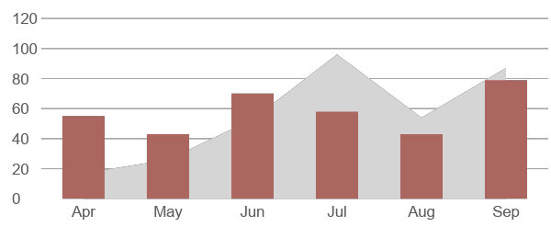
Operation Plan
Growth Overview
There is an increase in annual profits as of April 2022. There is an increase in customer satisfaction with produced products as of June 2024. Also there is increase in product sale in the market as of March 2023.

Slide 14
Operation Plan
Organizational Structure
The company’s operations is led by the CEO. The Project Manager, the Client Management Director, Technical Director & Creatives Director are all under the CEO. The Creatives Director, Technical Director & their team of web designers & content creators carry out the services & strategies that the clients need for their websites, social media accounts, etc. The Project Manager oversees the different projects the company has & works with the Client Management Director who engages with prospective clients.
Cortex Industries

Slide 15
Operation Plan
Customer Satisfaction
The head of the Marketing Division is responsible for creating & implementing Analytic Strategies, & market research. The team in this department also manages client concerns & collaborates with the Graphics Development division in resolving any customer issues.
Cortex Industries

Slide 16
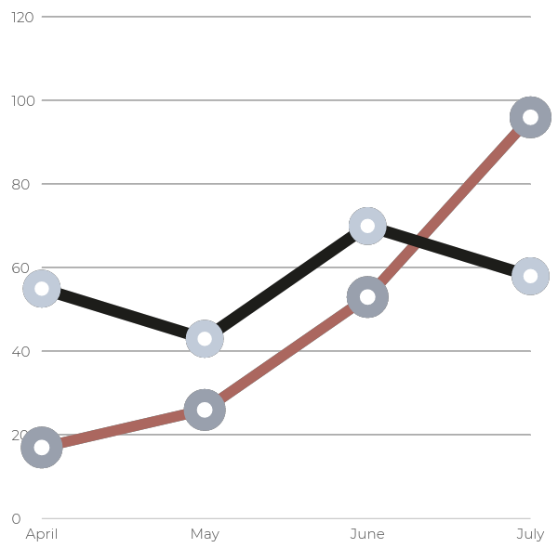
Operation Plan
Productivity
Rate
Over the years, The company has been given a lot of projects to work on. As reflected in the Productivity Chart, Cortex Industries objective is to deliver quality services on-time and on-budget for every assignment, regardless of size, scope or location. Theres is a significant increase to this months productivity rate compared to past months.
Cortex Industries

Slide 17
Testimonials
“Me along with half of my family is under the employment of Cortex Industries. The company has had a big impact on my life.”
^{- Cyndia D. Thomas, 53, Nurse}
“Retco Industries has worked hard to keep our clients satisfied with our work. Our continued business today just goes to show it.”
^{- Jenny J. Wyans, 32, Engineer}

Slide 18
End
Cortex Industries
_{Cortexindustries.com}

