Slide 1

Modern
Pitch Deck

Slide 2

About Us
Home Sale Inc. is a furniture merchandise company based in Miami, Florida. It has been in the industry since 2012 and was opened by Samantha Miles who was an interior design graduate from New York School of Interior Design.

Slide 3
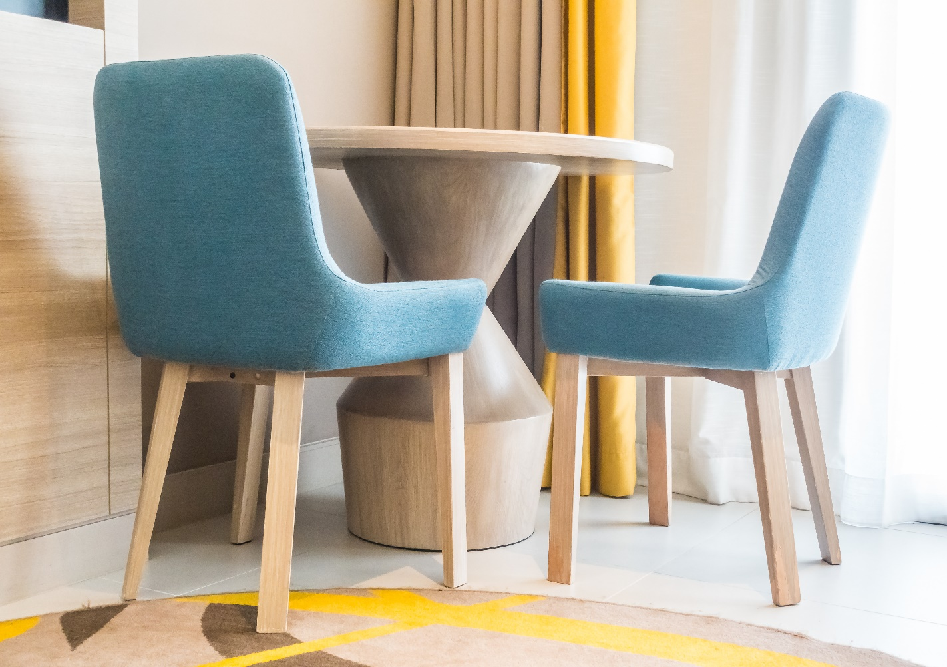
Vision
Our vision is to :
Become the largest furniture firm in the country,
Acquire global recognition, and
Establish 5 branches across the country by the year 2030.

Slide 4
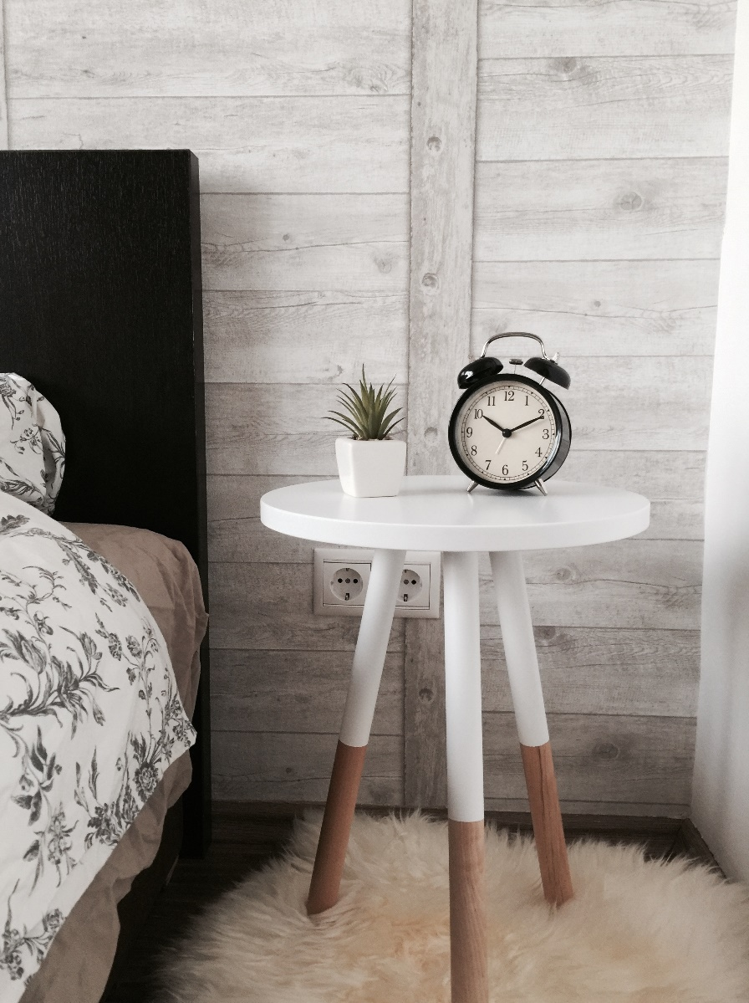
Mission
Our mission is to provide well crafted, sturdy, and reasonably priced furniture and equipment.

Slide 5


THE TEAM
Aaron Brian
Chief Operating Officer
Manages the general company operations and gives the final say on multiple company and department decisions.
Joshua Holmes
Interior Design Committee Head
Oversees the interior design committee which produces designs for home furniture & equipment.

Slide 6


THE TEAM
Kate Black
Quality Inspection Head
Secures the quality of products & manages the rules and regulations for quality assurance.
David Smith
Marketing Manager
Secures & develops effective marketing strategies & campaigns in addition to identifying opportunities for marketing affiliations and joint marketing activity

Slide 7

The Problem
According to a survey by Architectural Digest conducted in 2014, at least 20 companies in the interior design industry failed to provide the high quality of interiors expected by the residents of the city. This results in a gradual decrease of sales by as much as 70% for various companies that market home furniture and home equipment across Miami.
70%

Slide 8
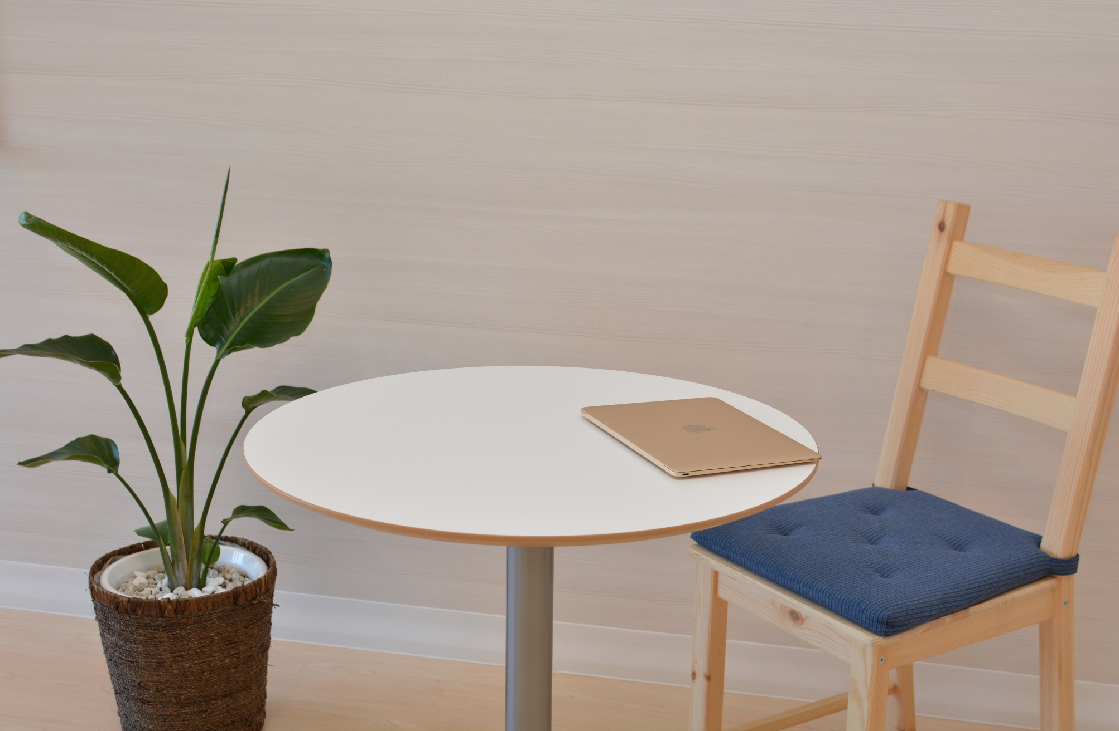
Our Solution
Home Sale Inc. offers an excellent quality of home furniture and equipment. We also prioritize quality assistance to all of our customers by providing them with hassle-free products & services at reasonable rates that start at $12.99.

Slide 9
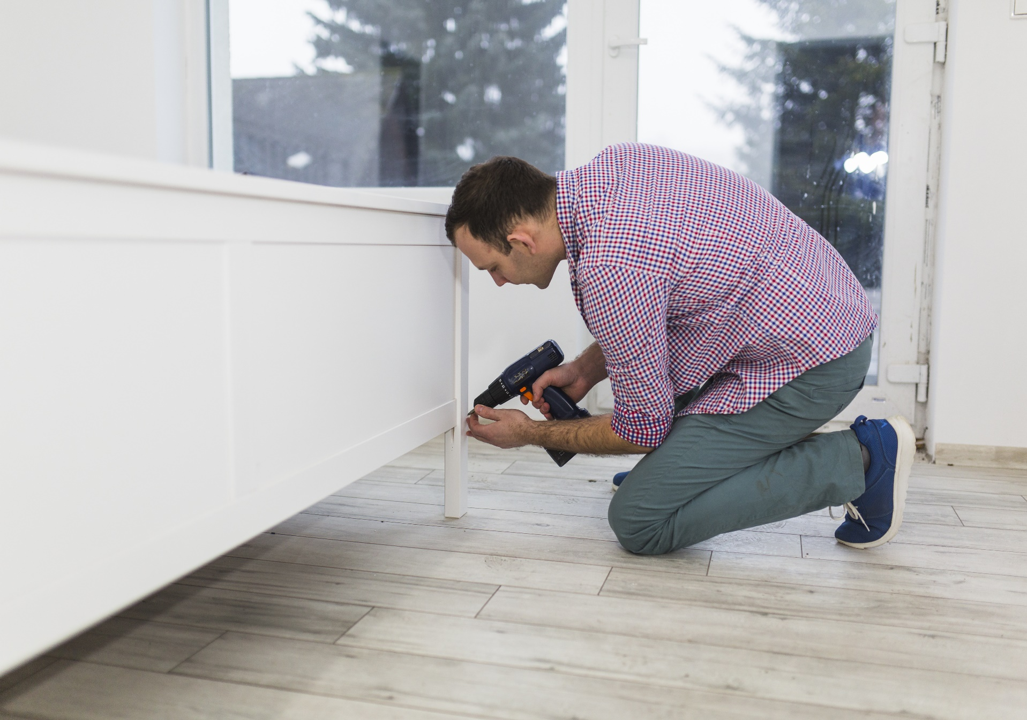
Advantages
We will provide excellent services and affordable home furniture from various well known and reliable brands. Home Sale Inc. will make the process easier by providing efficient hassle-free service.

Slide 10

All Around Furniture
Our newly developed products under our program called ALL AROUND FURNITURES is aimed to provide products that are useful and well designed. With over 50 uniquely made products, ALL AROUND FURNITURES will surely have something for you.

Slide 11
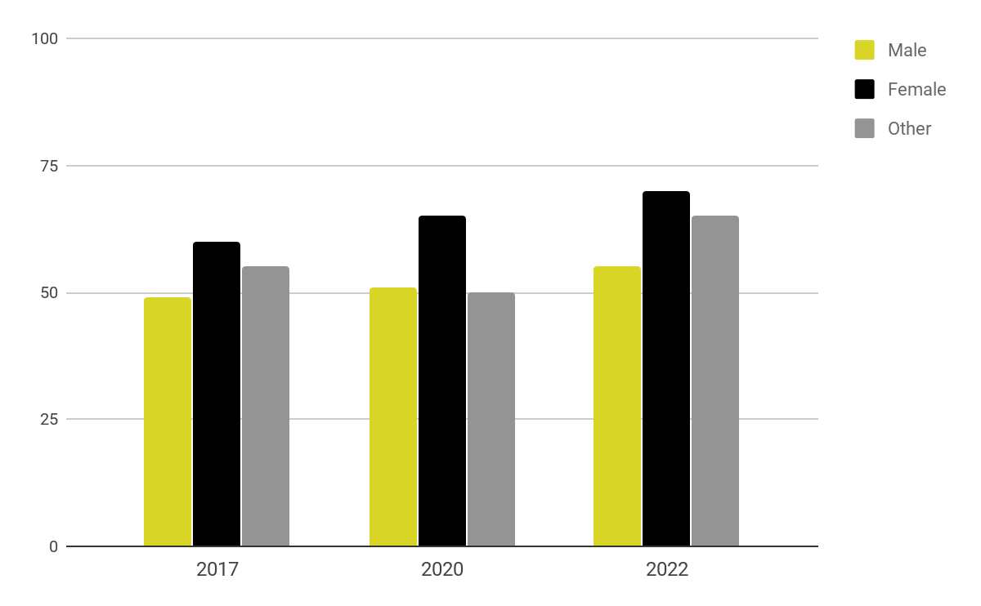
Traction
Based on a census conducted by the bureau, Miami has a total of 5.5 million residents as of 2017. About 49% are male and 51% are female and at least 55.7% of the total population are in the labor force. In addition, there are 88, 199 families that need assistance with regards to house furniture planning and interior decorating.

Slide 12
Target Market
The chosen target market will be the residents of Miami. This specific group of individuals was chosen based on the following factors :
88,199
Families reside in Miami.
112,261
Individuals who are renting a place in Miami.
3,063,500
The total population in Miami are in the labor force.

Slide 13
Competition
Based on a survey conducted in 2017, Home Sale Inc. concluded that the following companies will be considered as direct competitors on the basis that they offer similar services to the residents of Compton:
$15.99
$19.99
$10.99
JBC Home Tools Inc. offers a wide range of home appliances with starting prices
Depot Inc. offers a wide range of home furniture with starting prices
Warehouse Inc. offers a wide range of home equipment with starting prices

Slide 14

Alternative Solutions
The alternative solutions Home Sale Inc. can provide are the following:
25% discount for all products for a total purchase of $199.99 and beyond.
Free home furniture consultation.
Lifetime Membership Card.
25%
Discount

Slide 15

Business Model
The company will utilize the following business model which will be implemented by early 2019:
[SPECIFY BUSINESS MODEL]
Revenue equivalent to roughly $75,000 to $80,000 will be expected by the end of 2019.

Slide 16

Schedule
The company’s schedule will be as follows :
[SPECIFY COMPANY SCHEDULE]

Slide 17

Investment
In order to officially begin, the company will require a budget estimated between $60,000.00 and $70,000.00. This amount will be collected from the following sponsors :
1. Steel and Fabrication Retailer
2. Woodchuck Enterprises
3. PRC Lending Inc.
Each sponsor has agreed to contribute and invest at least $20,000.00 to $25, 000.00 for Home Sale Inc.

Slide 18

Contact Us
Visit our warehouse every Monday to Sunday from 10am to 8pm at [ADDRESS].
Get in touch and contact any of these details :
[Phone Number]
[Email]
[Website]
[Social Media Account/S]

Slide 19

Thank You

