Slide 1
BLCK CHERRY MARKETING
+7729 98723
www.blckcherrymarketing.com
blckcherrymarketing@info.com

Slide 2
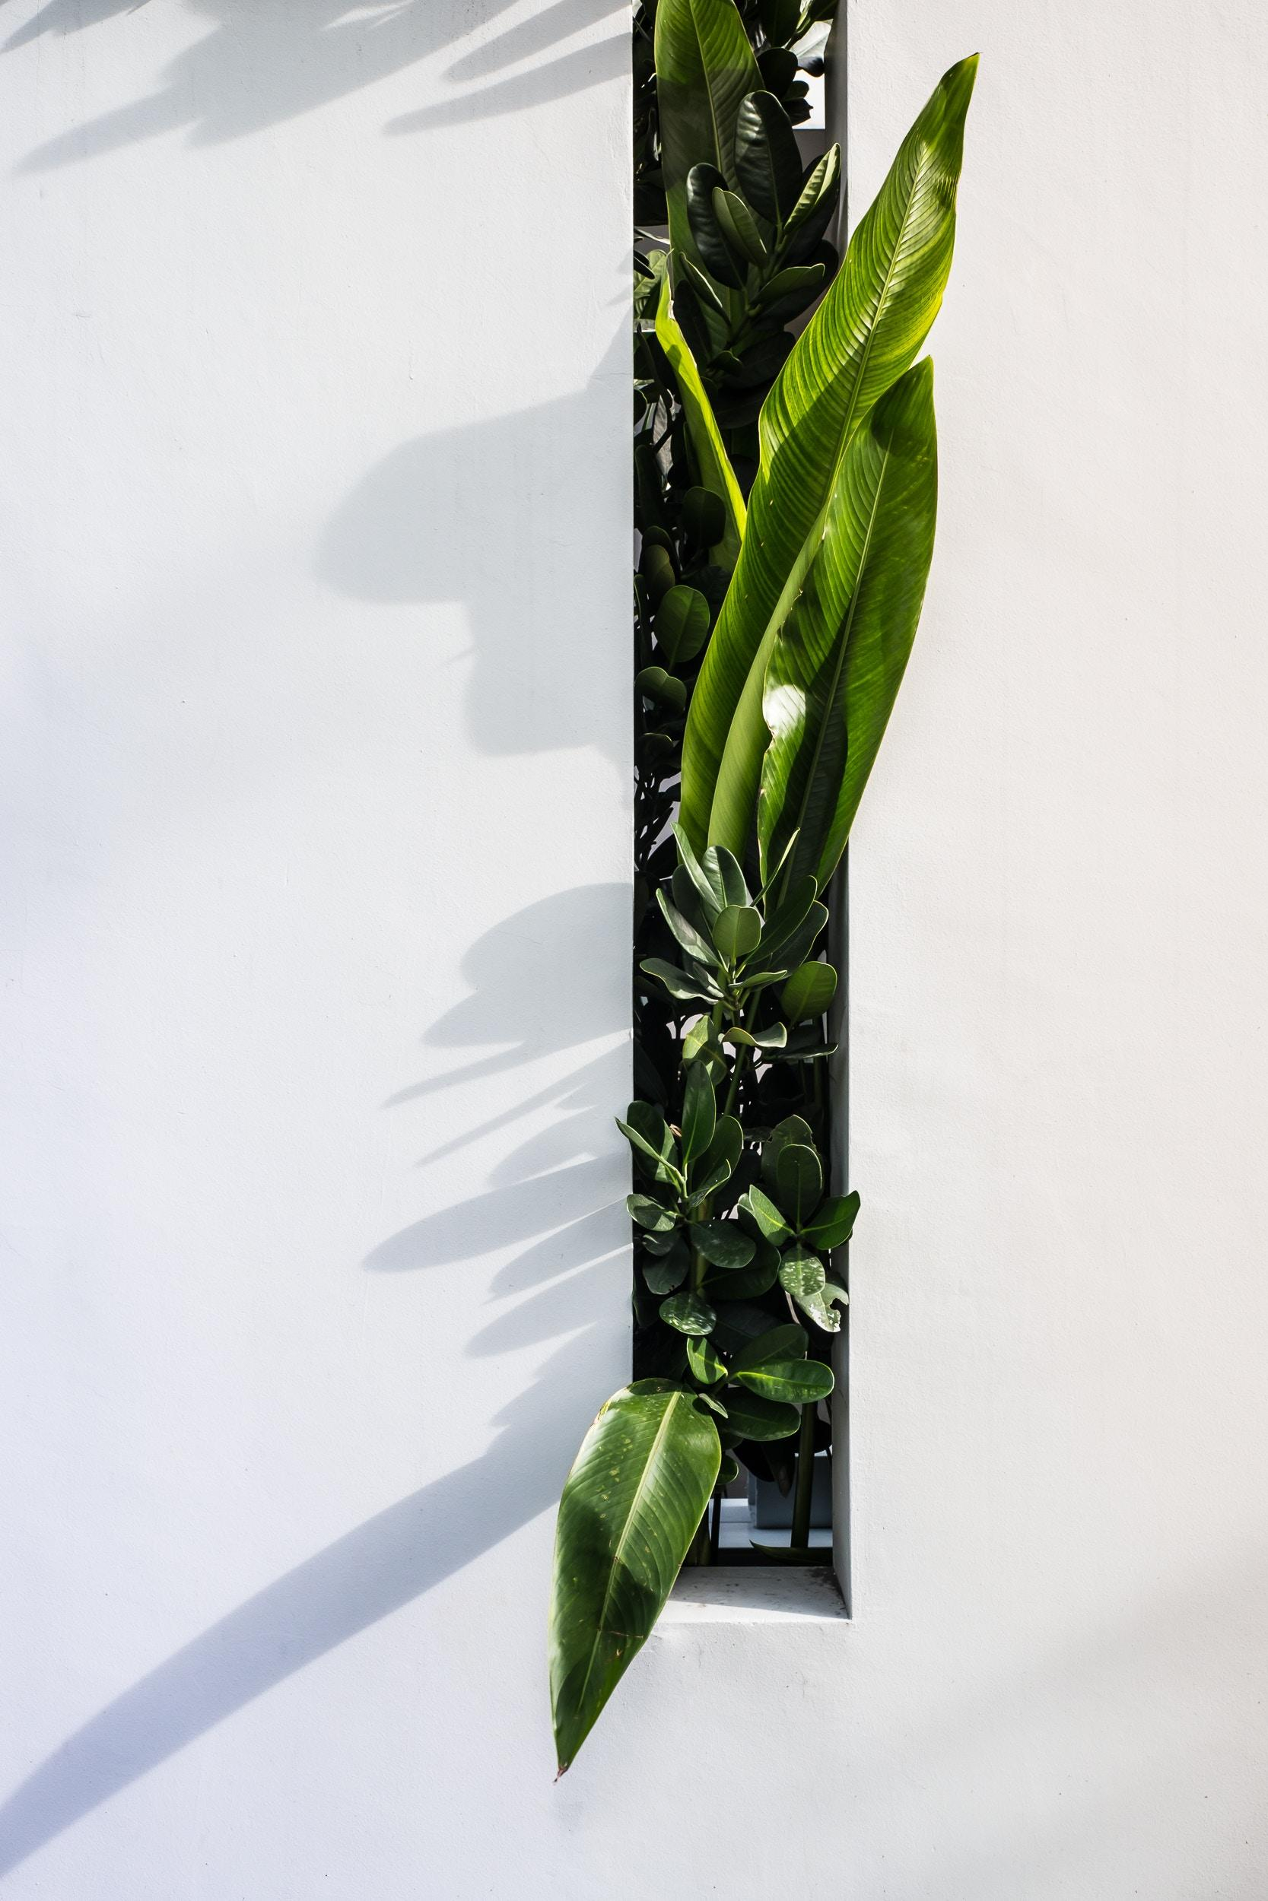
About
Sylvia Canete
Founder & Chairman
Blck Cherry Marketing started its operation in the social media industry in 2000. Initially, the first few years of the company was a success yet had many trials & challenges due to the drastic & extreme competition in the industry. In the year 2009, Blck Cherry Marketing achieved its first mainstream success due to its connections & excellent service with its customers. Ultimately, the company was duly recognized by many firms.

Slide 3
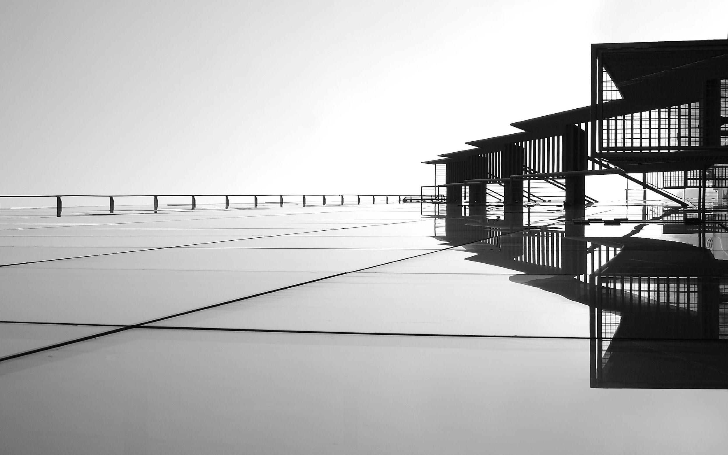
More
This newly developed project called “DEFINITIVE” is aimed to provide all marketing enthusiasts with a new line of products that are centered on college graduates and college students from the different universities across the country. Tentatively, each product can be sold for up to $20 and each sale package can be sold for up to $15. Profits generated from this project can be used for the office renovation and system upgrade of Blck Cherry Marketing.

Slide 4
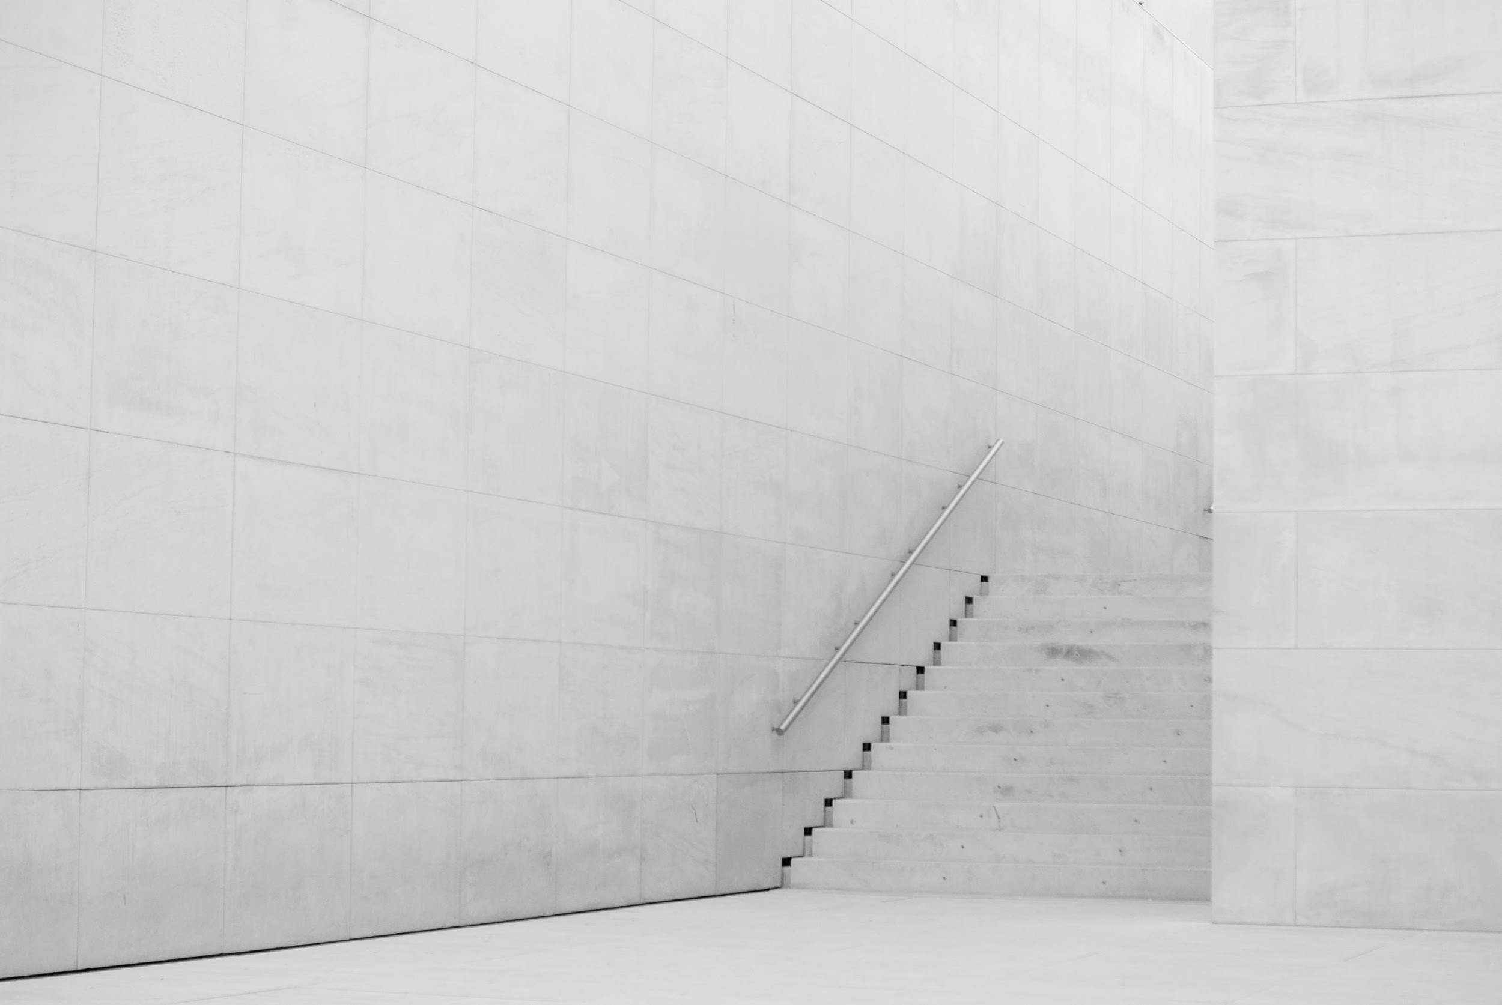
History
First established in 2005 by Sylvia Canete, Blck Cherry Marketing is a proud provider of superior marketing guidelines and plans. With nearly 13 years of experience, Blck Cherry Marketing has been providing the best and excellent products for all marketing companies. Today, Bright Marketing Agency has 5 fully operating branches across the country.

Slide 5
Objectives
The main goal of Bright Marketing Agency is to become a leading marketing agency across the country by offering and producing the best marketing guidelines and plans for all marketing based companies.

Slide 6
Testimonials
“I am always happy and satisfied with my purchases at Blck Cherry Marketing.
-Carol Duncan, 38, Real Estate Broker
“Satisfied with my purchases at Blck Cherry Marketing. They do their best to help me find effective marketing strategies that are best suited to my needs at comparatively affordable prices.”
-Chiz Evan, 30, Graphic Designer

Slide 7
Testimonials from Developers
“We genuinely developed these products for all people to provide more convenient, simplified, and effective service. ”
-Stephany Bowers., 27, Junior Marketing

Slide 8
WHAT WE OFFER
Effective Marketing Strategies
Free Marketing Agent Consultation
Excellent Marketing Packages
Friendly Customer Care & Service

Slide 9
TODAY’S AGENDA
01
DEFINITIVE
Project discussion will be held at Blck Cherry Marketing Conference Hall on January 23, 2021 from 12pm to 6pm. This newly developed project called “DEFINITIVE” is aimed to provide all marketing enthusiasts with a new line of products that are centered on college graduates and college students from the different universities across the country. Tentatively, each product can be sold for up to $20 and each sale package can be sold for up to $15. Profits generated from this project can be used for the office renovation and system upgrade of Blck Cherry Marketing.
02
DIVERSIVE
A project discussion in the business sector will be held at Blck Cherry Marketing Convention Hall on July 4, 2021 from 12pm to 6pm. This newly developed project titled “DIVERSIVE” is aimed to create launch products available to all races and nationalities without promoting discriminative contents. The products can be sold to all at affordable prices that tentatively start at $19.99. If the project can be implemented by the members of the board, profits gained from this project will be donated for the Long Beach, California Local Clean Up Drive.
03
COLLECTIVE
Project discussion will be held at Blck Cherry Marketing CEO Room on February 14, 2021 from 12pm to 6pm. This newly developed project called “COLLECTIVE” promotes different collections of products customized and developed by our Junior Marketing Developers. Ideally, the products from this project can be sold up to $15 which is enough to be donated for the office renovation and computer upgrade of the non-government office called “AFRICAN KIDS FOUNDATION”.

Slide 10
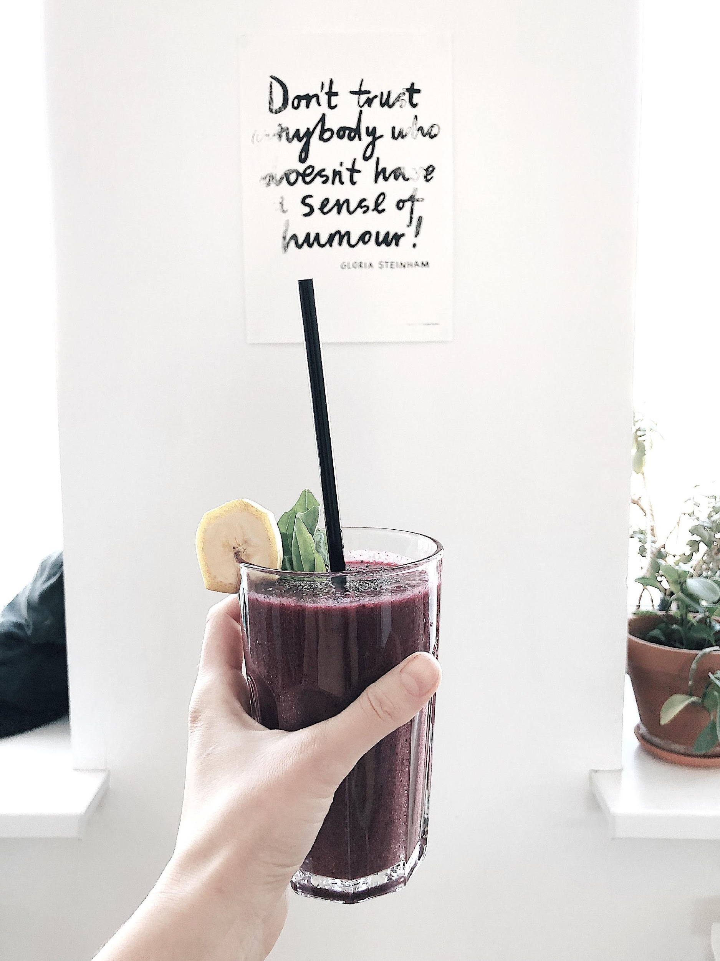
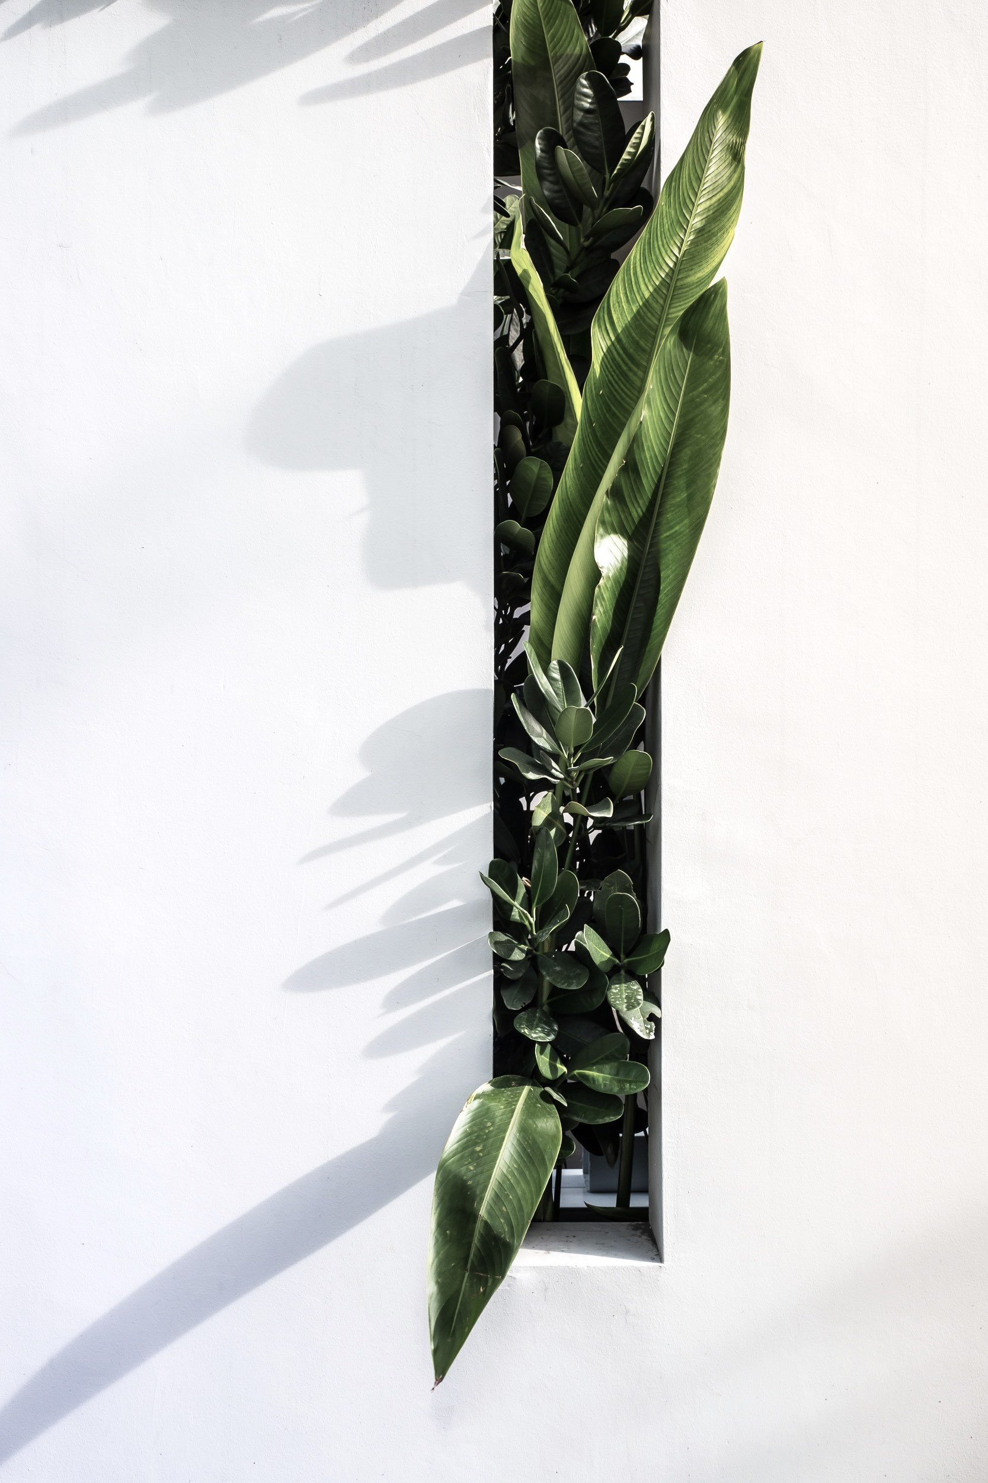

Slide 11
The Team
Sylvia Canete Chairman & CEO
Coltrane Holt
Chief Operating Officer
Cherry Blue Chief Marketing Manager

Slide 12
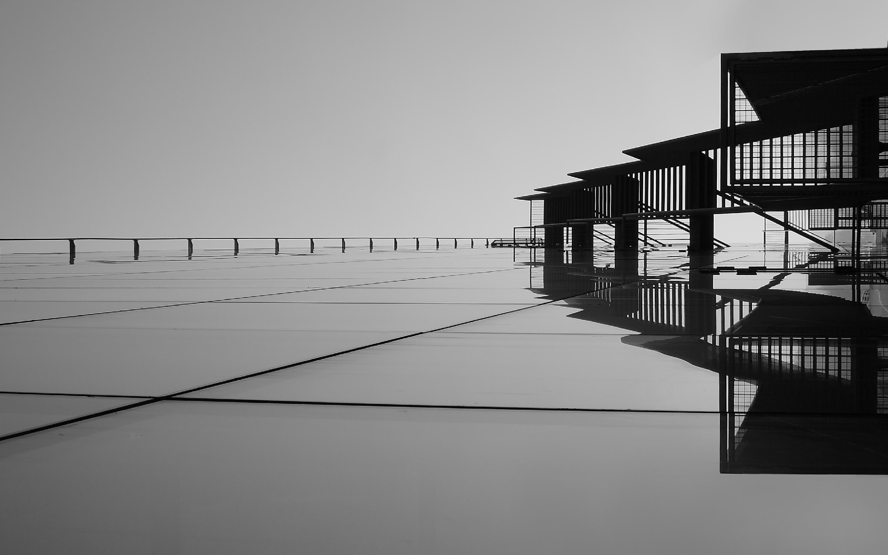
BLCK CHERRY MARKETING
THANK YOU!
+7729 98723
www.blckcherrymarketing.com
blckcherrymarketing@info.com

