Slide 1
ROCKS AND SAND BUILDERS
+76 37368 8728 | ras@builders.com

Slide 2
AGENDA

Slide 3
BRIDGING BRIDGE PROJECT
This will be held at SAS Conference Room on February 13, 2021 from 9am to 12pm. This event will mainly discuss the future projects the company will be holding and handling this coming 2025. Profits to be used will be discussed and planned for the entire project together with the special sponsors.

Slide 4
ROAD MANAGEMENT PROJECT
This meeting will be held at SYF Conference Room on March 15, 2022 from 1pm to 6pm. The agenda of this meeting is to discuss the future road management project for the year 2025. Other agenda includes the planning of construction, implementing specific deadline for the project and hiring of workers for the project.

Slide 5
PROJECT BOARD MEETING
This special meeting will be held at SAS Conference Room on January 23, 2020 from 1pm to 6pm. This will serve as a special meeting for the planned projects this coming 2022 and will focus on the future building projects to be organized and carried out. This will also include the follow up of a new set of projects to be carried out from 2025 to 2030.

Slide 6
ABOUT
Rocks and Sand Builders is a construction company established and operating since 1987. This company was first founded by Bruno Rock who is an engineer, philanthropist and entrepreneur. Today, the company has handled over a hundred projects at affordable prices while also providing highly reliable services.

Slide 7
MESSAGE FROM THE CEO
“As the founder & chairman of Rock and Sand Builders, I am pleased to announce our exciting future construction projects this coming 2023 to 2030 .”
Bruno Rock, 47, Chairman & CEO

Slide 8
BRIDGING BRIDGE PROJECT
SAS Conference Room
February 13, 2021
9am to 12pm
This event will mainly discuss the future projects the company will be holding and handling this coming 2025. Profits to be used will be discussed and planned for the entire project together with the special sponsors.

Slide 9
ROAD MANAGEMENT PROJECT
SYF Conference Room
March 15, 2022
1pm to 6pm
The agenda of this meeting is to discuss the future road management project for the year 2025. Other agenda includes the planning of construction, implementing specific deadline for the project and hiring of workers for the project.

Slide 10
PROJECT BOARD MEETING
SAS Conference Room
January 23, 2020
1pm to 6pm
This will serve as a special meeting for the planned projects this coming 2022 and will focus on the future building projects to be organized and carried out. This will also include the follow up of a new set of projects to be carried out from 2025 to 2030.

Slide 11
HISTORY
Rock and Sand Builders was founded by Bruno Rock in 1987 and is a proud provider of quality construction supplies, equipment, and projects. This company made its first public appearance in 1988 and has garnered recognition from multiple institutions by being dubbed the best provider of construction products and services in the state.
During late 2015, Rock and Sand Builders achieved its best increase in profit and sales which allowed the company to gain better traction and boost its reputation in the industry. Today, it is a fully operating provider of construction services with over 100 privately and publicly handled construction projects.

Slide 12
CLIENT TESTIMONIAL
“If you are looking for the best and most affordable construction services, Rock and Sand Builders has what you’re looking for. From quality assured materials to best construction service, the company shows nothing less than excellence and reliability.”
-April May, 39, House Owner

Slide 13
MAIN GOAL
Pound for Pound Construction, Inc. aims to become the top leader of construction services through quality assured construction packages and efficient time management.

Slide 14
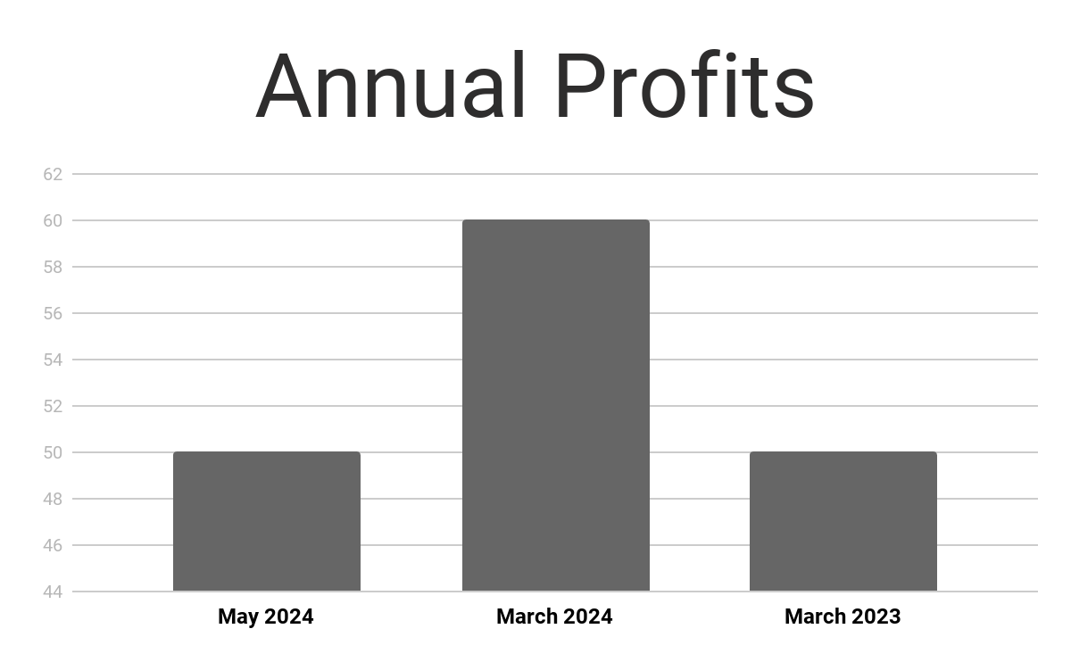
OVERVIEW OF GROWTH
40% increase in annual profits as of May 2024.
60% increase in construction service approval as of March 2025.
50% increase in new clients as of March 2023.

Slide 15
WHAT WE OFFER
The Best Construction Service
Efficient Construction Time Management
Extensive and Meticulous Construction Planning
Friendly and Quality Assured Customer Service

Slide 17
Engr. Brian Iowa
Founder & CEO
Engr. Bill Zoe
Quality Control Officer
Rose Yumimoto
Chief Marketing Officer

Slide 18
THANK YOU!
+76 37368 8728
ras@builders.com

