Slide 1

presenter@name.com
    SCIE TECH PROJECT
    PRESENTATION

Slide 2

AGENDA
01
GENESIS X PROJECT PROPOSAL
02
ARTIFICIAL TREE SEEDS PROPOSAL
03
ANNUAL PROJECT MEETING

Slide 3
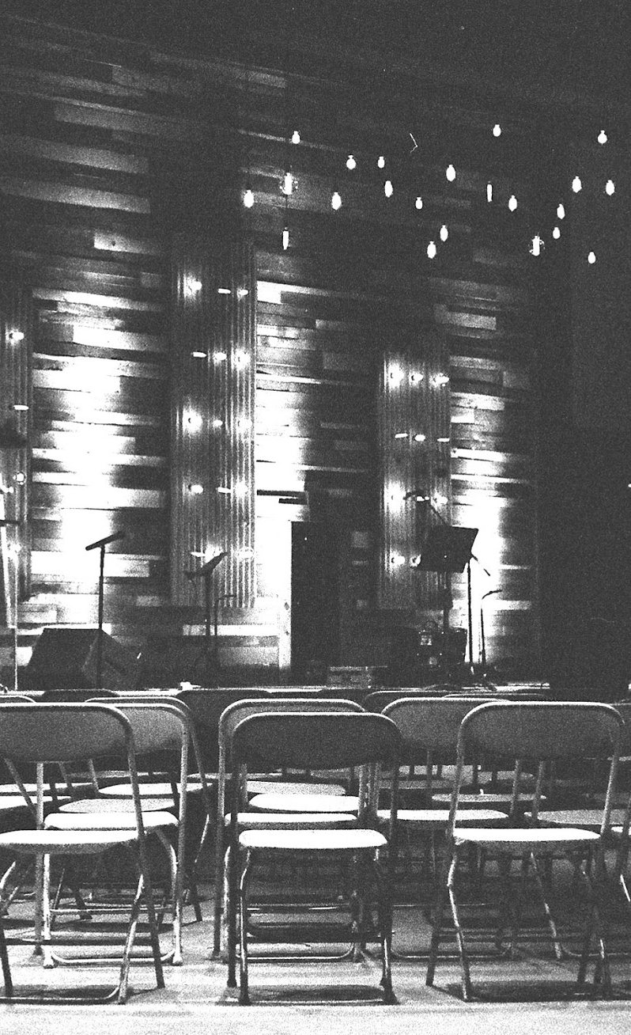
GENESIS X PROJECT PROPOSAL
This project proposal will be held at the Lincoln Conference Room on July 17, 2024 from 9am to 12pm. Tickets start at only $10 and will entitle attendees to watch the live interview of Dr. James Alan. This event is dedicated to Dr. Alan, a chief sponsor of the research with profits being utilized for the project implementation off the Genesis X Project.

Slide 4
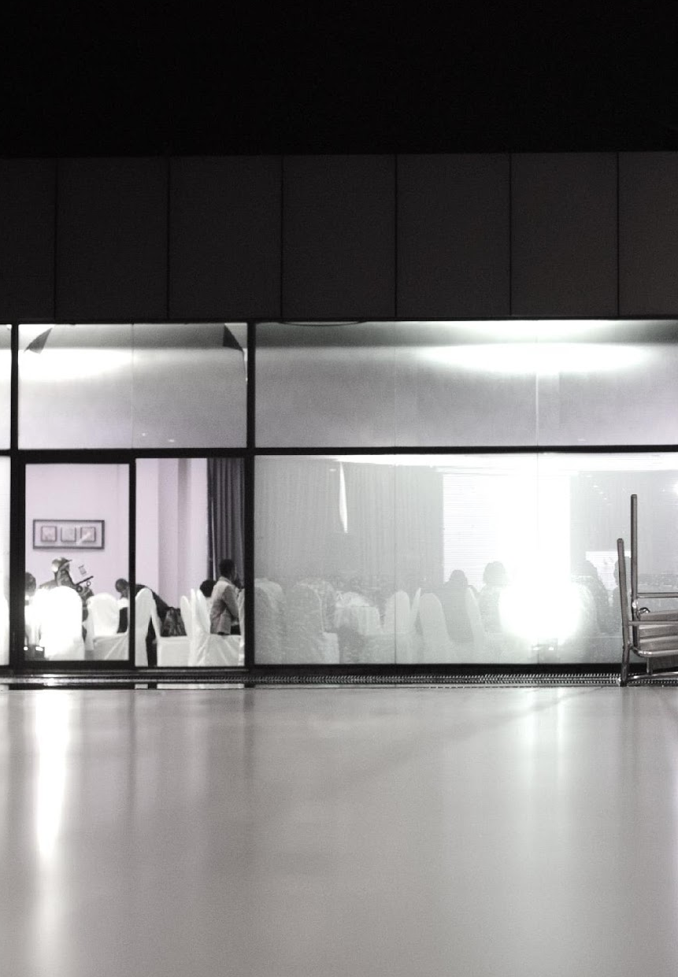
ARTIFICIAL TREE SEEDS PROPOSAL
This project proposal will be held at the Lincoln Conference Room on July 17, 2024 from 9am to 12pm. Tickets start at only $10 and will entitle attendees to watch the live interview of Dr. James Alan. This event is dedicated to Dr. Alan, a chief sponsor of the research with profits being utilized for the project implementation off the Genesis X Project.

Slide 5

ANNUAL PROJECT MEETING
All researchers, sponsors and management will be having their annual meeting at the Scie Tech Corp Meeting Room on January 20, 2020 from 12pm to 6pm. The purpose of this meeting is to discuss the future projects of the Scie Tech Corporation and will include the review and revisions of the thesis and project proposals proposed by the researchers in the corporation that are aimed to be published by 2030. The developed project and research are for the benefit of the aboriginal and local people in the perimeter of Amazon Forest in Brazil.

Slide 6
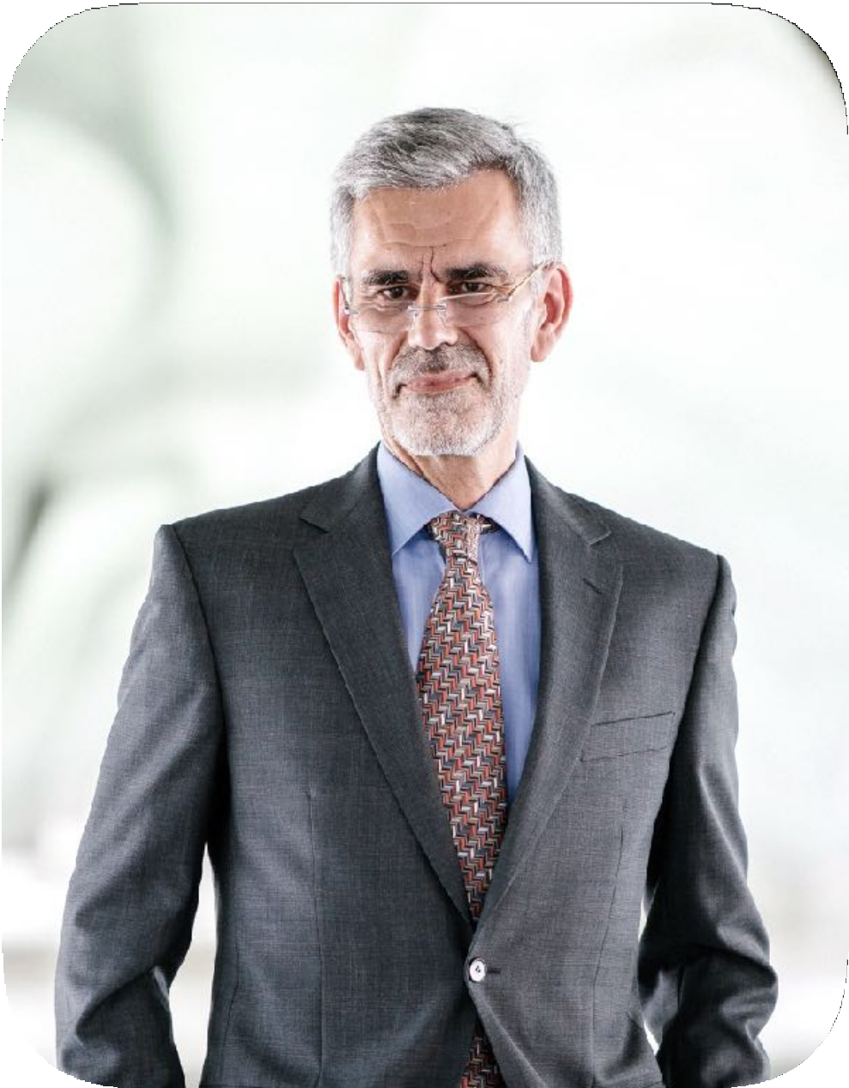
Dr. Kevin West
Founder & CEO
I am pleased to introduce you the science and technology research center aimed to help the aspiring future scientist and researches in the industry, the Scie Tech Corporation.
This corporation is a pioneering company handling the aimed projects and thesis proposed by the different future scientist across the country. All of the projects conducted are aimed to benefit the human race, nature, plants and animals. Additionally, we are also proud to present our newly developed events and project proposals made by doctors: Rick Fujiwara and James Alan.
Dr. James Alan and Dr. Rick Fujiwara have created these to help in the progress of human race and the stabilization of the Amazon Forest. Ultimately, Scie Tech Corp. will be providing scholarships for graduate and non-graduate students who aspire to present and develop new inventions capable of benefiting the world.

Slide 7

History
First established in 1985 by Dr. Kevin West, Scie Tech Corp. is now on its 33 years of operation and has been promoting and helping future and aspiring inventors and scientists to succeed.

Slide 8

TESTIMONIALS
FROM GUESTS
“Scie Tech Corp. showcases numerous inventions that will
help this world move forward towards success and progress.”
-Steven Jamill, 35, Tech Columnist

Slide 9

MAIN GOAL
Scie Tech Corp commits itself to provide lots of beneficial inventions and quality service assistance for all aspiring future scientist and inventors.

Slide 10
WHAT WE OFFER
State of the Art Facilities
Quality Assured Service and Assistance
Up to 50% to 90% Monetary Sponsorship

Slide 11




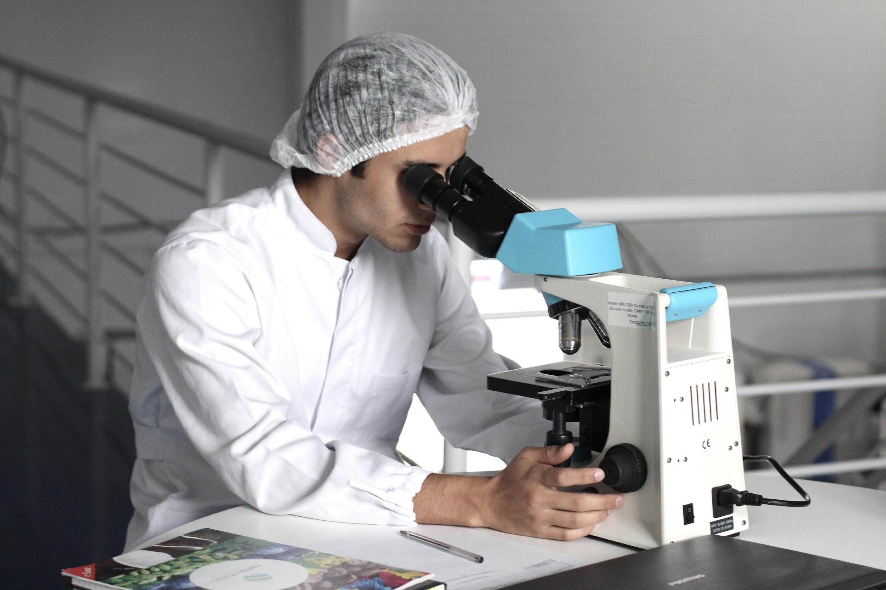
IMAGE
GALLERY

Slide 12
presenter@name.com
    THANK YOU!

