Slide 1
Insperion Creatives
_{insperioncreative.com}

Slide 2
About
The Company
The Team
Goal
Execution
Operation Plan
Testimonials

Slide 3
The Company
About
Founded in the year 2025. Insperion Creatives is an organization
composed of dedicated & passionate graphic designers who enjoys
what they do for a living. Can think outside the box & come up with
innovative designs that would surely attract lots of attention.
Organized professionals whose employees have had experience in
graphic design for more than 5 years.
Insperion Creatives

Slide 4
The Company
Vision
We look for solutions that can have an impact beyond
the project, that can move the needle in some way
and contribute to society and culture. Our design
process is open, interactive, and collaborative.
We believe that great design need not be created
through arrogance and ego, but in a way that can
sustain us all and allow each of us to grow and learn.
Insperion Creatives

Slide 5
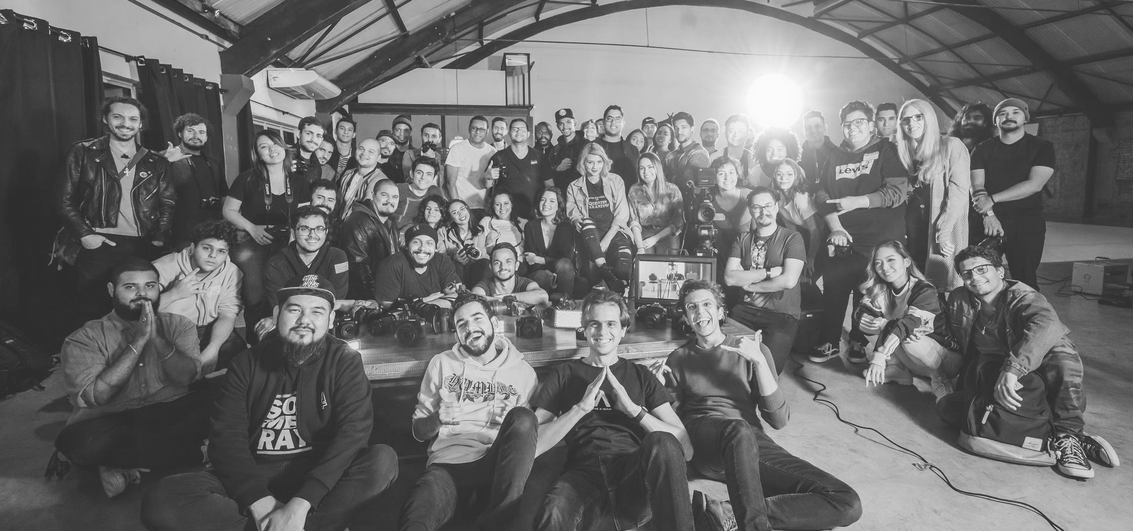
Mission
To innovate, to lead, to enhance, to provide best-value products and services to global customers. To make a difference and To enhance the quality of life for our business partners,customers and employees. Insperion Creatives sees itself to becoming the gateway for clients who are dreaming of the perfect design management.
Insperion Creatives

Slide 6
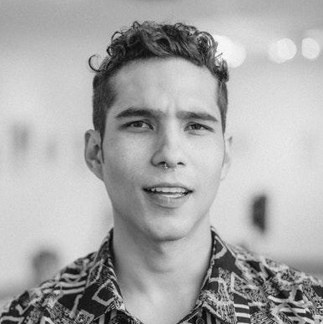
The Company
The Team
John Newman
Rod Crest
Sapphire Cressman
Founder & CEO
Chief Marketing Officer
Chief Operating Officer
Insperion Creatives

Slide 7
Execution
Goal
We strive to be a caring and well-managed
organization for our business partners ,
customers and employees, and a responsible
corporate citizen to our society.
^{Insperion Creatives embraces a}
responsibility to make our projects a success.
This has resulted in an exceptionally high rate
of repeat clients, as well as lifelong
relationships that we value highly. We believe
deeply in the importance of designing
^{sustainably.}
Insperion Creatives

Slide 8
Value Proposition
Pricing Strategy
Clients seeking a trusted, affordable design company. Clients looking for agencies that will provide cost-efficient Design options.
Insperion Creatives uses a cost-plus pricing strategy. It is accessible & affordable to more users in the target demographic.
Insperion Creatives

Slide 9
Operation Plan
Marketing Analysis
Marketing for Digital Design operations involves designing advertisements or promotional offers that will best draw customers toward a Design firm. In order to do this well, marketers conduct surveys or interviews with target consumers in order to establish their needs, what they respond to and what they look for when choosing such an organization. Marketers must then be able to use this information to draft successful campaigns that increase business and profits. In order for design businesses to succeed, they rely on marketing professionals to link potential consumers with their services and operations.

Slide 10
Operation Plan
28 %
Analytics
We’re well equipped to handle today’s planning and design challenges, whether the project is Educational, Corporate, Process / Industrial, Municipal or Governmental in nature. It’s our duty as a pioneering Design firm to deliver true, value-based Design solutions to meet any design challenge, through skilled planning and
^{tested experience.}
45 %
74.6 %
33.5 %
Posters
Focuses on target audience through
^{social media & printed flyers.}
Advertising the perfect Design package
for clients who are interested in Mock- Ups. Effectively engaging with potential clients.
Magazine
Cards
Tickets
Insperion Creatives

Slide 11
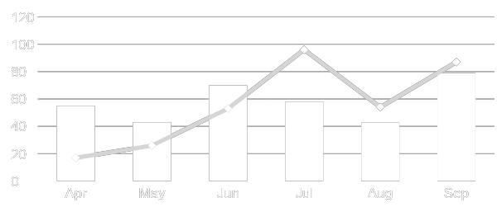
Operation Plan
Growth Overview
There is an increase in annual profits as of April 2022. There is an increase in customer satisfaction with produced products as of June 2024. Also there is increase in Mock Up downloads in the market as of March 2023.

Slide 12
Operation Plan
Organizational Structure
The CEO of the company is the head of
operations. Under the CEO is the Marketing Division Head & Graphics Development
^{Division Head.}
The head of the Marketing Division is
responsible for creating & implementing marketing plans, strategies & market
research. The team in this department also manages client concerns & collaborates
with the Graphics Development division in resolving any design issues.
Insperion Creatives

Slide 13
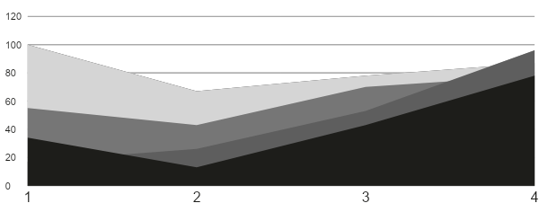
Operation Plan
Customer Satisfaction
The head of the Marketing Division is responsible for creating & implementing Analytic Strategies, & market research.
The team in this department also manages client concerns & collaborates with the Graphics Development division in
^{resolving any customer issues.}

Slide 14
Operation Plan
Company Milestones
The team in this department also manages client concerns & collaborates.
Short-term Goals | Milestones
Social media brand marketing | Reached 50% of audience target.
Company Building Expansion | Construction started 2024
Long-term Goals | Milestones
Partnership with Asia Printing Pro | Contract signing on February 2027
Brand expansion in New York & New Jersey | Budget proposal drafted as of July 2026

Slide 15
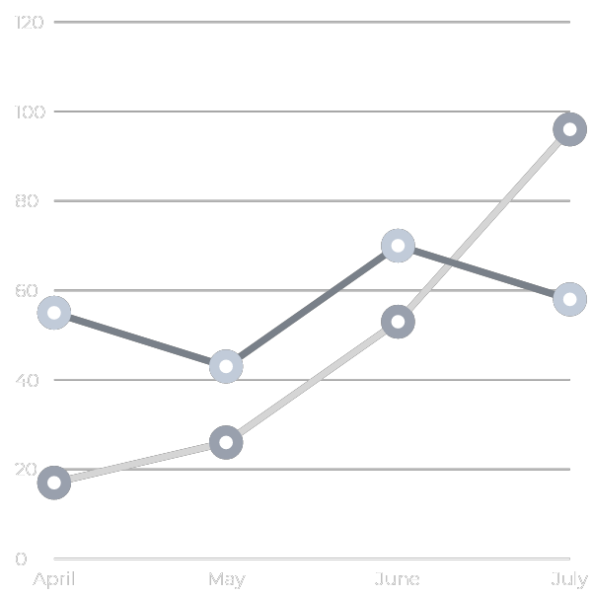
Operation Plan
Productivity
Rate
Over the years, The Firm has been given
a lot of projects to work on. As reflected
in the Productivity Chart, Insperion
Creatives objective is to deliver quality
services on-time and on-budget for
every assignment, regardless of size,
scope or location. Theres is a significant increase to this months productivity rate compared to past months.
Insperion Creatives

Slide 16
Operation Plan
Outlook
We look for solutions that can have an impact beyond the project, that
can move the needle in some way and contribute to society and
culture. Our design process is open, interactive, and collaborative. We
believe that great design need not be created through arrogance
and ego, but in a way that can sustain us all and allow each of
^{us to grow and learn.}
“
full-on stylish to minimalistic, all of our templates are graphically designed to suit our client’s individual tastes.
”

Slide 17
Testimonials
“Insperion Creatives was a worthwhile investment for me.
Knowing that I can’t have many of the things I used to have
hen I was younger, I needed all the help I could get in
Design. Now I can with Insperion Creatives”
^{- Cyndia D. Thomas, 53, Nurse}
“My dad isn’t getting any younger. I needed as much assistance as I could in terms of keeping my design business alongside his medication without having to take up too much of my personal work as well. I’d highly recommend this to any designers out there that needs help.
- Wylang J. Wyans, 32, Engineer
Insperion Creatives

Slide 18
End
Insperion Creatives

