Slide 1
SAVORY SPICE RESTAURANT
“Home of Spicy, Savory Dishes”
+38619 28862 | spice@savory.com

Slide 2
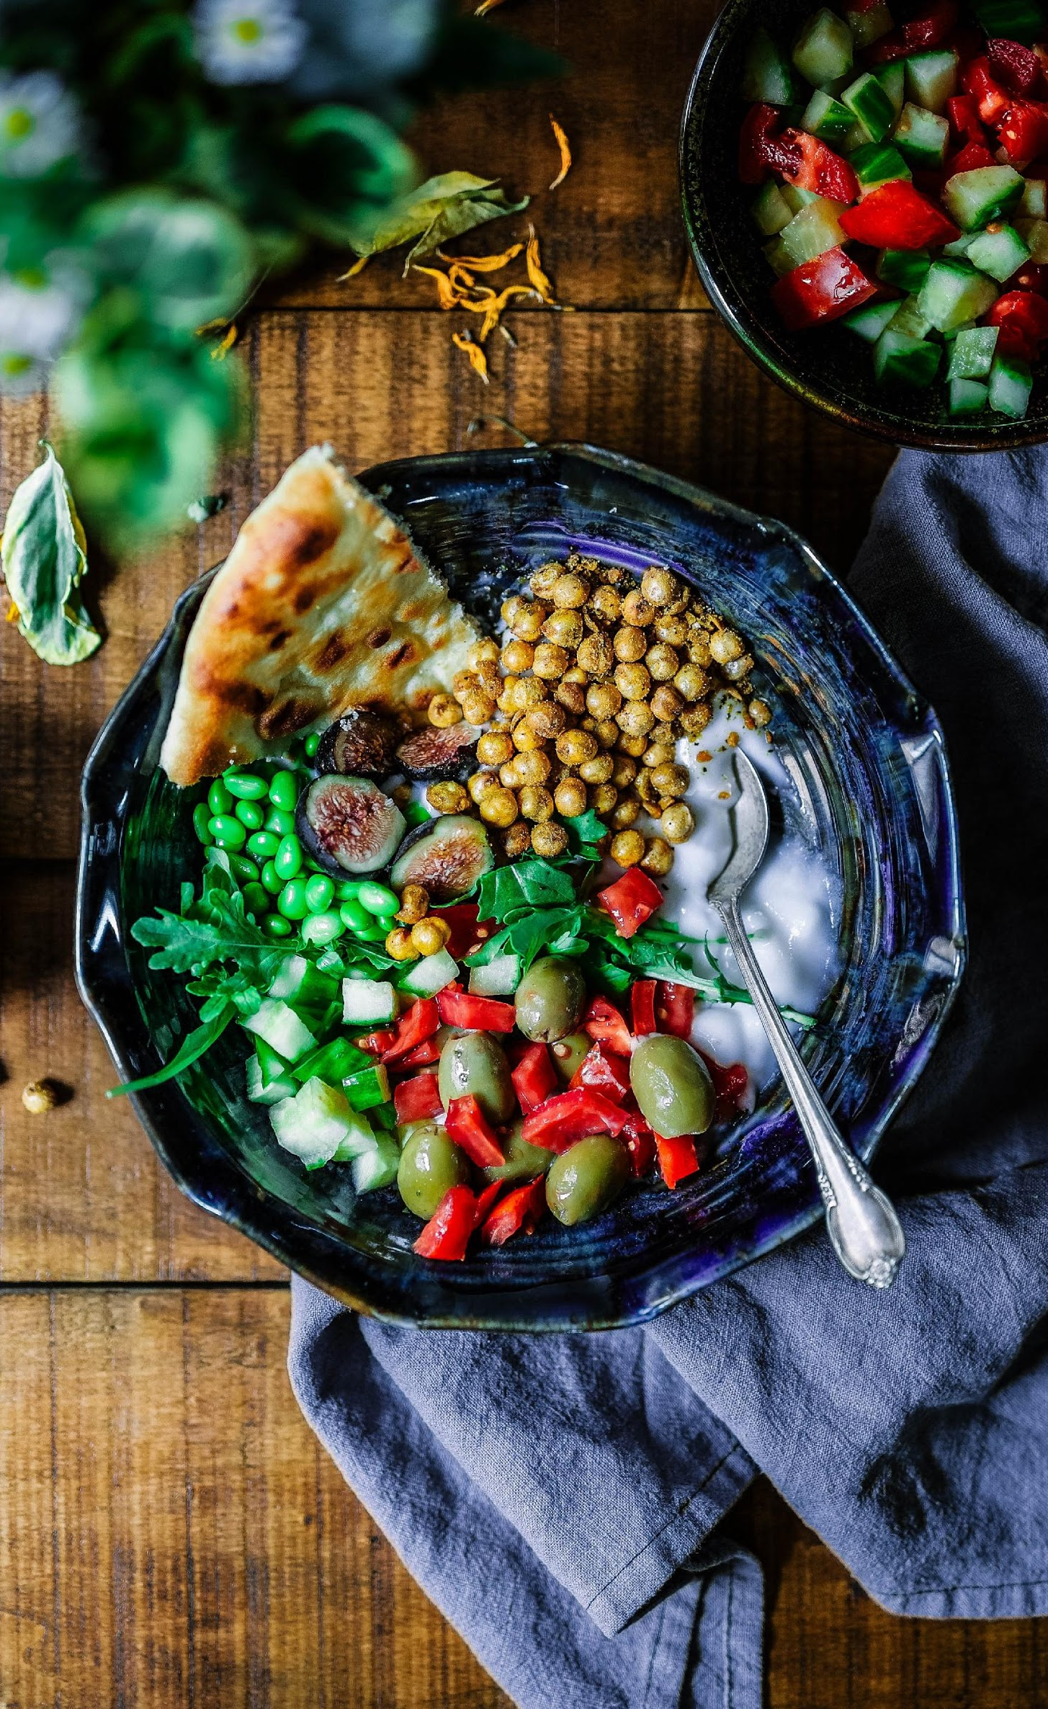
AGENDA
01
FOOD SHOPPE EXPO
This grand expo is dedicated to the late Steve Mcvoy who was the co-founder of the restaurant and will be held at the Grand Con Eleven Convention on June 14, 2022 from 10am to 9pm. Tickets start at $30 and will entitle all attendees to exclusive discounts of up to 30% off. Profits will be donated to Local Government Units across Oakland, California.
02
MEDITERRANEAN CUISINE
This event is aimed to promote the newly developed menu of Savory Spice Restaurant with the theme “Mediterranean Cuisine”. It will be held at the Food Bazaar Convention Hall on July 23, 2025 from 10am to 8pm. Tickets start at $30 and will entitle attendees to an exclusive meal coupon bundle. Profits will be utilized for the office renovation and system upgrade of the Dogs Life Foundation Center.
03
ANNUAL BOARD MEETING
Members of the Board will be having their annual meeting at the Savory Spice Restaurant Conference Room on January 11, 2020 from 12pm to 6 pm to discuss the future plans and events of the restaurant’s status. This meeting will also include the general planning, revising and reviewing of the resort’s status and performance for the year 2025 to 2030. It is aimed to boost the marketing impact, profit and status of the restaurant.

Slide 3
LILY JONES
Founder & Chairman
I am pleased to introduce to you the best tasting restaurant across the country, Savory Spice Restaurant.
This restaurant holds a diverse food menu with a wide variety of tastes from the Pacific to the Atlantic region, Savory Spice Restaurant offers nothing but quality, good tasting dishes.
As a restaurant operating for over 20 years, Savory Spice Restaurant had its ups and downs as a business. Today, it is dedicated more than ever to provide satisfying dishes to all of its valued customers who helped us progress and succeed in the restaurant industry.
We are proud to present our new dishes and products that our company can offer, starting off with our brand new “Mediterranean Menu”. Savory Spice Restaurant will always be dedicated towards excellent taste and reliable customer service.

Slide 4
TESTIMONIALS
“As a restaurant operating for over 20 years, Savory Spice Restaurant is pleased to announced its new and exciting Mediterranean Menu.”
-Lily Jones, 59, Founder & Chairman

Slide 5
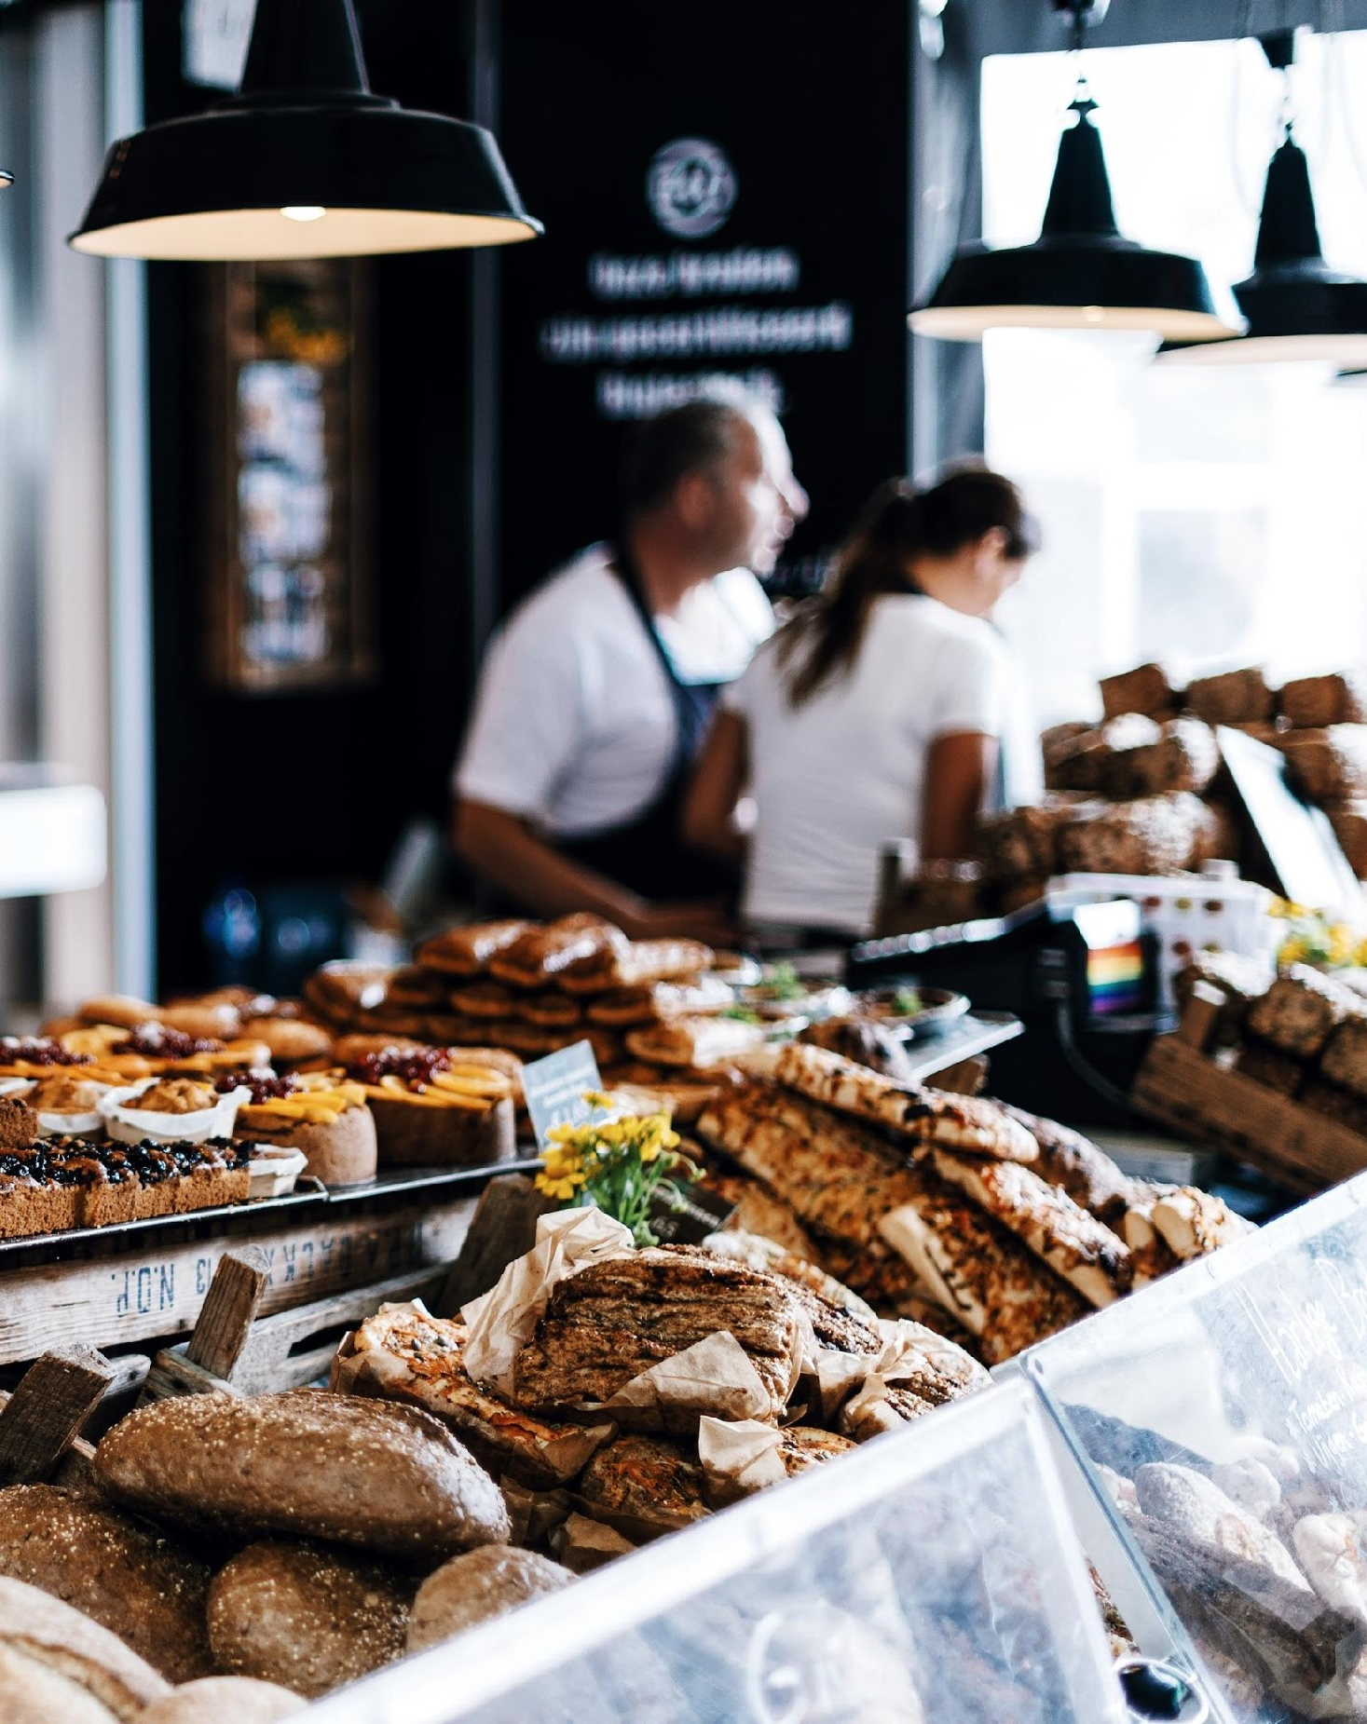
FOOD SHOPPE EXPO
Grand Con Eleven Convention
June 14, 2022 | 10am to 9pm
This grand expo is dedicated to the late Steve Mcavoy who was the co-founder of the restaurant and will be held at the Grand Con Eleven Convention on June 14, 2022 from 10am to 9pm. Tickets start at $30 and will entitle all attendees to exclusive discounts of up to 30% off. Profits will be donated to Local Government Units across Oakland, California.

Slide 6
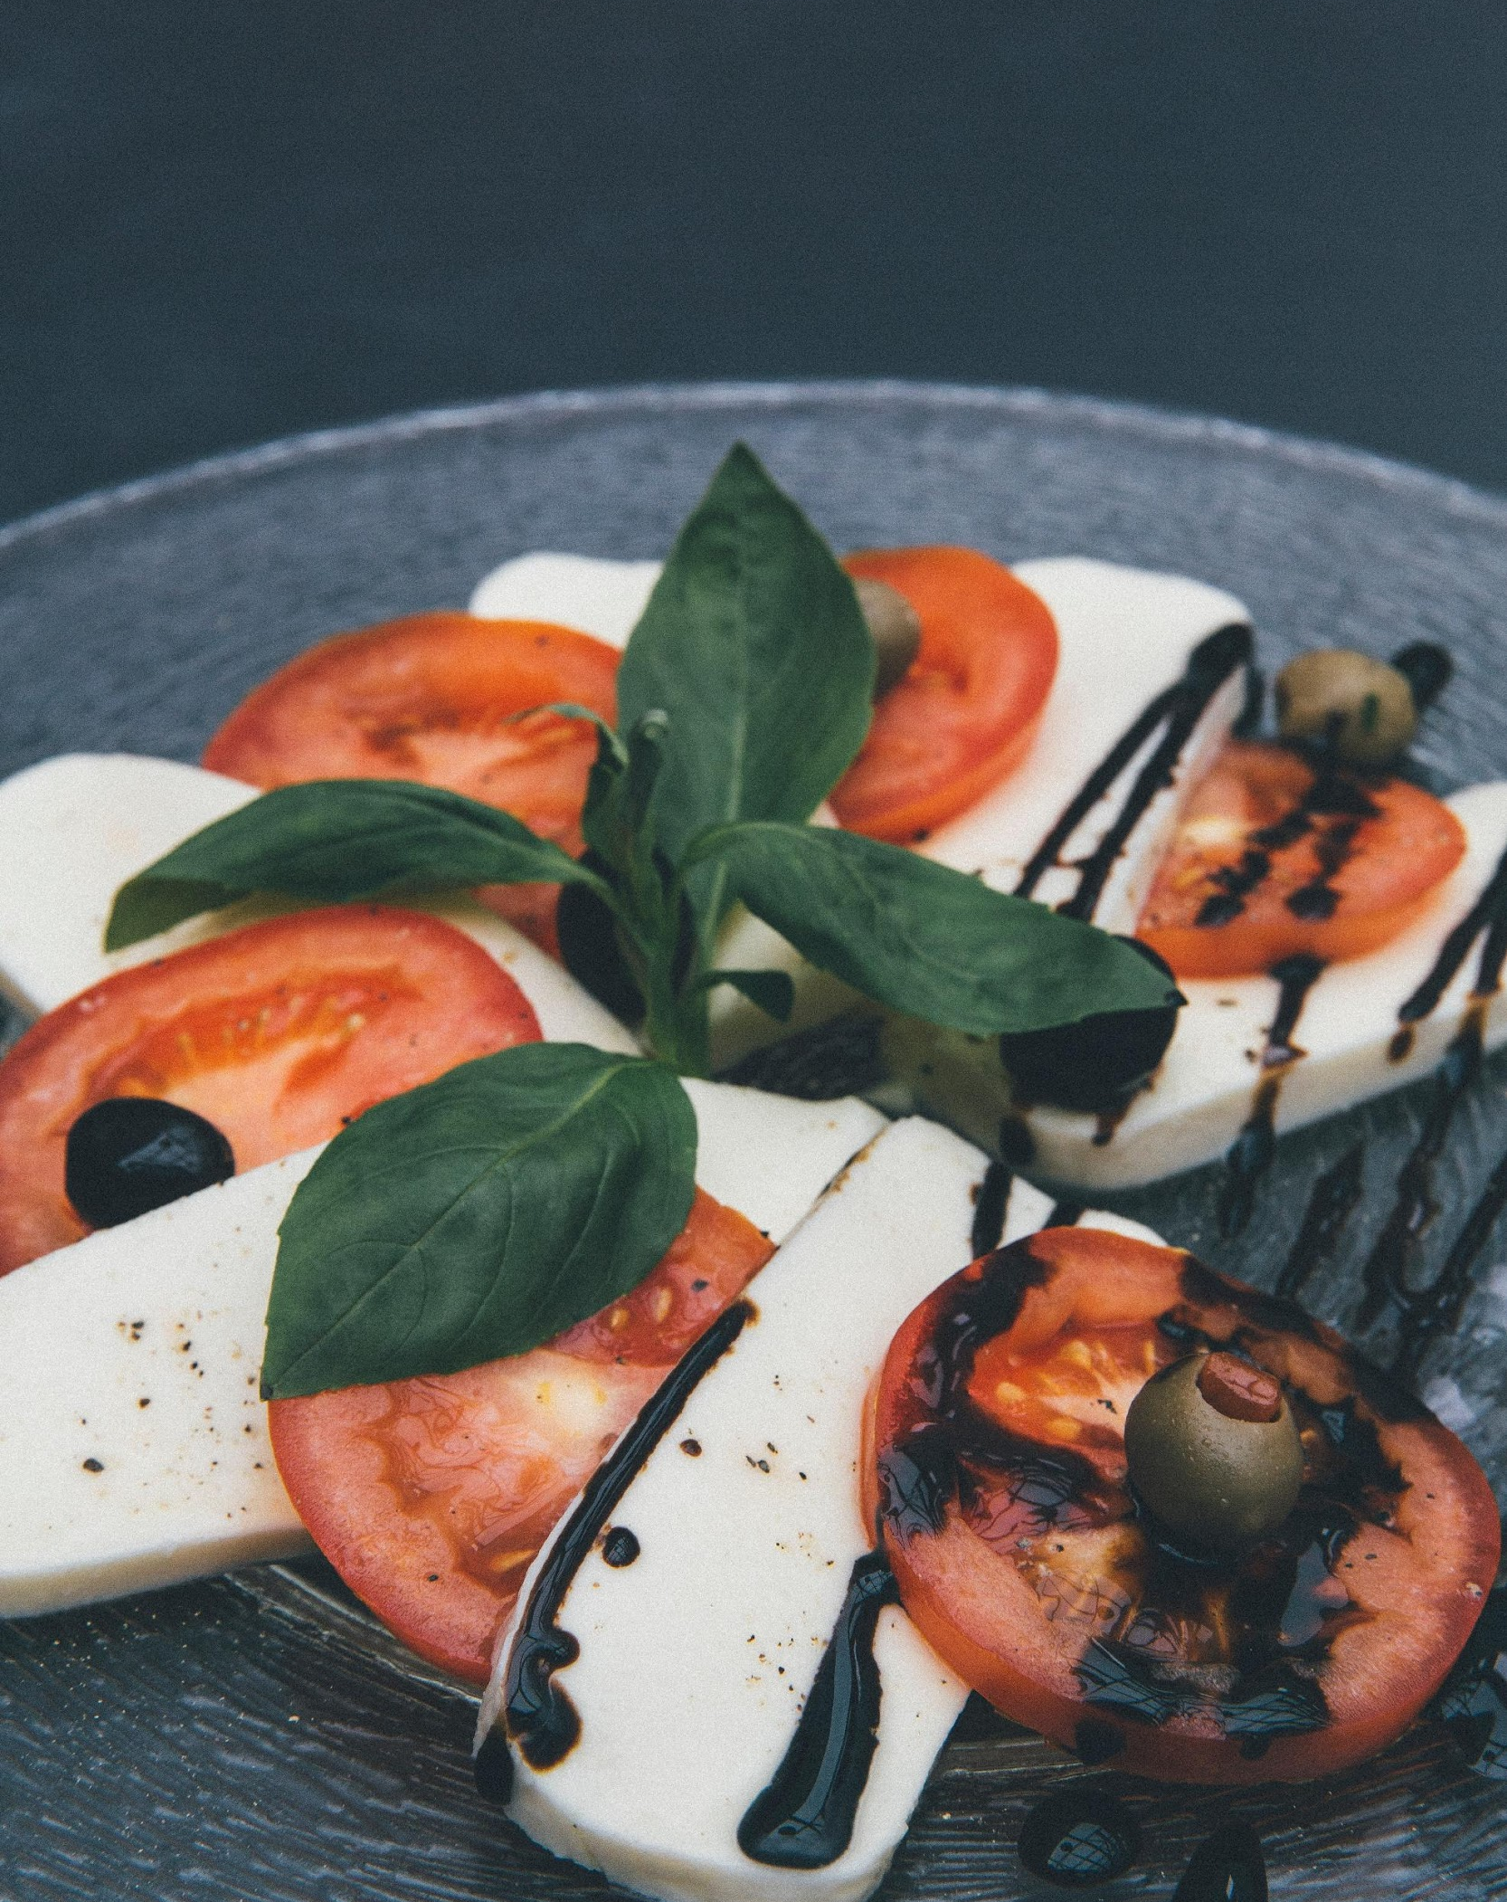
MEDITERRANEAN CUISINE
Food Bazaar Convention Hall
June 2, 2022 | 10am to 8pm
This event is aimed to promote the newly developed menu of Savory Spice Restaurant with the theme “Mediterranean Cuisine”. It will be held at the Food Bazaar Convention Hall on July 23, 2025 from 10am to 8pm. Tickets start at $30 and will entitle attendees to an exclusive meal coupon bundle. Profits will be utilized for the office renovation and system upgrade of the Dogs Life Foundation Center.

Slide 7
ANNUAL BOARD MEETING
Spice Restaurant Conference Room
January 11, 2020 | 12pm to 6pm
This meeting will also include the general planning, revising and reviewing of the resort’s status and performance for the year 2025 to 2030. It is aimed to boost the marketing impact, profit and status of the restaurant.

Slide 8
ABOUT
Lily Smith was a former executive chef at the grand and prestigious Diamond Hotel in Saudi Arabia. Her 20 years of experience in the restaurant industry gave her the advantage in handling and managing her own restaurant. Today as a restaurateur and philanthropist, Lily Smith is dedicated more than ever towards developing quality, affordable dishes at convincing price points.

Slide 9
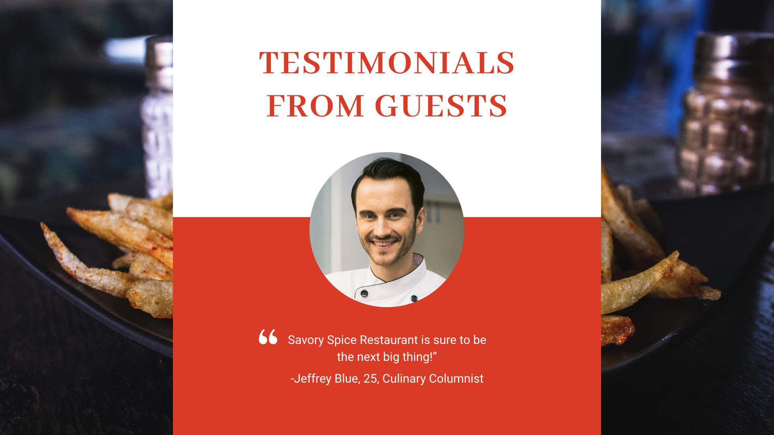
TESTIMONIALS FROM GUESTS
“
Savory Spice Restaurant is sure to be the next big thing!”
-Jeffrey Blue, 25, Culinary Columnist

Slide 10
MAIN GOAL
Savory Spice Restaurant commits itself to provide fresh, authentic, and affordable dishes for everyone to enjoy.

Slide 11
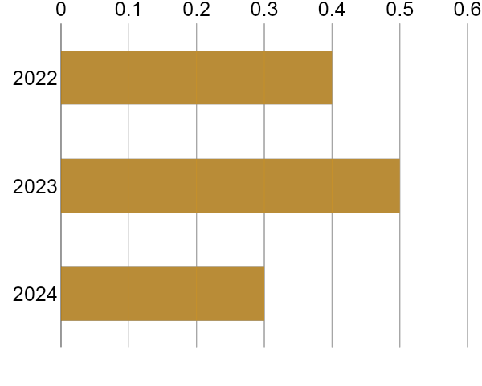
OVERVIEW
OF GROWTH
40% increase in annual profits as of May 2022.
50% increase in customers and clients as of March 2023.
30% increase in food satisfaction as of March 2024.

Slide 12
IMAGE GALLERY

Slide 14
WHAT WE OFFER
Tasty, Fresh & Authentic Dishes
Affordable Food Package
Spacious and Relaxing
Restaurant Ambience
Quality Assured and
Friendly Customer Care

Slide 15
THANK
YOU

