Slide 1

Social Media
Pitch Deck

Slide 2

About Us
Active Tech is a social media advertising company with clients in U.S.A, Europe, and Asia. We are based in Los Angeles, California and have been in the business for over 8 years.

Slide 3

Vision
Active Tech’s vision is to become a well renowned ad reliable provider of advertising content and social media marketing services for a variety of businesses at reasonable price points.

Slide 4
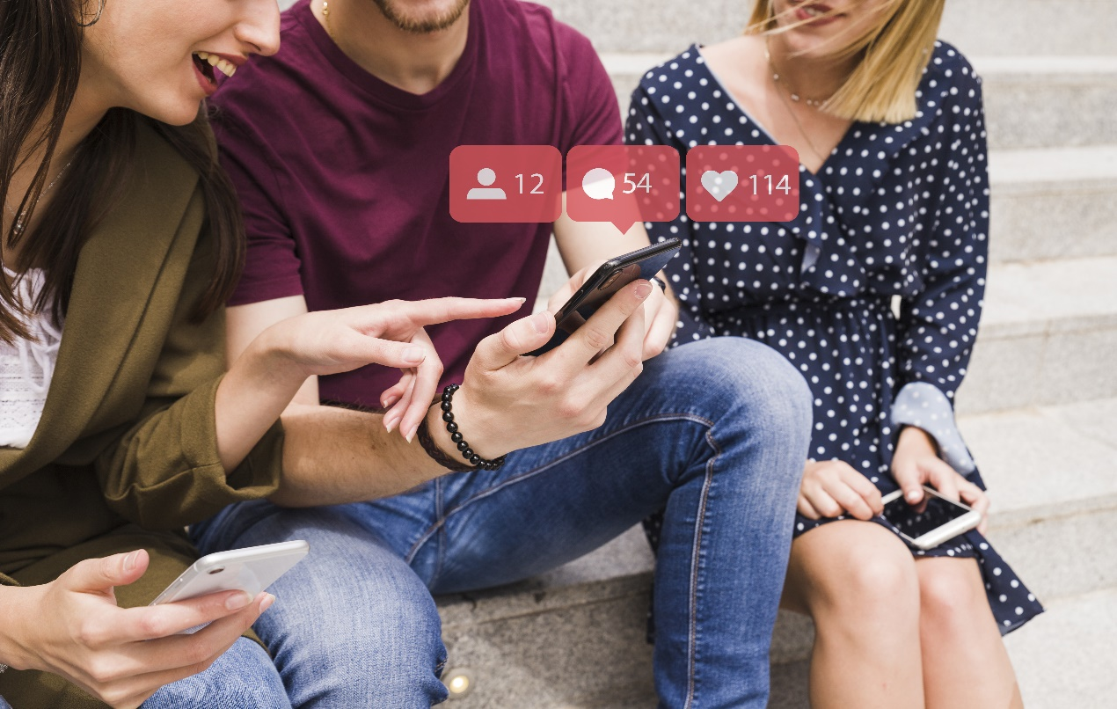
Mission
Active Tech’s mission is to become the leading social media advertising company by the year 2025.

Slide 5
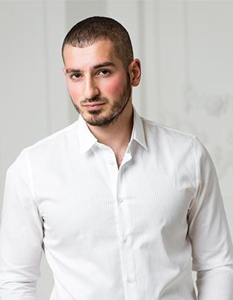
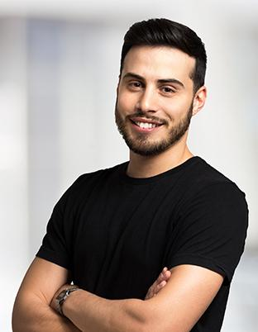
The Team
Julian Hunts
Jenny Su
Chief Operating Officer
Marketing Head
Secures and sustains the functional and financial growth of Active Tech.
Plans, implements, and controls strategies to be sold and marketed by the company.

Slide 6

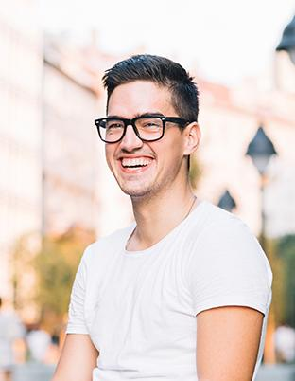
The Team
Kyle Fox
Jerome Bautista
Advertising Manager
Customer Service & Relations Manager
Produces content for promotion and advertising to be used and sold by the company.
Trains, guides, and advises all customer service representatives in the company.

Slide 7

The Problem
According to a study conducted by Amanda Hart in December 2016, around 75% of businesses in the city of Los Angeles that use social media ads have (1) been unsuccessful in attaining their desired profit and following numbers and (2) fail to establish meaningful connections with their online followers and viewers . Due to this, as many as 300 companies experience a lack of profit based on their respective social media pages.

Slide 8

Our Solution
Active Tech offers effective social media advertisements that are carefully developed to cater to a variety of businesses. Our team is well versed in what today’s social media platforms need in terms of content, advertising, and marketing.

Slide 9

Advantages
Over 20 efficient and effective social media marketing and advertising strategies to choose from.
Professional and passionate staff members who are well versed in marketing and advertising.
Affordable and reasonable priced services starting at just $14.99 per month.
Free consultations and online skype meetings with marketing and advertising advisors.

Slide 10

Campaign To Gain
Campaign To Gain seeks to provide online businesses with affordable and effective marketing solutions starting at just $7.99 per month. This project was developed by our team to specifically get customers a larger following that is more interactive and interested in what the business has to offer.

Slide 11
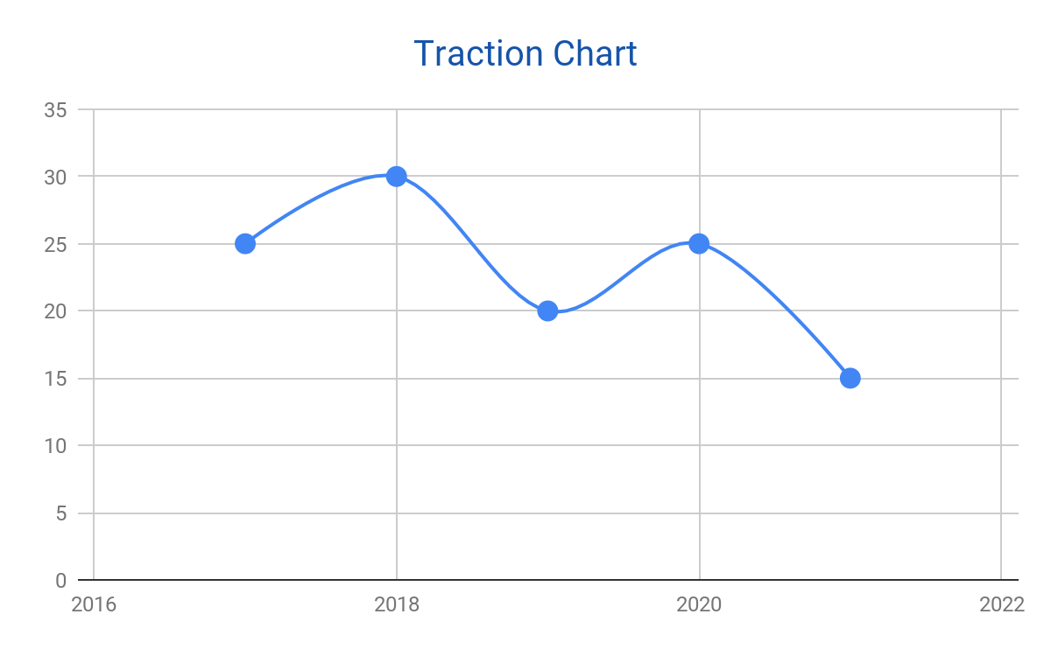
Traction
Based on a census conducted by the government, Los Angeles has a total of 10, 163, 507 residents as of 2017. About 25% of the estimated population conducts business who use social media advertising, thus giving us a high chance of gaining interested clients.

Slide 12

Target Market
The chosen target market will be the residents of Los Angeles, California. This specific group of individuals was chosen based on the following factors :
[FACTOR]
[FACTOR]

Slide 13

Competition
Based on a survey conducted in 2017, Sugarcane Delights concluded that the following companies are direct competitors on the basis that they offer similar products and services :
J&J Logistics offers 2000+ social media advertising packages to choose from.
Static Solutions offers 4000+ social media advertisement strategies to choose from.
Winzar Digitals offers 5000+ pre-made social media content for social media advertising.

Slide 14

Alternative Solutions
Active Tech will provide solutions such as the following :
[SOLUTION]
[SOLUTION]

Slide 15

Business Model
The company will utilize the following business model which will be implemented by January 2019:
[SPECIFY BUSINESS MODEL]
Revenue will be expected by May 2019.

Slide 16

Schedule
The company’s schedule will be as follows :
[SPECIFY COMPANY SCHEDULE]

Slide 17
Investment
In order to officially begin, the company will require a budget estimated between $45,000.00 and $50,000.00 and will be collected from the following sponsors :
1. Geneva Computers Inc.
2. Dasein Corporation
3. Z&T Company
This budget will be utilized as follows :
50%
Starting Capital
10%
Rental Fee
20%
Employee Salaries
15%
Unit Maintenance
5%
Others

Slide 18

Contact Us
Visit our office every Monday to Saturday from 9am to 6pm at [ADDRESS].
Contact [NAME OF COMPANY] through any of these contact details:
[Phone Number]
[Email]
[Website]
[Social Media Account/S]

Slide 19

Thank You

