Slide 1

Startup
Pitch Deck

Slide 2
About Us
Virtuoso is an Italian inspired restaurant based in Manhattan, New York. Operating since 1990, it was founded by Alain Rom who was a culinary graduate from La Cuisine Paris.

Slide 3
Vision
Our vision is to be able to provide fresh, authentic, and affordable Italian food to all of our customers.

Slide 4
Mission
Our mission is to become one of the leading fine dining restaurants around the globe in the year 2026 by acquiring the prestigious Michelin Star award.

Slide 5
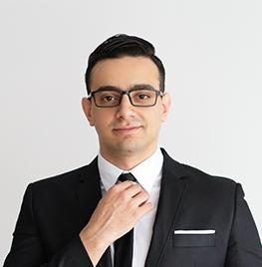
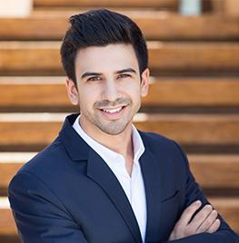
Company Staff
Chef. Jacob West
Chef. Scarlet Ye
Executive Chef
Sous Chef
Manages the kitchen staff, menu creation, plating design and supplies.
Directs the food presentation, manages the work schedule and ensures food quality.

Slide 6
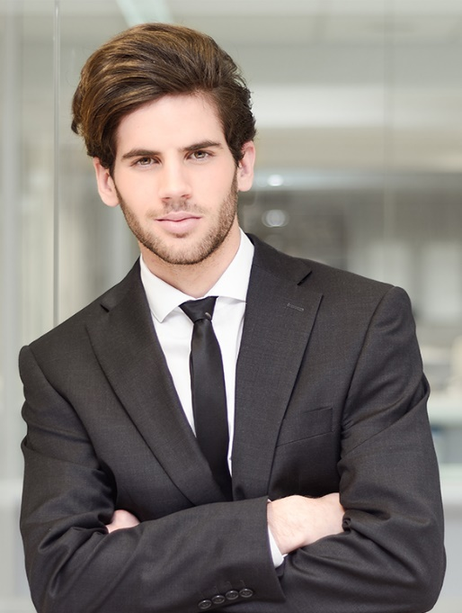
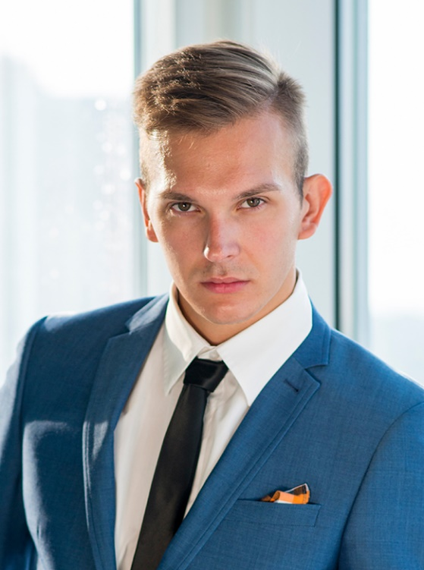
Company Staff
Chef. Mike Tsu
Chef. Patrice Johnson
Station Chef
Dessert Chef
In charge of preparing and serving appetizers, dishes and beverages
In charge of preparing and serving desserts.

Slide 7
The Problem
The 2017 Michelin Guide survey shows that only 2 out of 300 Italian restaurants around Manhattan have Michelin star ratings due to poor services and mediocre Italian dishes.

Slide 8
Our Solution
Virtuoso will plan, produce, and provide all of its customers with Italian dishes, desserts, and beverages. These will be made with only the freshest, high quality ingredients sourced from within the state of Manhattan that will be handled by well trained professional chefs.

Slide 9
Advantages
Virtuoso will provide Italian food enthusiasts with :
An Italian garden inspired restaurant to provide the customers with a friendly, inviting ambiance
Affordable, appetizing Italian appetizers, dishes, desserts, and beverages starting at just $4.99
Free parking and Wi-Fi for all dining customers
Free delivery for orders worth more than $39.99

Slide 10
Magnifico
Virtuoso will prepare a menu entitled Magnifico, a menu that will feature only the most exquisite Italian dishes, desserts, and beverages. From crispy Focaccia Bread, to decadent Tiramisu, cheesy Margherita pizza, and scrumptious pesto pasta. Authentic Italian dishes can now be all yours every other month starting at just $8.99.

Slide 11
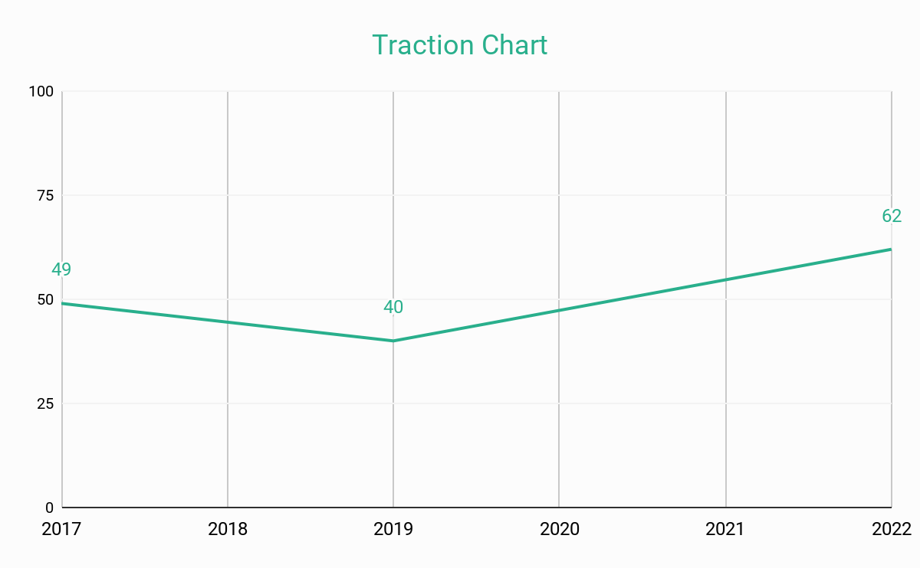
Traction
Based on a census conducted by the national census board of New York, Manhattan has total of 2, 632, 249 population as of 2016.
About 49% of the population are fine dining enthusiasts who are looking for a restaurant that will provide an inviting fine dining experience.
49%
Population

Slide 12
Target Market
The chosen target market will be the residents of Manhattan. This specific group of individuals was chosen based on the following factors :
Male
47.9%
Female
52.1%
65.9%
Percent of the entire population are workers who dine out every week
Roughly 200, 000+ of the overall Manhattan’s population are looking for a new and exciting dining experience.

Slide 13

Competition
Based on a survey conducted in 2017, Virtuoso concluded that the following companies will be considered as direct competitors :
Exquisite Restaurant offers fresh Greek inspired dishes starting at only
Vienna Dishes offers Austrian inspired meals starting at only
Raclette offers a variety of Swiss inspired cheese dishes starting at only
$19.99
$20.99
$18.99

Slide 14
Alternative Solutions
The alternative solutions The Virtuoso Restaurant can provide are the following:
Free dine-in for the first 50 customers.
20% off on great selection of dishes.
Weekly coupons and vouchers for lucky customers.
Free Dine-in For The First 50 Customers
20%
Off On Great Selection Of Dishes

Slide 15
Business Model
The company will utilize the following business model which will be implemented by early 2019:
[SPECIFY BUSINESS MODEL]
Revenue equivalent to roughly $80,000 to $90,000 will be expected by the end of 2019.
Revenue equivalent to roughly $80,000 to $90,000 will be expected by the end of 2019

Slide 16
Schedule
The company’s schedule will be as follows :
[SPECIFY COMPANY SCHEDULE]

Slide 17
Investing
In order to officially begin, the company will require a budget estimated between $60,000.00 and $70,000.00. This amount will be collected from the following sponsors :
1. Glassware Inc.
2. Manhattan National Finance Foundation
3. JYA Financial Corp.
Each sponsor has agreed to contribute and invest at least $20,000.00 for Virtuoso.
Each sponsor has agreed to contribute and invest at least $20,000.00 for Virtuoso

Slide 18
Contact Us
Visit our restaurant every Monday to Friday from 12pm to 12am and Saturday from 11am to 11pm at [ADDRESS].
For more bookings and reservations contact any of these contact details :
[Phone Number]
[Email]
[Website]

Slide 19
Thank You

