Slide 1
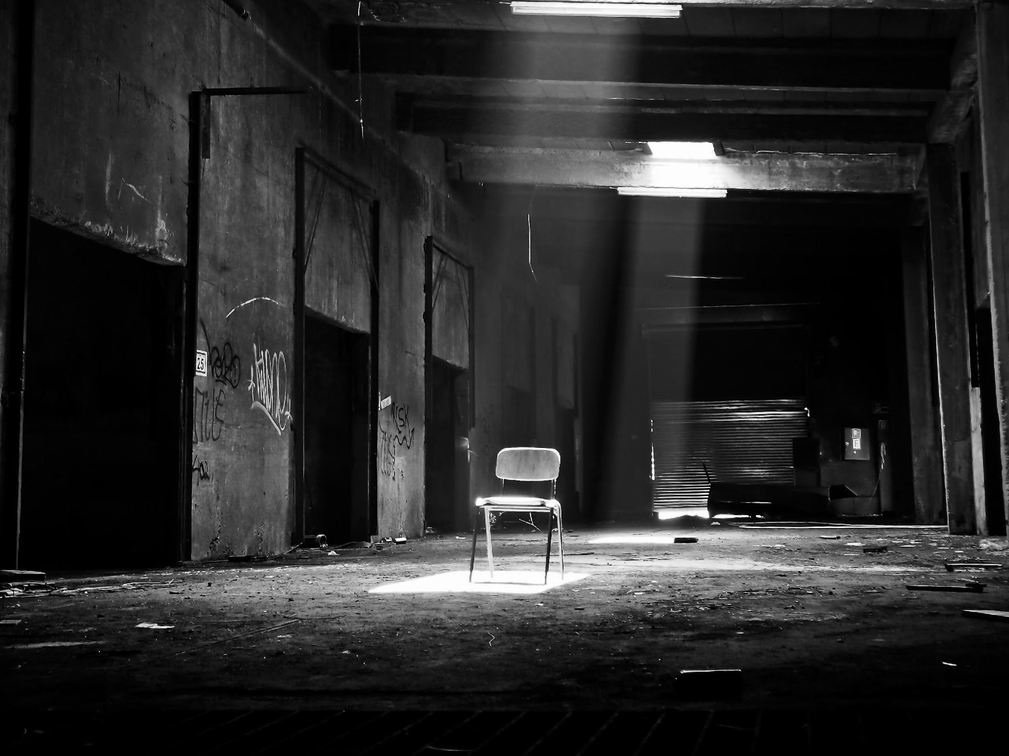
THE SCARY
ARCHIVES
Business Plan For The Year 2036
^{Phoebe Keaton}
^{phoebekeaton@scaryarchives.com}
⁶⁵¹⁻²⁵⁵⁻⁶⁰⁸⁵
^{www.thescaryarchives.com}
2734 Haul Rd., New York, NY 10020, USA

Slide 2

The Show
Offers & Services
Execution
Operational Plan
Startup Summary
Testimonials

Slide 3

The Show
Offers & Services
Execution
Operational Plan
Start-up Summary
Testimonials
Executive Summary
The Scary Archives is a television show produced in New York, New York. It has been in production
since 2009 & was created by Phoebe Keaton who is a writer & director.

Slide 4

The Show
Offers & Services
Execution
Operational Plan
Start-up Summary
Testimonials
Executive Summary
The Scary Archives aims to tell stories to provide not only entertainment but also insight & ways to start a conversation among its viewers.

Slide 5
The Show
Offers & Services
Execution
Operational Plan
Start-up Summary
Testimonials
MISSION
VISION
PHILOSOPHY
Our mission is to provide the best, high-quality performance storytelling through the content we put out there.
Our vision is to become one of the most influential television series by setting new standards of storytelling on TV.
We believe in starting change & awareness through stories & entertainment.

Slide 6

The Show
Offers & Services
Execution
Operational Plan
Start-up Summary
Testimonials
Outlook
TV has been one of the most common form of media & almost everybody in the world have access to televised content:
It’s a universal source of entertainment.
It’s one of the earliest & still socially relevant ways to view entertainment.
Televised shows allow the audience to be kept entertained for a long period of time.

Slide 7
The Show
Offers & Services
Execution
Operational Plan
Start-up Summary
Testimonials
Organizational Structure
Operational Plan
Business Structure
Ownership
^{Entertainment}
^{Management}
^{President, Michael J. Gregory}

Slide 8

The Show
Offers & Services
Execution
Operational Plan
Start-up Summary
Testimonials
Creator
The one who came up with the concept of the television show. Has the final say on the direction of the show’s production.
Writer
Generally assists the creator on coming up with stories for the television show.
Producer
Came up with who can provide the needed role for a production crew.

Slide 9
The Show
Offers & Services
Execution
Operational Plan
Start-up Summary
Testimonials
Management Team
Role / Function
Skills
Leadership Skills, Organization Management Skill, Communication
Work Ethic
Rafe A. Gregson
General Manager
25 Years of Experience in the Entertainment Industry, Connections in the Network
Josh P. Gregory
Production Manager

Slide 10
The Show
Offers & Services
Execution
Operational Plan
Start-up Summary
Testimonials
Upcoming Spinoffs
The Scary Archives have gained enough viewers that are clamoring for more stories regarding popular episodes. TV shows currently in development are:
^{The Fear Beast}
^{Slice Him}
^{Isolation Chamber}
^{The Crying Boy}

Slide 11
The Show
Offers & Services
Execution
Operational Plan
Start-up Summary
Testimonials
Value Proposition
The property & rights to the characters, content & stories of The Scary Archives are worth millions of dollars.
Pricing Strategy
The Scary Archives generates money through its merchandise & advertisements from sponsors.
^{Formula:}
Profit Margin = 1-(Expenses/Net Sales)
^{The Scary Archives}
Profit Margin = 1 - ($114,000/$350,000)
^{=1 - 0.33}
^{=-0.67 or 67%}

Slide 12

The Show
Offers & Services
Execution
Operational Plan
Start-up Summary
Testimonials
Marketing Plan
Our marketing strategy emphasizes the combination of traditional & millennial styles of promoting the show.
Televised Commercials
Social Media Advertisements
Printed Media (Flyers, Billboards, Signs, Etc.)

Slide 13

The Show
Offers & Services
Execution
Operational Plan
Start-up Summary
Testimonials
Market Research
With the evolution of how information is disseminated, changing to new ways of promoting events became a substantial challenge for companies.
With the emergence of social media & internet, online advertisement has become prevalent.

Slide 14
The Show
Offers & Services
Execution
Operational Plan
Start-up Summary
Testimonials
Market Research
JANUARY 2037
FEBRUARY 2037
^{Season 2 Finale Air Date}
^{Start of Season 3 Production}
JUNE 2037
DECEMBER 2024
^{Advertisements & Press}
^{Season 3 Premiere}

Slide 15
The Show
Offers & Services
Execution
Operational Plan
Start-up Summary
Testimonials
Market Strategy
Focuses on target audience through social media & TV Promos.
Advertisement contain mysterious hints at what content is in store for them.
Effectively engaging with consumers through social media.

Slide 16
The Show
Offers & Services
Execution
Operational Plan
Start-up Summary
Testimonials
Marketing Strategy
Activities
Timeline
Success Criteria
The marketing & production team will create promotional videos.
July 2037
The new content is up on the company website alongside various social media accounts.
Promotion Videos
The marketing team will create a posting schedule.
August 2037
Steady growth of traffic & followers for the company website & social media accounts.
Regular Content
Updates

Slide 17

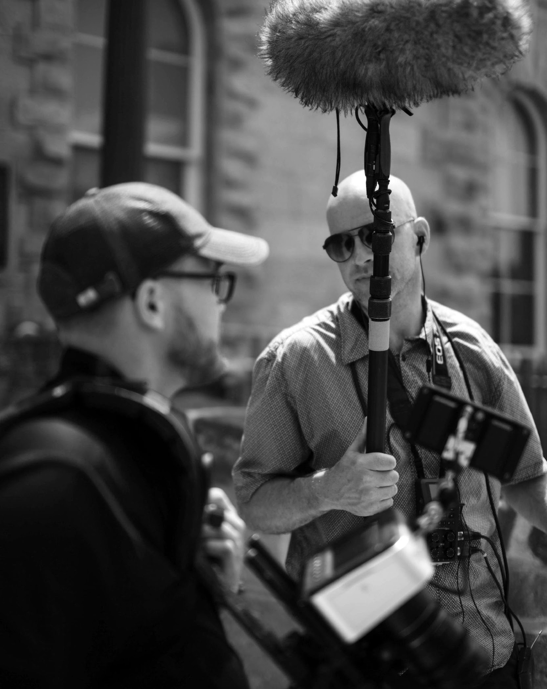
The Show
Offers & Services
Execution
Operational Plan
Start-up Summary
Testimonials
Location Facilities
Provide a sketch/ blueprint of the production sets.
Provide photos/
images of the production sets.

Slide 18
The Show
Offers & Services
Execution
Operational Plan
Start-up Summary
Testimonials
Activities
Timeline
Video Editing Software
2
Activities
Timeline
Desktop
2
Laptops
4
Cameras
3

Slide 19
The Show
Offers & Services
Execution
Operational Plan
Start-up Summary
Testimonials
Short Term Goals
Milestones
Garner more viewership
Reached 50% of audience target
Obtain a no. of episodes to pace the season’s story
Gained another episode in the form of a special summer episode.
Activities
Timeline
Getting Renewed for 1 more season to wrap the story
Contract signing on February 2038
Get recognition for directing & writing
Nominations for several production & cast for awards

Slide 20
The Show
Offers & Services
Execution
Operational Plan
Start-up Summary
Testimonials
Infrastructure
Existing (Y/N)
Description
Social Media
Y
The company has Twitter & Instagram accounts
TV Network
Y
The series is aired in several TV networks
Website
N
Website is still in development
Network Speed
Y
Network is working properly & causes no delay in
company operations
Data Storage
N
Company data storage, as of now, is still limited

Slide 21
The Show
Offers & Services
Execution
Operational Plan
Start-up Summary
Testimonials
Total Refunding Required
The start-up cost of 100K USD will be provided by the executive producer, which will be used for salary, equipment & other operations expenses.
Start-Up Funding
Start-Up Expenses
$50,000
Start-Up Assets
$50,000
Total Funding Required
$100,000

Slide 22
The Show
Offers & Services
Execution
Operational Plan
Start-up Summary
Testimonials
Start-Up Funding
Assets
Non-Cash Assets from Start-Up
$20,000
Cash Requirements from Start-up
$20,000
Additional Cash Raised
$5,000
Cash Balance on Starting Date
$5,000
Total Assets
$50,000

Slide 23
The Show
Offers & Services
Execution
Operational Plan
Start-up Summary
Testimonials
Total Refunding Required
Capital
Owner
$50,000
Other
$0
Additional Investment Requirement
$0
Total Planned Investment
$100,000
Loss at Start-Up (Start-Up Expenses)
-$50,000
Total Capital
$50,000
Liabilities
$0
Total Capital & Liabilities
$50,000

Slide 24


The Show
Offers & Services
Execution
Operational Plan
Start-up Summary
Testimonials
Laura O’Brien, 27, Viewer
Marisha Baker, 31, Viewer
“TSA is such a great horror series! Everything about it is so entertaining!”
“The number one series. It’s my obsession. I hope this show keeps on going!”

