Slide 1
Tech Startup
Pitch Deck

Slide 2
About Us
Interface Inc. is a technology company based in lower Manhattan, New York City, US. Established since 2001, it was founded by Mario Marks who was a graduate of computer & software engineering from Harvard University.

Slide 3
Vision
Interface Inc.’s vision is to:
Become one of the leading information technology companies in the year 2030, and
Establish at least 5 branches by the year 2030.

Slide 4
Mission
Our mission is to develop and provide fast, reliable, quality computers at affordable prices.

Slide 5
Key People
Jim Stevenson
Andy Blanch
Chairman
Chief Executive Officer
Provides overall leadership to the board of directors of the company by maintaining the company’s growth and sustainability and monitoring its members’ duties.
Invents plans, strategies and activities that the company plans to execute.

Slide 6
Key People
Lisa Goldman
Blake Porter
Chief Financial Officer
Chief Operating Officer
Manages the overall finances of the company through record keeping, income, revenue, investment monitoring, etc.
Manages the day-to-day basis of the company’s performance including administrative functions, process improvement, etc.

Slide 7
The Problem
According to the general consensus from Forbes Magazine in 2016, 8 out of 10 technology based companies sell and provide computers at prices ranging between $800 and $2000. This gives most of the people in the middle class and various starting companies with limited affordable options in terms of computers and computer parts.

Slide 8
Our Solution
Interface Inc. offers top notch computers at affordable prices Our staff will be made up of professional and passionate staff members who will search, develop, and provide computers that are durable and reliable.

Slide 9
Advantages
Interface Inc. will provide quality technology and computer assistance at price points lower than even the most affordable computer companies within the lower Manhattan district.

Slide 10
“Steel Vi OS”
Our new project called “STEEL VI” is the computer that you’ve been waiting for. STEEL VI features CPU Processor i9 and a hologram touch screen which is the world’s first and feature to ever be installed in a computer in the market. The STEEL VI project is dedicated to those in need of affordable but highly reliable computer starting at just $399.99intel core i15
Highly reliable computer starting at just $399.99 Intel core i15

Slide 11
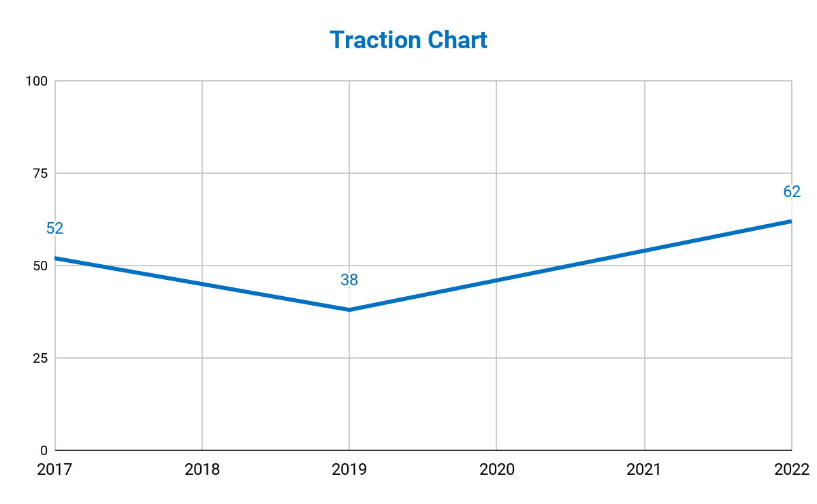
Traction
Based on a census conducted by the bureau, Manhattan has a total of 1, 664, 727 population as of 2017. About 300+ starting companies and 749,127 of the entire population wishes to own reliable and fast yet affordable computers.
52%
Population

Slide 12
Target Market
The chosen target market will be the residents of Manhattan and New York. This specific group of individuals was chosen based on the following factors :
At least 45% of Manhattan’s population wishes own an affordable computer device
About 100+ entrepreneurs are looking for affordable yet reliable computers to be used in business
Roughly 300+ starting companies in the business industry are looking for an affordable computers aimed to be used in operations

Slide 13
Competition
Based on a survey conducted in 2016, Interface Inc. concluded that the following companies will be considered as direct competitors :
Apple Inc. offers a wide range of computers and devices starting at $2000
Top Computers Inc. offers a wide range of computers and devices starting at $1000
Zy Inc. offers wide range of Chinese brand computers and devices starting at $800

Slide 14
Alternative Solutions
The alternative solutions Interface Inc. can provide are the following:
Free cleaning and technical service for the first 2 years.
10%
Discount for the first 100 customers.
Lifetime product warranty.

Slide 15
Business Model
The company will utilize the following business model which will be implemented by early 2019:
[SPECIFY BUSINESS MODEL]
Revenue equivalent to roughly $300,000 to $500,000 will be expected by the end of 2019.
$300,000 - $500,000
2019

Slide 16
Schedule
The company’s schedule will be as follows :
[SPECIFY COMPANY SCHEDULE]

Slide 17
Investing
In order to officially begin, the company will require a budget estimated between $200,000.00 and $250,000.00. This amount will be collected from the following sponsors :
1. Unli Accessories Ltd.
2. NYC Financial Lending Corp.
3. German Investment Inc.
Each sponsor has agreed for Interface Inc to contribute and invest at least
$90,000.00

Slide 18
Contact Us
Visit our headquarters every Monday to Saturday from 9am to 6pm at [ADDRESS].
For more information contact any of these contact details :
[Phone Number]
[Email]
[Website]

Slide 19
Thank You

