Slide 1
DIGITAL
INTERFACE
Edward Ferguson
(+1) 910 561 8001
592 Finley St., Pittsburgh, PA 102, USA
edward.ferguson@digitalinterface.com
www.digitalinterface.com

Slide 2
The Company
Products & Services
Execution
Operational Plan
Start-Up Summary
Testimonials

Slide 3
The
Company
Products
& Services
Execution
Operational
Plan
Start-Up
Summary
Testimonials
Executive Summary
Digital Interface, Inc. offers substantial digital data handling & marketing for company websites & social media accounts. We value a strong identity in the market to help every company establish its brand online.

Slide 4
The
Company
Products
& Services
Execution
Operational
Plan
Start-Up
Summary
Testimonials
Executive Summary
Digital Interface, Inc. promotes innovative, efficient online solutions to boost the company’s traffic & brand on both social media & internet platforms.

Slide 5
The
Company
Products
& Services
Execution
Operational
Plan
Start-Up
Summary
Testimonials
Executive Summary
Mission
Vision
Philosophy
Digital interface, Inc. aims to provide efficient SEO solutions for any kind of business that aims to thrive online.
Digital Interface, Inc. aspires to provide a consistent service for the growth of your business.
Digital Interface, Inc. incorporates modernity & efficiency from for every client who aims to achieve success in the industry.

Slide 6
The
Company
Products
& Services
Execution
Operational
Plan
Start-Up
Summary
Testimonials
Outlook
Due to the widespread net usage, the SEO industry is becoming one of the top growing businesses in the market. With the rise of net usage, every company is riding the trend to promote its brand & garner more people online.

Slide 7
The
Company
Products
& Services
Execution
Operational
Plan
Start-Up
Summary
Testimonials
Organizational Structure
Type of Industry
SEO Industry
BusinessStructure
Sole Proprietorship
Ownership
Sole Proprietorship,
Matthew Travis

Slide 8
The
Company
Products
& Services
Execution
Operational
Plan
Start-Up
Summary
Testimonials
Organizational Structure
Owner & Chairman
Head of the company.
Manages the overall department of the company.
Chief Operations Officer
Oversees the daily operation of the company leading to stability & success.
Technical Director
Oversees the web design team & content creators with their services & strategies for clients’ websites, social media & online accounts.

Slide 9
The
Company
Products
& Services
Execution
Operational
Plan
Start-Up
Summary
Testimonials
Management Team
Management Team | Role / Function | Skills
Peter West | Chief Operations Officer | 15 Years of Business Operations Experience, Work Ethic, Critical Analysis, Leadership, Organize, Professionally Competent
Andrew Wood | Technical Director | Creativity, Leadership, Organized, Performance Management

Slide 10
The
Company
Products
& Services
Execution
Operational
Plan
Start-Up
Summary
Testimonials
Company Milestones
Minor Goals | Milestones
Achieve a 30% increase of traffic online | Achieved 10% increase as of June 2024
Achieve a 20% increase in clients | Achieved 15% increase as of July 2024
Major Goals | Milestones
Hire 20 competent designer team members | Hired 10 well-experienced & with online design degree members as of June 2024
Hire 50 competent traffic specialist team members | Hired 20 traffic specialist members as of May 2024

Slide 11
The
Company
Products
& Services
Execution
Operational
Plan
Start-Up
Summary
Testimonials
Description
Digital Interface, Inc. provides SEO services to companies that aim to reach a great amount of traffic for their website. The company provides practical designs & online strategies for every business to achieve their personal goals & objectives.

Slide 12
The
Company
Products
& Services
Execution
Operational
Plan
Start-Up
Summary
Testimonials
Value Proposition
The company provides practical designs & online strategies for every business to achieve their personal goals & objectives.
Pricing Strategy
Digital Interface, Inc. uses a combination of cost-plus & price bundling when offering its services.
Formula:
Profit Margin = 1-(Expenses/Net Sales)
Digital Interface, Inc.
Profit Margin = 1 - ($114,000/$350,000)
=1 - 0.33
=-0.67 or 67%

Slide 13
The
Company
Products
& Services
Execution
Operational
Plan
Start-Up
Summary
Testimonials
Marketing Plan
Digital Interface, Inc. is dedicated to promoting its brand to small starting local businesses who have been operating for 3 years or less. It aims to reach its target market online through promotional videos & content that will keep every account updated. Digital Interface Inc. will also utilize the traditional method of cold email usage.

Slide 14
The
Company
Products
& Services
Execution
Operational
Plan
Start-Up
Summary
Testimonials
Market Research
As the internet use becomes rampant, more businesses see this as an opportunity to reach a bigger audience to stay relevant & promote their brand online in the market. This gives every company the challenge to stay on trend.

Slide 15
The
Company
Products
& Services
Execution
Operational
Plan
Start-Up
Summary
Testimonials
Market Research
SWOT Analysis | Strengths | Weaknesses | Opportunities | Threats
Digital Interface, Inc. | - Proven quality service - Specializes in brand building | - Still expanding; might not be able to give its full attention to some clients | - Many small & local businesses look for services that can help them build their brand | - Other companies with larger businesses as clients
Net Surface, Inc. | - Large SEO company - Quality general SEO services | - Expensive pricing | - Most international companies look for SEO companies that can handle the scale of their brand | - Growing number of small businesses that prefer low price or price bundling for SEO services
Market Net Solutions | - Specializes in niche SEO services | - Limited SEO services | - There are many niche businesses who prefer SEO that fit their specific brand needs | - Other companies who offer more SEO services

Slide 16
The
Company
Products
& Services
Execution
Operational
Plan
Start-Up
Summary
Testimonials
Marketing Strategy
Digital Interface, Inc. plans to regularly update its website & social media accounts with new content to continuously engage with its audience & reach out to more people who can be potential clients.
The company has also done its research to identify clients that will fit its target. The marketing teams have started building a client list & have sent cold emails to some companies on the list.

Slide 17
The
Company
Products
& Services
Execution
Operational
Plan
Start-Up
Summary
Testimonials
Market Strategy
Marketing Strategy | Activities | Timeline | Success Criteria
Promotion Videos | The marketing team will create testimonials & promotional videos. | May 2025 | The new content is up on the company website & various social media accounts.
Regular Content Updates | The marketing team will create a posting schedule. | May 2025 | Steady growth of traffic & followers for the company website & social media accounts.
Cold Emails | Write templates for the emails to be sent out to potential clients. | June 2025 | The cold emails are ready to be sent.

Slide 18
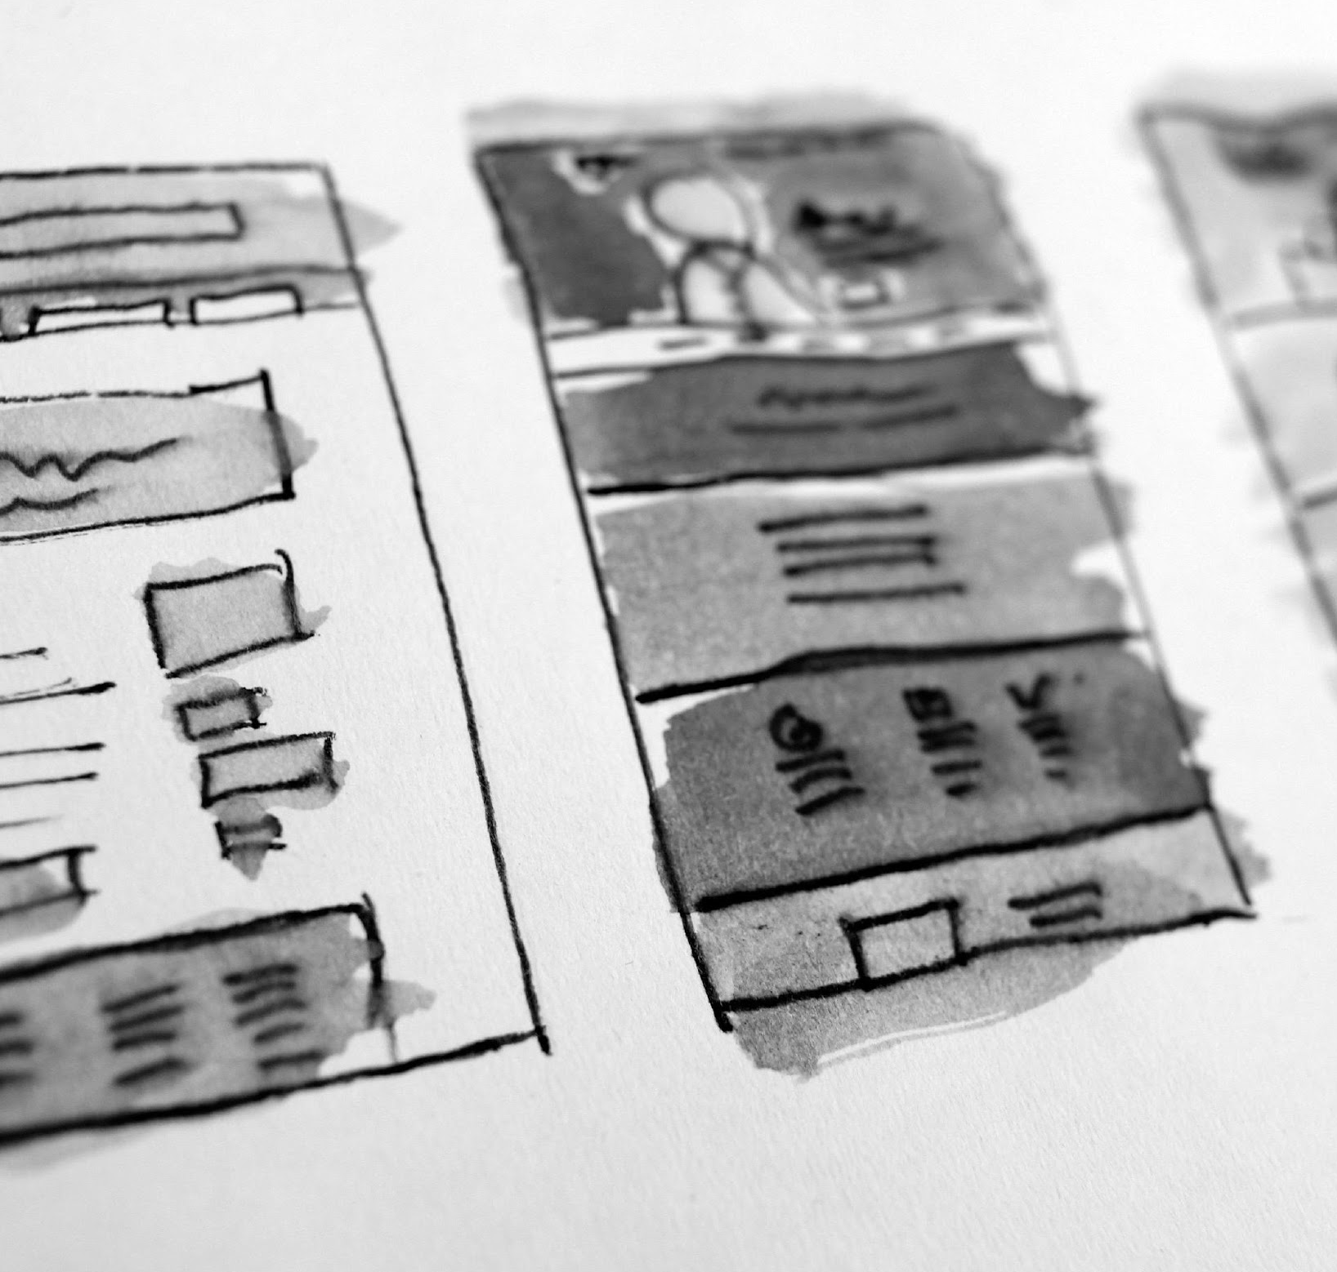
The
Company
Products
& Services
Execution
Operational
Plan
Start-Up
Summary
Testimonials
Local Facilities
Provide a sketch/ blueprint of the facility.
Provide photos/images of the facility.

Slide 19
The
Company
Products
& Services
Execution
Operational
Plan
Start-Up
Summary
Testimonials
Software | Quantity
Micro Net Software | 1
Soft Interface | 15
Hardware | Quantity
Desktop | 50
Laptops | 15

Slide 20
The
Company
Products
& Services
Execution
Operational
Plan
Start-Up
Summary
Testimonials
I.T. Infrastructure
Infrastructure | Existing (Y/N) | Description
Social Media | Y | The company has Twitter & Instagram accounts.
Website | N | Website is still in development.
Network Speed | Y | Network is working properly & causes no delay in company operations.
Data Storage | N | Company data storage as of now is still limited.

Slide 21
The
Company
Products
& Services
Execution
Operational
Plan
Start-Up
Summary
Testimonials
Total Funding Required
The start-up cost of 70K USD will be provided by the owner, which will be used for salary, equipment & other operational expenses.
Start-Up Funding
Start-Up Expenses | $40,000
Start-Up Assets | $30,000
Total Funding Required | $30,000

Slide 22
The
Company
Products
& Services
Execution
Operational
Plan
Start-Up
Summary
Testimonials
Total Assets
Assets
Non-Cash Assets from Start-Up | $5,000
Cash Requirements from Start-up | $5,000
Additional Cash Raised | $5,000
Cash Balance on Starting Date | $2,000
Total Assets | $30,000

Slide 23
The
Company
Products
& Services
Execution
Operational
Plan
Start-Up
Summary
Testimonials
Total Capital & Liabilities
Capital
Planned Investment
Owner | $70,000
Other | $ 0
Additional Investment Requirement | $ 0
Total Planned Investment | $70,000
Loss at Start-Up (Start-Up Expenses) | -$30,000
Total Capital | $40,000
Liabilities | $0
Total Capital & Liabilities | $40,000

Slide 24
The
Company
Products
& Services
Execution
Operational
Plan
Start-Up
Summary
Testimonials
Total Capital & Liabilities
Start-Up
Requirements Start-Up Expenses Rent - 5 Months | $10,000
Advertising | $5,000
Legal Fees | $5,000
Staff Training | $8,000
Insurance | $12,000
Other | $0
Total Start-Up Expenses | $40,000
Start-Up Assets Cash Required | $10,000
Start-Up Inventory | $10,000
Other Current Assets | $6,000
Long-Term Assets | $4,000
Total Assets | $30,000
Total Requirements (Total Start-Up Expenses + Total Assets) | $70,000

Slide 25
The
Company
Products
& Services
Execution
Operational
Plan
Start-Up
Summary
Testimonials
Customer Testimonials
Nathan Holiday
Jeanie Taft
Owner of Sports Cool Garments
Owner of Maryline Makeup
“As a sports garment store, Digital Interface, Inc. delivers the best type of service I need for my store expansion! They helped me reach up to 60% increase in online sales due to their efficient, effective service.”
“Our company is aiming to reach a bigger audience online but don’t know how to do it. Good thing is, Digital Interface, Inc. helped us out by providing the practical specifications we needed in expanding our products! “

Slide 26
THANK YOU!
(+1) 910 561 8001
592 Finley St., Pittsburgh, PA 102, USA
edward.ferguson@digitalinterface.com
www.digitalinterface.com

