Slide 1


SHUMWAY CORPORATION
303-231-6450 | youremail@info.com
^{yourwebsite.com}

Slide 2
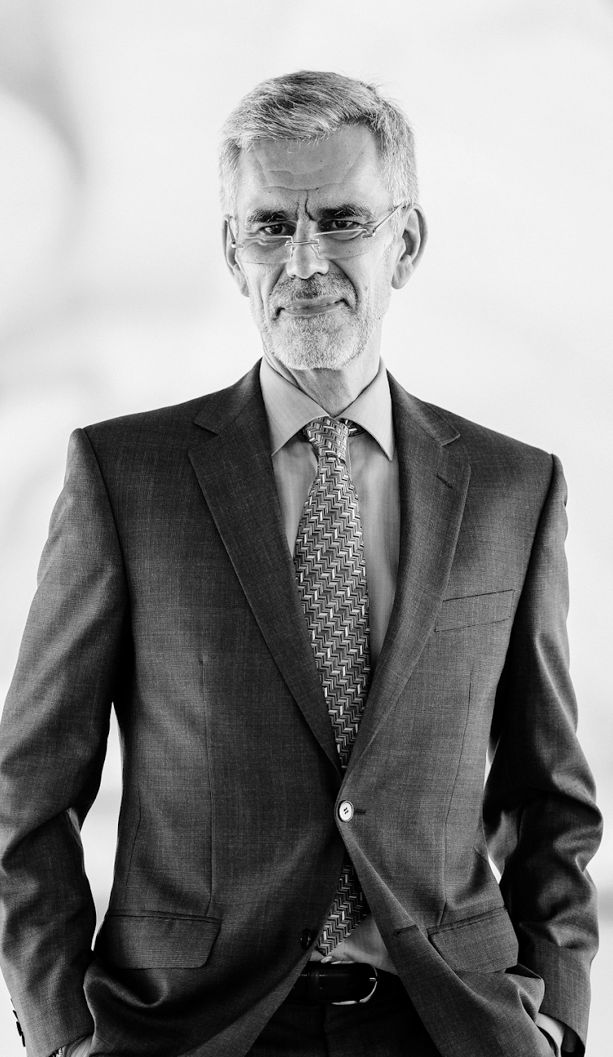
MESSAGE FROM THE FOUNDER
“Shumway Corp. aims to be able to provide all businesses, no matter how big or small, with highly specialized & reliable solutions that will make the greatest positive impact with the most cost-efficient methods. This is what we always aim for.”
^{-Mr. William E. Shumway}

Slide 3
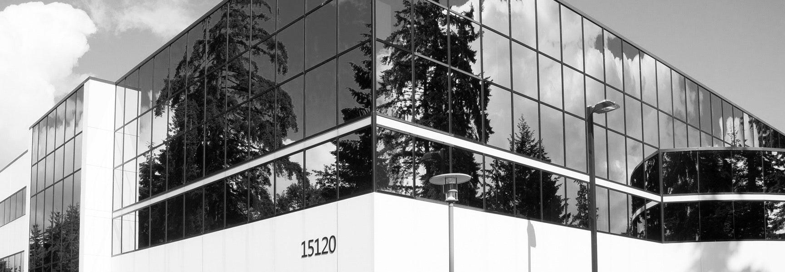
ABOUT THE CORP.
Shumway Corp. was founded in 2025 by Mr. William E. Shumway, a business graduate of the University of Colorado who wanted to be able to create efficient, effective & affordable solutions that all businesses can avail to help improve their products, services & strategies for better sales.
It currently has 4 branches across America providing assistance to over 200 companies from different industries such as SEO marketing, event planning, medical & I.T. to name a few.

Slide 4


OUR CLIENTS
Shumway Corp. is proud to have successfully helped the following companies over the years, just to name a few.
^{Rizer Co.}
^{Halloway Hospital}
^{Jinxed I.T.}
^{Elle & Dave}
^{Roger’s Raves}
^{Gibster Event Planners}
^{Kringle App Developers}

Slide 5



TESTIMONIALS
“My business has managed to improve its sales by as much as 20% thanks to marketing solutions recommended & implemented by Shumway Corp.”
Jonathan Rizer, CEO of Rizer Co.
“One of the greatest investments I have ever made for my numerous businesses!”
Kelley Brooks, VP of Kringle App Developers.
“We have managed to provide more patients with quality medical consultations & care thanks to what we have learned from our consultation with Shumway Corp.”
Emily Halloway, Founder of Halloway Hospital.

Slide 6

MISSION
To be able to provide all businesses, no matter how big or small, with highly specialized & reliable solutions that will make the greatest positive impact with the most cost-efficient methods.

Slide 7

VISION
To eliminate the bias that more expenses equate to more effective business solutions. We hope to be able to advocate affordable business solutions that all businesses can avail of when needed or desired.

Slide 8

MISSION
Successfully serve a total of 50 clients before the end of this year.
Provide no less than 5 different packages at minimum rates.
Open the first international branch in Asia within a
^{2 year period.}

Slide 9

MOST RECENT ACHIEVEMENTS
Helped Gibster Event Planners increase their number of monthly clients by 30% through online marketing strategies.
Assisted Elle & Dave with boosting their marketing campaign for their upcoming sales.
Implemented a better SEO marketing strategy for 3 different companies.

Slide 10

MAIN GOAL THIS YEAR
Increase the profits of all our clients by no less than an average of 3%.

Slide 11



MEET THE TEAM
^{Jake Clandon}
^{General Manager}
^{George Wood}
^{CEO}
^{Jake Clandon}
^{General Manager}
^{Emily Han}
^{HR Head}

Slide 12

THANK YOU
³⁰³⁻²³¹⁻⁶⁴⁵⁰
youremail@info.com | yourwebsite.com

