Slide 1

e-Commerce
Pitch Deck
A2Z.com

Slide 2

About Us
A2Z.com is an electronic commerce company based in Charlotte, North Carolina, . Active since 2005, it was founded by Ryan Hutcheson who is an internet entrepreneur.

Slide 3

Vision
Our mission is to provide the reliable and convenient ecommerce services to all of our clients.

Slide 4
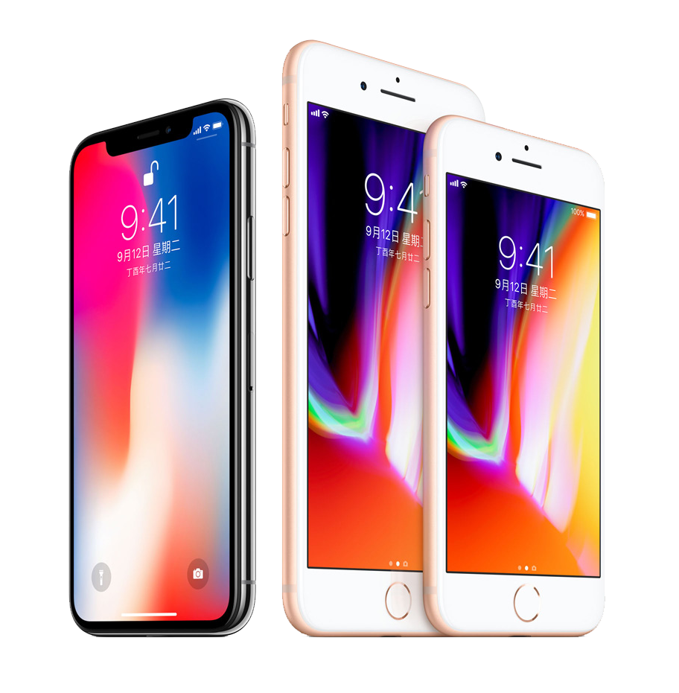

Mission
Our vision is to become a leading electronic commerce company through the installment of 5 different branches by the year 2025.

Slide 5



Company Staff
Aldrich Summers
Chief Executive Officer
Heads and manages all major decisions and operations over all major departments within the company.
Allen Stevenson
Chief Technology officer
Heads and manages all major decisions and operations over all technology departments within the company.

Slide 6

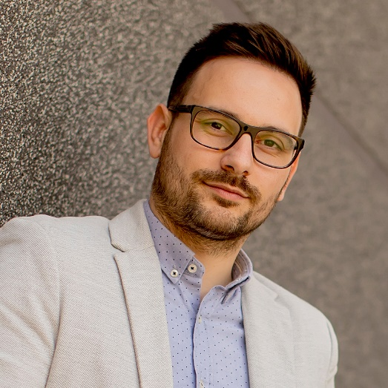

Company Staff
Autumn Hill
Customer Service Representative
Interacts with the customers by providing information about products as well as assisting them with any problems regarding their transactions.
Nicky Jefferson
Customer Service Representative
Interacts with the customers by providing information about products as well as assisting them with any problems regarding their transactions.

Slide 7

The Problem
The recently conducted Reader’s Digest survey showed that 6 out of 10 people in the overall population have insufficient time to purchase products from malls due to busy working schedules, transportation expenses, and expensive prices among others.

Slide 8
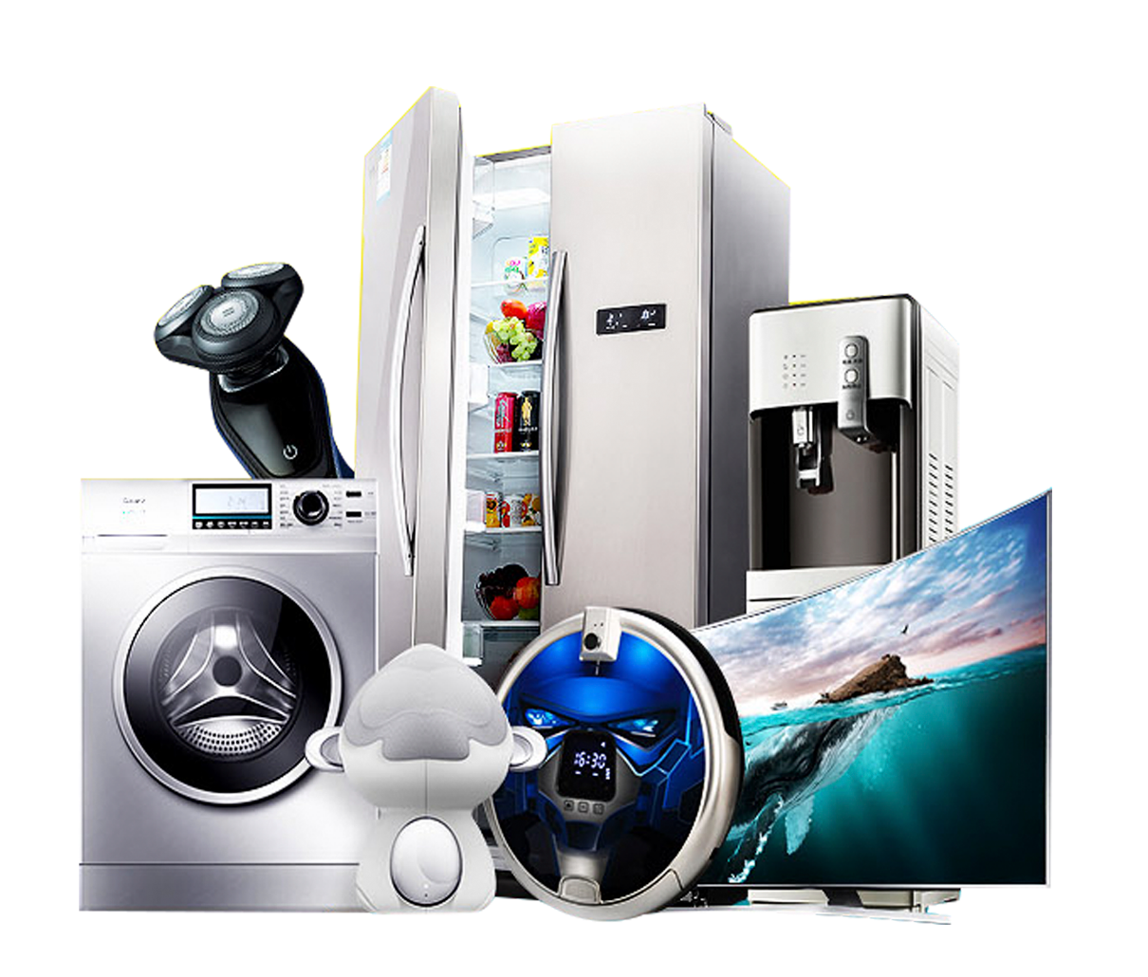
Our Solution
A2Z.com offers a convenient online purchasing experience for all online shoppers. It provides nothing but quality products that are made available at affordable prices.

Slide 9
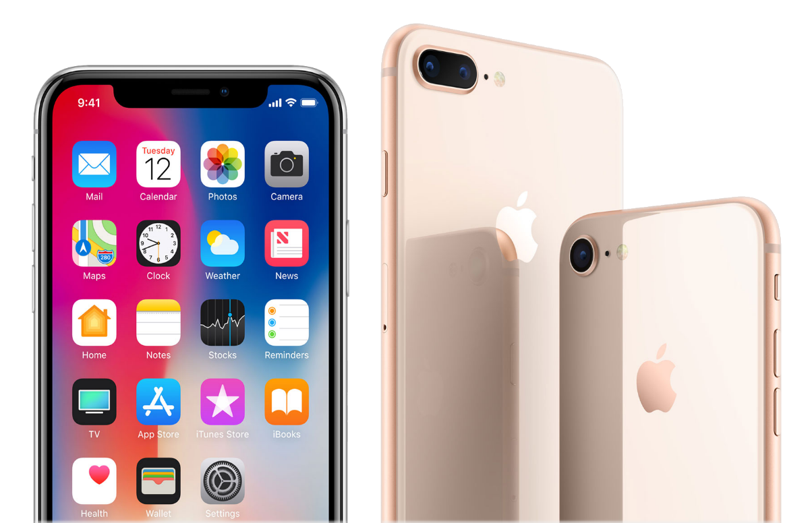
Advantages
A2Z.com prioritizes its shoppers’ valued time. Thus, we created a website with a user friendly interface that even first time browsers can easily navigate through with ease. Apart from a 24/7 customer service hotline, there is also a live chat box where you can ask regarding the products your are interested in purchasing.

Slide 10

One Click Shop
“ONE CLICK SHOP” provides clients access to over 100,000 high quality products that can be purchased with just a single click starting at just $10.00. Most transactions will only take on average 3 minutes to complete and accepts transactions with all major debit and credit card companies.

Slide 11
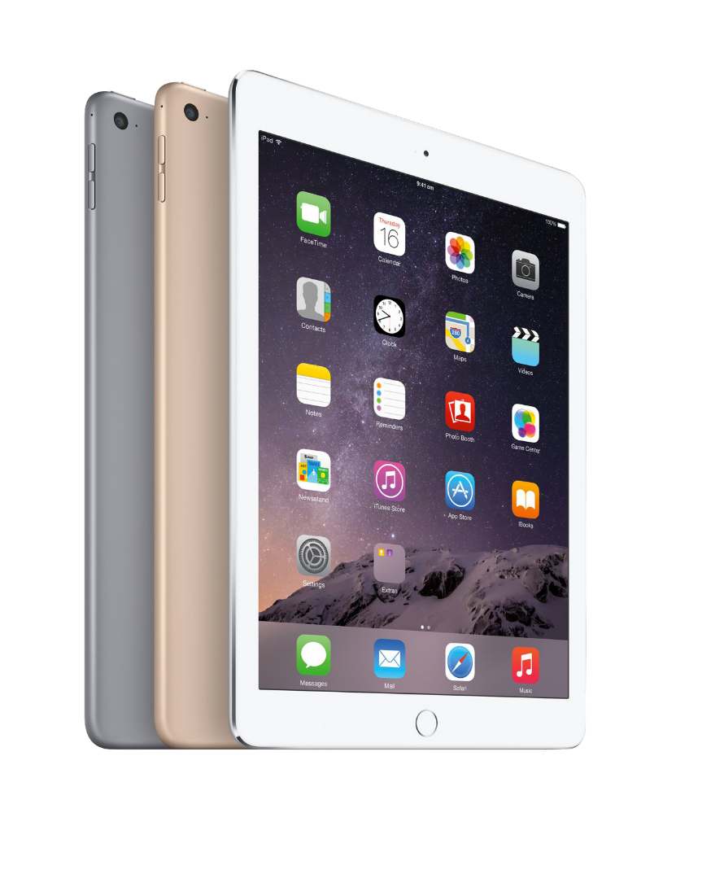
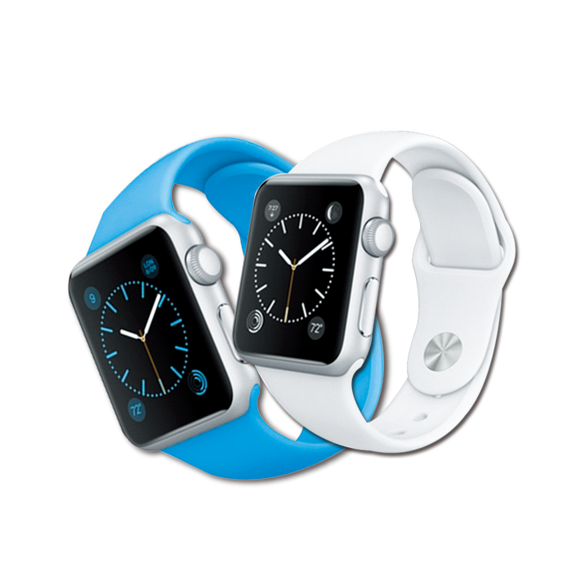
Traction
Based on a census, Charlotte has total of 2, 632, 249 population as of 2016. About 60% of the population use online store to buy products.

Slide 12
Target Market
The chosen target market will be the residents of Charlotte, North Carolina. This specific group of individuals was chosen based on the following factors :
Up to 47.9% are male and 52.1% are female residents of Charlotte, North Carolina.
65.9% percent of the entire population are workers and utilize online store to purchase products to save time on traveling and gas.
Roughly 1, 500, 000+ of the overall Charlotte’s population are looking for a hassle-free online store that will accept most major debit and credit card transactions.

Slide 13
Competition
Based on a survey conducted in 2016, A2Z.com concluded that the following companies will be considered as direct competitors :
Amazon.com Inc., offers a variety of online products with free shipping for purchases more than $30.
Ebay.com offers a wide range of online products with free shipping for purchases more than $40.
Bestbuy.com offers a wide range of online products with free shipping for purchases more than $50.

Slide 14

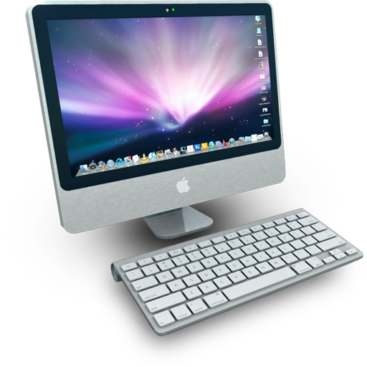
Alternative Solutions
The alternative solutions A2Z.com can provide are the following:
Free shipping for items $20 and above.
Monthly discounts of up to $70 on selected online items.
3% rebate for all debit & credit card holders.

Slide 15

Business Model
The company will utilize the following business model which will be implemented by early 2019:
[SPECIFY BUSINESS MODEL]
Revenue equivalent to roughly $100,000 to $150,000 will be expected by the end of 2019.

Slide 16
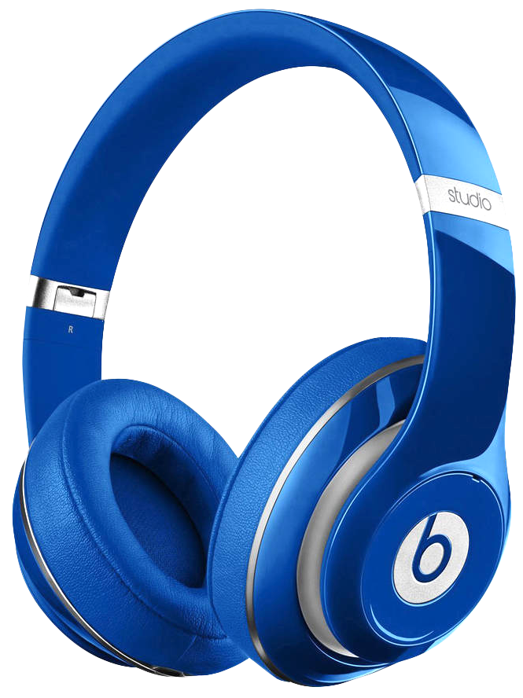
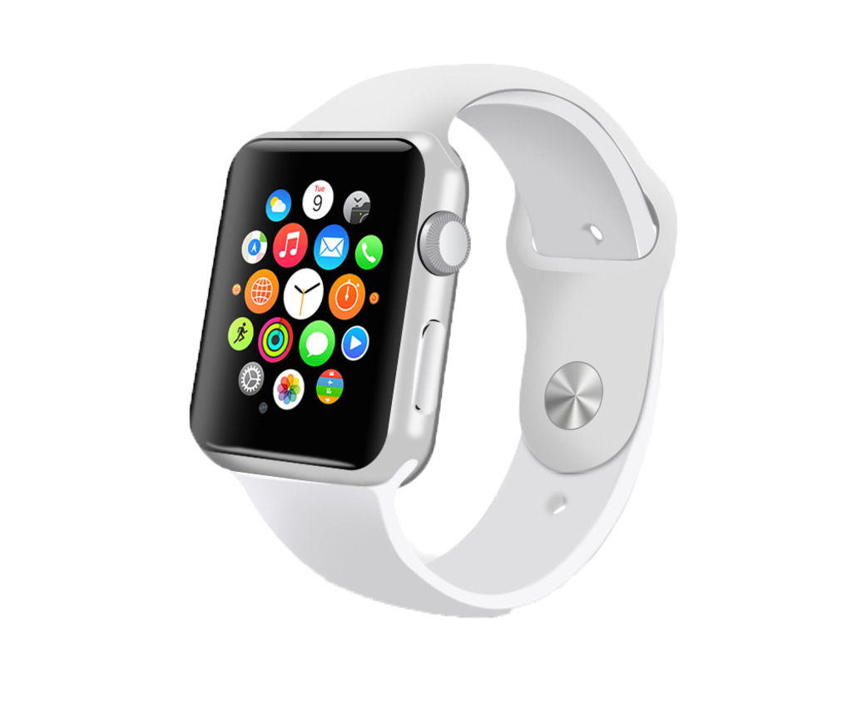
Schedule
The company’s schedule will be as follows :
[SPECIFY COMPANY SCHEDULE]

Slide 17
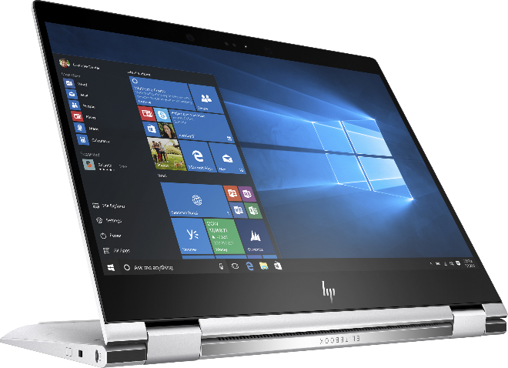
Investment & Sponsorship
In order to officially begin, the company will require a budget estimated between $80,000.00 and $95,000.00. This amount will be collected from the following sponsors :
1. Interface Computers Inc.
2. Carolina Finance Foundation
3. Hornets Investment Corp.
Each sponsor has agreed to contribute and invest at least $30,000.00 for A2Z.com.

Slide 18


Contact Us
Visit our office every Monday to Friday from 9am to 6pm and Saturday from 9am to 4pm at [ADDRESS].
For more information contact any of these contact details :
[Phone Number]
[Email]
[Website]
[Social Media Account/S]

Slide 19

Thank You

