Slide 1
HEALTH CARE PHARMACY
PHARMACEUTICAL PRESENTATION

Slide 2
BUSINESS PRESENTATION
-HEALTH CARE -
MEDICATION CARAVAN
This event will be held at General Doctors Compound on April 17, 2023, from 9 AM to 6 PM. This medication caravan is aimed to provide all the people in the community with affordable yet effective medicine in the market that can cure generic diseases and sickness experienced by the majority of the community.
ALL SALE MEDICINE
All Sale Medicine will be available starting May 1, 2023, to May 31, 2023, at the Health Care Pharmacy. This project aims to give up to 80% discount on all medicines for individuals of all ages & who possess a legally certified health card.
MONTHLY BOARD MEETING
This monthly board meeting will start on January 13, 2021, from 12 PM to 6 PM and will be held at the Health Care Pharmacy CEO Meeting Room. This meeting is aimed to discuss and review the future events that the pharmacy developed and will handle for the year 2023.

Slide 3
Dr. Lorie Deus
Founder & Chairman
As a pharmacy that always strives for better service, I am proud to present to you an even better Health Care Pharmacy.
This pharmacy stays true to its mission of “Good Health For All.” in which we aim to source, develop, & provide various medicines & access to necessary medical treatments that a pharmacy can offer.
-HEALTH CARE -

Slide 4
Executive Testimonial
“Health Care Pharmacy aims to give you effective yet affordable medicine aimed to cure a wide variety of diseases and sickness.”
-Dr. Michelle Dmitri, 47, Chief Operating Officer

Slide 5
Medication Caravan
-HEALTH CARE -
April 17, 2023 | 9 AM - 6 PM
General Doctors Compound
The medication caravan developed by the pharmacy will give access to people in the community to affordable & effective medicines & treatments that can cure the generic diseases and sickness experienced by the majority of the community. This event will give up to 80% discount for all senior citizens, children aged 1 to 12 years old and all individuals who possess health card.
The profits gained from this caravan will be donated to all leprosy patients in the “Leprosy Care Foundation”.

Slide 6
All Sale Medicine
May 1-31, 2023 | 9 AM - 6 PM
Health Care Pharmacy
This project willl give an 80% discount on all medicines for all senior citizens, children ages 1 to 12 years old and all individuals who possess a legally certified health card. Profits gained from this sale project will be allocatedted to the “Feeding America Foundation” for all children and people who are underweight and malnourished.
-HEALTH CARE -

Slide 7
Montly Board Meeting
January 13, 2021 | 12 PM - 6 PM
Health Care Pharmacy CEO Meeting Room
This meeting will discuss and review the future events that the pharmacy developed and will handle for the year 2023. This meeting will also discuss the monetary assisting funds from the profits from the previously held events which will be donated for all foundations who are in dire need of help in money and medical assistance.
-HEALTH CARE -

Slide 8
History
Founded by Dr. Lorie Deus in 1989, it has been operating and competing in the pharmaceutical industry for over 29 years. Health Care Pharmacy is a proud provider of the cheapest yet effective and reliable medicine for all in the community. As of today, it helped 10, 000 poor communities and 3 million people in the community and will continue to do so.
-HEALTH CARE -

Slide 9
Testimonials from Clients
“I was given the rare opportunity to have my 10-year long disease cured by the medicine and health assistance given by the Health Care Pharmacy. I will always thank them for their unconditional service.”
-Matilda Johnson, 42, Housewife

Slide 10
-HEALTH CARE -
Main Goal
Health Care Pharmacy commits itself towards producing and giving high quality, effective, and affordable healthcare and medicine assistance for all.

Slide 11
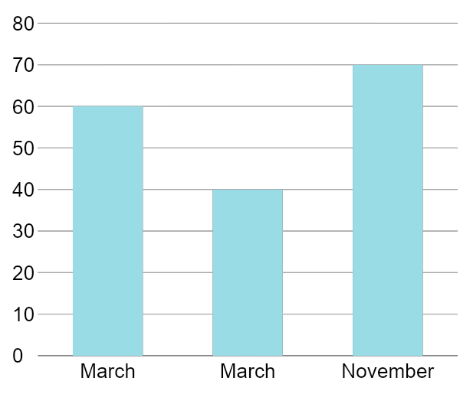
Projected Growth
60%
Increase in sold medicine products and packages for March 2024.
40%
Increase in new clients for March 2023.
70%
Increase in annual profits for November 2025.
-HEALTH CARE -

Slide 12
What We Offer
Customer Friendly Prices
Effective Medicine and Health Products
Excellent Customer Care
Affordable Healthcare and Medicine Assistance
-HEALTH CARE -

Slide 14
The Team
Dr. Lorie Deus
Dr. Michelle Dmitry
Willie Levine
Founder & Chairman
Chief Operating Officer
Chief Marketing Officer
-HEALTH CARE -

Slide 15
THANK YOU!

